Slide 1
Introduction
Brief overview of the project goal: Designing an end-to-end ML model for a Robo Advisor.
Emphasis on integration between model design and production environment.
Time allocation: 30 seconds.

Slide 2
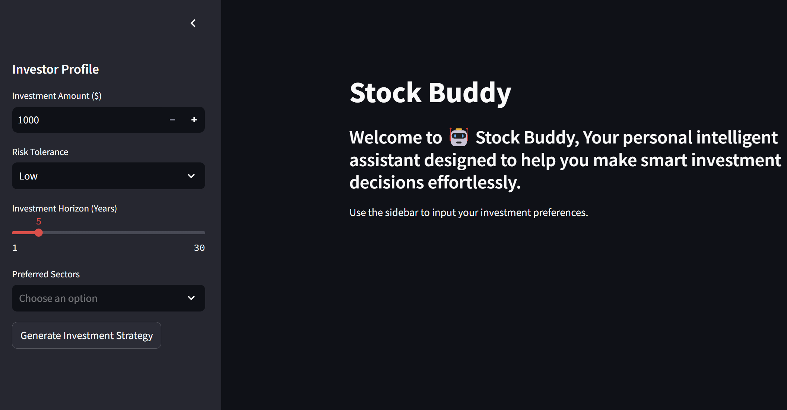
GUI Design
Notes:
Description of the input form (e.g., user risk preferences, investment amount).
Output visualization: Performance graphs, risk metrics (e.g., Sharpe Ratio).
Importance of intuitive design for user interaction.
Time allocation: 30 seconds.

Slide 3
Data Collection
Types of data: Asset prices, economic indicators, news sentiment.
Time period: Last 5 years; Frequency: Daily and intraday.
Data sources: APIs (Yahoo Finance, Alpha Vantage), news feeds.
Time allocation: 30 seconds.
Notes:
Description of the input form (e.g., user risk preferences, investment amount).
Output visualization: Performance graphs, risk metrics (e.g., Sharpe Ratio).
Importance of intuitive design for user interaction.
Time allocation: 30 seconds.

Slide 4
Data Cleaning
Rule: Exclude data around major news events (e.g., Fed meetings, earnings reports).
Handling missing values and outliers.
Ensuring data consistency across sources.
Time allocation: 30 seconds.

Slide 5
Feature Engineering
Y variable: Asset return over the next N periods.
X variables: Moving averages, RSI, MACD, volatility, volume trends, sentiment scores, etc.
Explanation of feature calculation.
Time allocation: 45 seconds.

Slide 6
Performance Metrics
Primary metric: Sharpe Ratio (risk-adjusted return).
Additional metrics: Annualized return, drawdown, win rate, profit factor.
Importance of multiple metrics for comprehensive evaluation.
Time allocation: 30 seconds.

Slide 7
Data Splitting
Method: Time-based split to avoid data leakage.
Example: 70% training, 15% validation, 15% testing.
Rolling window approach for robust backtesting.
Time allocation: 30 seconds.

Slide 8
Data Processing & Model Training
Data normalization and feature scaling.
Model selection: Random Forest, XGBoost, Neural Networks.
Hyperparameter tuning and cross-validation.
Time allocation: 45 seconds.

Slide 9
Trading Strategy Definition
Strategy based on predicted returns (Y variable).
Buy/sell signals: Threshold-based or probabilistic approach.
Risk management: Stop-loss, position sizing.
Time allocation: 30 seconds.

Slide 10
Production Deployment
Database: PostgreSQL for data storage, real-time updates via APIs.
Trade Execution: Automated scripts with API integration (Interactive Brokers, Alpaca).
Execution logic: Checks for exclusion criteria (news events), trading hours.
Time allocation: 1 minute.

