Slide 1
Detectify: Real-Time Object Detection with OpenCV & YOLO
Devtown Bootcamp Project
Kaushlendra Shukla

Slide 2
Project Objective
• Build and deploy a real-time object detection system
• Process live video streams
• Detect multiple objects simultaneously
• Display results with bounding boxes & labels

Slide 3
Tools & Technologies
• Python, OpenCV, PyTorch
• YOLOv5 (Pre-trained on COCO Dataset)
• Skills: Dataset handling, thresholds, speed vs. accuracy

Slide 4
Implementation Steps
1. Environment Setup: Python, OpenCV, PyTorch, YOLOv5
2. Model Loading: Pre-trained YOLOv5 with COCO labels
3. Testing: Inference on sample images
4. Real-Time Detection: Webcam with OpenCV
5. Optimization: Confidence threshold & input size tuning

Slide 5
Output / Results
• Real-time detection successfully implemented
• Detected objects like person, bottle, laptop etc.
• Bounding boxes with class labels and confidence scores

Slide 6
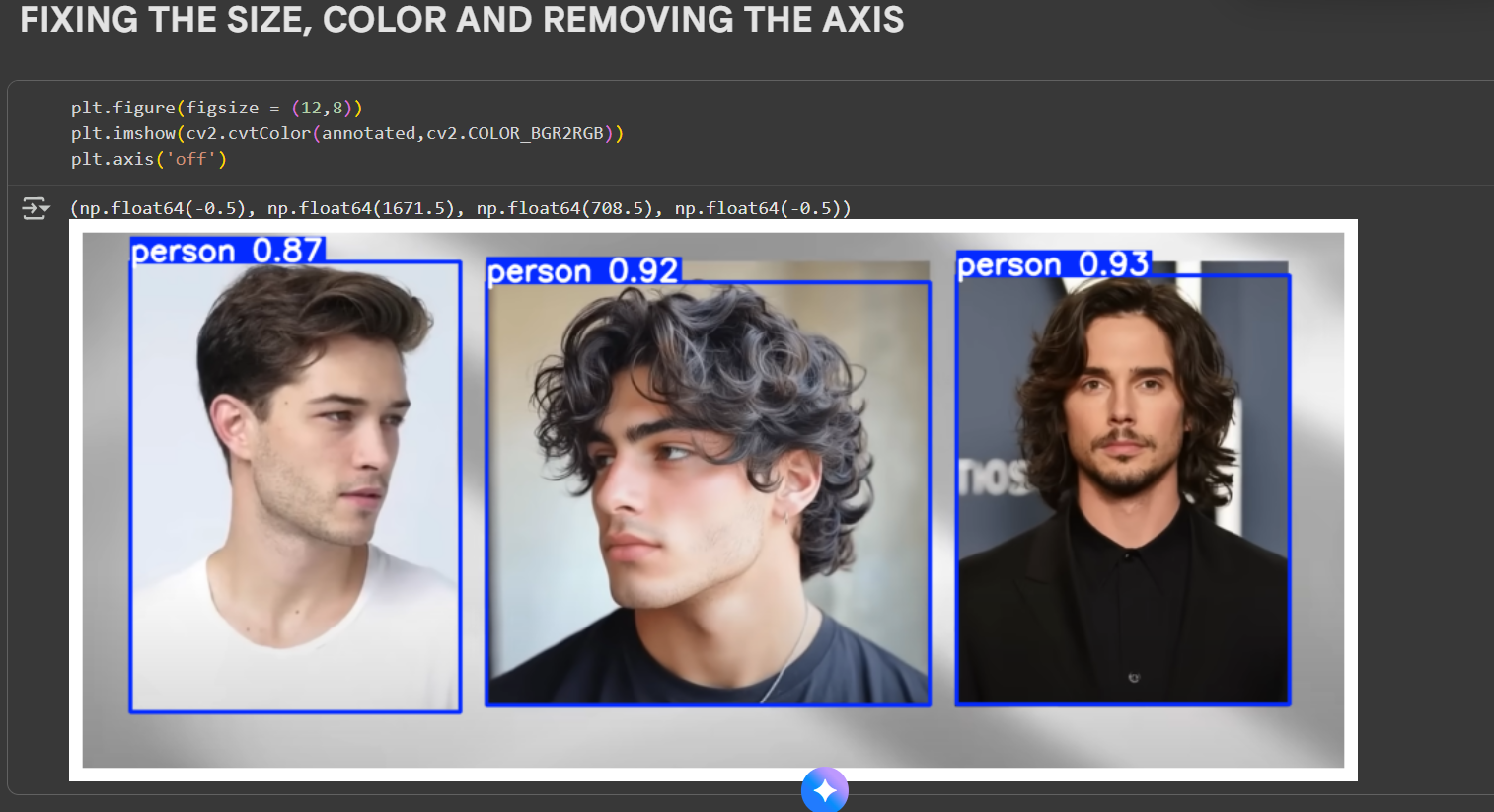

Slide 7
Learnings & Future Scope
• Fundamentals of object detection & preprocessing
• Model inference and deployment-ready scripts
• Future: Optimize for mobile/edge devices
• Explore YOLOv8 & real-world applications
• Thank You!

