Slide 1

PRODUCT PRESENTATION
One secure workspace
for every branch
FlexPOS
Enterprise point-of-sale
and business management
Prepared for FlexPOS · 2026
01

Slide 2
FLEXPOS · ENTERPRISE POS
PROJECT INTRODUCTION
FlexPOS brings checkout, inventory, purchasing, accounting and analytics into one tenant-aware workspace.
◆ Built for branch-based operations and fast cashier workflows.
◆ Server-enforced money and stock movements with Supabase RLS.
◆ Responsive interface for desktop and smaller screens.
02

Slide 3
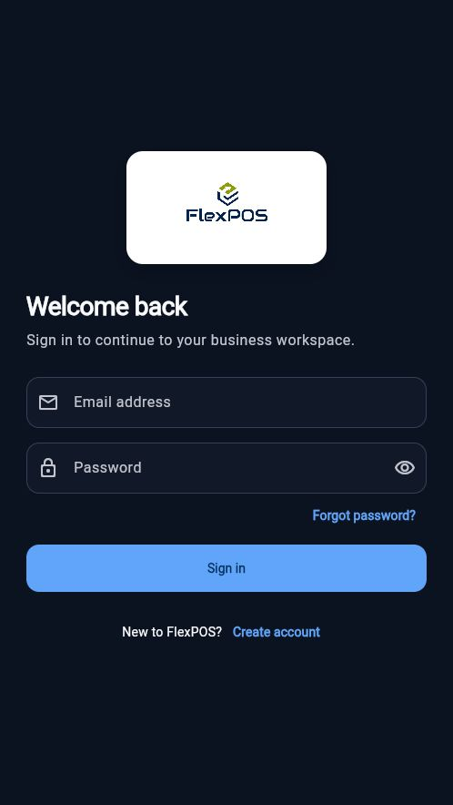
FLEXPOS · ENTERPRISE POS
LOGIN AND SPLASH EXPERIENCE
SCREEN OVERVIEW
◆ Branded loading screen with a short 0–100% progress sequence.
◆ Email and password authentication through Supabase Auth.
◆ Responsive sign-in surface with recovery and account creation paths.
03

Slide 4
FLEXPOS · ENTERPRISE POS
REGISTER AND ACCOUNT RECOVERY
Authentication covers the full entry journey before a user reaches a business workspace.
◆ Create an account with email verification.
◆ Resend verification and request password recovery.
◆ Update password through the PKCE recovery flow.
04

Slide 5
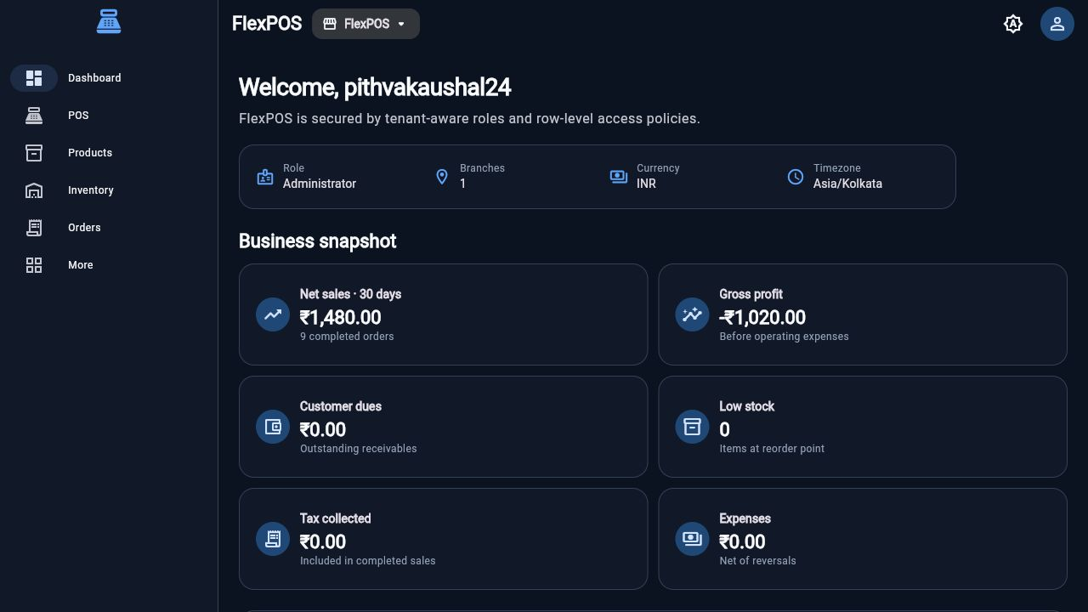
FLEXPOS · ENTERPRISE POS
DASHBOARD
SCREEN OVERVIEW
◆ Business snapshot with net sales, gross profit, customer dues and expenses.
◆ Role, branch, currency and timezone context stays visible.
◆ Quick actions open the most common operational workflows.
05

Slide 6
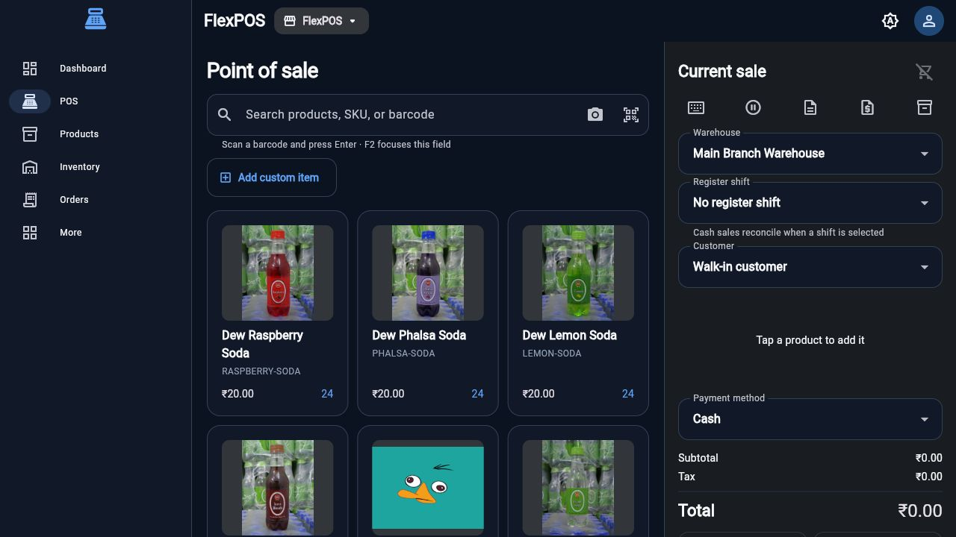
FLEXPOS · ENTERPRISE POS
POINT OF SALE
SCREEN OVERVIEW
◆ Search by product, SKU or barcode and add items to the current sale.
◆ Warehouse, register shift and customer context stay in the checkout panel.
◆ Cart totals, taxes, discounts and completion actions remain visible.
06

Slide 7
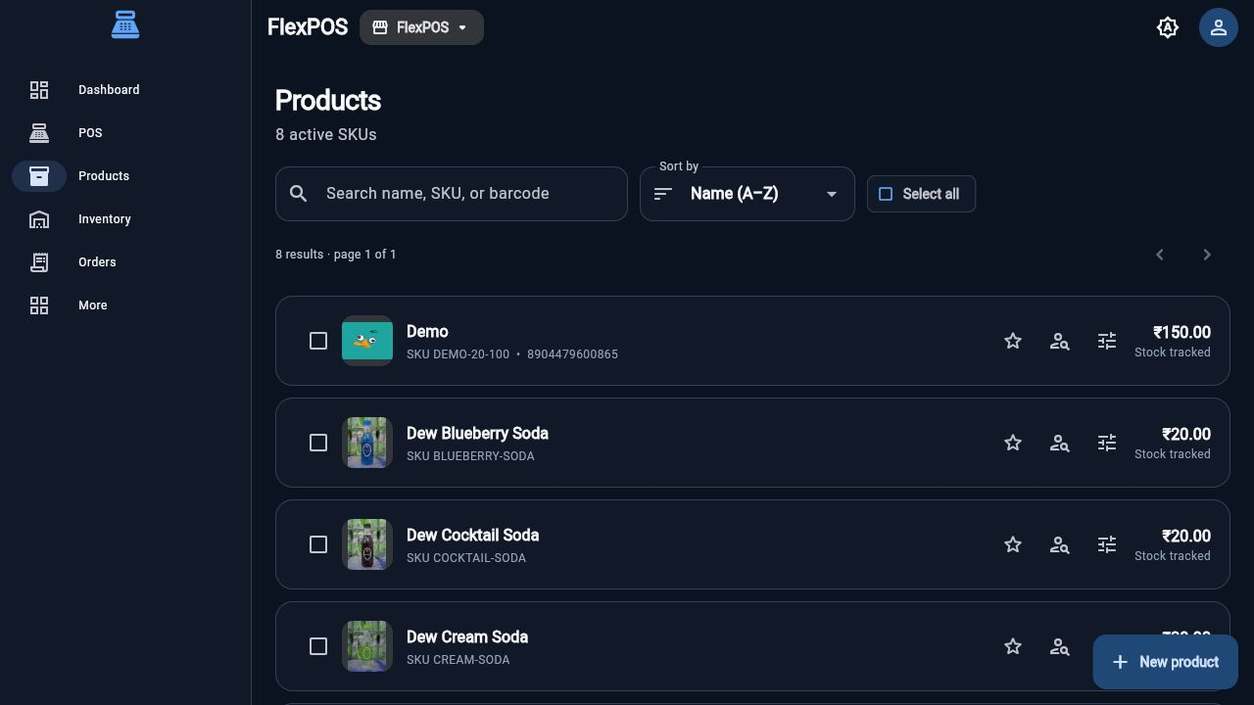
FLEXPOS · ENTERPRISE POS
PRODUCT CATALOG
SCREEN OVERVIEW
◆ Search, sorting, pagination and bulk selection across active SKUs.
◆ Product images, SKU, barcode, price and stock state appear together.
◆ Catalog actions support variants, pricing and stock tracking.
07

Slide 8
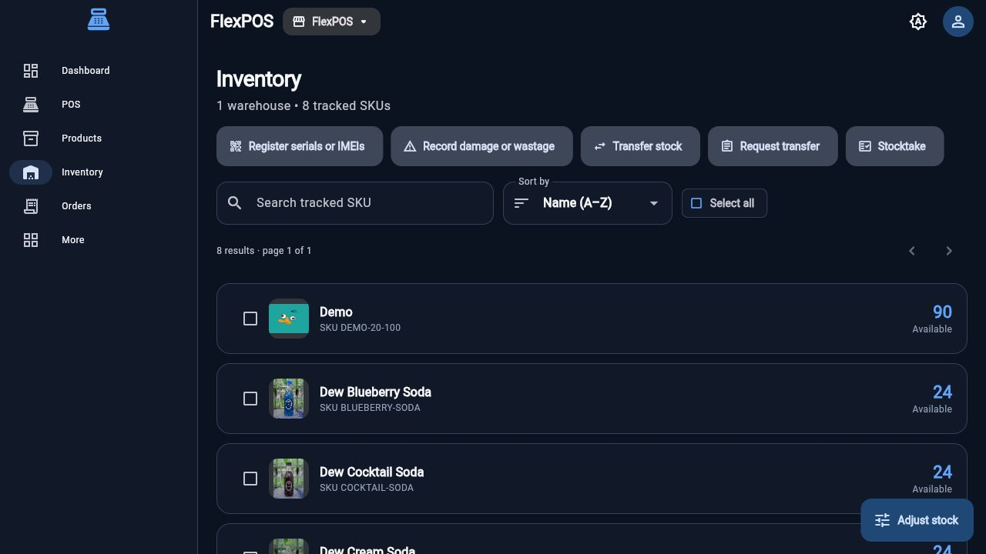
FLEXPOS · ENTERPRISE POS
INVENTORY
SCREEN OVERVIEW
◆ Available quantities are shown per tracked SKU and warehouse.
◆ Stocktake, damage, transfer and adjustment actions are accessible at the top.
◆ Images keep the physical product easy to identify during operations.
08

Slide 9
FLEXPOS · ENTERPRISE POS
STOCK ADJUSTMENTS AND TRANSFERS
Inventory movements stay auditable from the warehouse to the stock ledger.
◆ Record wastage, damage and manual corrections with a reason.
◆ Transfer quantities between warehouses and branches.
◆ Use stocktake workflows to reconcile physical counts.
09

Slide 10
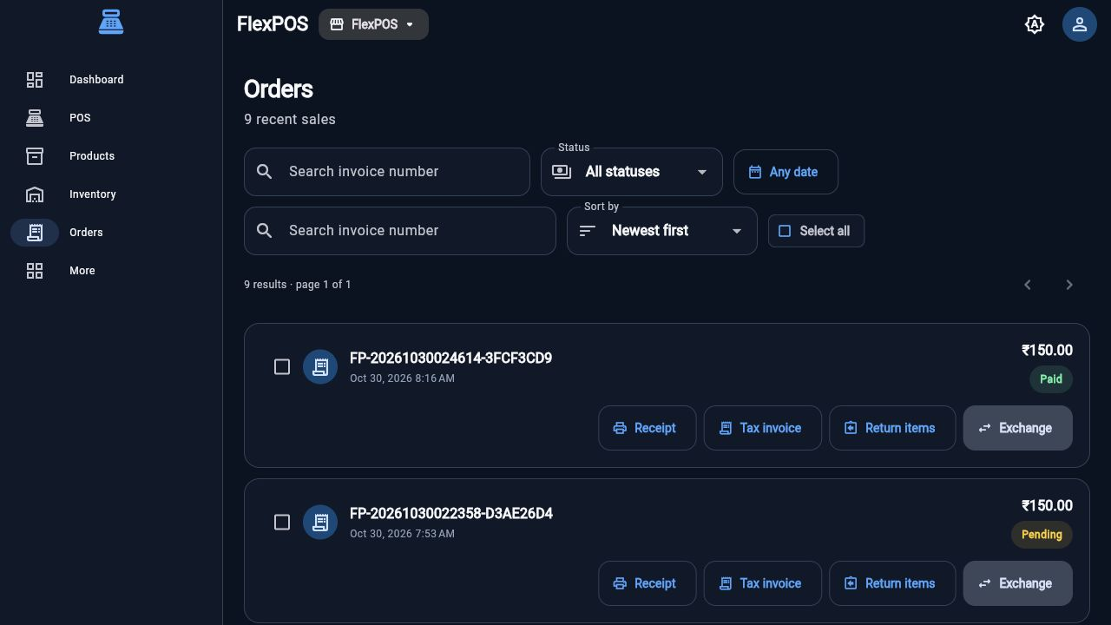
FLEXPOS · ENTERPRISE POS
ORDERS AND RECEIPTS
SCREEN OVERVIEW
◆ Recent sales are searchable by invoice number and date.
◆ Status filters separate paid, pending, refunded and cancelled orders.
◆ Receipt, tax invoice, returns and exchanges are available from each order.
10

Slide 11
FLEXPOS · ENTERPRISE POS
RETURNS AND EXCHANGE
Post-sale workflows keep the original sale traceable while correcting stock and payment outcomes.
◆ Return selected items or quantities from an invoice.
◆ Exchange items with a clear value difference.
◆ Keep return reasons and downstream ledger entries auditable.
11

Slide 12
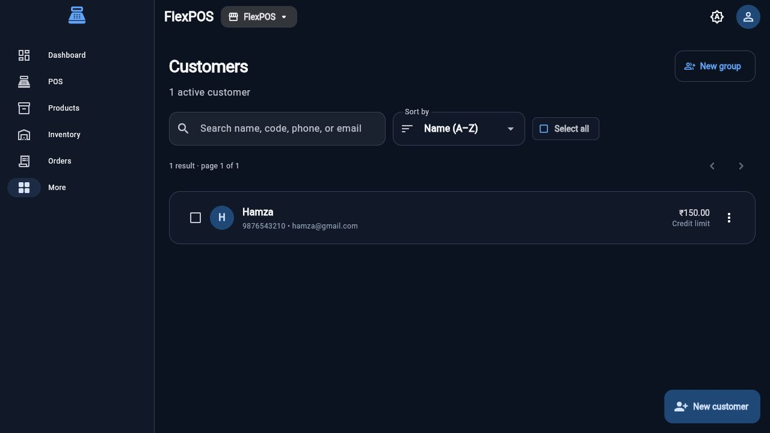
FLEXPOS · ENTERPRISE POS
CUSTOMERS
SCREEN OVERVIEW
◆ Customer records include contact details, groups and credit context.
◆ Search works across name, code, phone and email.
◆ Customer selection flows directly into POS checkout and ledger views.
12

Slide 13
FLEXPOS · ENTERPRISE POS
CRM AND CUSTOMER RELATIONSHIPS
CRM workflows extend the customer record beyond the point of sale.
◆ Track leads, opportunities and follow-ups in one tenant.
◆ Keep notes, reminders and quotations tied to the right customer.
◆ Use role-based access for customer data and activity.
13

Slide 14
FLEXPOS · ENTERPRISE POS
SUPPLIERS AND PURCHASING
Purchasing connects supplier records to the products and stock they replenish.
◆ Manage supplier contacts, terms and purchasing history.
◆ Create requisitions and purchase orders by branch or warehouse.
◆ Keep supplier lists searchable with shared data controls.
14

Slide 15
FLEXPOS · ENTERPRISE POS
PURCHASE ORDERS AND GOODS RECEIPTS
Inbound stock becomes a controlled, reviewable business process.
◆ Receive ordered quantities against a purchase order.
◆ Capture costs, taxes and discrepancies before stock is posted.
◆ Use goods receipts to maintain a reliable inventory trail.
15

Slide 16
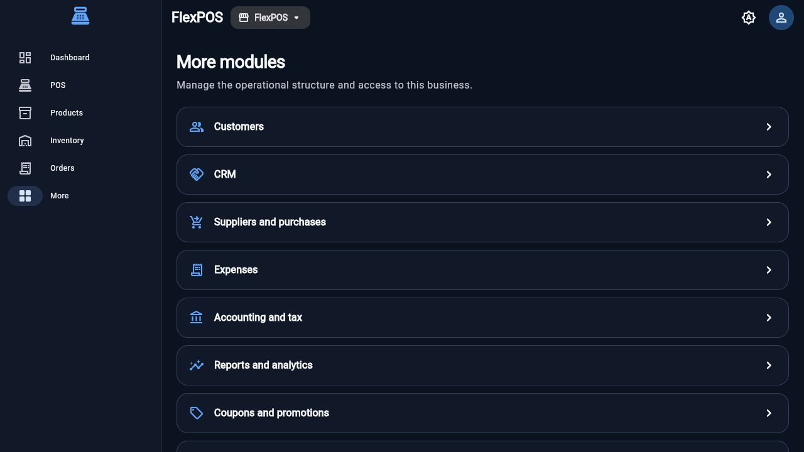
FLEXPOS · ENTERPRISE POS
FEATURE MODULES
SCREEN OVERVIEW
◆ Customers, CRM, suppliers, expenses, accounting and reports are grouped by operational purpose.
◆ Shared navigation keeps the workspace predictable across modules.
◆ Each module follows tenant-aware permissions and data access.
16

Slide 17
FLEXPOS · ENTERPRISE POS
PAYMENT OPTIONS
Checkout supports the payment paths used by FlexPOS without cluttering the cashier workflow.
◆ Cash records an immediate tendered payment.
◆ UPI shows a bill-specific QR and requires a success or failed confirmation.
◆ Razorpay opens the real provider checkout in test mode.
17

Slide 18
FLEXPOS · ENTERPRISE POS
UPI CHECKOUT
The cashier can present the exact bill amount through the configured UPI address.
◆ UPI ID: kaushal.pithva@ptaxis.
◆ QR payload includes the bill value before checkout is finalized.
◆ Success records the payment; Failed leaves the sale unfinalized.
18

Slide 19
FLEXPOS · ENTERPRISE POS
RAZORPAY TEST CHECKOUT
Razorpay uses the provider order and signature verification flow rather than a placeholder QR.
◆ The client requests a server-created Razorpay order.
◆ Checkout opens in test mode with provider callbacks.
◆ Server verification records the final payment state.
19

Slide 20
FLEXPOS · ENTERPRISE POS
RECEIPTS AND TAX INVOICES
Every completed sale can produce a compact receipt or a tax-ready invoice.
◆ Small receipt output fits thermal printer widths.
◆ Tax invoice includes line items, tax splits and business context.
◆ Print and export flows are kept separate from sale completion.
20

Slide 21
FLEXPOS · ENTERPRISE POS
AUTHENTICATION AND TENANTS
A user signs in once and works inside the business context assigned by membership.
◆ Business, branch and membership relationships stay explicit.
◆ RLS policies scope reads and writes to the active tenant.
◆ The removed Orange Hotel tenant no longer appears in the workspace.
21

Slide 22
FLEXPOS · ENTERPRISE POS
ROLES AND PERMISSIONS
FlexPOS separates what a user can see from what they can do.
◆ System roles cover administration, cashier, inventory and accounting work.
◆ Memberships connect users to a business and role.
◆ Permission checks protect sensitive operations and management screens.
22

Slide 23
FLEXPOS · ENTERPRISE POS
BRANCHES AND REGISTERS
The same tenant model supports multiple operational locations.
◆ Branches carry timezone, contact and active-state configuration.
◆ Registers and shifts reconcile cash activity by location.
◆ Warehouse and register context follow the active branch.
23

Slide 24
FLEXPOS · ENTERPRISE POS
CUSTOMER CREDIT AND LEDGER
Credit is treated as a ledger-backed balance rather than an informal note.
◆ Customer dues surface on dashboards and reports.
◆ Receipts and repayments update the ledger.
◆ Credit limits remain visible when selecting a customer in POS.
24

Slide 25
FLEXPOS · ENTERPRISE POS
EXPENSES
Operating expenses stay connected to the business and reporting period.
◆ Record expense categories, payees and amounts.
◆ Attach notes and supporting context where needed.
◆ Expense totals flow into management reporting.
25

Slide 26
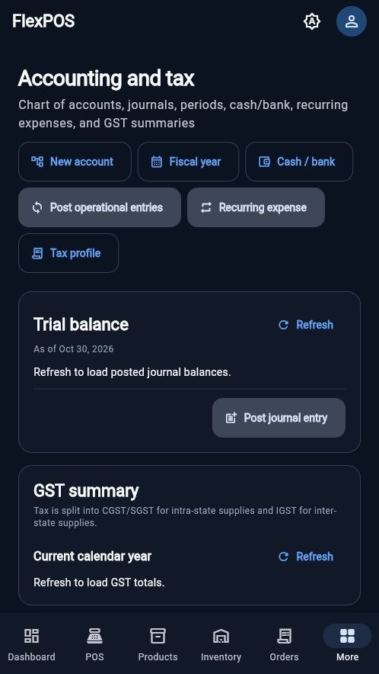
FLEXPOS · ENTERPRISE POS
ACCOUNTING AND TAX
SCREEN OVERVIEW
◆ Chart of accounts, fiscal year and cash/bank tools share one control surface.
◆ Trial balance and GST summary are available from the accounting module.
◆ Operational entries and recurring expenses can be posted from the same screen.
26

Slide 27
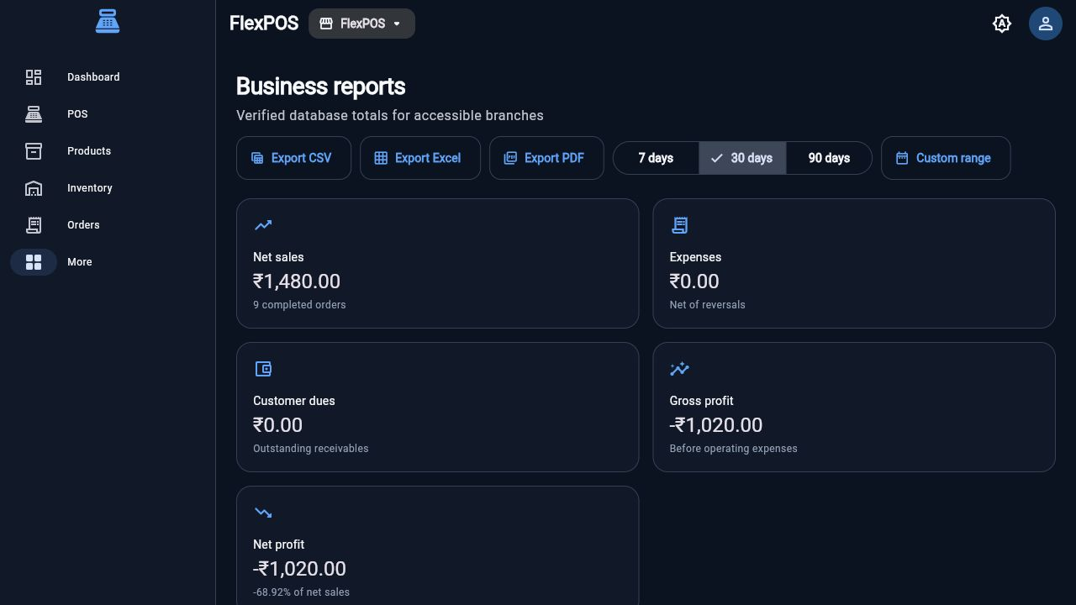
FLEXPOS · ENTERPRISE POS
REPORTS AND ANALYTICS
SCREEN OVERVIEW
◆ Net sales, expenses, customer dues and gross profit are available by period.
◆ Reports support 7-day, 30-day, 90-day and custom ranges.
◆ CSV, Excel and PDF export actions keep reporting portable.
27

Slide 28
FLEXPOS · ENTERPRISE POS
AUDIT LOGS AND GOVERNANCE
Operational actions leave a trace that helps owners review changes.
◆ Tenant-scoped audit logs record important business operations.
◆ Sensitive actions require the relevant permission.
◆ History supports reconciliation, review and incident follow-up.
28

Slide 29
FLEXPOS · ENTERPRISE POS
HARDWARE AND SCANNING
FlexPOS keeps hardware workflows online and explicit for a reliable counter experience.
◆ Camera and keyboard barcode input find products quickly.
◆ Printer and device bridges expose capability and heartbeat state.
◆ Physical scanner validation remains a deployment check for each device.
29

Slide 30
FLEXPOS · ENTERPRISE POS
ONLINE-ONLY OPERATIONS
The product intentionally keeps the source of truth online instead of introducing an offline queue.
◆ Checkout, stock and payments require an authenticated connection.
◆ No deferred offline sales or background sync are enabled.
◆ Connectivity and authorization failures surface to the operator.
30

Slide 31
FLEXPOS · ENTERPRISE POS
ENGINEERING QUALITY
Production readiness is supported by a shared design system and repeatable checks.
◆ Responsive Material 3 surfaces keep desktop and mobile layouts aligned.
◆ Structured logs redact passwords, tokens and provider secrets.
◆ Analyzer, unit and integration checks protect core workflows.
31

Slide 32
FLEXPOS · ENTERPRISE POS
TESTING AND PRODUCTION VERIFICATION
The release workflow validates the paths that move money and stock.
◆ Auth, products, sales, returns and purchasing have integration coverage.
◆ Payment verification checks provider status and signatures.
◆ Concurrent sessions and hardware checks remain explicit release evidence.
32

Slide 33
FLEXPOS · ENTERPRISE POS
DEPLOYMENT AND RELEASE READINESS
FlexPOS can ship as a web or mobile application with environment-specific configuration.
◆ Supabase project configuration is supplied through environment files.
◆ Razorpay secrets stay server-side in Edge Functions.
◆ Signing, packaging and production smoke tests are part of the release checklist.
33

Slide 34
FLEXPOS · ENTERPRISE POS
SECURITY AND RLS
Tenant isolation is enforced at the database boundary, not only in the client.
◆ Public tables use row-level security with business-aware predicates.
◆ Service-role secrets never enter the Flutter client.
◆ Business deletion was scoped by exact tenant ID and verified afterward.
34

Slide 35
Thank You
FlexPOS · Enterprise POS and business management
35

