Slide 1

E-commerce Website Project
Daily.Shop
Project Presentation
Presented by : KISHOR KUMAR

Slide 2
Introduction
Brief Overview:
Online platform for buying & selling products.
Facilitates transactions between businesses & customers.
Purpose:
User-friendly & secure shopping experience.
Efficient supplier & inventory management.
Key Features:
shopping cart, secure payments, feedback system.

Slide 3
Modules Overview
Main Modules:
Home
Shop
Feedback
Supplier
User
Admin

Slide 4
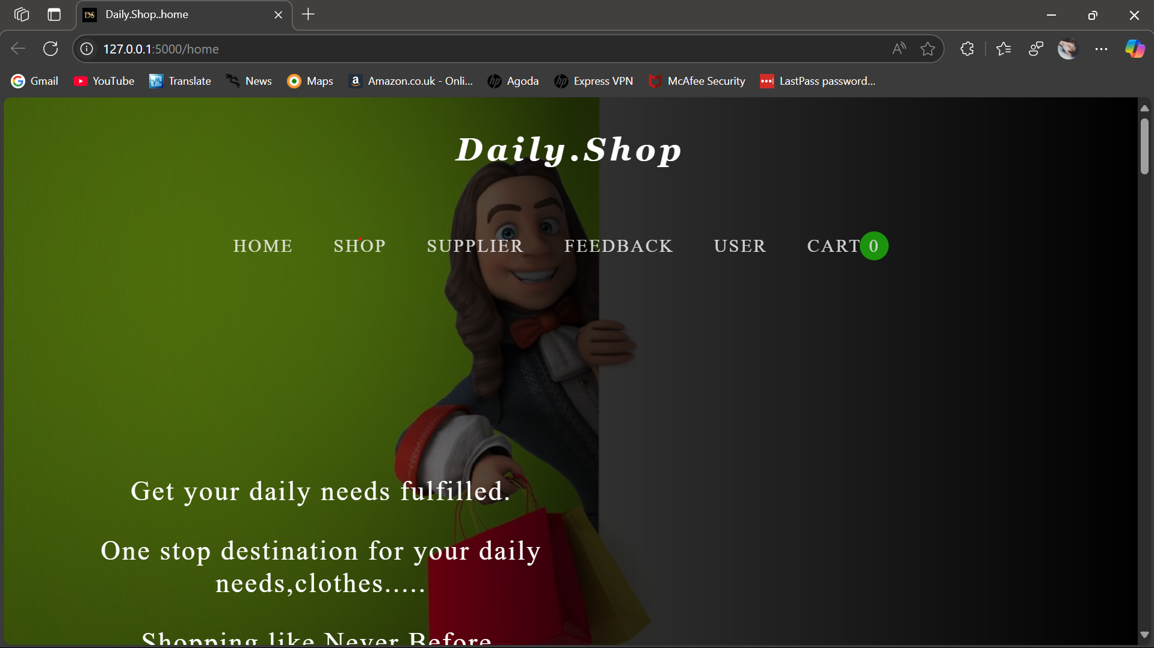
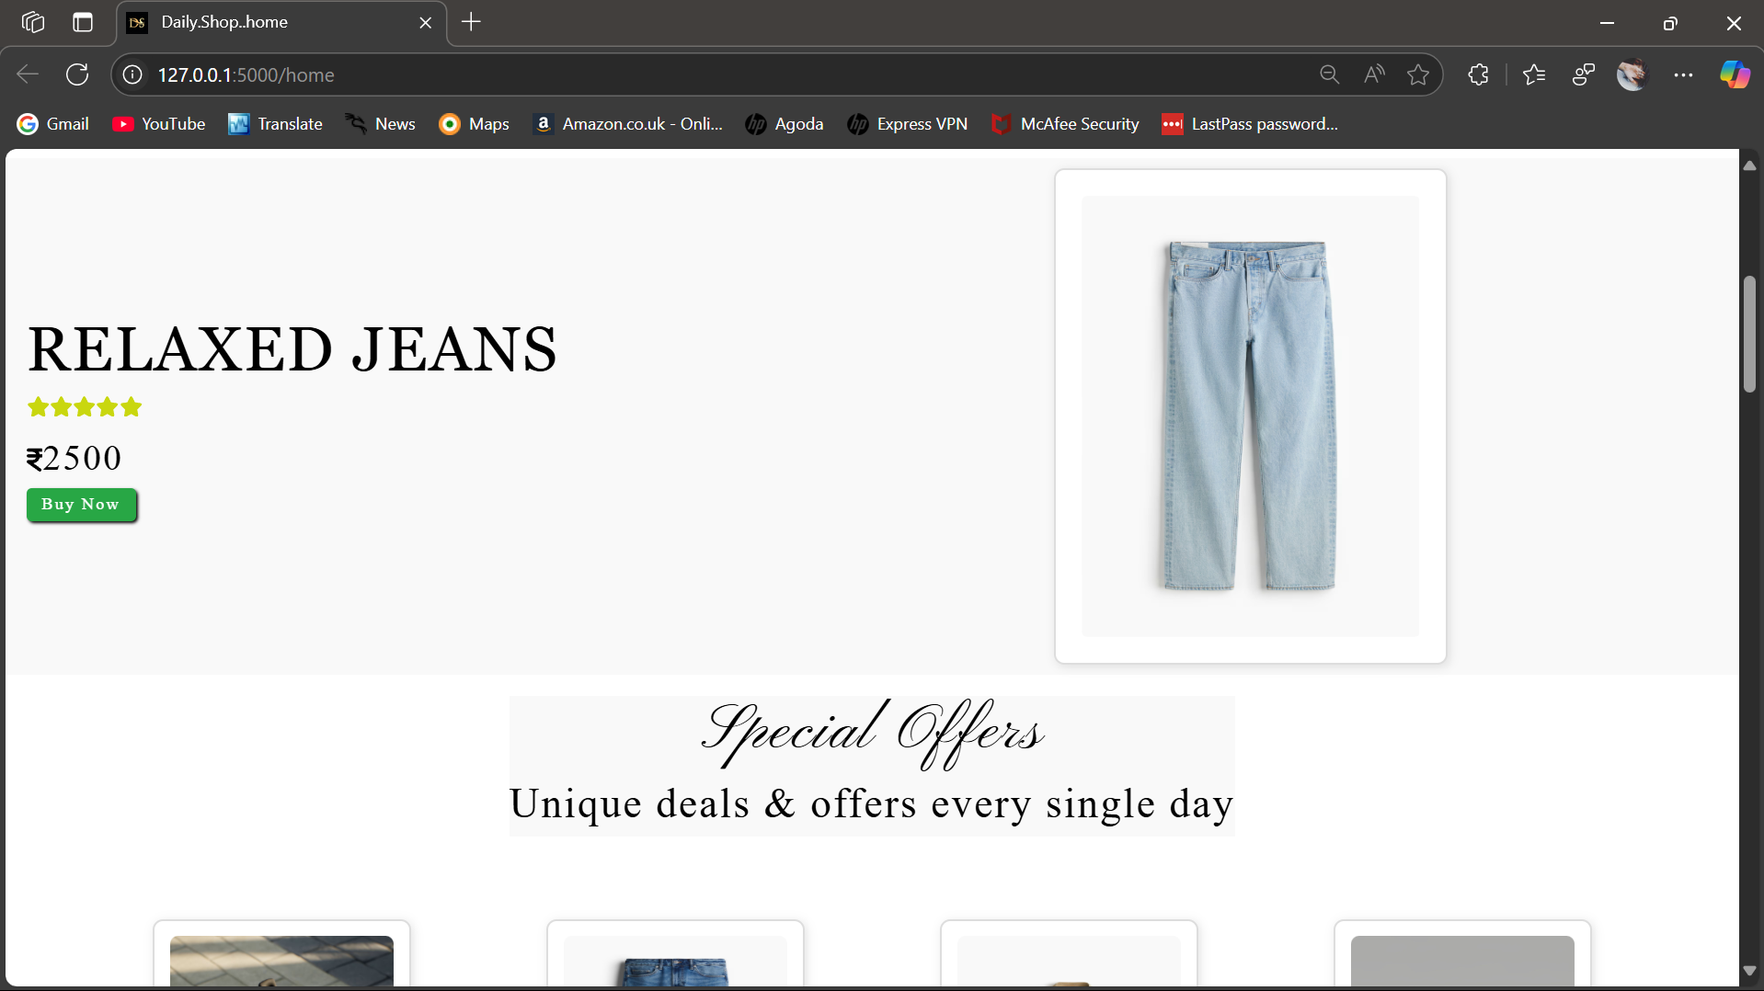
Home Module
Features:
Customer registration, Otp verification
Shown all products.

Slide 5
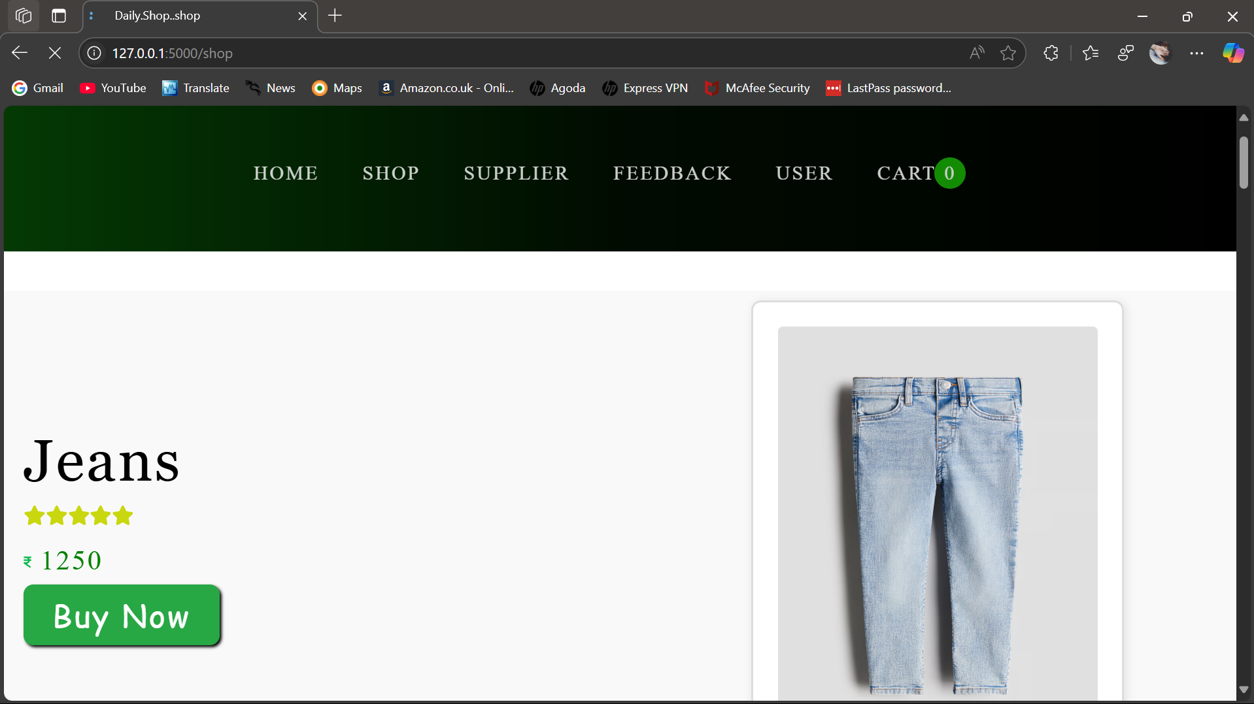
Shop Module
Features:
Displays products with descriptions & prices.
Add to cart & checkout options.

Slide 6
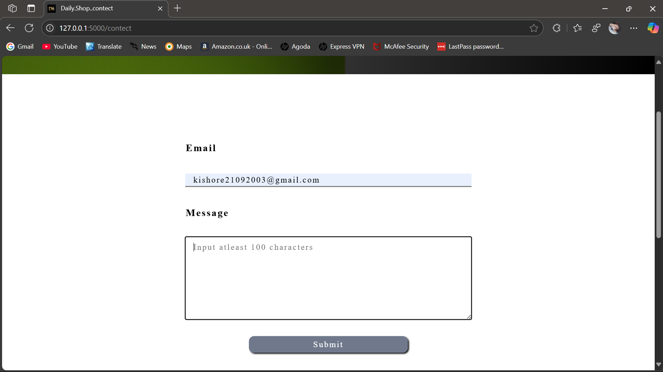
Feedback Module
Features:
Users can provide ratings & reviews.
Helps improve product quality & services.
Admin manages feedback

Slide 7
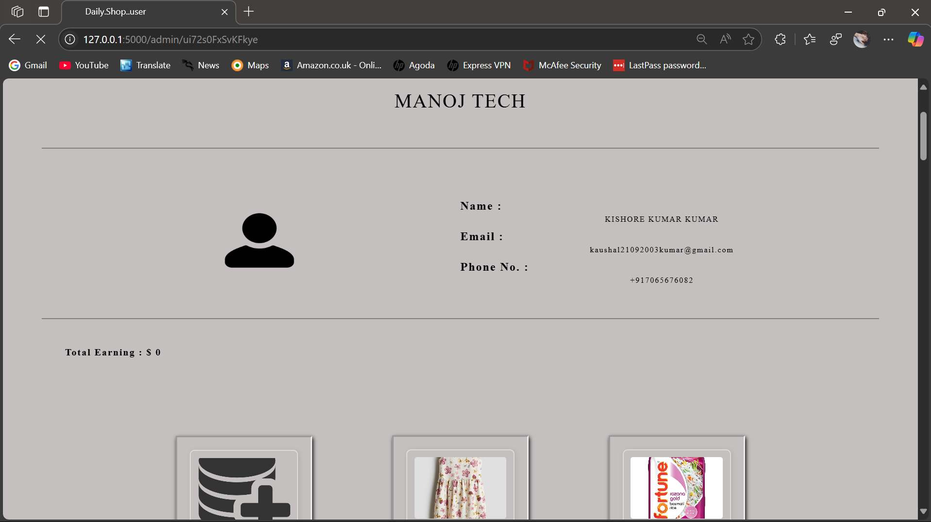
Supplier Module
Features:
Manages suppliers & their products.
Tracks inventory & stock availability.
Ensures seamless supply chain.

Slide 8
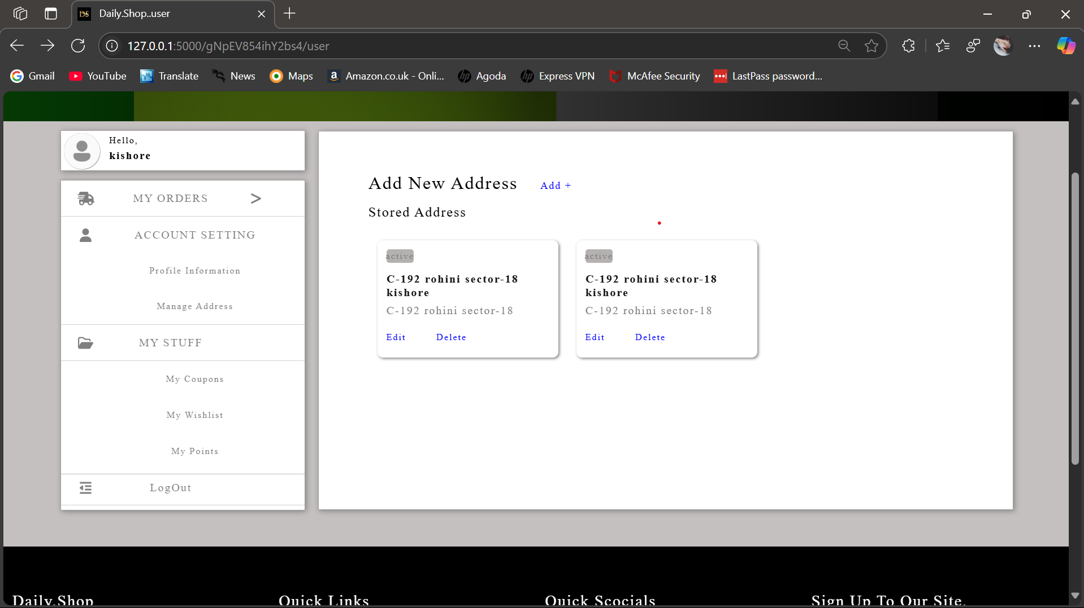
User Module
Features:
User registration & login.
Profile management & order history.
Secure payment gateway integration.

Slide 9
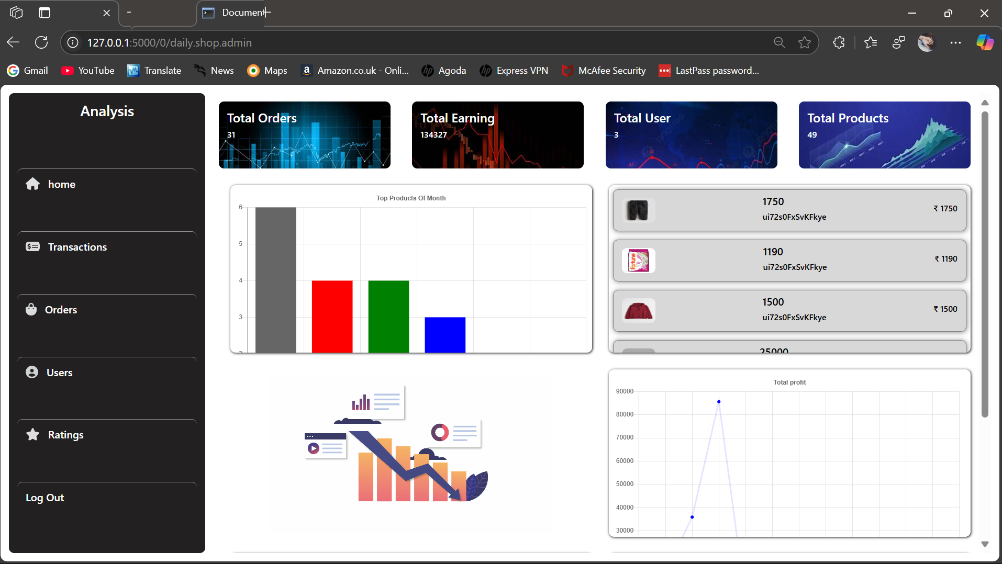
Admin Module
Features:
Manages users, products, orders, and feedback.
Access control & website settings.
Generates reports for analytics.

Slide 10
Technologies Used
Frontend: HTML, CSS, JavaScript
Version :
HTML : 5
CSS : 4.15
JS : ES5
Backend: Python (flask)
Version : 3.1.0
Database: MySQL
Version : 8.0
Frameworks & Tools: Bootstrap
Version : 5

Slide 11
System Architecture
User Flow:
- Users → Shop → Checkout → Payment → Order Processing.
- Shows role of each module in request-response cycle.

Slide 12
Challenges & Solutions
Challenges:
- Managing large data.
- Ensuring security.
- Handling high traffic.
Solutions:
- Optimized database management.
- Secure payment gateway.
- Cloud hosting & caching mechanisms.

Slide 13
Future Enhancements
Planned Improvements:
- AI-based product recommendations.
- Enhanced UI/UX design.
- Mobile app integration.

Slide 14
Conclusion
Summary:
- Secure shopping experience with user & admin management.
- Streamlined supplier & inventory handling.
- User-friendly interface & robust backend.
Impact:
- Improved accessibility & efficiency.
- Enhanced business growth & user satisfaction.
Open for Questions & Feedback.

