Slide 1
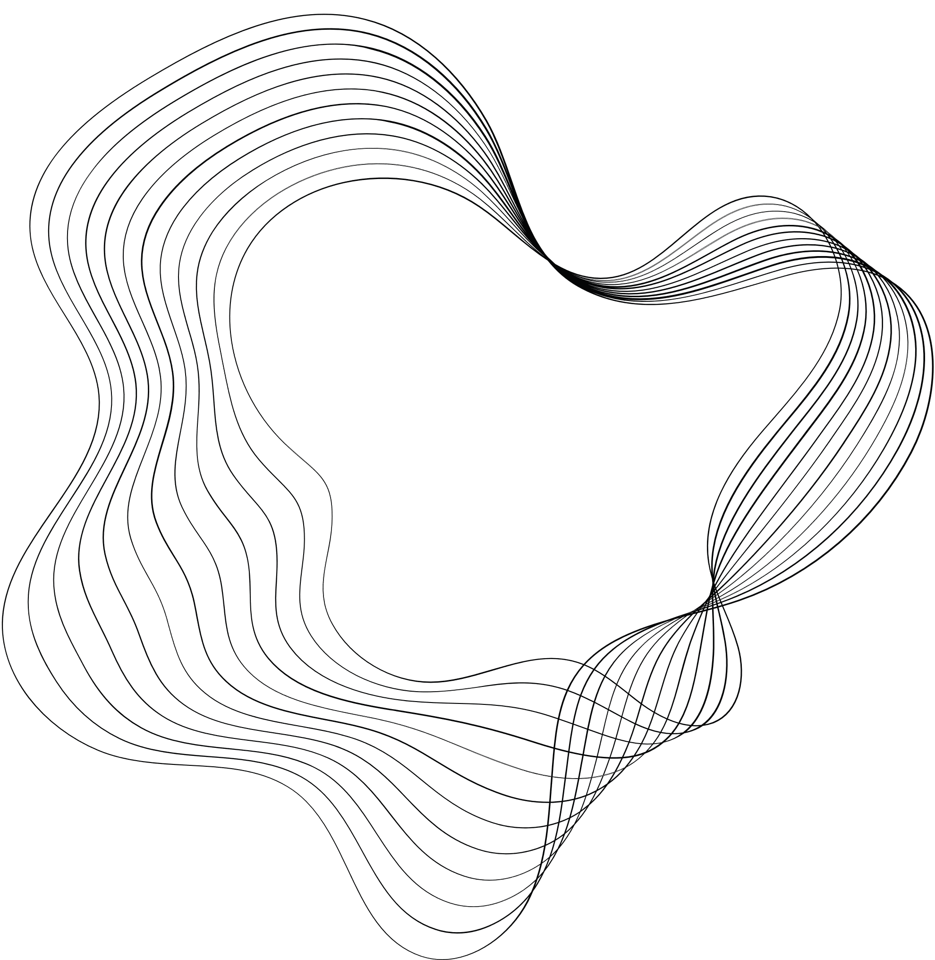


TOPICS IN DEEP LEARNING
UE21CS343BB2
PNEUMONIA DETECTION IN CHEST X-RAY IMAGES
NAME : S.R.N:
CHANTELLE I DMONTE PES2UG21CS139
DIVYA D PES2UG21CS165
HARSHAN K A PES2UG21CS191
R GAGANA REDDY PES2UG21CS421

Slide 2
CONTENT
01
PROBLEM STATEMENT
02
ABSTRACT
03
DATASET USED
04
METHODOLOGY
05
TRAINING AND TESTING PROCESS
06
EVALUTION METRICS
07
RESULTS

Slide 3

PROBLEM STATEMENT
Develop an ensemble deep learning model for pneumonia detection in X-ray images of lungs, aiming to improve detection accuracy and robustness
A Convolutional Neural Network (CNN) is designed using Keras with a custom architecture consisting of convolutional layers, batch normalization, max pooling, and dense layers.
The goal is to create a model that can accurately differentiate between pneumonia and normal cases in X-ray images, providing reliable support for medical professionals in diagnosing pneumonia.

Slide 4

ABSTRACT
This project focuses on developing a deep learning model to detect pneumonia from chest X-ray images. We use a custom convolutional neural network (CNN) architecture and preprocess the images before training. The model is trained, validated, and tested on a dataset containing images labeled as "Normal" or "Pneumonia." Our goal is to create an accurate and efficient model that can assist healthcare professionals in diagnosing pneumonia from chest X-ray images.

Slide 5

DATASETS USED
Kermany dataset :
https://www.kaggle.com/paultimothymooney/chest-xray-pneumonia

Slide 6

METHODOLOGY
The chest X-ray images are preprocessed, including resizing to a uniform size, normalization to prepare them for training.
The model is compiled with the categorical cross-entropy loss function and the SGD optimizer. It is trained on the preprocessed chest X-ray images
A custom Convolutional Neural Network (CNN) architecture is designed using Keras
The trained model is evaluated on the testing set to assess its performance in detecting pneumonia from chest X-ray images. Metrics are used to evaluate the model's performance.

Slide 7

TRAINING PROCESS
Data Preprocessing: Chest X-ray images are resized, normalized, and augmented to enhance variability and quality.
Model Selection : A custom Convolutional Neural Network (CNN) architecture is designed using Keras. The model comprises several convolutional layers followed by batch normalization, max pooling, and dense layers, culminating in a softmax output layer.
Model Training: The model is compiled with the categorical cross-entropy loss function and the SGD optimizer.
Evaluation: The performance of the custom CNN architecture is evaluated using a five-fold cross-validation scheme on the Kermany. Various evaluation metrics, including accuracy, sensitivity, precision, and F1-score, are calculated.

Slide 8
TESTING PROCESS
Model Evaluation: The trained custom CNN model is tested on unseen data from the Kermany and RSNA datasets.
Statistical Validation: The model's performance is evaluated using standard metrics such as accuracy, precision, recall, and F1-score. These metrics provide insights into the model's ability to correctly classify pneumonia and normal chest X-ray images.

Slide 9

EVALUTATION METRICS
ACCURACY
F1 SCORE
Overall correctness of predictions in classifying pneumonia and normal cases.
Balances precision and recall, considering false positives and false negatives.
PRECISION
Measures the proportion of correctly identified pneumonia cases out of all predicted pneumonia cases, without including false positives.
RECALL
AUC
Indicates sensitivity to detecting pneumonia cases without missing any.
Assesses discrimination ability between pneumonia and normal cases across thresholds.

Slide 10
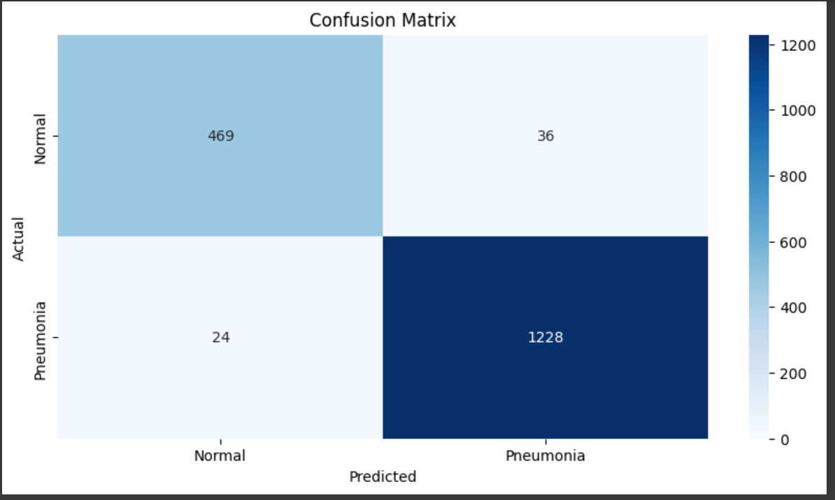
RESULTS

Slide 11
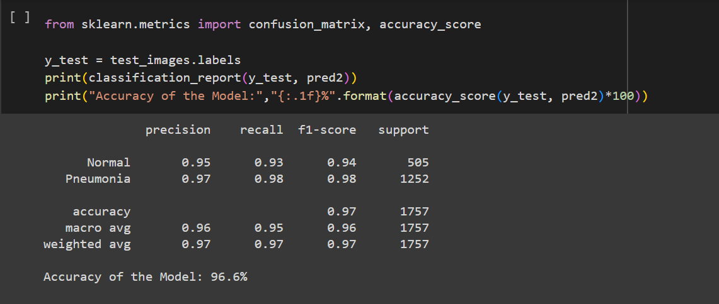
RESULTS

Slide 12
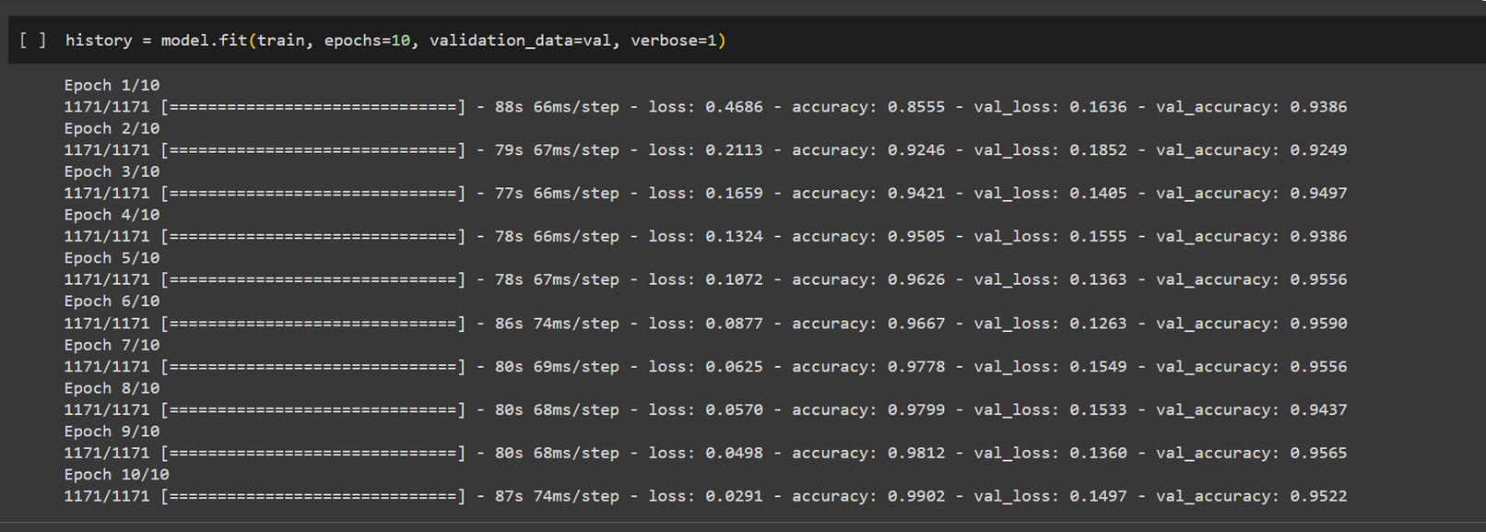
RESULTS

Slide 13
THANK YOU

