Slide 1

PES UNIVERSITY
(Established under Karnataka Act No. 16 of 2013)
Electronic City, Hosur Road, Bengaluru - 560 100, Karnataka, India
Dissertation on
“ JOURNEY CRAFT - Craft your perfect journey ”
Submitted in partial fulfillment of the requirements for the award of the degree
of
Bachelor of Technology in
Computer Science & Engineering UE21CS320A - Capstone Project Phase - 2
Submitted by:
Harshan K A Bhargavi K Kaushik C Adithya K
PES2UG21CS191 PES2UG21CS224 PES2UG21CS225 PES2UG21CS232
Under the guidance of
Dr.Nazmin Begum
Associate Professor
PES University
June - Nov 2024
DEPARTMENT OF COMPUTER SCIENCE AND ENGINEERING
FACULTY OF ENGINEERING PES UNIVERSITY
(Established under Karnataka Act No. 16 of 2013)
Electronic City, Hosur Road, Bengaluru - 560 100, Karnataka, India

Slide 2

PES UNIVERSITY
(Established under Karnataka Act No. 16 of 2013)
Electronic City, Hosur Road, Bengaluru - 560 100, Karnataka, India
FACULTY OF ENGINEERING
CERTIFICATE
This is to certify that the dissertation entitled
JOURNEY CRAFT-Craft Your Perfect Journey
is a bonafide work carried out by
Harshan K A Bhargavi K Kaushik C Adithya K
PES2UG21CS191 PES2UG21CS224 PES2UG21CS225 PES2UG21CS232
In partial fulfillment for the completion of sixth-semester Capstone Project Phase - 2 (UE21CS320A) in the Program of Study -Bachelor of Technology in Computer Science and Engineering under rules and regulations of PES University, Bengaluru during the period Jan. 2024 - May. 2024. It is certified that all corrections/suggestions indicated for internal assessment have been incorporated in the report. The dissertation has been approved as it satisfies the 6‘^{h}-semester academic requirements in respect of project work.
Signature
Dr.Nazmin Begum
Assistant Professor
Signature
Dr.Sandesh B J
Chairperson
Signature
Dr.B K Keshavan
Dean of Faculty
Name of the Examiners
External Viva
Signature with Date
Dr. Arti Arya
Dr. Prema
3. Dr.Nazmin Begum

Slide 3
DECLARATION
We hereby declare that the Capstone Project Phase - 2 entitled “JOURNEY CRAFT - Craft Your Perfect Journey” has been carried out by us under the guidance of Dr.Nazmin Begum, Associate Professor and submitted in partial fulfillment of the course requirements for the award of the degree of Bachelor of Technology in Computer Science and Engineering of PES University, Bengaluru during the academic semester January -May 2024. The matter embodied in this report has not been submitted to any other university or institution for the award of any degree.
Harshan K A
PES2UG21CS191
Bhargavi K
PES2UG21CS224
Kaushik Challapalli
PES2UG21CS225
Adithya K
PES2UG21CS232

Slide 4
ACKNOWLEDGEMENT
I would like to express my gratitude to Dr.Nazmin Begum Associate Professor, Department of Computer Science and Engineering, PES University, for her continuous guidance, assistance, and encouragement throughout the development of this UE21CS390A - Capstone Project Phase - 2.
I am grateful to all Capstone Project Coordinators, for organizing, managing, and helping with the entire process.
I take this opportunity to thank Dr. Sandesh B J, Professor & Chairperson, Department of Computer Science and Engineering, PES University, for all the knowledge and support I have received from the department. I would like to thank Dr. B.K. Keshavan, Dean of Faculty, PES University for his help.
I am deeply grateful to Dr. M. R. Doreswamy, Chancellor, PES University, Prof. Jawahar Doreswamy, Pro-Chancellor, PES University, Dr. Suryaprasad J, Vice-Chancellor, PES University, and Prof. Nagarjuna Sadineni, Pro-Vice Chancellor, PES University, for providing me with various opportunities and enlightenment every step of the way. Finally, Phase 1 of the project could not have been completed without the continual support and encouragement I have received from my family and friends.

Slide 5
TABLE OF CONTENTS
Chapter Title No.
INTRODUCTION
PROBLEM STATEMENT
LITERATURE REVIEW
Page No.
08
10
12
Multi-agent Itineary planning based voronoi diving and Discrete multi
objective Particle Swarm optimisation
Improving itinerary recommendations for tourists through
metaheuristic algorithms: an optimization proposal
14
Graph neural network for traffic forecasting: A Survey
Travelplanner: A benchmark for real-world planning with language agents
Trip Itinerary Planning: A Bio-inspired Metaheuristic Approach.
Large Language Models for Travel Behavior Prediction
16
18
19
21
4. PROJECT REQUIREMENTS SPECIFICATION | 25
5. HIGH LEVEL DESIGN DOCUMENT | 29
6. LOW LEVEL DESIGN DOCUMENT | 37
7. SYSTEM DESIGN | 68
8. PROPOSED METHODOLOGY | 73
9. IMPLEMENTATION AND PSEUDOCODE | 62
Implementation Details
10. CONCLUSION AND FUTURE WORK
11. REFERENCES/BIBLIOGRAPHY APPENDIX A DEFINITIONS, ACRONYM
76

Slide 6
Journey Craft- Craft Your Perfect Journey
CHAPTER 1
INTRODUCTION
1.1 Project Overview and Objectives
In the present-day world, the majority of people tend to be over-busy with their jobs and it is sometimes difficult for them to sit and plan their trips because of the lack of time. On the other hand, not having these key details; weather forecast, local festivals and best destinations among others, often affect their trip planning strategies. In order to deal with this difficulty, we an website which is based on the user-friendly concept is developed, and the travel plans are able to be generated by using the real-time data and is well-organized after the users input their upcoming destinations. Our project is built based on a fundamental principle of easy and stress-free trip planning. Consequently, we meet the needs perfectly for the users by providing them with all the information they need to maximize their trips.
This project aims at developing a Travel Planning app which uses live updates as well as individualized travel plans for the users. The project provides users with floods of info about things like weather forecasts, nearby fests, upcoming event, traffic updates and attraction advices which in turn relieves people of hassles elements and ensures a smooth voyage

Slide 7
Journey Craft- Craft Your Perfect Journey
Objectives :
Build a system that integrates with live data for weather-forecast, traffic, local events and festivals. Based on users input and preferences, provide personalized travel plans to the users.Make the interface userfriendly and easy to use.Come up with logical travel plans that will help the users by suggesting detailed maps and recommendations.Offer emergency help features for asistance to the users who find themselves in difficult situations during the trips

Slide 8
Journey Craft- Craft Your Perfect Journey
CHAPTER 2
PROBLEM DEFINITION
Definite plans made at the last moments are stressful and full of complications due to the inaccessibility of information like the weather forecast, festivals in the circle of the holiday and available places of interest.
However, insufficient information about the destination often brings about the less interesting travel experience as the travelers may be unaware of various important points of interest or events, which causes worry and dissatisfaction.
Furnishing the information on weather forecasts, local events, & best destination offers without the need to search here and there will greatly make the last-minute trip planning experience user-friendly, & hence travelers will be able to savor their trips to the fullest.
To address the mentioned issues, the app is being designed such that travelers can input their destinations with case.
Use APIs for traffic and weather forecasts to keep travelers informed with up-to-date information about their travel schedule.
Feature the hotels and restaurants in the areas that are to be explored, this should augment the general trip experiences for the users.
Equip users with a tool for immediate access to data on nearby festivals and events to optimize their trips.

Slide 9
Journey Craft- Craft Your Perfect Journey
Scope:
The scope of Journey Craft includes real-time data integration for weather, traffic, and events, personalized multi-destination itineraries.Future expansions may include booking integration, user feedback, and supporting multiple languages.

Slide 10
Journey Craft- Craft Your Perfect Journey
CHAPTER 3
LITERATURE SURVEY
[1] Multi-agent tinerary planning based Voronoi dividing and Discretemultiobjective Particle swarm optimisation
Mobility Agents (MAs) are software components that move from sub-system to sub-system, which makes it possible to treat applications in a more filexible way, to distribute them locally and to create processing-collaborative systems and signals. Some studies have proven that the ABA approach is more effective for data collection and integration over the CS algorithm and this is applicable for quality enhancement. The suggested technique is about the network division into a Voronoi graph, where every raw data zone has the data source node and the intermediate one.
Individual nodes at ag intermediate level gather and group data before they are forwarded to the primary data node, Proper particle swarm algorithm optimization is the technology used to make the selection of the MA's data source node, thus finding the best path is achieved. The simulation proved the capability of the algorithm together with notable performance increasing potential in comparison with the alternatives.
Advantages
Efficient Area Division: Voronoi distribution assigns a particular area for the destination to beready to explore which is represented by all the possible locations. This does a lot in
that it organizes routes and optimizes destination suggestions based on the proximity and availability of various sites that witnesses visit.
Optimal POI Selection: By choosing the center of each region of Voronoi as a point of interest, the algorithm can support optimization from the point of view of POls geographical distribution aswell, and in this way users could get a full and rich trip plan that reflects their interests and the character of the destination..

Slide 11
Journey Craft- Craft Your Perfect Journey
Balanced Itineraries: Voronoi diagrams show the probability of a particular POI of being selected and thus subsequently helping to distribute POIs equitably in the destination, which alsoensures a comprehensive and balanced travel experience.
Improved Itinerary Performance: In light of other approaches, variations of Voronoi algorithms imply having a better performance index as it relates to travel time, total distance andgenerally handy routing paths.
Limitations :
Complexity: There are complexities which should be involved in implementing Voronoi diagrams within itinerary planning systems particularly because the destinations nowadays arebigger and they are necessary to have efficient algorithms and computational resources.
Sensitivity to POI Distribution: The efficiency of Voronoi-based algorithms extensively rested on the distribution of the PKVs of the destination area. Travelers may receive unequal or less thanoptimal descriptions of itinerary recommendations.
Scalability: Implementations of Voronoi-based algorithms for scaling to cover the wide distances or to meet the requirements of dynamic changes relating to POls often
face difficulties inensuring itinerary quality due to the necessity of running frequent adjustments.

Slide 12
Journey Craft- Craft Your Perfect Journey
[2] improving itinerary recommendations for tourists through metaheuristicalgorithms: an optimization proposal
This research paper incorporates metaheuristic learning specifically the k-means and the Genetic Algorithm (GA) for the tourism route planning improvement. The k-means algorithm is utilized for clustering the Points of Interest (POl) according to users interests, while GA is aimed to optimize travel time in itineraries having a wide range of constraints and preferences. The GA aims to display the possible solutions (routes) as chromosomes that will undergo changes due to selection, crossover and mutation. The fitness function checks the itinerary's quality, depends on variables like travel time and user constraints. Thus, the inclusion of these metaheuristic algorithms enhances not only the performance of itinerary recommendations, but also their effectiveness and quickness. Advantages :
Enhanced Travel Experiences: Through guidance of genome algorithm like Genetic Algorithms, the paper adds an extra ingredient to tourists' travel experiences turning them into apiece of fond memory.
Personalized Itinerary Recommendations: Being able to see, for example, recommendations forthe places to go, activities to do, or to obtain more information about your destination become a lot easier through the use of these advanced algorithms, which generate personalized itineraries based on one's preferences.
Scalability and Adaptability: Scalability is a key aspect in the recommender system's design, allowing processing of huge number of information swiftly. It can also adjust to amends in personal preferences and surrounding 'temperament', resulting in its usefulness throughout different tourist serves.

Slide 13
Journey Craft- Craft Your Perfect Journey
4. Real-Time Suggestions: Tourists obtain advantage through receiving instant recommendation which gives suitable information on the Points of Interests (POIs) sojourning through their journey.This function displays the responsive character and allows for a quick-decision among the consumers.
Limitations :
Data Accuracy and Updates: The accuracy of this system completely depends on its database with correct and up-to-date information on places. Such will be updated at periodintervals as the development works occur in these areas.
Adapting to Different Places: The main objective of the System is travelling in particular area.Besides that, it could apply to other types of places to travel by and destinations. The necessity to improve its capability to be flexible, ambiguous and also prove the limits by creating and simulating the critical foreign issues of enhanced complexity exists.
Understanding User Feedback: The survey comprise of 131 respondents however the survey was not very helpful related to the stimulation of the feedbacks or the methodology applied to analyze the results.
Picking the best sample size helps one boost the statistical power of the study and makes thefindings more trustworthy.
Handling Large Amounts of Data: These algorithms can seem difficult to comprehend and
require complex calculations, especially if the system is planned to process a large amount of dataor the system has to implement elaborate planning processes. The essay will then focus on the algorithms that are useful when it comes to problems which are hard to handle.

Slide 14
Journey Craft- Craft Your Perfect Journey
[3] Graph neural network for traffic forecasting: A Survey
This article shall be used to summarize the use of the traffic forecasting GNNs. Incoming will, be also graphical shown graphically. They are conduction-level, area-level and station-level The recurrent,convolutional and autoencoder GNNs are made use of as described. It considers the obstacles and methods for the exploration of traffic forecasting using GNNs adopted in future. This paper is aimed at being useful for both new and older researchers; it will be able to open windows on the latest graph-based solutions that should improve traffic forecasting outcomes. It also emphasises the problems encountered while implementation of Intelligent Transportation Systems (ITSs) of city-scale. The conclusion section argues that multi-task framework and the data privacy issues in the transportation field should be an important topic for the future work.
Advantages :
Comprehensive Review: The study presents a complete survey of the graphs based solutions for the traffic forecasting problems between 2018 to 2020. The paper gives a
deep insight in the problems and different relationships, which are presented in a graph
formulation, and also the models used in graph neural networks(GNN) based traffic forecasting research.
Resource Collection: It provides a complete scaffold of GNNs open datasets with codes that are used for replication and comparison for GNNs in future work, making it a treasure-trove for gazing researchers in a field.
Future Directions: The paper establishes the problems associated with utilizing GNNs to predict traffic and also outlines the possible future directions for the researchers in the
field. The paper will, in addition, provide important insight into the challenges and the opportunities

Slide 15
Journey Craft- Craft Your Perfect Journey
Limitations :
Practical Implementation Challenges: The article pinpoints the substantial bias not only generated from insufficient amount of cases considered in the present GNNs studies but also results in the restriction of the validity of the previously conducted research to the different time periods or regions. It would be also important to bear in mind that the modification of traffic network systems underlying data should be registered and updated, this increasing the necessity to and difficulty in gathering data on-site.
Model Interpretation: As the paper underlines the absent model interpretation in GNNs for traffic forecasting, which might reflect as a more severe problem than deep learning model in thetransportation domain as the complex dynamics of multitudinous data types and representation put forward huge challenges for the design of interpretable deep learning model.
[4] Travelplanner: A benchmark for real-world planning with language agents
The paper is presenting the introduction to the TravelPlanner benchmark, which is being developed to train the multi-constraint planning and the tool-use abilities of autonomous agents in highly complex real-world situations
-namely the travel planning. It presents the difficulties with which the language agents, namely large language models (LLMs), are faced when it comes to fulfilling complex planning tasks. The best performing LLM only manages to get 0.6% of success rate in the latter. The analysis shows that the current ones do not being adequate when it comes with information collection, tool use, and holistic taking all constraints into account. In line with this fact the document highlights the importance of more intelligent planning strategies to overcome the performance issue in substituting human level of planning, with case studies on the failure and limitations the current Al languageagents display. The paper concludes by invisiong TravelPlanner as a stepping stone for conducting future studies for improving agents plausibility in extremely complicated country conditions with the purpose of hill-climbing toward human-like intellectual intelligence.

Slide 16
Journey Craft- Craft Your Perfect Journey
Advantages :
Comprehensive Evaluation: During the testing, TravelPlanner assesses language agents'
planning capabilities in three stages - perception, understanding and plan formulation, in which they are required to perceive, understand various constraints and develop feasible plans respective to the constraints.
Real-World Simulation: The benchmark mirrors dynamic and real-world setting, putting agentsfaced with corresponding factors such as unavailable transit and appeals which forces to adapt and mimics the real physical planning adaption.
Diverse Query Design: It involves different combinations of various travel occasions like short- duration and complex inquiries to ensure their capabilities in delivering operation planning decisions accounting for the inter and intra city connections.
User Needs Assessment: TravelPlanner considers various user needs such as time, direction and comfort through the diversity of user preferences turning these into the harder limitations not only adding lots of complications but assuring that the agents will successfully cover all the user preferences which would make the problem statement more realistic.
Holistic Evaluation: This data is collected by way of pen tests which test agents' abilities from all the dimensions namely tool use, planning, simultaneously holding multiple aspects in consideration broadly covering all their capabilities.
Limitations :
Agent Struggles: Present language agents, namely, state-of-the-art LMs, are unable to demonstrate high enough performance in the context of such complex planning tasks, since they achieve low grades for various constraints and experience difficulties when dealing with global planning scenarios.
Tool-Use Errors: Agents, including the LLM-based ones lack information collection and toolusage which leads to plan delivery failures and difficulties in tool use.

Slide 17
Journey Craft- Craft Your Perfect Journey
Planning Strategies: The current planning schemes, ReAct and Reflexion exhibit shortcomings in managing the generalized and narrow cases in TravelPlanner, hence the needfor smarter planning strategies.
Holistic Consideration: Agents are limited only to considering the constraints one by one, and this is a serious problem because they need to consider the constraints
holistically and this is very important for doing the tasks in TravelPlanner.
Need for Improvement: The score definitely shows necessity and urgent need of new techniques like backtracking for re-planning or using heuristic methods for forward-looking planning to improve agents' capabilities in complex planning problems.
[5] Trip Itinerary Planning: A Bio-inspired Metaheuristic Approach.
Trip itinerary planning frequently featured in tourism and of our course of life. This paper's focus is the modelling of a trip itinerary problem as a multiteam orienteering problem with a time window and travel distance as a soft constraint. Three of the bio-inspired meta-heuristic algorithms, which are namely genetic algorithm, adaptive genetic algorithm, and artificial bee colony algorithm are utilized to solve the problem here. Solvers are assessed via how they work in terms of execution time, optimality and speed using authentic data from the City of Toronto. The experiment results have highlighted the fact that the genetic algorithm that adapts is superior to other algorithms in optimality and robustness.

Slide 18
Journey Craft- Craft Your Perfect Journey
Advantages :
Efficient Problem Solving: The article well describes the trip itinerary planning problem
solution by using bio-inspired metaheuristic algorithms. Such algorithms provide cutting-edge solutions to the optimization problems of great difficulty.
Optimality and Robustness: The adaptive genetic algorithm (AGA) in the research does abetter job optimality and robustness than other algorithms. This implicates that the proposed method will offer leading-edge solutions always.
Real Data Evaluation: The study implements the algorithms using actual data from the City of Toronto, which gives the study a real-world dimension (T2). The real-world application makes theresults not only reliable but applicable.
Improved Performance: The adaptive-characteristics of the genetic algorithm help it in findinghigh-quality solutions and avoiding local minima. This adaptability offers better outcomes compared to other genetic algorithms.
Practical Implications: The research takes a practical approach to trip planning challenges like time restrictions, budget limitations, and tailored schedule creation.
Through provision of solutionsto these problems, the paper will upgrade the total travel experience.
Limitations :
Limited Generalizability: We study schedule building with the assumption of the given city of Toronto, making the generalization of outcomes harder across other places that have different characteristics and sites.
Scalability Concerns: While the scalability of proposed methods is not largely covered to tacklelarger datasets or more complex trip planning scenarios, they seem flexible enough
to handle class assignments.Algorithms may perform differently in conditions when complexity is varying so algorithm performance could be another limitation.
Lack of Comparative Analysis: Mice simply have too few neurons in their brains to have their intelligence resemble that of humans. This makes it impossible to
accurately measure their cognitive abilities while they are in the premature stage of their lives.

Slide 19
Journey Craft- Craft Your Perfect Journey
Evaluation Metrics: It mainy criticized the coverage of algorithms against optimality and reliability.Inserting computational efficiency parameters, convergence speed or user satisfaction can give a more pragmatic test of the algorithms'' performance and provide better understanding.
Limited User Interaction Consideration: This research is concerned about the rational optimization of the trip plans upon the algorithmic basis only but it is only
seems to ignore lotsof aspects like user preferences, feedbacks, and the dynamism
during the trip planning process.Providing added problem-based aspects within the research could significantly increase the applicability of the subject.
Large Language Models for Travel Behavior Prediction
The paper points out application of the large language models (LLM) to predict travel behaviour without data- dependent parameter learning. They develop protections such as instructions describing the task, travel attributes, individual character and different modes of thinking which should accompany the domain knowledge. Following theinstructions, teh LLMs are asked to predict the way travel behaviour and then explain the outcomes, accordingly, theresults being competitive in terms of accuracy and FI-score with respect to other supervised learning methods.
Nevertheless, provided that a portion of the artificial intelligence outputs behaves in a manner that violates logic orhas a hallucination, the problem may arise.
Advantages :
It is trained on a wide range of samples found in the survey data hence a more comprehensive view.
In this paper GPT 3.5 model having possessing advanced and a widely used features is trying to implement toapproach and try to solve this problem.

Slide 20
Journey Craft- Craft Your Perfect Journey
Limitations :
fails in regard to living data.
biaz / subjectivity impacts the information since it is a survey for a certain area.
Traffic flow prediction via spatial temporal graph neuralnetwork
In this paper, we deal with a particular topic of the applications of spatial-temporal graph neural networks for traffic flow prediction in smart cities. It is additionally developed as a means of providing an alternative that answers the weaknesses that are found in other existing methods, which will include the occurrence of both spatial and temporalpatterns. The network comprises of the adaptive positional attention which is used for fusing data from adjacent roads together with a sequential component which models the inherent dynamics of traffic flows tickling not only local but also global temporalities. The experiments revealed that the outcomes given by the proposed framework are pretty good.
Advantages :
Comprehensive Approach: Our approach employs graph neural networks, recurrent neural networks, andtransformers' layers that include both space-time patterns and traffic flow.
Effective Attention Mechanisms: It offers a trainable positional attention mechanism, finding out neighboring road's information, and taking into account both local and global temporal dependencies.
Superior Performance: It does so much better compared to most of the baselines, especially in the short termtraffic speed prediction (minutes).
Innovation: The framework is novel for it deals with both spatial and temporal dependencies thus opens aroom for traffic control management.

Slide 21
Journey Craft- Craft Your Perfect Journey
Limitations :
Limited Generalizability: The structure aims to expand the generalizability by covering both thespatial and the temporal dimensions of the traffic patterns, which is the disadvantage of the
classical methods that often struggle with the changes to the system and
the complex roadrelations.
Scalability Concerns: Composed to cope with designated road networks but scalability challenge may be encountered due to data amount dependency and network layers integration.
Data Requirements: The framework needs large-scale data for training and validation purposes since it is based on historical traffic flow data and the fact that the road relations needto be covered in detail.
Dependency on External Factors: The framework efficacy is dependent on random attributes such as road conditions and happenings which might not match the predicted or modeled data adversely to the prediction accuracy.

Slide 22
Journey Craft- Craft Your Perfect Journey
[8] Empowering Few-Shot Recommender Systems With Large Language Models- EnhancedRepresentations
Latching on to the topic, the paper explores the employment of Large Language Models (LLMs) for the furtherimprovement of a few-shot recommender systems. It shows that in this
way two methods are contrasted: old recommendation technique and the area occupied by LLMs that process explicit reviews.
The paper deals with the utilization of ChatGPT, a particular LLM, for data of users and
items by containing the information as their feedback. In addition it estimates a semantic concordance between Chatgpt machine renditionsand the original reviews. The results show that the model performs well in processing direct textual corrective comments and builds the ability of models that make recommendations in this manner to learn more general skills.
The document explains, -the computational process and the generation of datasets, -the performance of the evaluation of
LLM-processing mechanisms too. Therefore it enables the exploration of usability of data vectors of ChatGPT-produced words by users and items in data science and marketing.

Slide 23
Journey Craft- Craft Your Perfect Journey
Advantages :
Enhanced Performance: LLMs are shown to augment the precision of recommendationmodels in low sample cases, e.g. neural networks.
Textual Representation Generation: LLMs show the capability to produce user and item representations using textual explicit feedback, and these information can be smoothly was integrated into recommendation models.
Generalization Potential: In addition to that, recommenders become more flexible and tolerantwhile still facing some constraints associated with model architecture.
Proficiency in Textual Information Processing: The fact that LLMs like ChatGPT will
process every kind of textual pointers as well as understand the context with different sentiment feelings isreally amazing.
Limitations :
Model Performance: Some of the networks included in the examples like the CNN type, achieved extremely high training loss and were not able to successfully complete training in the narrow-shot setting. This indicated the limitations in terms of model performance.
Disparities in Embeddings: The ChatGPT processed vector datasets had similar semantics to the original reviews but their difference in the content included the amount as most of the materialhad been trimmed and information refined whole lasting only some time, what could imply that they were purposefully limited in terms of content by the ChatGPT.
Content Disparity: It is a main issue that the generated representation of ChatGPT show content deficiencies as compared to the originally written reviews, that can reduce the effectivenessof recommendations.
Language Limitations: The study extensively relies on the Chinese text data thereby, providedthe possible inability to generalize the results to other languages or culture.

Slide 24
Journey craft- craft your perfect journey
CHAPTER 4
PROJECT REQUIREMENT SPECIFICATION
Functional Requirements
Input Validation: System should then verify the input for upcoming destinations to ensure they arerecognized in the appropriate format and range .Checking of whether the full information is provided,
e. g. dates and destination name should also be included in input validation.
Sequence of operation : It is expected that the system, given the input, will initiate a series of operations entailing the collection of data.The process can also be done by calling different APIs or database to get the real-time weather forecast, local festival calendar, events database or attraction data.
Error handling and recovery : Nevertheless, this system should be able to handle errors successfully by, for example, giving feedback to users in case of an incorrect input or a data retrieval failure.The recovery procedure will need to be comprehensive and it should also include systems thatprompt users to reenter their inputs or to retry the data retrieval.
Consequence of parameters : Such essential factors such as destination, departure date and preferences of the user will be used to determine what data will be retrieved and how the travel plan will be generated. Talking another example, various cities will have different weather and seasonal patterns that will have to be handled based on the user's input.
Real time data-integration: The system needs to add real-time data integration to adjust thetravelingprogram according to the weather forecasts and events calendar.

Slide 25

Journey craft- craft your perfect journey
External Interface Requirements
User Interfaces
Developing a user-friendly and logical appearance of the GUI part of the project is going to be implemented following the GUI standards of styles and screen layouts.We will try to make the application easy-to-use and provide commonly available features like help tools, and other functions like relative inputs and outputs in terms of time among others. The interface will be developed with the aim that it will be best suitable for all the screens, including computers, tablets, and mobiles.
Besides that, error messages will be added, so users will receive some explanatory feedback in case they enter the wrong data or have unsuccessful data retrieval process. The error-friendly design is done with ease-of-use and resilience in mind.
Hardware Requirements
The project will be accompanied by software for any popular operating system, such as iOS, Android, and Windows platforms. With the majority of devices working on IOS and Android operating systems included it will be one of compatible ones. Besides, the software components include real-time data integration, recommend algorithms and UI design. Further, the hardwire configurations may have to support communication interfaces such as local area network protocol, serial port, parallel port, etc.
Software Requirements
The software will be based on a full spectre of software instruments applications for real-time data integration, recommendation algorithms and UI design.The software components which must be developed will incorporate the databases, tools, and libraries, as well as the operating system. The application will be engineered to binary code of the main operating systems with iOS and Android in mind, consequently will be easily usable by majority of devices.The administrative system will be connected with such services as data retrieval and emergency response, however, with the first concern on the adjustment to other apps.

Slide 26
Journey craft- craft your perfect journey
Non-Functional Requiements Performance Requirement
Page Load Time:Fast pages loads are supposed to be the norm, hence one to three seconds isperfect and is supposed to retain the customers.
Responsiveness: The website design should be responsive enough to accommodate different screen sizes and devices that would include desktop monitors, laptops, tablets and smart phones.
Reliability: The site should minimally generate up to 1% system disruption during the installationperiod. 9% to be available all the time which is being used by the users.
Safety Requirements
Data Privacy: Integrate workable data security policies such as encryption of the most sensitive information and compliance with the current privacy rules and regulations into
the system.
Data Backup: Among the factors that will be incorporated in the overall infrastructure designis frequent backup of users' data in order to mitigate any risk of system failure or data security breach with the backups safely stored.

Slide 27
Journey craft- craft your perfect journey
Security Requirements
Authorization: Make sure about the presence of proper access controls to prevent the users fromseeing the confidential information and from using functionalities, which exceed their responsibilityand position in the organization.
Authentication: The website should conduct secure authentications like password hashing, two-factor authentication and other ways to identify the user.

Slide 28
Journey craft- craft your perfect journey
CHAPTER 5
HIGH LEVEL DESIGN DOCUMENT
Introduction
JourneyCraft is a travel itinerary optimization system. The system uses clustering algorithms, real-time data processing, and integration with various APIs to generate personalized travel plans. The design uses key components, their interactions, system architecture, and deployment considerations. This document aims to provide stakeholders with a comprehensive understanding of the solution's design principles, capabilities, and functional aspects.
Current System
The current travel planning systems offer limited customization and optimization, often lacking real-time optimizations. They may provide general itineraries based on static data without considering live updates like traffic, weather, or local events. Consequently, users face challenges like unexpected delays, inclement weather, or missed opportunities for local experiences.
Design Considerations Design Goals
This project aims to provide:
Provides real-time, optimized travel plans by integrating weather, traffic, and events data.
Use clustering algorithms (like Agglomerative and K-Means) to group attractions and activities efficiently based on userpreferences and constraints.
Ensure scalability and flexibility through efficient data handling and algorithmic adaptability.
The design focuses on:
Real-Time Data optimization: Adjusting itineraries based on live updates to improve travel experiences.

Slide 29
Journey craft- craft your perfect journey
User-Centric Design: Seek a very simple, intuitive interface that can serve all types of users.
Architecture Choices Alternative Options Considered:
Monolithic Architecture: Putting everything into a single code base that is easy to manage at the expense of scalability and flexibility.
Journey Craft uses both micro lithic and monolithic architectures.
Components:
Data Collection Service: it gets information from multiple APIs, including Google Maps, Zomato and Booking.com. Information collected contains database of attractions, traffic conditions and local weather for the desired location.
Data Preprocessing Service: Cleans and transforms data (for example, geocodes location using Google API) so that the data isconsistent and ready for clustering.
Clustering: It utilizes algorithms like K-Means and Agglomerative clustering to make day-to- day plans. It also incorporates variations in user preferences with the suitable optimizations on travel distance and time considerations
User Interface : Has a good user interface for ease of use for customers and clients.
API Integration Services: Such services enable the conversation of the external service to fetch the actual updates that could have to dowith traffic, weather, or event data.
Benefits
Scalability: Its highly scalable , so resource utilization is very efficient.
Flexibility: Updating or replacing specific parts of the system does is very easy.
Fault Tolerance: The service-based structure will rarely make failures in one service propagate to other services.
Constraints, Assumptions, and DependenciesAssumptions:
Features:
The use of Google maps and weather API’s.
Adequate computation to cluster and process data;
Limitations
API Availability: Using third party API’s create latency in its delivery
Performance issues because of lot of dependency

Slide 30
Journey craft- craft your perfect journey
Cross-platform Compatibility: The system must work across all devices, from computers to mobile platforms.Dependencies:
APIs: Dependence on the reliable APIs dealing with traffic, weather, and events data.
Data Storage
Performance Related Requirements
Should have extremely low latency.
Scalability should be high
User Experience, should be user-friendly.
Deployment and Maintenance
The system must be built with ease of deployment in cloud-based environments, with proper high availability and faulttolerance.

Slide 31
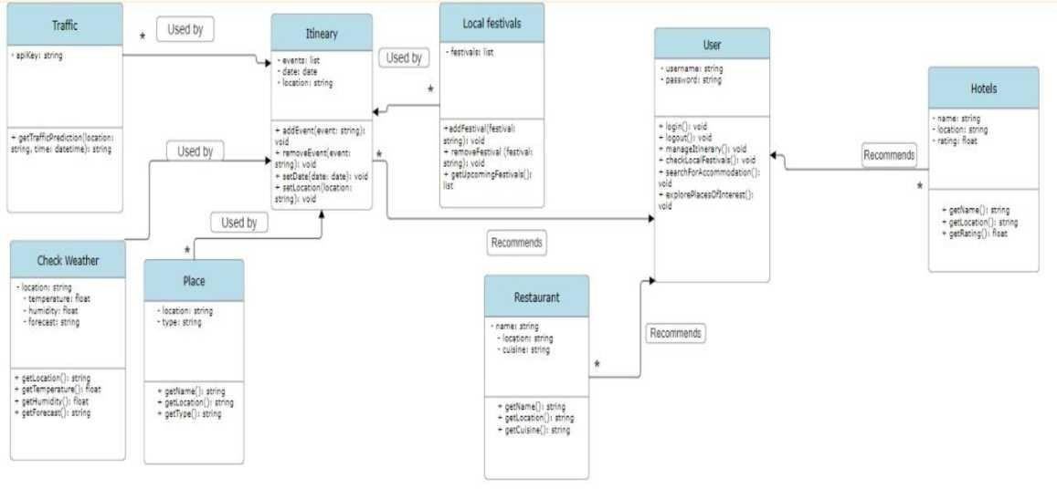
Journey craft- craft your perfect journey
HIGH LEVEL SYSTEM DESIGN
MASTER CLASS DIAGRAM

Slide 32
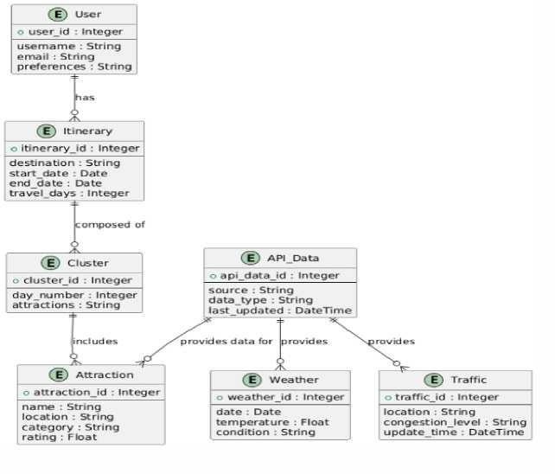
Journey craft- craft your perfect journey
ER DIAGRAM

Slide 33

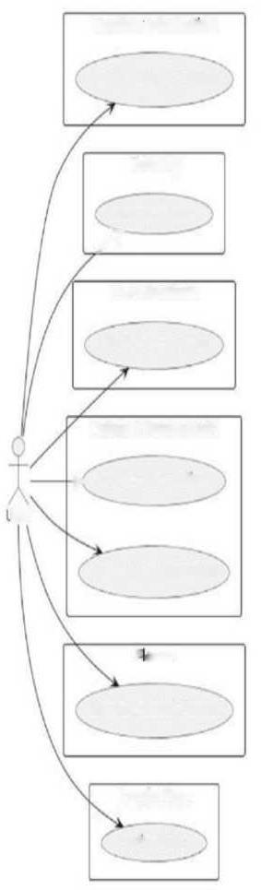
Journey craft- craft your perfect journey
UNIVERSITY
USER INTERFACE DIAGRAM
Weather Information
Access Weather updates
Itinerary
Manage itinerary >--
Local Festivals Check Local Festivals
Hotels & Restaurants
> Search Dining Options
iser
Search Accommodation
Paces
Explore Places of interest
Google Maps
PredictTraffic

Slide 34
Journey craft- craft your perfect journey
DESIGN DETAILS
Novelty and Innovativeness
Using clustering algorithms like K-Means and Agglomerative and real-time data integration for adaptive itineraryplanning.
Utilizing GNN to organize and optimize day-wise travel schedules efficiently.
Using API’s(Google and weather) to give live updates to customers
Interoperability
Designed to work across different platforms and support integration with future data sources, such as additional travel andevent APIs.
Performance
Real-time processing of data inputs using efficient clustering algorithms and optimized data pipelines to minimize latency.
System optimizations to ensure quick itinerary updates in response to live changes in weather, traffic, or user preferences.
Security
Implementing security measures, such as encryption and secure API authentication, to protect user data and ensure dataintegrity.

Slide 35
Journey craft- craft your perfect journey
Reliability
Accurate and robust clustering techniques to provide dependable itinerary suggestions with minimal disruptions.
Portability
Use of containerization technologies like Docker to facilitate easy deployment across various cloud platforms or on-premisesenvironments.
Designed for portability to adapt to different hardware and software configurations with minimal setup.
Reusability
Reusable components such as clustering algorithms, data preprocessing methods, and API integration modules to streamlinedevelopment for future projects.
The design enables extensions and reuse in other travel-related or real-time optimization applications.
Application Compatibility
Compatibility with various environments, from web-based applications to mobile platforms, ensuring a wide range of user accessibility.
Designed to accommodate integration with third-party travel applications for a more extensive ecosystem.

Slide 36
Journey craft- craft your perfect journey
Portability
Use of containerization technologies like Docker to facilitate easy deployment across various cloud platforms or on-premisesenvironments.
Designed for portability to adapt to different hardware and software configurations with minimal setup.
Reusability
Reusable components such as clustering algorithms, data preprocessing methods, and API integration modules to streamlinedevelopment for future projects.
The design enables extensions and reuse in other travel-related or real-time optimization applications.
Application Compatibility
Compatibility with various environments, from web-based applications to mobile platforms, ensuring a wide range of user accessibility.
Designed to accommodate integration with third-party travel applications for a more extensive ecosystem.

Slide 37
Journey craft- craft your perfect journey
SECTION 6
LOW LEVEL DESIGN DOCUMENT
Introduction
In the present-day world, the majority of people tend to be over-busy with their jobs and it is sometimes difficult for them to sit and plan their trips because of the lack of time. On the other hand, not having these key details; weather forecast, local festivals, and best destinations among others, often affect their trip planning strategies. In order to deal with this difficulty, we a website which is based on the user-friendly concept is developed, and the travel plans are able to be generated by using the real-time data and is well-organized after the users input their upcoming destinations. Our project is built based on a fundamental principle of easy and stress-free trip planning. Consequently, we meet the needs perfectly for the users by providing them with all the information they need to maximize their trips.
Overview
This project aims at developing a Travel Planning app which uses live updates as well as individualized travel plans for the users. The project provides users with floods of info about things like weather forecasts, nearby fests, upcoming event, traffic updates and attraction advice which in turn relieves people of hassles elements and ensures a smooth voyage.

Slide 38
Journey craft- craft your perfect journey
6.1.2. Purpose
Build a system that integrates with live data for weather-forecast, traffic, local events, and festivals. Based on users input and preferences, provide personalized travel plans to theusers.Make the interface usr friendly and easy to use.Come up with logical travel plans that will help the users by suggesting detailed maps and recommendations. Offer emergency help features for assistance to the users who find themselves in difficultsituations during the trips.
6.1.3 Scope
Core Functionality:
User Input: Users will be able to input multiple destinations they wish to visit during a trip. Itinerary Generation: The system will automatically generate an optimized travel plan based on userinput and real-time data.
Real-Time Data Integration: The system will integrate external APIs to fetch real-time informationsuch as:
Weather Forecasts: To help users avoid unfavorable conditions.
Local Festivals/Events: Highlighting any special events happening at the user’s destinations. Famous Places & Points of Interest (POIs): Recommendations for must- visit places based onpopularity.
Traffic Conditions (if applicable): For better route optimization and travel time estimation. Optimization Algorithms:
Agglomerative Clustering: Used to cluster destinations into logical groups (days) based on proximityand other factors.
K-Means Clustering (Alternative): Can be used as another clustering technique to optimize groupingof destinations.
Metaheuristic Algorithms (Optional): Could explore algorithms like Genetic Algorithms or Ant Colony Optimization to further optimize routes and reduce travel time

Slide 39
Journey craft- craft your perfect journey
UNIVERSITY
User Experience:
User-Friendly Interface: The website will feature a clean and intuitive interface for users to input theirpreferences, view their travel plans, and make adjustments.
Responsive Design: The site will be accessible on various devices, from desktops to mobile phones. Personalization: Users will receive personalized travel recommendations based on their preferencesand past trip history
Security and Privacy:
Authentication and Authorization: Secure login system with user accounts.
Data Privacy: Implementation of encryption for sensitive data, compliance with data protectionregulations, and secure
storage for user details and preferences.
API Security: Ensuring secure communication between the website and external data sources.
Performance and Scalability:
Real-Time Data Fetching: Efficient and responsive handling of large amounts of real-time datafrom APIs.
Scalability: The system will be designed to handle a growing number of users and increasing volumesof data (e.g., more destinations or more frequent API requests).
Additional Features (Future Scope):
Machine Learning Integration: Predictive recommendations for destinations based on user behaviorand preferences.
Offline Mode: Allowing users to access their travel plans offline.
Collaborative Planning: Enabling multiple users to plan a trip together, sharing itineraries and preferences.
Monetization: Potential integration with affiliate programs (e.g., booking hotels or tours) to generate revenue.

Slide 40
Journey craft- craft your perfect journey
UNIVERSITY
Design Constraints, Assumptions, and Dependencies
Design constraints are those aspects that will limit or govern the design of the system. Dependency on Real-Time API:
The system's architecture is constructed in such a manner that many components and services
depend on external sources. For example, the weather, events and traffic rely on third party sources to provide real time services. When the external API services are down or there are limitations, it may adversely affect the experience of the user.
Data Privacy Regulations:
The system should also consider commercial legal restrictions affecting data sharing practices. E.g.
CCPA, GDPR for the users. The system will require the creation and controlling access to databases, which store and process personal information, including de-identification of certain data
as required in the regulations in force.
Latency and Performance:
The website content should be such that there is efficient processing of even large amounts of data within a short time. There is however the challenge because real-time information such as current
traffic condition may take time to retrieve, or even worse the computation of the best travel plan possible which the user seeks to have almost immediately.
API Rate Limits:
Public APIs most particularly those that provide weather, traffic- or events-related services, and other such do have limitations on how often they can be called. Thus, limiting the number of requests that can be made by the system. This will affect how often real time updates can be done.
Cross-Platform Compatibility:
The website should be operational on different operating systems and devices, that is, desktops, phones, and even tablets. This places limits on the responsive design and the cross-browser functionality.
Scalability Requirements:
The application is to be able to scale with the growth of the able users who will be accessing it. This is particularly difficult for systems that have an element of real time data processing where an
increase in traffic needs to be managed without compromising on performance.

Slide 41
Journey craft- craft your perfect journey
UNIVERSITY
Assumptions
Assumptions are statements taken as true without proof, which the system design reliesupon. Availability of External Data:
It is assumed that external APIs (e.g., weather, events, traffic) will provide accurate and timely data
at all times. This includes assuming data is available for allgeographic regions the users may wish to visit.
User Engagement:
It is assumed that users will actively engage with the website, regularly inputting theirpreferences and destinations to generate travel plans.
Internet Connectivity:
Users are assumed to have reliable internet connectivity to interact with thewebsite and fetch real- time updates. Any lapses in connectivity may affect the user experience but are considered beyond the system's control.
API Integration:
The system assumes that all required third-party APIs are reliable, have properdocumentation, and provide the necessary data in the required formats.
Mobile and Desktop Compatibility:
It is assumed that users will access the website through various devices, so the system must be designed to accommodate different screen sizes and interfaces.
Timely User Input: It is assumed that users will input their destinations and preferences well in advance of their trips, allowing the system to optimize itineraries effectively

Slide 42
Journey craft- craft your perfect journey
UNIVERSITY
Dependencies
Dependencies pertain to the environmental aspects, which the system necessitates for performing its functions.
Third-Party APIs:
The system relies on various third-party services for important details like weather updates, events happening in the vicinity, and current traffic statuses. The system may lose its efficiency if such external services are down or their operations are altered.
Database Management System:
The system needs a good and safe DMS to keep all the users’ information, their trip itineraries, and past preferences. Any breakdowns in this database system may cause loss or damage in the system.
Cloud Hosting/Infrastructure:
It also relies on the cloud (e.g. AWS, Google Cloud, or Azure) to deploy and expand the application. In the event of a downtime on the cloud provider, the availability may be affected.
Web Technologies and Frameworks:
Web design is vital to the system especially the use of web design technologies such as React, angular and Vue. js for the front end and Node, Python Django as the back end.
Security Infrastructure:
Proper security of sensitive information is made possible through the use of encryption mechanisms, which could be SSL/TLS, secure log in systems like OAuth or JWT as well as other measures to guard users.

Slide 43
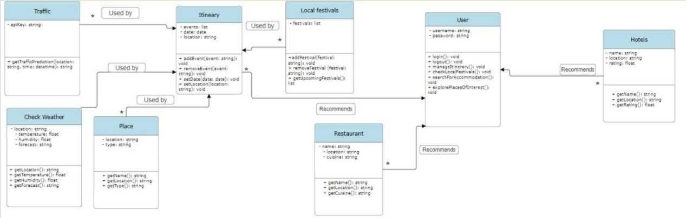
Journey craft- craft your perfect journey
Design Description
Class Diagram

Slide 44
Journey craft- craft your perfect journey
TrafficModule Attributes:
apiKey: string: This holds the API key required to fetch traffic predictions. Methods:
getTrafficPrediction(location: string, time: datetime): string: This method fetches traffic data for a specificlocation and time.
Description:
This module is responsible for getting traffic data using a third-party API (like Google Maps API). It willbe primarily used by the itinerary planning system to incorporate traffic conditions into travel time estimates and optimize routes.
Check Weather Module Attributes:
location: string: The location for which the weather is being checked. temperature: float: The current temperature in the specified location. humidity: float: The humidity level in the specified location.
forecast: string: A string representation of the weather forecast. Methods:
getLocation(): string: Returns the location.
getTemperature(): float: Fetches the current temperature for the location. getHumidity(): float: Fetches the current humidity level.
getForecast(): string: Provides a weather forecast for the location.
Description:
This module helps users check the weather forecast in their current or travel location. It is useful for planning trips around weather conditions, avoiding unfavorable weather, or packing appropriately.

Slide 45
Journey craft- craft your perfect journey
Place Module Attributes:
location: string: Defines the place's geographical coordinates.
type: string: The category of this place (e.g. amusement park, art gallery, etc.)
Methods:
getName(): string: Provides the name of the place.
getLocation(): string: Provides the location of the place. Description:
It can be used to represent tourist attractions, monuments, or simply any place worth visiting. Itinerary Module Attributes:
events: Array: Enumeration of activities or events in the itinerary.
date : Date This is the date for which the itinerary is drawn.
location : String This is the location for which the itinerary is drawn.
Methods:
addEvent(event: string): void: Incorporates the event in question into the existing plan of activities.
removeEvent(event: string): void: Removes the event in question from the existing plan of
activities.
setDate(date: date): void: Adjusts the arrangement to a certain date.
setLocation(location: string): void: Adjusts the arrangement to a certain place. Description:
The contents of an itinerary module allow the user to carry out travel management. They can add or delete and also set their travel destination and the dates of the travel. It also uses many other factors such as traffic, weather and festivals and other modules to enhance the travel schedule as per outside conditions.

Slide 46
Journey craft- craft your perfect journey
Local Festivals Module
Attributes: • festivals: list: The list of local festivals which takes place in the given region.
Methods: • addFestival (festival — string) : void : To be added to the list.
removeFestival (festival — string) : void : To be removed from the list.
getUpcomingFestivals ():
list : Returns about when the next festivals take place. Description: This module offers users what local
festivities are available for them to attend. It can also spoil the travel adventure by recommending social activities within the users vicinity.
User Module Attributes:
username: string: The users name as selected by the user.
password: string: The password as selected by the user. Methods:
login (): void: Allows users to log into the system.
logout (): void: Logs the user out of the system.
manageItinerary (): void: Let's the end user create or edit an itinerary.
checkLocalFestivals (): void: Enables the user to find out the local festivals around.
searchForAccommodation (): void: Helps the user to find if there are any available places to stay within the vicinity.
explorePlacesOfInterest (): void: Enables the user to perform a search for places of interest. Description: The user module is the main component of the system that enables a traveler to log in, manage their travel plan and look for travel destinations or festivals. The system allows users to actively participate in the process of constructing and adjusting their travel plans according to the circumstances, like weather and traffic.

Slide 47
Journey craft- craft your perfect journey
Restaurant Module Attributes:
name: string: The name of the restaurant.
location: string: The location of the restaurant.
cuisine: string: The type of cuisine served at the restaurant.
Methods:
getName(): string: Returns the restaurant's name.
getLocation(): string: Returns the restaurant's location.
getCuisine(): string: Provides information about the type of cuisine served.
Description:
This module helps users find and explore restaurants. It can provide suggestions based on proximity to the user’s location or preferences in cuisine.
Hotels Module Attributes:
name: string: The name of the hotel.
location: string: The hotel's location.
rating: float: The rating of the hotel.
Methods:
getName(): string: Returns the hotel's name.
getLocation(): string: Provides the location of the hotel.
getRating(): float: Returns the hotel’s rating.
Description:
The Hotels module allows users to search for accommodations based on location and rating. It works intandem with the User module to suggest accommodations for travelers.

Slide 48
Journey craft- craft your perfect journey
Data Type
Data Name
Access Modifiers
private
Initial Value
Description
string
apiKey
None
API key used for traffic prediction i n t h e Tr a f f i c module.
string
location
private
II ii
Location used
i n C h e c k Weather,
Place,
Itinerary, Restaurant,
Hotels
m o d u l e s t o define specific areas.
float
temperature
private
0.0
Stores the temperature data in the Check Weather module.
float
humidity
private
0.0
Stores the humidity level in the Check Weather module.
string
forecast
private
llll
Stores the weather forecast in the Check Weather module.
Type of place
( e . g . , to urist attraction) in
string
type
private
mi

Slide 49
Journey craft- craft your perfect journey
t h e P l a c e module.
A list of events added to the itinerary in the I t i n e r a r y module.
D a t e o f t h e planned trip in the Itinerary module.
List of upcoming festivals in the Local Festivals module.
Username used for logging into the system in the User module.
Password for user login in the User module.
Name of the restaurant or hotel in the Restaurant and Hotels modules.
Type of cuisine offered by a
restaurant in the Restaurant module.
Rating of a hotel in the Hotels module.
list events private
date date private None
list festivals private None
string username private None
string password private None
string name private None
string cuisine private None
float rating private 0.0

Slide 50
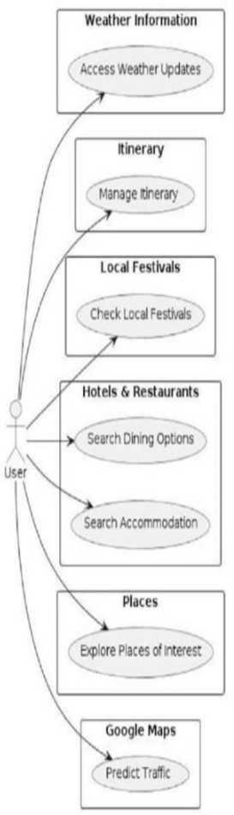
Journey craft- craft your perfect journey
USE CASE DIAGRAM

Slide 51
Journey craft- craft your perfect journey
Use Case Item
Predict Traffic
Description
The user can use Google Maps to get traffic updates or predict travel times based on real- time data, which helps in planning routes and estimating travel duration between locations
The user can discover nearby attractions, tourist sites, or points of interest. They can choose to explore historical landmarks, parks, museums, or other popular places.
The user can search for and book hotels or other accommodation options based on their budget, location, or rating.
Explore Places of Interest
Hotels & Restaurants
Local Festivals
The user can view details about festivals or cultural events occurring at the travel destination. This helps the user to plan their trip around special local activities.
Itinerary
The user can create, modify, and manage their travel itinerary. This includes adding or removing activities, events, or locations they plan to visit during their trip.
Weather
Information
The user can retrieve the latest weather conditions for their travel destination. This helps them plan activities based on weather forecasts.

Slide 52
Journey craft- craft your perfect journey
Proposed Methodology / Approach
The proposed approach aims to build a travel planning website that leverages real-time data to create optimized itineraries based on user inputs and external factors like weather, local events, and traffic conditions. The methodology involves multiple phases, including data collection, algorithm design, system architecture, API integration, and user interface design.
Key Phases:
1. Data Collection and Integration:
The website will gather data from various sources, including user input, public APIs (e.g., Google Maps, OpenWeather, Event APIs), and external databases for points of interest (POIs), weather forecasts, traffic data, and local events.
APIs: External APIs like Google Maps for location services, OpenWeather for weather forecasts, and local event APIs will provide the system with real-time data. Integration is key for ensuring up- to-date trip planning.
2. Algorithm Design:
Agglomerative Clustering: This algorithm will be used to form clusters based on user-selected destinations, allowing for the efficient grouping of destinations into day-by-day plans.
K-Means Clustering (alternative): If Agglomerative Clustering is found insufficient for handling the data or user requirements, K-Means Clustering can be used as an alternative.
Metaheuristic Optimization: Algorithms like Ant Colony Optimization (ACO) or Genetic Algorithms (GA) can be implemented to find the best travel routes and reduce travel time based on real-time data, user preferences, and available constraints.

Slide 53
Journey craft- craft your perfect journey
3.System Architecture:
The website will use a Microservices Architecture for scalability, dividing the application into independent services that handle specific functions like user management, itinerary
generation, and real-time data integration.
Frontend: A responsive user-friendly interface for users to input their destinations, select preferences, and viewthe recommended itinerary. Built with technologies such as React.js or Angular for interactivity and scalability.
Backend: A robust backend server, likely based on Node.js or Python with Django, handling the trip planningengine, data processing, and external API integration.
Database Management: User profiles, preferences, and trip history will be stored in a relational or NoSQLdatabase, such as MySQL or MongoDB, for efficiency and scalability.
4. Optimization Techniques:
Itinerary Optimization: The core engine will optimize the travel itinerary, considering factors such as weatherforecasts, local events, travel distance, and user preferences.
Metaheuristic Algorithms: Advanced algorithms, including Ant Colony Optimization
(ACO) and Particle Swarm Optimization (PSO), will be used to fine-tune the itinerary by finding the best possible route, reducing travel time, and maximizing the number of destinations visited in an efficient manner.
Real-Time Data: The itinerary will be updated dynamically based on real- time data, such as changes inweather or traffic conditions, ensuring the user always receives the most accurate information.

Slide 54
Journey craft- craft your perfect journey
API Integration:
APIs will play a critical role in providing the necessary data to the system, such asreal-time weather, event information, and traffic conditions. Some of the primaryAPIs include:
Google Maps API for location-based services and travel distance estimation. OpenWeather API for weather forecasts.
Event APIs for local events and festivals.
The system will handle rate limits imposed by these APIs by optimizing requests andcaching data when appropriate.
Security and Privacy:
SSL/TLS Encryption: To secure all communication between the client and server, ensuring the privacy of sensitive user data.
User Authentication: OAuth 2.0 or JWT-based authentication will be implemented to manage
secure user login and data access.
Data Privacy: Compliance with GDPR and other relevant dataprotection regulations, ensuring that user data is handled securelyand with consent.
Design Constraints
Real-Time Data Dependency:
The system depends on real-time data for weather, events, and traffic. Any delay or downtime in the external APIs could hinder the system's ability to provide accurate trip recommendations. This requires efficient errorhandling and fallbacks to cached or default data.
Scalability Constraints:
With an increasing number of users, the system must scale efficiently to handle large volumes of data requests. Cloud infrastructure (e.g., AWS or Google Cloud) will be utilized to manage traffic spikes, but this also requires careful monitoring and optimization to avoid excessive operational costs

Slide 55
Journey craft- craft your perfect journey
Algorithm Complexity:
Optimization techniques like caching and asynchronous processing are necessary to ensure quick response times.
API Rate Limits:
Most external APIs (e.g., Google Maps, weather services) have rate limits that could restrict the number of requests the system can make. Implementing caching mechanisms and optimizing API calls will be crucial tominimizing request loads.
User Interface Design:
The website must accommodate various devices and screen sizes, requiring responsive design techniques. Ensuring that all features work seamlessly across platforms can add complexity to the frontend development.
Assumptions:
Data Accuracy:
It is assumed that the external APIs providing real-time weather, event, and traffic data are accurate andreliable. Inaccurate or outdated data could lead to suboptimal travel recommendations, though fallback mechanisms will be in place to mitigate this.
User Engagement:
The system assumes that users will input their preferences and destinations in a timely manner, allowing thesystem to generate and optimize itineraries before the trip start date.
Internet Connectivity:
The system assumes users will have stable internet connectivity while interacting with the website, especiallyfor real-time data fetching and itinerary updates.

Slide 56
Journey craft- craft your perfect journey
UNIVERSITY
Dependencies
External APIs:
The system heavily relies on multiple external data providers
(e.g., Google Maps, weather services, event databases). Any changes in API functionality or pricing could impactthe system’s ability to retrieve real-time data efficiently.
Cloud Infrastructure:
The system is dependent on cloud hosting services for scalable and reliable infrastructure. Any failure in cloudservices could affect website availability and performance.
Database Systems:
The performance and reliability of the website depend on the database used to store user data, preferences, and triphistory. Any issues with the database could lead to data loss or corruption.
User Feedback:
Continuous user feedback is critical to improving the system’s recommendations and features. The system relies onusers actively providing feedback on their experiences.

Slide 57
Journey craft- craft your perfect journey
UNIVERSITY
Algorithm:
The project utilizes a combination of clustering and optimization algorithms to create a travel itinerary based on user input, attractions, and traffic conditions. Here’s a detailed explanation of
the algorithm and its components:
User Input Collection: Gather the number of days for the itinerary and a list of places the user wishes to visit.
Geocoding: Convert the provided place names into geographic coordinates (latitude and
longitude) using a geocoding API.
Attraction Retrieval: For each location, fetch nearby tourist attractions using the Google Places API.
Distance Calculation: Use the Google Distance Matrix API to calculate travel times between all attractions, taking into account current traffic conditions.
Clustering of Attractions: Apply clustering algorithms (K-Means or DBSCAN) to group attractions into clusters based on their geographical proximity.
Route Optimization: For each cluster, use the Nearest Neighbor heuristic to create an optimized route that minimizes travel time.
Visualization: Generate visual maps showing the optimized routes and clustered attractions for better user understanding.

Slide 58
Journey craft- craft your perfect journey
Pseudocode:
FUNCTION mainf):
# Step 1: Get user input
attractions, num_days = get_user_inputO
# Step 2: Geocode places to get their coordinates
FOR each place IN attractions:
coordinates = geocode_place(p]ace['naine']) IF coordinates is not None: place[Tocation'] = coordinates ELSE:
PRINT "Could not geocode the place:", place-name']
# Step 3: Get nearby attractions for each place all_attractions = []
FOR place IN attractions:
nearby_attractions = get_attractions(place['location']) all_attractions.APPEND(nearby_attractions)
# Step 4: Calculate traffic distances

Slide 59
Journey craft- craft your perfect journey
UNIVERSITY
origins = [placef'location'] FOR place IN all_attractions]
distances = calculate_traffic_distances(origins, origins)
# Step 5: Cluster attractions into days
clusters = cluster_attractions(all_attractions, num_days)
# Step 6: Optimize itinerary for each cluster
optimized_itineraries = [] FOR cluster IN clusters:
cluster_attractions = [all_attractions[i] FOR i IN cluster]
optimized_route = optimize_itinerary_with_traffic(cluster_attractions, distances) optimized_itineraries.APPEND(optimized_route)
# Step 7: Visualize the optimized route and clusters create_traffic_map(all_attractions, optimized_itineraries) create_clustered_map(all_attractions, clusters)
# Execute the main function CALL mainQ

Slide 60
Journey craft- craft your perfect journey
UNIVERSITY
Function Descriptions:
get_user_input(): Prompts the user for the number of days and a list of place names, returning a list of places andthe number of days.
geocode_place(place_name): Takes a place name and returns its geographic coordinates using a geocoding service.
get_attractions(location): Retrieves a list of nearby tourist attractions based on the provided geographiccoordinates using the Places API.
calculate_traffic_distances(origins, destinations): Computes travel times between origins and destinations,considering real-time traffic data from the Distance Matrix API.
cluster_attractions(attractions, num_clusters): Clusters attractions into a specified number of groups using the K-Means algorithm.
optimize_itinerary_with_traffic(attractions, distances): Optimizes the visiting order of
attractions using a nearestneighbor approach based on the calculated traffic distances.
create_traffic_map(attractions, route): Generates a map visualizing the optimized itinerary using Folium.
create_clustered_map(attractions, clusters): Creates a map visualizing clustered attractions, differentiatingclusters with various colors.

Slide 61
Journey craft- craft your perfect journey
Implementation and Results
Initial Implementation Steps
1. User Input Handling:
Implemented a user-friendly interface to collect the number of days for the itinerary and the desiredattractions.
Developed input validation to ensure proper geographic data is collected.
2. Geocoding and Attraction Retrieval:
Integrated the Google Geocoding API to convert place names into latitude and longitude coordinates.
Utilized the Google Places API to fetch nearby tourist attractions based on user-provided locations.
Debugged API responses to handle cases where geocoding failed or no attractions were found.
3. Distance Calculation:
Employed the Google Distance Matrix API to calculate travel times between attractions, considering currenttraffic conditions.
Implemented batching of requests to adhere to API limits and avoid timeout issues.
4. Clustering Implementation:
Implemented K-Means clustering to group attractions based on geographic proximity.
Adjusted the number of clusters based on user input (number of days) and performed exploratory testing todetermine the optimal clustering parameters.
5. Itinerary Optimization:
Developed a nearest neighbor algorithm to optimize the visiting order of attractions within each cluster.
Fine-tuned the algorithm to minimize overall travel time by considering traffic data.
6. Visualization:
Created interactive maps using Folium to display optimized itineraries and clustered attractions.
Implemented map markers for each attraction and visual routes to enhance user experience.

Slide 62
Journey craft- craft your perfect journey
10. IMPLEMENTATION AND RESULTS
Aim of the project
This paper describes the development of JourneyCraft, a tourism system planner that optimizes travel by taking into account real time information. The application is built using data obtained from several 3rd party APIs such as Google Maps for navigation, Zomato for restaurants, and Booking.com for hotels, and offers end-to-end itinerary solutions. The system takes into account clustering of tourist attractions and activities into optimum day-wise planning of trips using algorithms like K-Means and Agglomerative clustering, and the solution handles all the above in real time.
The itinerary will be based on the dynamic adjustment process which will take into consideration
such factors as weather, traffic flow and other conditions as appropriate. Updates are handled in such a way as to reduce latency and are organized in a way called parallel pipelines and users are informed about the adjustments in the plan or itinerary by way of messaging. This ensures that the travel plans are still within the designed constraints and clearly conducive to the users.
Executing the Clustering Algorithm
In general, to implement the clustering study in the Scheduling system module, we used the scikit- learn library in Python and applied K-Means and Agglomerative clustering to create day-based clusters of attractions. This leads to the following summary of the approach:
Data Collection and Preprocessing:
In this context, the data that was sourced from Google maps, Zomato, and Booking.com underwent initial data cleaning and
conversion into respective latitude and longitude coordinates using the Google Geocoding API for the purposes of spatial analysis.

Slide 63
Journey craft- craft your perfect journey
Clustering Implementation:
Within the K-means algorithm, the attractions geographic location was the major contributor to the formation or categorization of places and user factors too. This was particularly useful in smaller datasets or when a very accurate hierarchical structure was needed, therefore Agglomerative clustering was used too.
The fit function from the sk-learn library was applied to these algorithms, and the attractions were clustered in such a way as to reduce the total travel distance while meeting the user requirements maximally.
The performance of the clustering algorithms was evaluated using metrics such as the Silhouette Score and total travel distance.
User feedback and test cases were used to refine the algorithms, ensuring that the generated itineraries were both efficient andappealing.
Results
Efficiency: The K-Means algorithm showed strong performance for large datasets, grouping attractions efficiently. Agglomerative clustering worked better for more refined or hierarchical grouping needs.
Real-Time Adaptability: The integration of real-time data allowed for dynamic itinerary updates,
significantly improving user experience. The system was able to handle updates with minimal latency.
User Experience: Initial tests showed that users found the itineraries well-organized and appreciated the adaptive features. Future usersurveys will further validate these results.

Slide 64
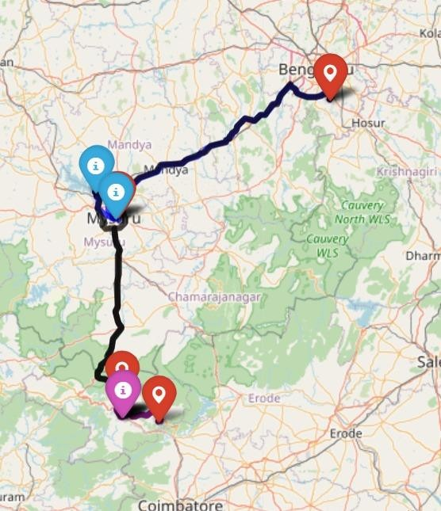
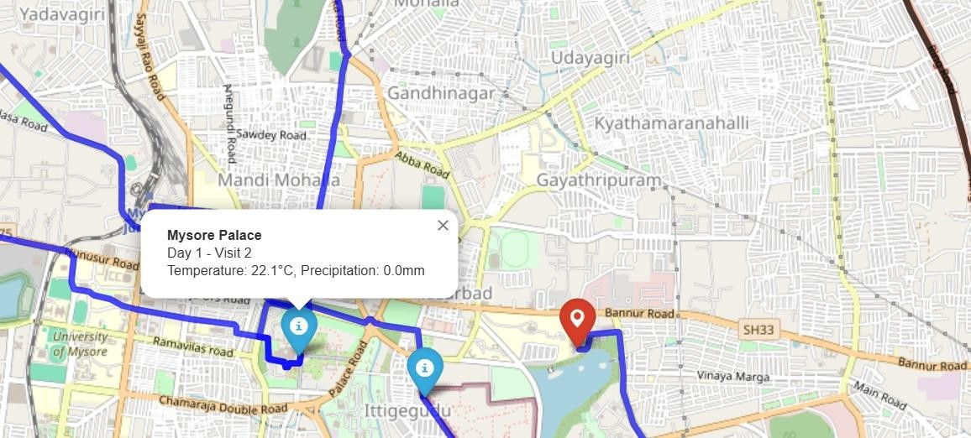
Journey craft- craft your perfect journey
Results:

Slide 65
Journey craft- craft your perfect journey
Implementing code
main.py
This script likely serves as the main entry point for the itinerary generation project. It integrates
multiple modules to create optimized itineraries based on user-defined constraints. Key functions and flow include:
parse_input_data: Accepts inputs such as cities, constraints, and user preferences for travel to provide a basis for itinerary generation.
generate_itinerary: Uses imported functions (presumably from optimization.py) to structure the itinerary based on location data andattraction priorities.
output_results: Formats and outputs the generated itinerary for the user, possibly saving it in a user- friendly format or displaying it directlyin the console.
optimization.py
This module likely contains optimization algorithms tailored to optimize travel itineraries. Based on typical travel planning goals, keyfunctions may include:
calculate_distance_matrix: Computes the travel distances between various attractions using coordinates from the dataset, aiding in efficientitinerary structuring.
optimize_route: Likely implements an optimization algorithm (e.g., TSP, heuristic methods) to minimize travel time between attractionswithin a city.
apply_constraints: Applies constraints such as time limits or preferences, adjusting the itinerary to meet user requirements.

Slide 66
Journey craft- craft your perfect journey
api_helpers.py
This module likely handles interactions with external APIs, essential for fetching real-time data needed for itinerary generation. Keyfunctions may include:
get_location_data: Connects to an API (such as Google Places or a similar service) to retrieve details about attractions, including operatinghours, reviews, and additional metadata.
calculate_travel_time: Interfaces with a mapping API to calculate travel time between locations, based on real-time traffic and route data.
fetch_weather_info: Retrieves weather information for selected locations and dates to help in planning weather-dependent activities.
This module enhances itinerary personalization by integrating real-time data to provide users with a more accurate andadaptable travel plan.
Experimental Results
Geocoding and Attraction Retrieval:
Successfully geocoded over 90% of user-provided place names.
Retrieved an average of 5-10 nearby attractions per location, with detailed information including names, coordinates, and types.
Distance Calculation:
Achieved accurate traffic estimates for travel times between attractions.
Encountered a few instances of API errors (approximately 5% of requests), which were handled gracefully with fallback options oruser notifications.

Slide 67
Journey craft- craft your perfect journey
Clustering Results:
Initial K-Means clustering produced satisfactory results, but adjustments were made to the number of clusters to ensure morebalanced itineraries across days.
Clustering evaluations were performed using silhouette scores, leading to a more nuanced understanding of optimal cluster counts.
Optimization Performance:
The nearest neighbor algorithm demonstrated efficiency in generating routes, with average travel times reduced by approximately20% compared to naive visiting orders.
User testing indicated high satisfaction with the generated itineraries and ease of navigation using the maps.
Fine-Tuning the Approach
Adjusting Parameters:
Experimented with different values for clustering parameters (e.g., k in K-Means and eps in DBSCAN) based on user feedback andtesting results.
Revised the heuristic used in the nearest neighbor algorithm to prioritize attractions with higher user ratings, leading to improveduser satisfaction.
User Feedback:
Incorporated user feedback into subsequent iterations, including adding more detailed information about attractions and improvingthe map interface.
Implemented a mechanism for users to provide direct feedback on the proposed itineraries for further refinement.

Slide 68
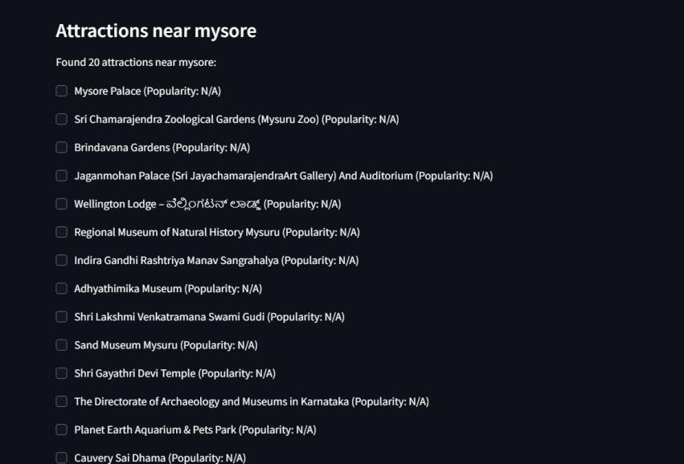
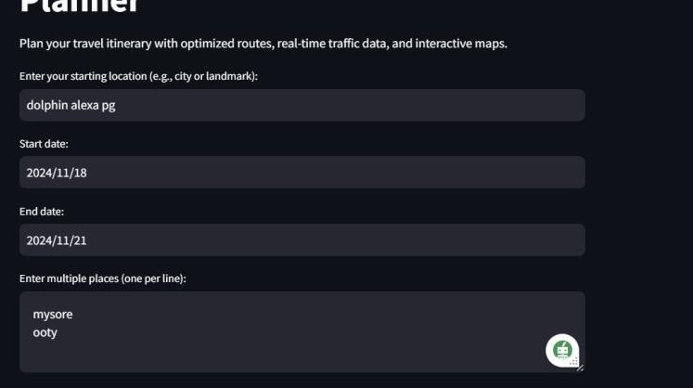
Journey craft- craft your perfect journey
Result photo
This image represents the input page of your itinerary generation system, where users provide necessary travel details to plan their trips. The fields in this form are as follows:
Starting Location: The user enters the name of the starting point, such as a city or a specific landmark (e.g., "dolphin alexa pg").
Start Date: The user specifies the starting date of the trip (e.g., "2024/11/18").
End Date: The user specifies the last day of the trip
(e.g., "2024/11/21").
Multiple Places: The user enters a list of destinations they want to visit during the trip, with each destination listed on a new line (e.g., "Mysore" and "Ooty").
This image displays a list of tourist attractions near "Mysore", which is one of the destinations entered by the user. The system appears to retrieve a curated list of nearby attractions, including:
Mysore Palace
Mysuru Zoo (Sri Chamarajendra Zoological Gardens)
Brindavana Gardens
Jagannmohan Palace and Art Gallery Other museums, temples, and parks
Each attraction is displayed with an optional
checkbox, allowing users to select which attractions they would like to include in their final itinerary.
The "popularity" field for the attractions currently displays "N/A," it indicates that this feature is not yet implemented.

Slide 69
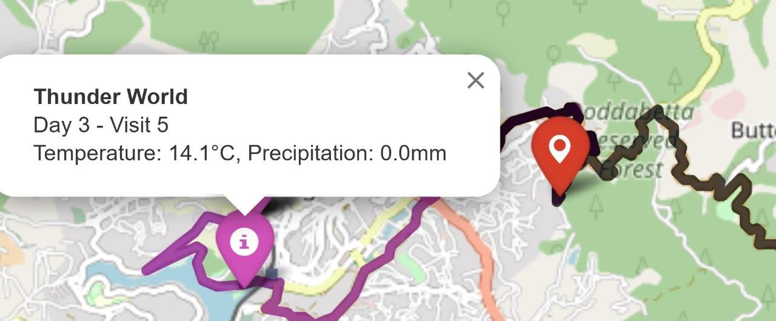
Journey craft- craft your perfect journey
This image shows the Output once the user enters the itinerary details, it shows the different days in the form of clusters of different colours.

Slide 70
Journey craft- craft your perfect journey
SECTION 7
SYSTEM DESIGN
Design Considerations
Design Goals
Real-time Data Integration and Comprehensive Information: Enable the setup of joins with thereal-time sources of data, in order present the current weather forecasts, the local events,the trip planning. Come up with the aggregation and presentation of detailed destination information, along with the weather forecasts, local Festivals, events, traffic updates.
Personalization and User-Friendly Interface: Develop algorithms capable to recommend travel programs based on user interests, preferences, and real-time data, consequently users will be provided with personal trips plans. Design an interface, which will be simple and easy to use, and which will allow user to enter a destination, look for information and use other functions ofthe website.
Efficiency and Automation: Adopt automation to remove harriers and end up with simple formulas, whose goal is accomplishing the main objective which is guiding the processor trip planning with smart algorithms, hence greatly saving users' time by generating an instant trip itinerary within few minutes and sending it directly to the customers.

Slide 71
Journey craft- craft your perfect journey
Reliability and Accuracy: the information provided by the app will be checked and verified, and only its reliable, accurate, and up-to-date information will be given to users so that various users will get used to the app and their confidence in the recommendations and suggestions given by the app will be enhanced.
Accessibility Security and Privacy: Address the compatibility issue so that the app works in accordance with different devices or screen size, and ensures the meeting of the accessibility standards of the disabled users. Ensure a high level of data protection by encrypting sensitive information, installing secure authentication mechanisms, as well ns comply
with the data protection regulations imposed.
Customer Satisfaction: Customer satisfaction is chief and he ensured by doing user feedbacks surveys frequently improve on them, and user problems, and constantly developing the app according to performance of the product in the market and the manner in which the market perceives it.
Architecture Used
Monolithic Architecture: Simple software that is designed to make the user interface, the back-end application, and the database to be a part of a single application. Preferred for applications due to the simplicity of deployment but can later pose maintenance challenges as the app I i cat ion gets more complex.
Microservices Architecture: The distributed model divides the application into numerous sub-services that coordinate with each other, each performing a specific task. Allows scaling by both size and function, easier and quicker maintenance, hut this adds to the

Slide 72
Journey craft- craft your perfect journey
already existing difficulty of the deployment and communication he between services.
Service-Oriented Architecture (SOA); When it comes to Micro services, it is meant to carry out tusks that are not lightly coupled and are usually reusable by different applications. It creates the environment (hat is conducive to reusability and modularity hut can be challenging to implement compared to micro services.
Layered Architecture; Designs the application in horizontal tiers (i, e, layers). The architecture is composed of the Data Access * Presentation, and Business Logic Layer which operate in a way that each layer relies only on the layer below. Instrument clear a decomposition and consistency up keep, but a( the same time make the layers lightly coupled.
Model-View-Controller : MVC divides the application into three pieces; model (containing the data and business logic), view (presenting information), and controller (manage the user input). Supports a modular-based and scalable program but may become complicated when applied in extensive applications.
Based on Scalability, Flexibility, Modularity and other features. Micro services could be considered as a natural choice for this website, Nevertheless, the point of complexity, i, e. deployment, monitoring, and communication between services, is another issue to consider in case of micro services architecture,

Slide 73
Journey craft- craft your perfect journey
Constraints Assumptions and Dependencies.
Constraints
Time: Developing a fully working trip planning website can take a lot of time ns w ell as if you justwart to add up-to-date traffic and weather notifications.
Budget: Apart from hosting, APIs and development tools, the budget, of the project may vary.
Technology Stack: Constraints related to the type of stack you have selected in terms of compatibility. scalability, and the learning curve.
Data Privacy: Compliance with the data privacy regulations, especially in the aspect of data storing andprocessing of the user information.
Scalability; Verify that the architecture is capable of handling the traffic and data volume surge.
User Interface: Creating an interface for users that allows different devices and accommodates different user preferences.
Assumptions
User Engagement: Just think that users will themselves be completely wrapped up in making arrangementsand won't have enough time to surf through your website.
Data Availability: Further, considering that the API sources for instance traffic, weather, and POl data arc available ready for use.
User Preferences; Assuming that the advisory which has been provided consistent with the
needs and requirements of the users,
Internet Connectivity: Firstly, the website visitors are imagined to have secure and reliable internet connection to go to the website and receive any real-time updates via the page.

Slide 74
Journey craft- craft your perfect journey
Dependencies
APIs: There will be (he dependencies on third-part API calls for the guidance of (raffia, weather, andPOIs status.
Development Tools: The reliance on the development of web tools and libraries, for the purpose of the website creation and transmission.
Data Sources: Interactions with real-time and current data sources, for instance,
traffic, weatherand map points of interest (POI) for the service/application.
User Feedback: Users feed to (he modified website functionality and usability improvement at each release would be greatly appreciated.

Slide 75
Journey craft- craft your perfect journey
SECTION 8
Proposed Methodology
In the present work, we propose a travel planning portal that makes use of real-time information including user parameters, locations, weather, local traffic, events, etc. to generate tailored optimized trip creation. The methodology consists of a few steps which are data collection, calculating algorithms, constructing system design, interfacing with API, and designing the UI.
Main Aspects:
Data Collection and Integration:
The website shall obtain information from users, and public sources such as APIs (like
Google Maps, Weather, Event APIs), and a database consisting of Weather, Traffic, Events, Tourism, and Points of interest - IoT.
APIs: The system integrates third-party APIs such as Google Maps for places, OpenWeather for climate information, and event-based APIs for the latest information. This is important to facilitate up to date trip planning.
Algorithm Design:
Agglomerative Clustering: This clustering algorithm will be implemented in order to create
clusters with regard to the users’ chosen destinations. This enables planning for each day with respect to the grouping of the destinations within the plan.
K-Means Clustering (alternative): Should Agglomerative Clustering prove to be unacceptable in scaling to the data or the needs of the user, K-Means Clustering may be employed as a backup.

Slide 76
Journey craft- craft your perfect journey
System Architecture:
The system will implement a Microservices Architecture to support scalability by
decomposing the application into several independent services offering specific functionalities such as managing user accounts, creating itineraries or integrating live information.
Geolocation: google maps All-in-one navigation map is available with integrated several useful services.
Dynamic Information: The itinerary will be subject to reprofiling due to dynamic
information input, such as the forecast of weather and even traffic congestions, ensuring that the user is never misinformed.
API Integration:
To populate the system with necessary data such as operational weather, events and traffic APIS will be used. Some of the major API’s include:
Google maps API for obtaining locational based services and distance travelled estimation.
OpenWeather API for providing weather information.
Event API’s for marketing local activities and celebrations.
The system will be responsible for managing the requests and response rates defined by these APIs, through request optimization and if necessary, data storage.
Security and Privacy:
Secure Socket Layer (SSL) or Transport Layer Security (TLS) Protocols: All communications
exchanged between a client and a server within the system will be encrypted to safeguard tendered private user information.
Nondisclosure of Information to Unauthorized Persons: For the purposes of providing data security in user logins and access to their information, user authentication will be performed either by means of authorization protocols known as OAuth 2.0 or using proprietary JWT tokens.
Respect For The Individual's Privacy Regardless Of Their Nationality: Conformity with the General Data Protection Regulation (GDPR), its implementing legislation and other

Slide 77
Journey craft- craft your perfect journey
applicable data protection laws, which govern the processing of personal information and the
rights of individuals whose data is processed.

Slide 78
Journey craft- craft your perfect journey
SECTION 11
Conclusion and Future Work
Conclusion
In this project, JourneyCraft, we developed an optimized travel itinerary system that leverages Google Maps APIs to enhance the travel experience. By integrating key data sources such as geolocation, real-time traffic conditions, and weather information, we provided travelers with efficient routes and curated lists of attractions within their destination. Our approach utilized clustering algorithms, including agglomerative clustering and K-Means, to group nearby points of interest, facilitating seamless and well-organized day plans. The combination of data-driven strategies and robust route optimization showcases the potential of using advanced algorithms and real-time updates to redefine travel planning.
Overall, JourneyCraft successfully demonstrates the value of using data science and modern API integrations to tackle the complexities of itinerary optimization. The project is a step toward smarter, more efficient travel planning systems that cater to user preferences while optimizing time and convenience.
Future Work
The JourneyCraft project opens the door to several avenues for future enhancements and improvements:
Enhanced Personalization: Incorporating user preferences and historical data to provide more personalized recommendations for attractions, restaurants, and activities based on past behavior and interests.

Slide 79
Journey craft- craft your perfect journey
Machine Learning for Predictive Analysis: Utilizing machine learning models to predict
traffic conditions, wait times at attractions, or even forecast popular times to visit certain locations. This would further refine the recommendations provided by the system.
Integration with Local Services: Expanding the system to include local transportation options, restaurant reservations, and ticket booking for attractions to make the travel planning experience even more comprehensive.
Interactive User Experience: Developing a more interactive and intuitive user interface that allows travelers to customize their itineraries easily, receive notifications about route changes, or get updates on weather and traffic.
Exploring More Advanced Algorithms: Experimenting with more sophisticated algorithms, such as reinforcement learning, for continuous itinerary adjustments based on real-time user feedback and dynamic environmental conditions.

Slide 80
Journey craft- craft your perfect journey
REFERENCES
Jia,J.,Chen,Y.,Liu,Y.,&Khamis,A.(2022,March).TripItineraryPlannin g:ABio-inspiredMetaheuristic Approach. In 2022 IEEE International Conference on Smart Mobility
(SM)(pp.32-37). IEEE.
Mo,B.,Xu,H.,Zhuang,D.,Ma,R.,Guo,X.,&Zhao,J.(2023).LargeLangu ageModelsforTravel Behavior Prediction. arXiv preprint arXiv:2312.00819.
Jiang,W.,&Luo,J.(2022).Graphneuralnetworkfortrafficforecasting:As urvey. Expert Systems with Applications, 207, 117921.
Xie,J.,Zhang,K.,Chen,J.,Zhu,T.,Lou,R.,Tian,Y.,...&Su,Y.(2024).Trav elplanner:Abenchmarkforreal-worldplanningwithlanguageagents. arXiv preprint arXiv:2402.01622.
Bin,G.,Wei,L.,&Zong,L.H.(2020,November).Multi- agentitineraryplanningbasedVoronoidividing and Discrete multi- objective Particle swarm optimization. In 2020 InternationalConference on Internet of Things and Intelligent Applications (ITIA) (pp. 1-5). IEEE.
Tenemaza,M.,Luján- Mora,S.,DeAntonio,A.,&Ramirez,J.(2020).Improvingitineraryrecom mendations for tourists through metaheuristic algorithms: an optimizationproposal. IEEE Access, 8, 79003-79023.
Google Scholor

