Slide 1
Objective
To implement a robust IoT model for smart maintenance of green space.
This can be accomplished considering the soil temperature, soil moisture and other factors.
And also provide a user friendly Android Application through which actuators(pump, windows etc) can be controlled remotely.

Slide 2
Need of Smart Agriculture
Saving energy and resources.
Automating farm or nursery irrigation.
Avoiding irrigation at the wrong time of day.
Automated system.

Slide 3
Overview
IoT Platform
REST
Webservices
Gateway
Clients
MQTT
End Device
Web Browser
NodeMCU
Mobile App
DS18B20
DS18B20
YL-69
DS18B20
YL-69
YL-69
DHT22
DHT22
DHT22
Actuators

Slide 4
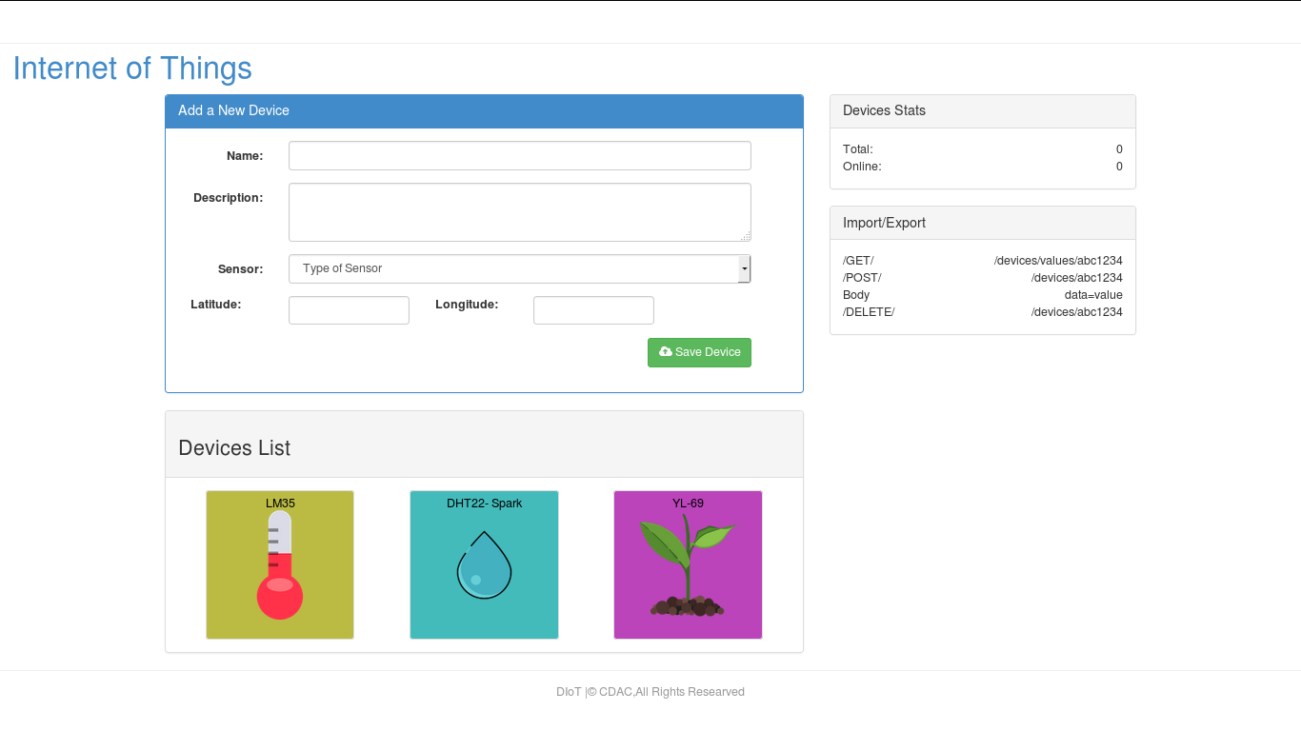
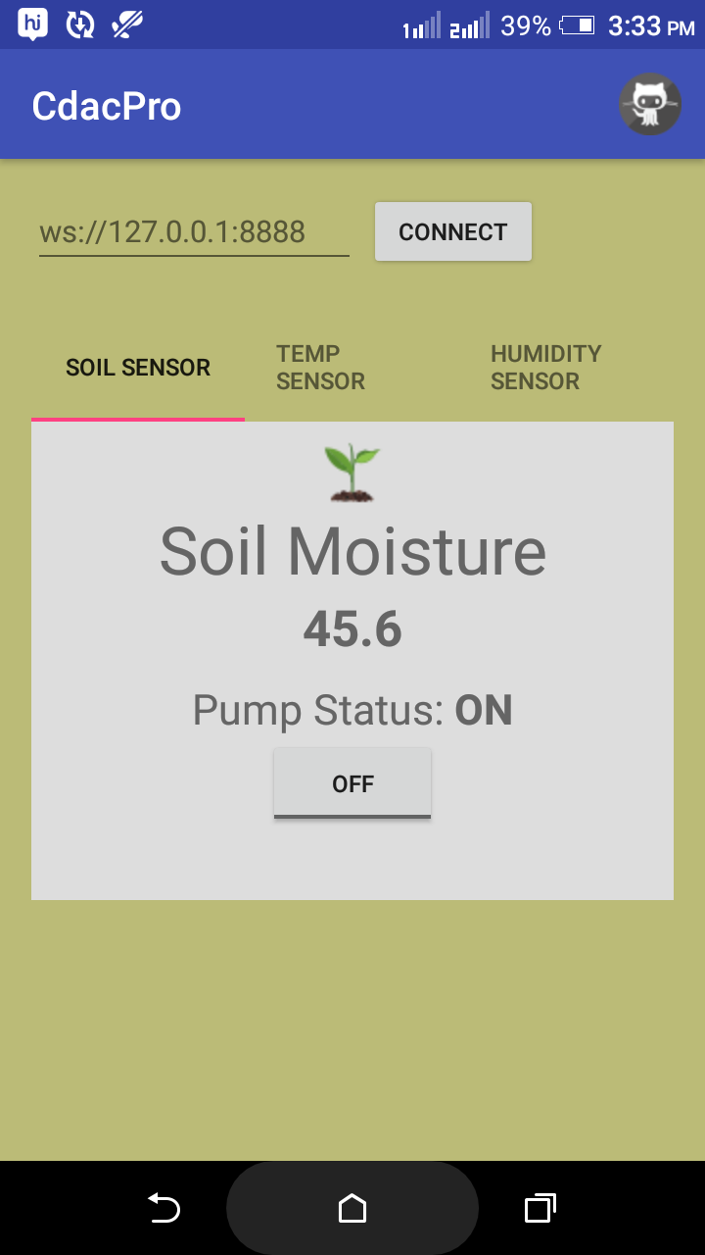
Raspberry Pi
YL-69
DS18B20
DHT22

Slide 5
Block Diagram to control actuators
IoT Platform
Node MCU
Pump
Relays
Ventilator

Slide 6
Conclusion
We have successfully interfaced soil moisture sensor,dht22 and soil temperature sensor.
Real time data is updated on Mobile App and IoT Platform
Actuator can be controlled through app.
THANK YOU

