Slide 1
A brief overview of working, application and benefits of containerization
SEMINAR-1
Kaushal Agarwal
001810501051
BCSE-IV
Jadavpur University

Slide 2
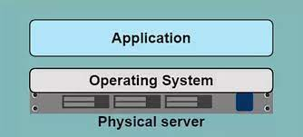
A Lesson in history
In the dark ages.....
One Application on one Server

Slide 3
Limitations
Costly
Wastage of resources
Difficult to scale and migrate
Deployment is slow and tedious
Dependence on architecture

Slide 4
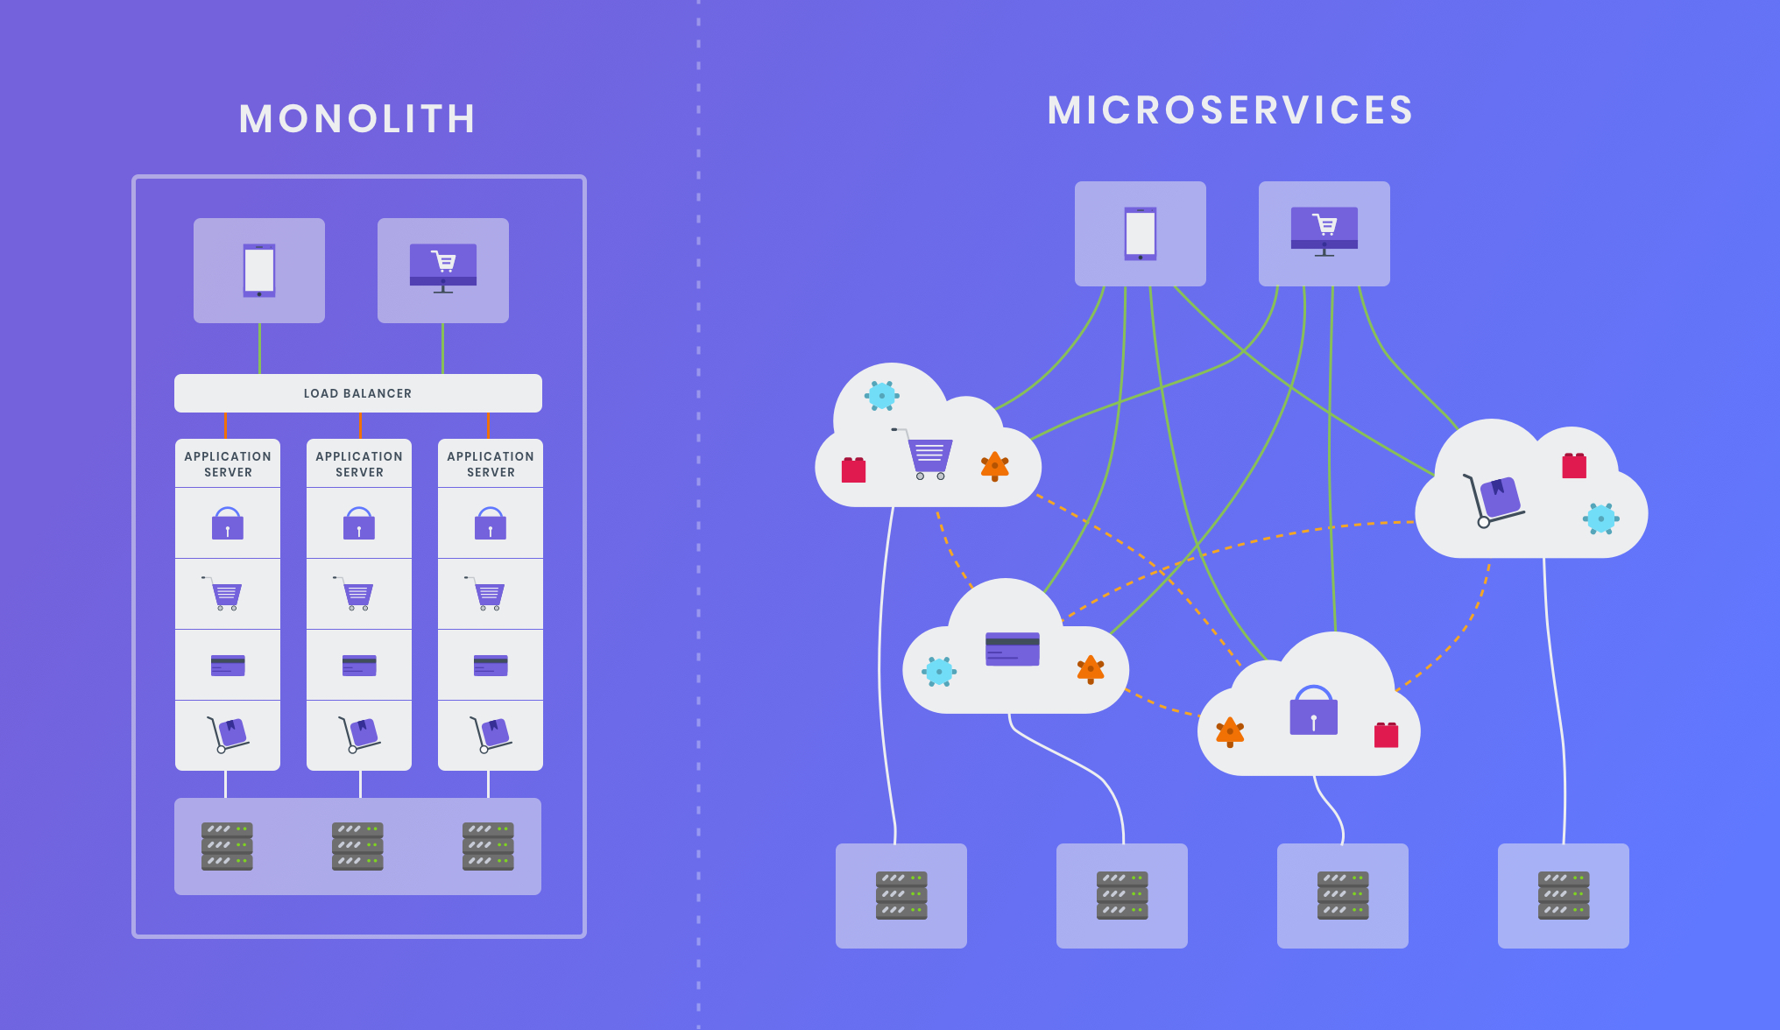
Applications are tranforming
Big Servers
Many small Servers

Slide 5
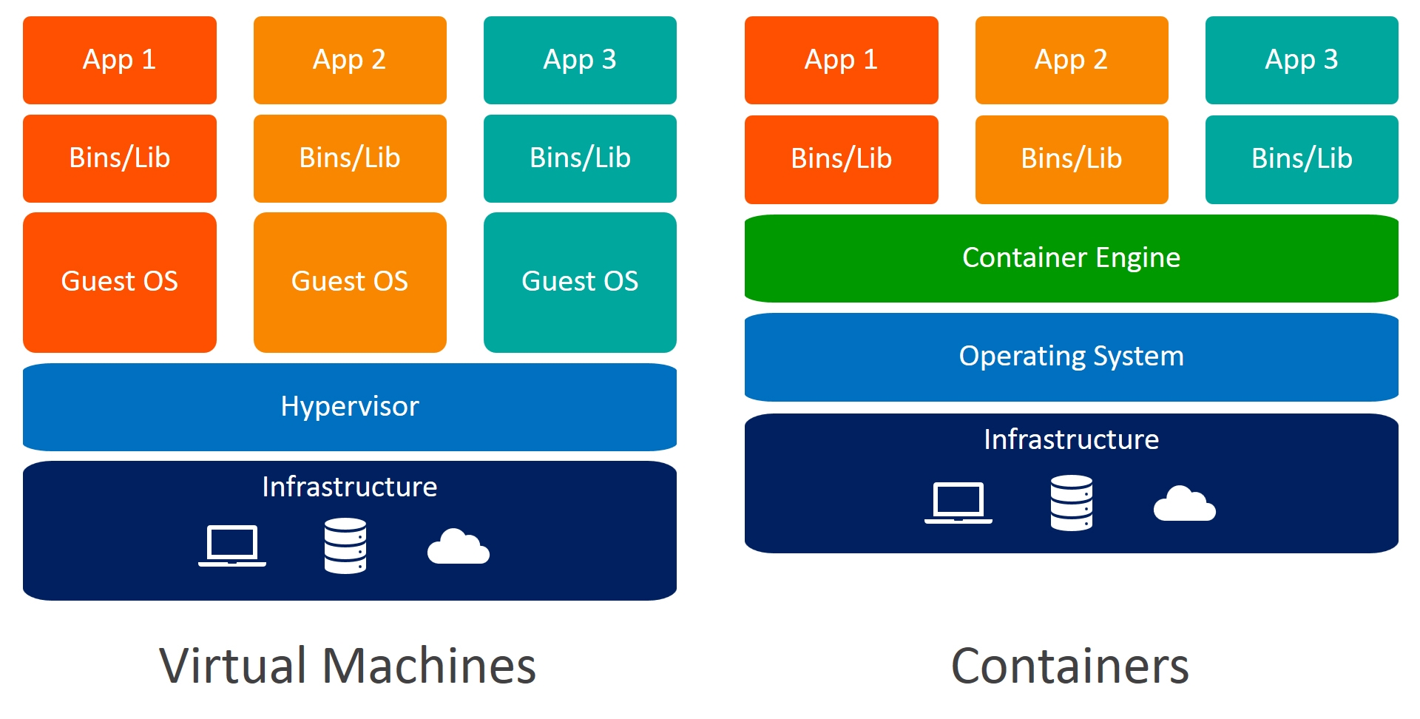
Virtual Machine
One physical server can have multiple virtual machines
Each application runs in a virtual machine

Slide 6
Virtual Machines
Benefits
Limitations
Better use of resources
Easier to scale
Minimal Downtime
Rapid elasticity in cloud
The more VMs , more resources is needed
Guest OS means wasted resources
Application portability not guaranteed
Costly to scale.

Slide 7
Containers
Containers are a lighter-weight, more agile way of handling virtualization since they don't use a hypervisor and there is no need of seperate guest OS.
Containerization packages together everything needed to run a single application or microservice (along with runtime libraries they need to run).
The container includes all the code, its dependencies and even the operating system itself. This enables applications to run almost anywhere — a desktop computer, a traditional IT infrastructure or the cloud.

Slide 8
Containers
The size of container images is generally measured in megabytes.
Every container running on a single server shares the same underlying OS.
They spin up in milliseconds and are more efficient for ephemeral use cases where instances must be spun up and down with changes in demand.

Slide 9
Containers vs VMs
Pros
Cons
Containers are more lightweight than VMs, as their images are measured in megabytes rather than gigabytes
Containers require fewer IT resources to deploy, run, and manage
Containers spin up in milliseconds Since their order of magnitude is smaller
A single system can host many more containers as compared to VMs
All containers must run atop the same OS – no mix and match of OSs or versions
Containers may be less secure than VMs since the underlying OS is shared
Containers are a newer technology, and the ecosystem is still evolving

Slide 10
Docker
Docker provides tooling and a platform to manage the lifecycle of your containers
Develop your application and its supporting components using containers.
The container becomes the unit for distributing and testing your application.
When you’re ready, deploy your application into your production environment, as a container or an orchestrated service.
Docker uses a client-server architecture.
The Docker client talks to the Docker daemon, which does the heavy lifting of building, running, and distributing your Docker containers.
The Docker client and daemon communicate using a REST API, over UNIX sockets or a network interface.

Slide 11
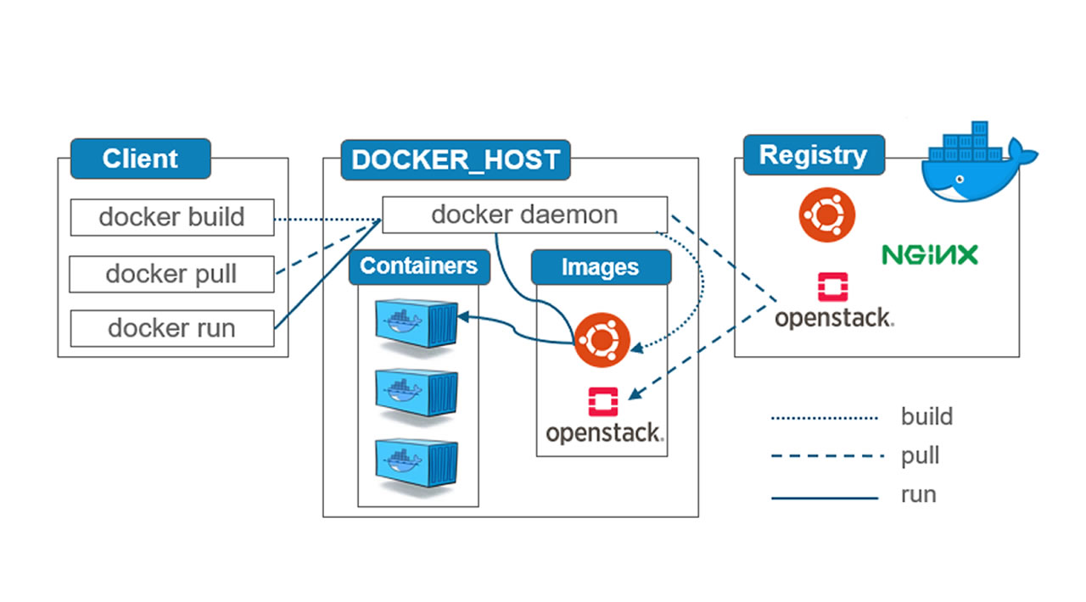
Architecture

Slide 12
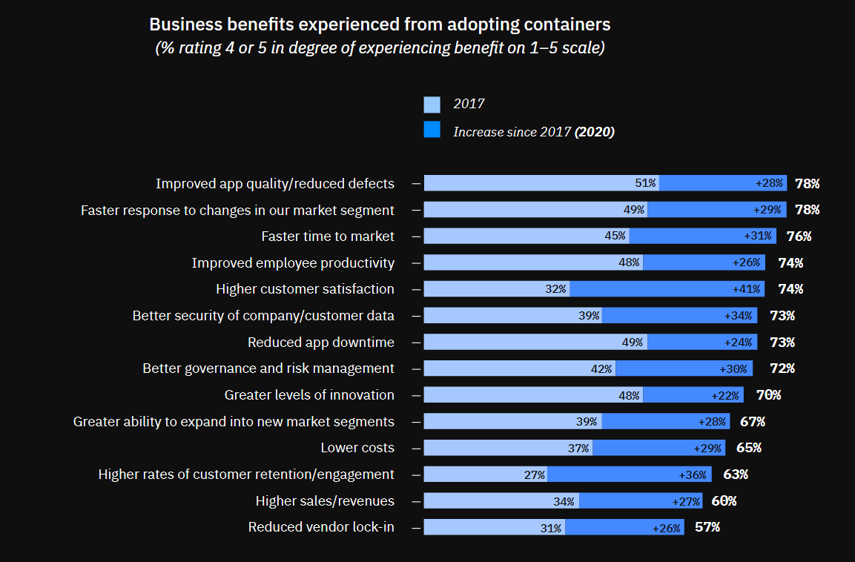
reference:-https://www.ibm.com/downloads/cas/VG8KRPRM

Slide 13
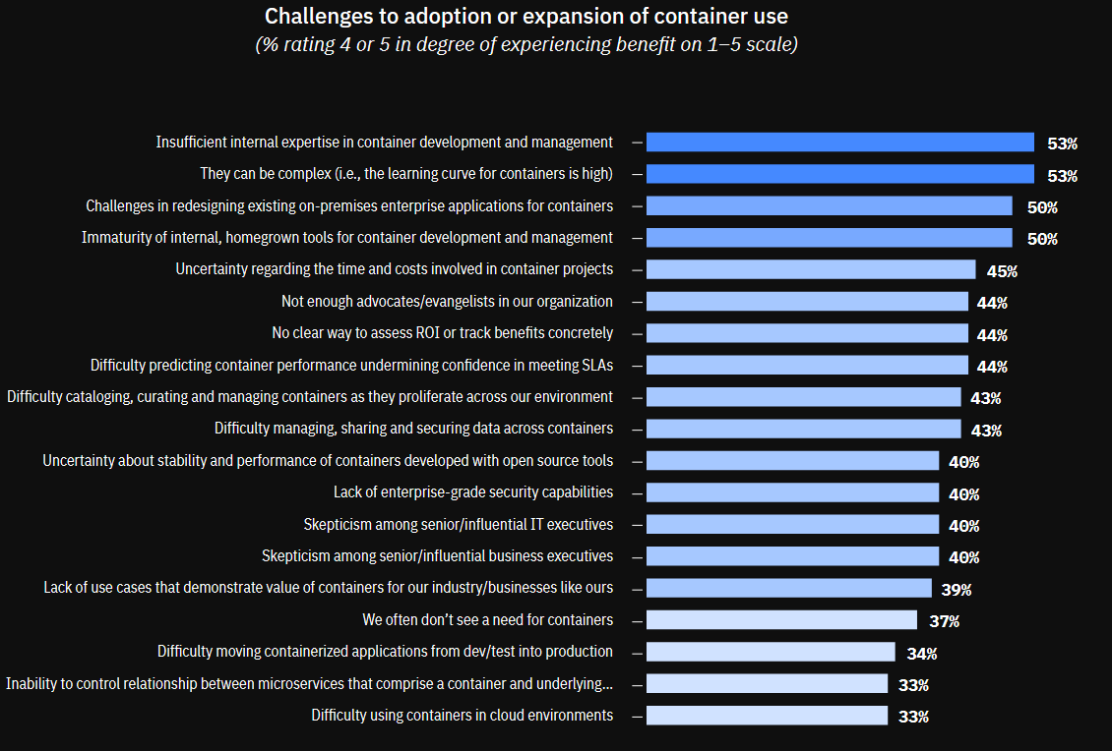
reference:-https://www.ibm.com/downloads/cas/VG8KRPRM

Slide 14
Benefits of containerization
Portability
Agility
Speed
Fault Isolation
Ease of management
Security

Slide 15
References
https://www.ibm.com/in-en/cloud/learn/containerization
https://www.netapp.com/devops-solutions/what-are-containers/
https://docs.docker.com/get-started/overview/
https://www.ibm.com/downloads/cas/VG8KRPRM

Slide 16
Thank you

