Slide 1
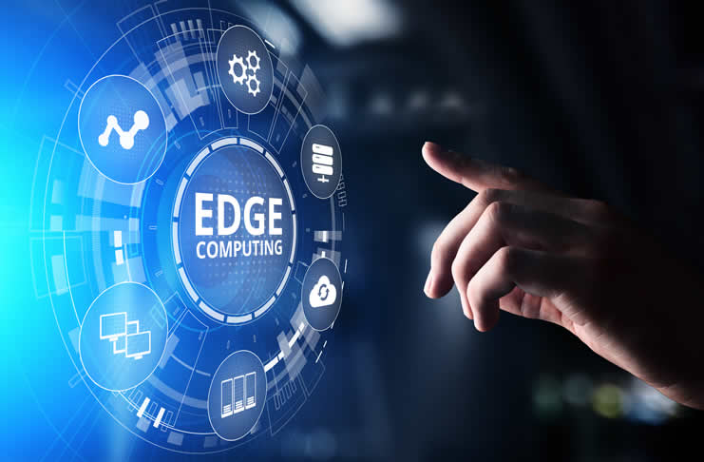
Seminar-2
Kaushal Agarwal
001810501051
BCSE-IV
Jadavpur University

Slide 2
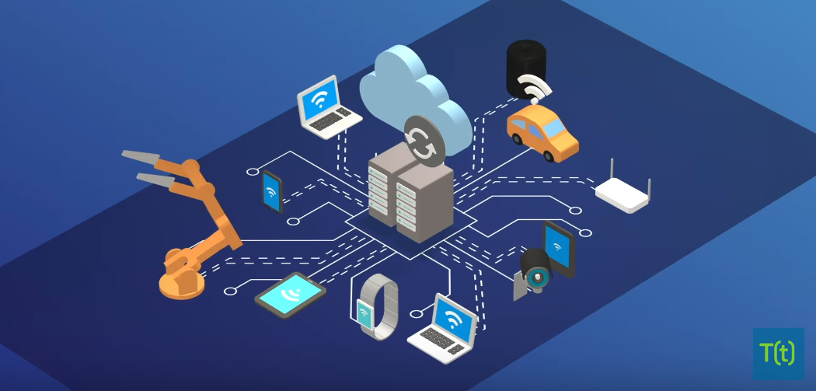
Introduction
The traditional computing paradigm built on a centralized data center and everyday internet isn't well suited to moving endlessly growing rivers of real-world data.
Bandwidth limitations, latency issues and unpredictable network disruptions can all conspire to impair such efforts. Businesses are responding to these data challenges through the use of edge computing architecture.

Slide 3
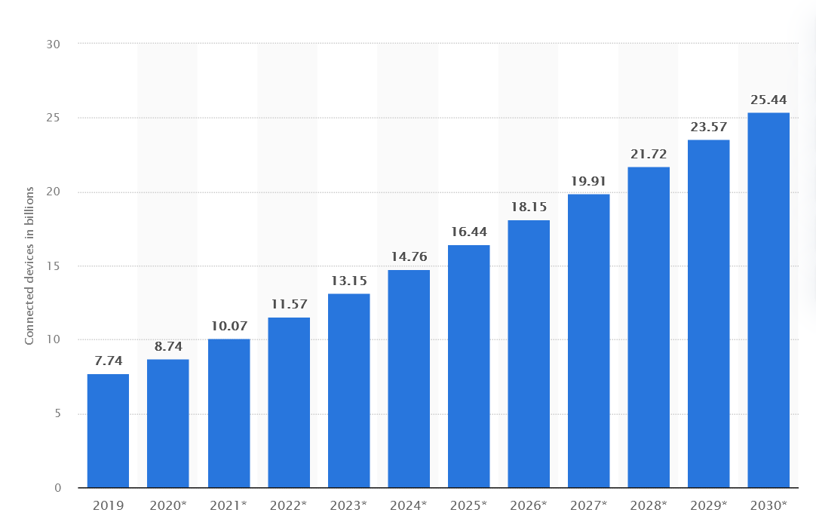
Number of Internet of Things (IoT) connected devices worldwide from 2019 to 2030 (in billions)
With increasing number of IoT devices coming online, the volume and velocity of data being generated by these devices would increase many folds
.
Transmitting and storing all these data in realtime in centralized data centers
is often undesirable apart from being costly and difficult.

Slide 4
Problems Faced
Shorter Response Time:- The data being generated by the IoTdevices need to be analyzed in realtime. But currently most of the processing of these data is done on cloud and thus high latency.
Security Risks:- Relaying information collected from IoT devices to cloud creates security challenges. Each hop that the information makes is a potential security breach junction.
Data Governance:- Large amount of data is generated. Need solutions that can help enterprises in overcoming the data governance challenge by reducing data clutter and contextualizing the data for better usability.

Slide 5
Edge Computing
Edge computing is a distributed open IT architecture that enables systems to compute data near or at the source of information rather than relaying the information to the cloud.
Edge computing enables realtime data processing without latency.
With edge computing capabilities,systems can perform efficient data processing as large amount of data can be processed at or near the source thereby reducing internet bandwidth usage.
Idea is to push applications, data and computing power to the edge of the Internet, in close proximity to mobile devices, sensors, and end users.
An early example is Akamai, with servers around the world to distribute web site content from locations close to the user (content delivery networks, or CDNs)

Slide 6
Components
Devices. The edge and IoT devices are equipped to run analytics, apply AI rules, and even store some data locally to support operations at the edge. The devices could handle analysis and real-time inferencing without involvement of the edge server or the enterprise region.
Edge server or gateway. Edge servers are used to deploy apps to the devices. They are in constant communication with the devices by using agents that are installed on each of the devices.If something more than inferencing is needed, data from the devices is sent to the edge server for further analysis.
Edge network. It can be viewed as a local cloud for devices to communicate with. The edge network reduces the distance that data from the devices must travel and thus decreases latency and bandwith issues especially with the advent of 5G. This region also offers more analytical capabilities and more storage for models.
Enterprise hybrid multicloud. This region offers the classic enterprise-level model storage and management, device management, and especially enterprise-level analytics and dashboards. This region can be hosted in the cloud or in an on-premises data center.

Slide 7
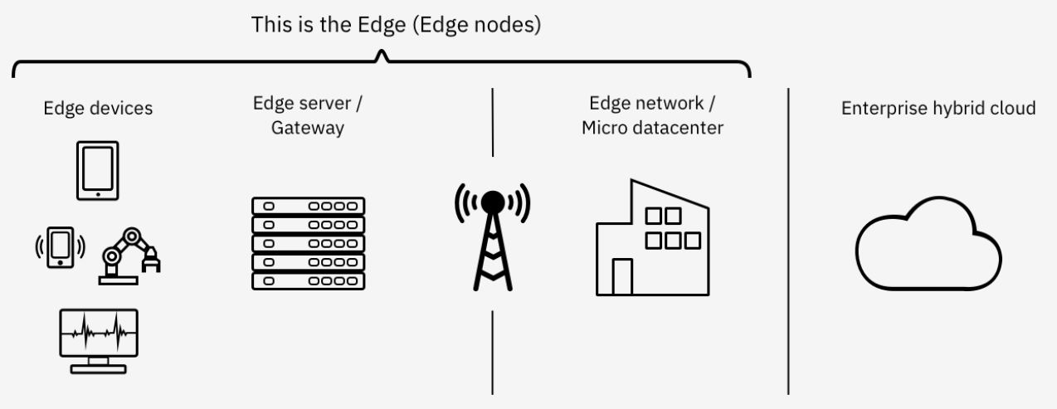
Diagram

Slide 8
Use Cases
The Telco View :- Opportunity for providing edge computing devices in existing infrastructure like micro data centers at the base of cellular towers.
The Cloud Provider View:- Goal is mainly to provide Content Delivery Network (CDN) services , IoT data processing and aggregation for data in transit to the cloud.Eg:- AWS cloudfront, AWS Greengrass,AWS wavelength.
Computation and Data in Disconnected Environments:- Providing computation-intensive capabilities and data at the edge when there is no access to the cloud Eg:- speech,face,image recognition,speech translation etc.

Slide 9
Pros
Latency :- data processing close to where it originates avoids round-trip time to the cloud
Bandwidth :-optimization of communication to and from the cloud
Privacy/security:- sensitive data stays local
Connectivity:- continued processing (in some cases) despite lack of connectivity to the cloud
Local dependencies:- data processing close to points of interaction with end users and other system components
Cons
Cost and Storage:- Even though cloud storage expenses are lower, there’s an additional cost on the local end. Much of this comes from creating storage capacity for edge devices.
Security:- Just as there’s a security advantage at the cloud and enterprise levels, there’s a security risk at the local level.
Data Loss:- When implemented, the system must be thoroughly planned out and programmed to avoid data loss
Hardware
Data and computation allocation to edge devices (especially at runtime)

Slide 10
Edge Computing vs Fog Computing
Edge Computing and Fog Computing are the extensions of Cloud Networks, which are a collection of servers comprising a distributed network.
Such networks allow organizations to exceed the resources that would be otherwise available to them.
The main advantage of cloud networks is that they allowed data to be collected from multiple sources, which is accessible anywhere over the internet.
While Fog Computing and Edge Computing are almost similar, where the talk about intelligence and processing of data at the time of creation.
Fog Computing focus more on intelligence at local area network and this architecture transmits data from endpoints to a gateway where it is sent to sources for processing and return to transmission
while Edge Computing focus more on computing power and processing of data locally at the edge of a network.
It performs processing on embedded computing platforms interfacing to sensors and controllers.

Slide 11
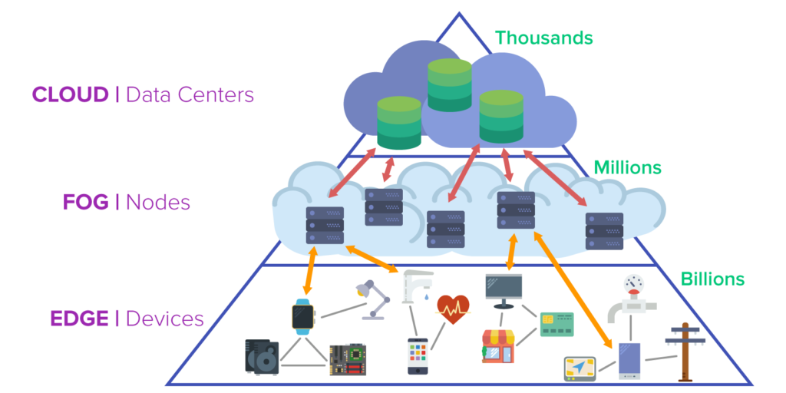

Slide 12
Edge Computing and 5G
5G and edge computing are two inextricably linked technologies: they are both poised to significantly improve the performance of applications and enable huge amounts of data to be processed in real-time.
5G increases speeds by up to ten times that of 4G, whereas mobile edge computing reduces latency by bringing compute capabilities into the network, closer to the end user.
This would bring ultra-low latency, necessary for various use case like gaming, autonomous Cars etc.
Edge can enable operators to change their backhaul business models. For data-heavy applications,even with 5G, sending data constantly back to the cloud will be expensive and deteriorate the customer experience.With edge much of data is filtered out and only what is necessary streamed and stored in the centralised cloud.

Slide 13
Will Edge replace Cloud?
There’s a case to be made that edge computing is more of a complement to cloud computing than its inevitable replacement. It can’t really replace cloud computing because there’s likely going to continue to be a need for centralized processing for some time.
Instead, edge computing is a response to cloud computing, a way of covering for some of its shortcomings. This approach works better when you have cloud computing on the one hand, and then the processing power is also used on the edges with an edge computing model for devices where this would be advantageous.

Slide 14
Market Activity
The edge computing market is evolving rapidly as more number of things are getting IoT enabled. As per market research firm Grand View Research, the edge computing market would reach $3.24 Billion by 2025.
Some of the major cloud service providers are emerging as leaders in the edge computing space as well. AWS Greengrass from Amazon enables devices to act locally on the data and leverage cloud computing capabilities for deeper analytics and reliable data storage.
With increased adoption levels of IoT and reduction in prices, it opens up business opportunities for not only in the IoT space but also in the edge computing area

Slide 15
References
https://www.ibm.com/cloud/architecture/architectures/edge-computing/
https://www.statista.com/statistics/1183457/iot-connected-devices-worldwide/
https://www.techtarget.com/searchdatacenter/definition/edge-computing
https://www.zenlayer.com/blog/edge-computing-cloud-computing-replace-coexist/

