Slide 1



Slide 2
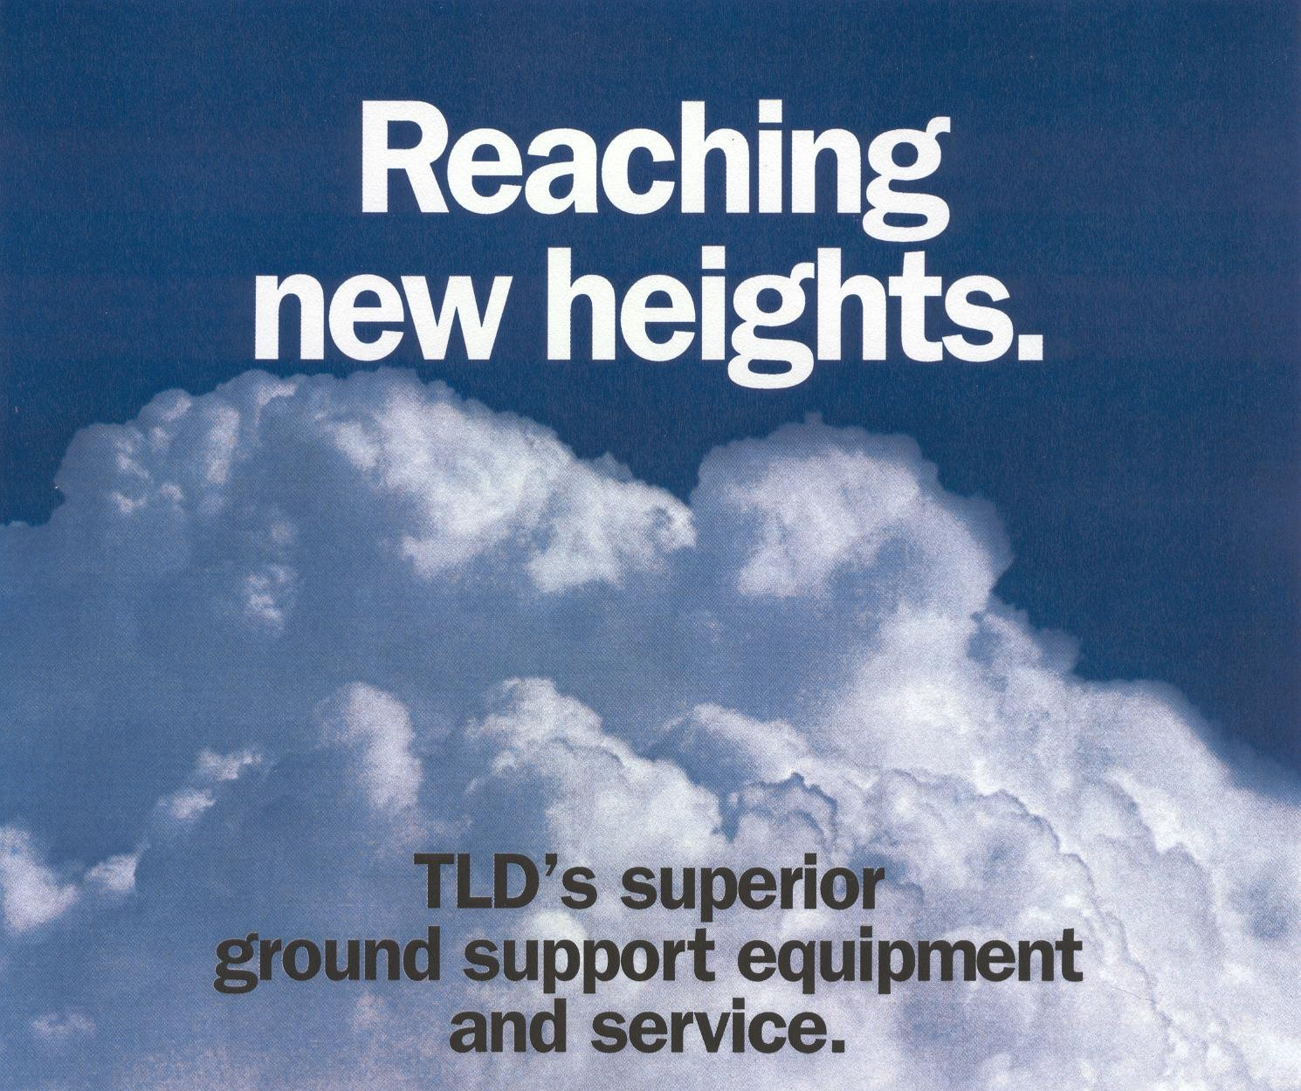

Slide 3

Our Shareholders
TLD (Teleflex Lionel-Dupont) has been listed on the Paris stock-exchange for decades
85 % of TLD capital is owned by MAAF a major French insurance company and institutional investor, which has consistently supported our strategy.

Slide 4
Our customers
Our customers are Airlines, Airports, Cargo Airlines, Ground Handlers, and Military organizations everywhere in the world.
TLD has sold new equipment to more than 250 customers during the past 3 years in more than 100 countries.
You can find TLD equipment in most airports worldwide.

Slide 5
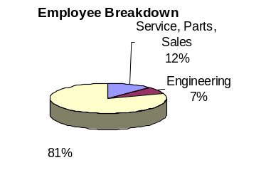
Our employees make the difference
A team fully dedicated to GSE
A unique committed team supporting the customer
A strong engineering team with many years of cumulative experience in GSE

Slide 6

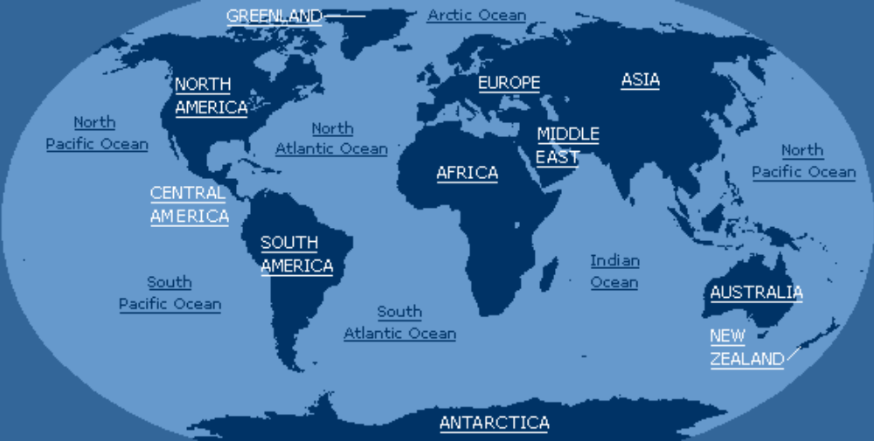
Everything,
Everywhere,
at Anytime
TLD Service & Parts HUB
TLD other Service locations

Slide 7
The Service and Sales Network
TLD has the most comprehensive worldwide network for Service and Sales
TLD network is divided in three entities that comprise many locations in the world for Service and Sales.
TLD AMERICA
TLD EUROPE
TLD
ASIA

Slide 8
TLD ASIA
ASIA, PACIFIC RIM
Headquarters: HONGKONG
Offices: Shanghai, Singapore, Taipei, and Bangkok

Slide 9
TLD EUROPE
EUROPE, AFRICA,
MIDDLE EAST and INDIA
Headquarters: PARIS - FRANCE
Offices : Madrid ( SPAIN ),
Milano ( ITALY), Moscow
(RUSSIA ), Mumbay ( INDIA )

Slide 10
TLD AMERICA
THE AMERICAS, AUSTRALASIA
Headquarters: WINDSOR, CT (USA)
Offices: New York, Salinas (CA),
Miami , Dallas, Chicago and Louisville (KY) and Sao Paulo (Brazil).

Slide 11






6 famous brand names in the GSE industry became TLD
The TLD group was built 12 years ago by the merger of these companies
12 years of experience in working together.

Slide 12

And TLD also means 50 Years of experience in GSE
Two of our TLD divisions are reaching 50 years in 2003
TLD Windsor (ACE) and TLD Montlouis (TRACMA) have been the pioneers in our GSE industry and are still leading it in 2003.
TLD will continue to invent the future of GSE

Slide 13
15 lines of equipment and more than 100 models
Jet starters
Air conditioning units
Towbarless tractors
Loaders
Transporters
Conventional tractors
Baggage tractors
Ground Power units
Belt loaders
Passenger steps
Lav and water truck
Special military equipment
Trailers and dollies
Maintenance platforms
Catering trucks

Slide 14
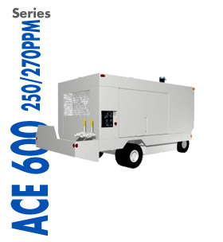
Air Starter units
6 different versions
Unique compressor design
Continuous flow or bottle type
TLD #1
Worldwide

Slide 15
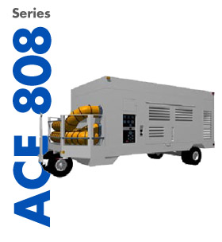
Air conditioning units
6 different types
A unique direct drive technology
Diesel electric and Pont-of-Use units also available
TLD #1
Worldwide

Slide 16
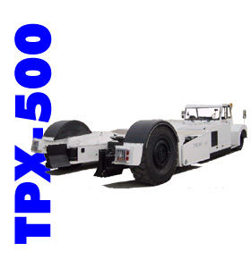
Towbarless Tractors
6 different types
A unique design for simplicity
The most reliable tractors
TLD #1
Worldwide

Slide 17
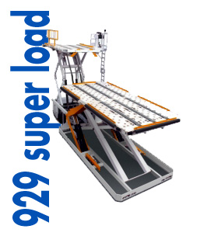
Loaders
5 different types of loaders
Designed for reliability and maintenance accessibility
A unique transfer system
A unique lifting mechanism

Slide 18
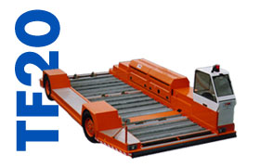
Transporters
6 different models
Designed for reliability
Longitudinal and lateral transfer
Elevating transporters
TLD #1
Worldwide

Slide 19
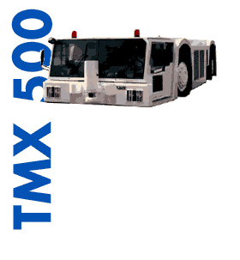
Conventional Aircraft Tractors
4 different versions
The best components for the best tractors

Slide 20
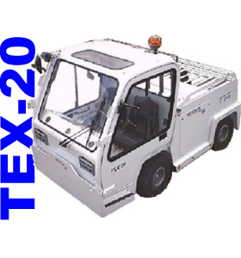
Baggage Tractors
3 models
Electric, Diesel, Gas or LPG

Slide 21
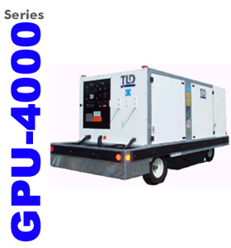
Ground Power Units
5 different power ratings
400Hz or 28,5VDC

Slide 22
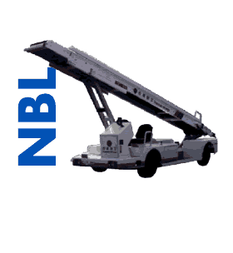
Belt loaders
3 different models
The NBL, belt loader of the 21th century
Electric, Diesel, Gas or LPG

Slide 23
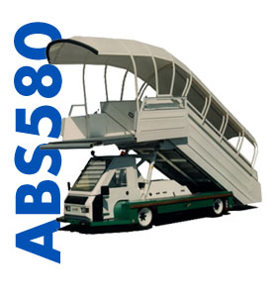
Stairs
6 different versions
The ABS580, luxury for your customers
Electric, Diesel, Gas or LPG

Slide 24
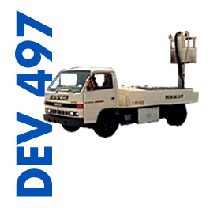
Lavatory and Water Trucks
10 different types
Truck mounted, vacuum assisted, RJ version...
Electric, Diesel, Gas or LPG

Slide 25
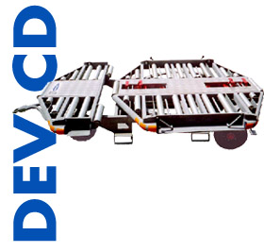
Trailers and dollies
5 basic models

Slide 26
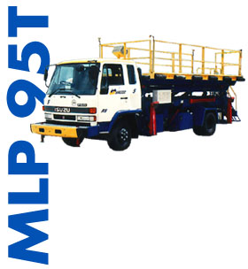
Maintenance platforms
3 different models
Truck mounted or self propelled

Slide 27
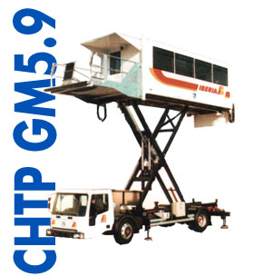
Catering trucks and derivatives
8 basic models
Catering, Cleaning or Ambulift versions
From commuter to Wide body aircraft

Slide 28
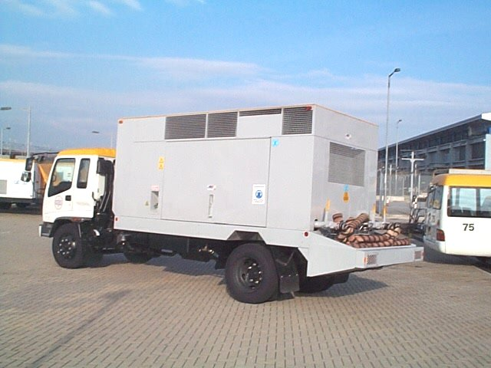
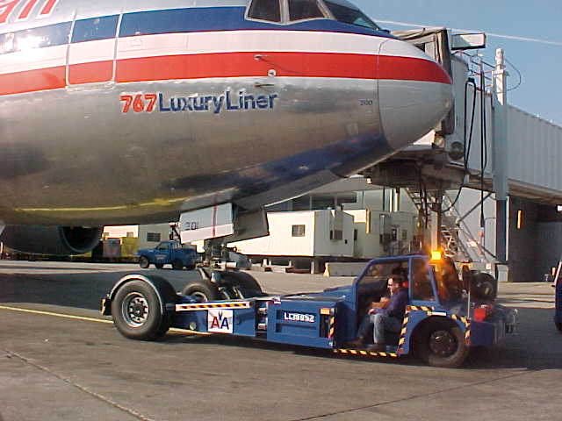
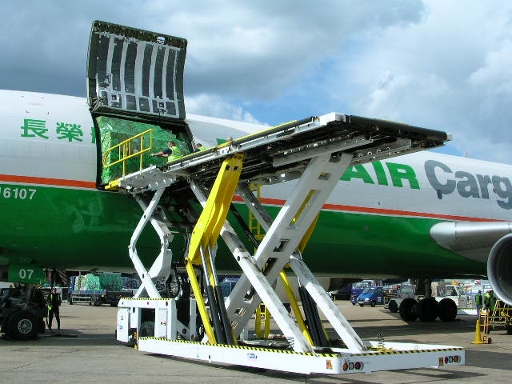
A Clear
Product strategy
Technology
Simplicity
Reliability
Performance as well as simplicity, high reliability and low maintenance costs continuously drive TLD engineering efforts.

Slide 29
A Clear
Product strategy
Four of our fifteen product lines represent two thirds of the TLD Sales
  Loaders
  Towbarless tractors
  Air Conditioning Units
  Air Starters Units
Focus on Technology

Slide 30
An Industrial Group
Our six TLD facilities are located throughout the world in order to be able to maintain close contact with our customer and improve responsiveness to specific market requirements.
Montlouis-sur-Loire, FRANCE
Saint-Lin, FRANCE
Shanghai, CHINA
Sherbrooke, Québec, CANADA
Taipei, TAIWAN
Windsor, Connecticut, USA

Slide 31
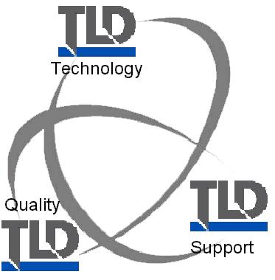
Our continuous common goals
Support

Slide 32
Your partner for the 21th century
For additional questions or information, you may contact us directly or visit our web site www.tldgse.com

