Slide 1
PRESENTATION OF TLD GROUP
May 2009

Slide 2

TLD GROUP is a leading industrial company specialized in
AIRPORT GROUND SUPPORT EQUIPMENT

Slide 3

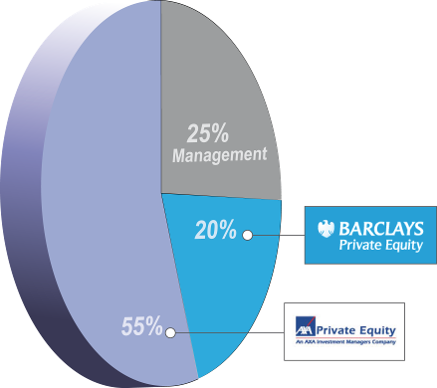
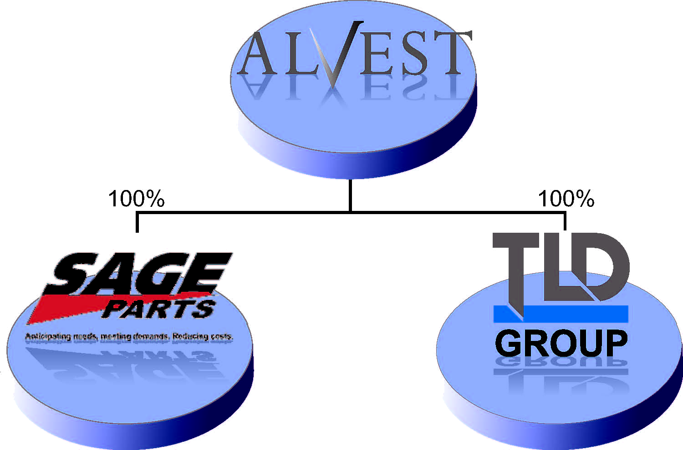
Our Shareholders
Capital Structure
AXA Private Equity, associated to Barclays Private Equity and the TLD management, has acquired the TLD GROUP in 2006 through a holding company named ALVEST
AXA is a World leading insurance Group
ALVEST acquired SAGE PARTS in June 2008
The Supervisory Board is chaired by Mr. Jean PIERSON (CEO of AIRBUS until 1998).

Slide 4


TLD was built in 1990 by the merger of
6 famous companies in the GSE
Three of the TLD divisions (formerly called ACE, TRACMA and LANTIS-COCHRAN) have reached 55 years and have been the pioneers of the GSE industry.
19 years of experience working
together as a group
Our History

Slide 5
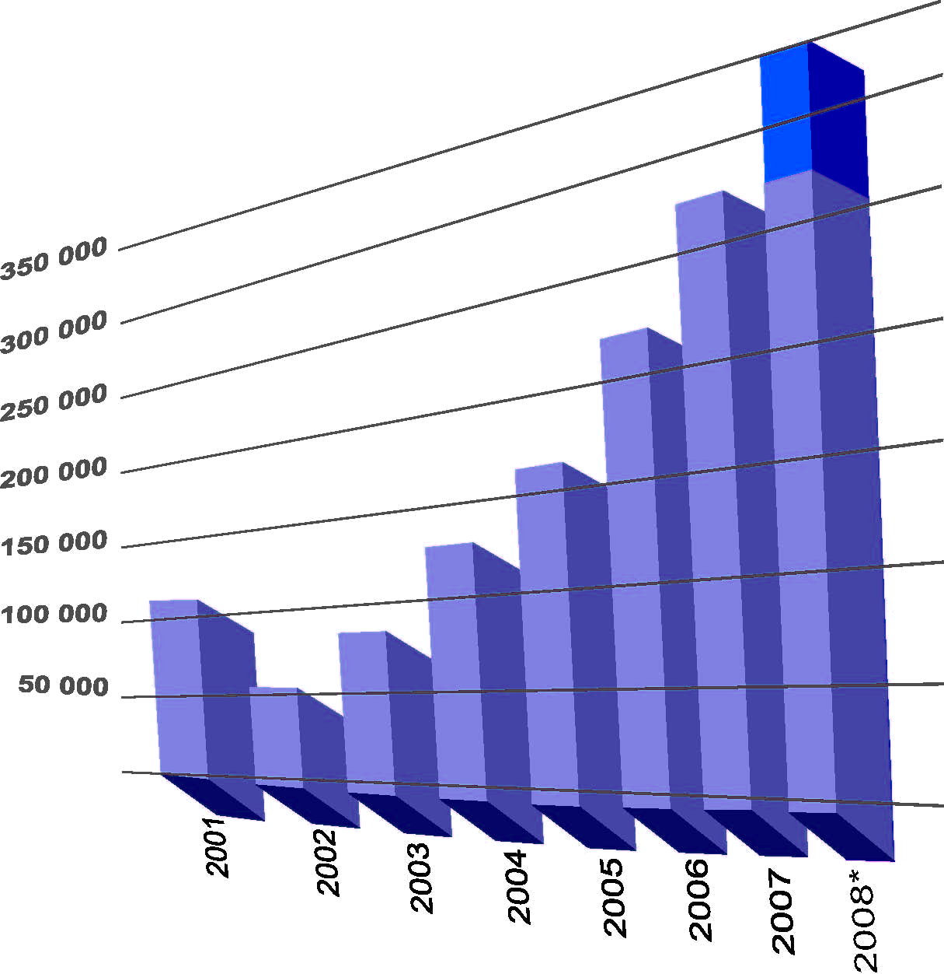
A fast growing leading Group
Sales Evolution
A position of Global Leader of the GSE industry with 350M$ sales for the total group.
The TLD Group revenues in 2008 amounted to 275MUSD and 2500 pieces of motorized equipment were delivered
2009 is expected to be a difficult year with lower sales.
ALVEST is a profitable group with a sound financial structure.

Slide 6
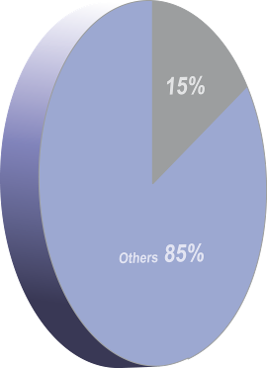
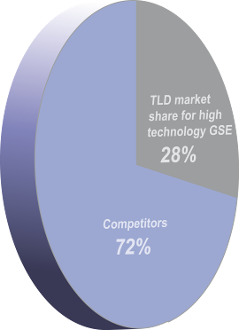
TLD Market Share
(confidential information)
TLD estimated market share for the high technology GSE products is 30% (aircraft tractors, loaders & transporters, jet starters and air conditioners)
and it is more than 40% for certain products.
The estimated market share of TLD in the total GSE market is over 15%

Slide 7
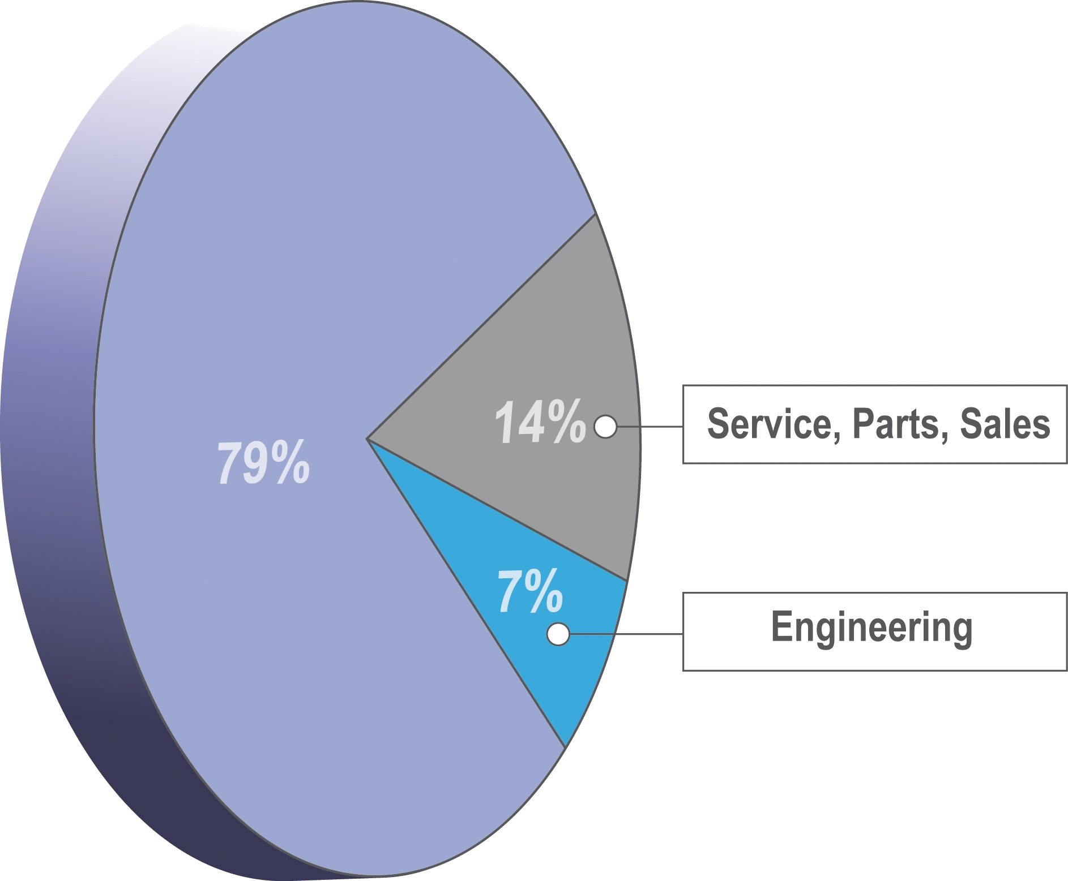
Our employees make the difference
A team fully dedicated to GSE
A unique committed team supporting the customer
A strong engineering team with many years of cumulative experience in GSE
The commitment of a Team

Slide 8

LOCAL contacts in a GLOBAL network
TLD has the most comprehensive worldwide network for Service and Sales
TLD network is organized in three regional entities with a total of 25 TLD offices
TLD AMERICA
TLD EUROPE
TLD
ASIA
Sales & Service Network

Slide 9

TLD Sales, Service & Parts HUB
TLD Sales & Service Offices
TLD Partner distributor
TLD Europe
TLD Asia
TLD America
Dubai
Opened in 2008
Sales & Service network

Slide 10

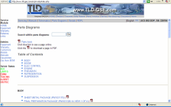
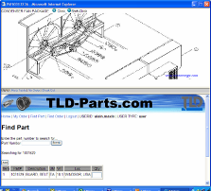
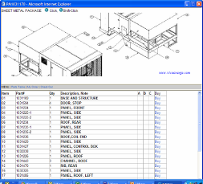
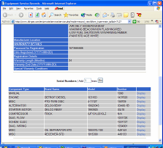
E-Customer Service
In addition to the most comprehensive field network, TLD has developed modern E-tools to improve efficiency of our customer service capabilities:
  E-Service
  E-Warranty Claims
  E-Manuals
  E-Service Bulletins
  E-Parts
All those E-applications allow us to communicate much faster with you and within TLD in order to offer you a more efficient service
Technology at your service

Slide 11
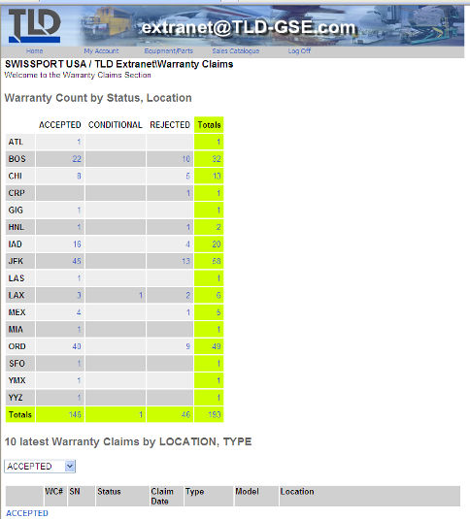
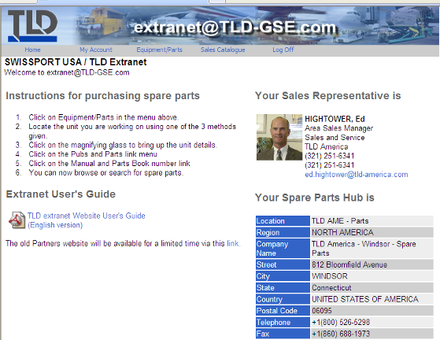
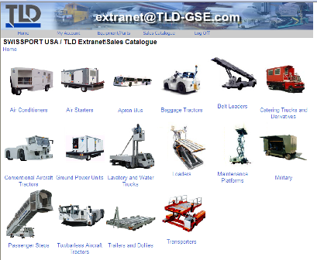
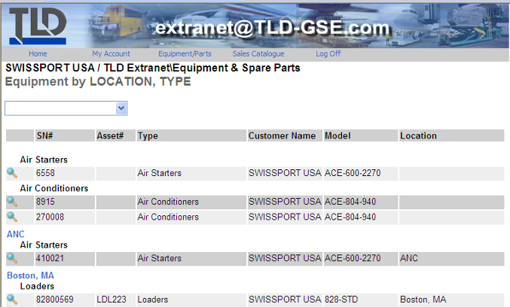
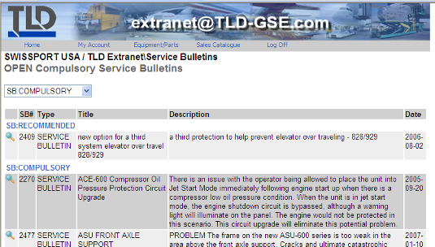
TLD EXTRANET
Any TLD customer can be granted access to the TLD EXTRANET functions that will allow them to:
  See online their complete fleet of TLD equipment
  Have access to detailed manuals of each piece of equipment
  Get informed and download all information regarding Technical Bulletins and software updates
  Follow up TLD service activity and in particular the Warranty Claim activity
  Buy parts online
  Detailed TLD equipment datasheets
  And much more…
Technology at your service

Slide 12
15 lines of equipment and more than 100 models

Slide 13
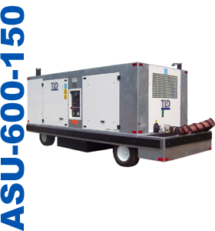
Jet starters

Slide 14
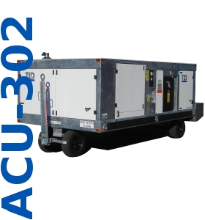
Jet starters
Air conditioning units

Slide 15
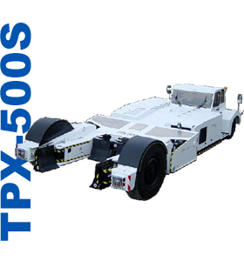
Jet starters
Air conditioning units
Towbarless tractors

Slide 16
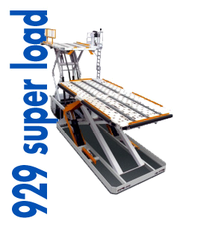
Jet starters
Air conditioning units
Towbarless tractors
Loaders

Slide 17
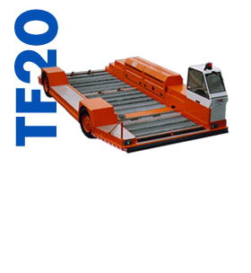
Jet starters
Air conditioning units
Towbarless tractors
Loaders
Transporters

Slide 18
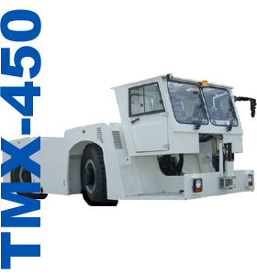
Jet starters
Air conditioning units
Towbarless tractors
Loaders
Transporters
Conventional tractors

Slide 19
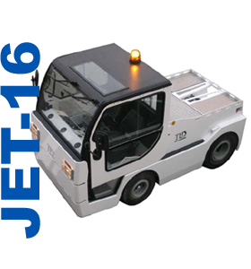
Jet starters
Air conditioning units
Towbarless tractors
Loaders
Transporters
Conventional tractors
Baggage tractors

Slide 20
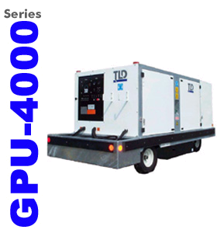
Jet starters
Air conditioning units
Towbarless tractors
Loaders
Transporters
Conventional tractors
Baggage tractors
Ground Power units

Slide 21
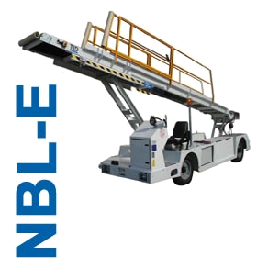
Jet starters
Air conditioning units
Towbarless tractors
Loaders
Transporters
Conventional tractors
Baggage tractors
Ground Power units
Belt loaders

Slide 22
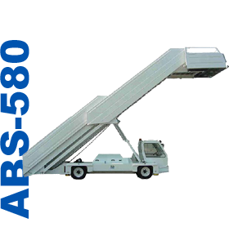
Jet starters
Air conditioning units
Towbarless tractors
Loaders
Transporters
Conventional tractors
Baggage tractors
Ground Power units
Belt loaders
Passenger steps

Slide 23
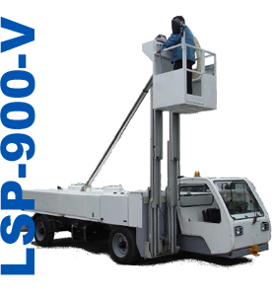
Jet starters
Air conditioning units
Towbarless tractors
Loaders
Transporters
Conventional tractors
Baggage tractors
Ground Power units
Belt loaders
Passenger steps
Lavatory & water trucks

Slide 24
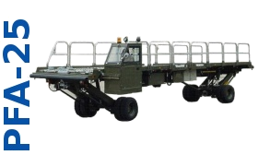
Jet starters
Air conditioning units
Towbarless tractors
Loaders
Transporters
Conventional tractors
Baggage tractors
Ground Power units
Belt loaders
Passenger steps
Lav and water truck
Special&military equipment

Slide 25
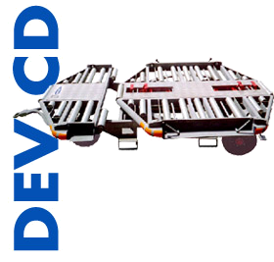
Jet starters
Air conditioning units
Towbarless tractors
Loaders
Transporters
Conventional tractors
Baggage tractors
Ground Power units
Belt loaders
Passenger steps
Lav and water truck
Special military equipment
Trailers and dollies

Slide 26
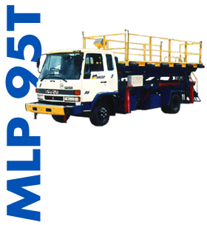
Jet starters
Air conditioning units
Towbarless tractors
Loaders
Transporters
Conventional tractors
Baggage tractors
Ground Power units
Belt loaders
Passenger steps
Lav and water truck
Special military equipment
Trailers and dollies
Maintenance platforms

Slide 27
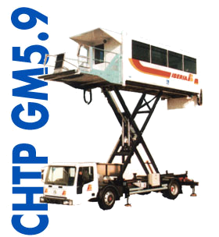
Jet starters
Air conditioning units
Towbarless tractors
Loaders
Transporters
Conventional tractors
Baggage tractors
Ground Power units
Belt loaders
Passenger steps
Lav and water truck
Special military equipment
Trailers and dollies
Maintenance platforms
Ambulift & Catering truck

Slide 28


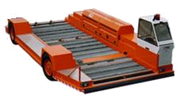
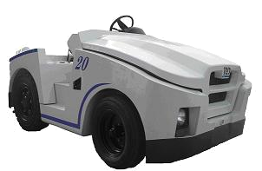


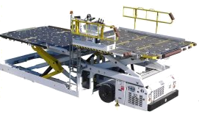

6 factories and 2 industrial partners on 3 continents
  Sherbrooke, QC-CANADA
Shanghai, CHINA
Montlouis-sur-Loire, FRANCE
JingJiang, CHINA (BAOLI, subcontractor)
Saint-Lin, FRANCE
Windsor, CT, USA
Wuxi, CHINA
Since early 2009
Mendoza, ARGENTINA (PALMERO, licensed partner)
The TLD International Industrial setup

Slide 29
TLD takes full advantage of its industrial network and of the modern IT organization and communication tools in order to implement an industrial strategy very adaptable to the market and world fast moving environment.
Through its RANGER and MASTER programs, TLD assembles its products in different facilities around the world, close to the customers operations while maintaining strong product design integrity and quality control
Industrial Strategy

Slide 30
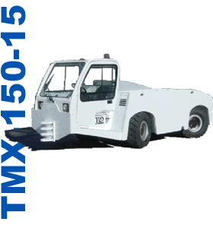
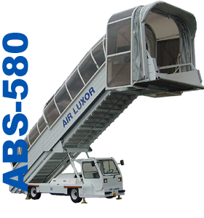

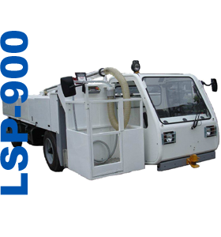
RANGER Program
RANGER & MASTER products availability

Slide 31
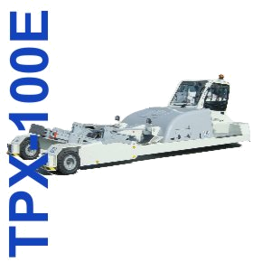

MASTER Program
RANGER & MASTER products availability

Slide 32
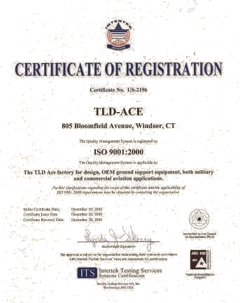
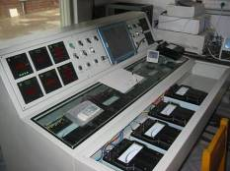
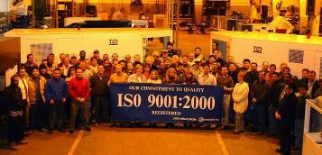
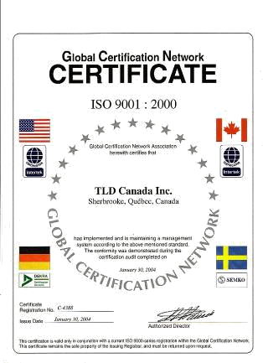
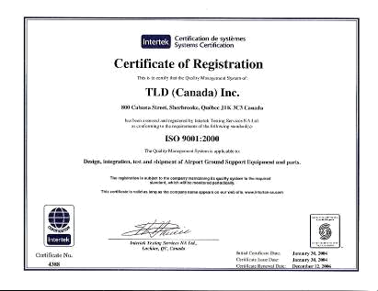
A GLOBAL Culture of Quality
The whole TLD organization is organized around ISO-9001-2000 Standards.
At TLD, our Pride is Quality

Slide 33
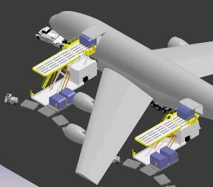
A clear Product Strategy
Four TLD product lines represent
60% of the TLD Sales
    Loaders
    Towbarless tractors
    Air Conditioning Units
    Air Starters Units
Simplicity, Reliability, Maintainability, Environment Respect & Energetic efficiency drive our engineering efforts to provide our customer with optimized TCO products
Focus on Technology

Slide 34

GREEN, CLEAN and Energy EFFICIENT
The environment has been a continuous concern for TLD. Zero emission (Electric), environment friendly (R134a), latest emissions standard engines and energy efficient equipment are driving the product development efforts of TLD.
Belt Loaders, Aircraft Tractors, Baggage tractors, Stairs, GPU, Loaders, ACU, Towbarless Tractors, Jet Starters and other TLD Products lines are available in environmental friendly versions.

Slide 35

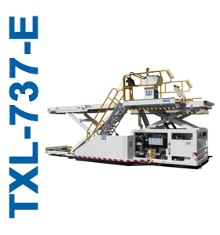

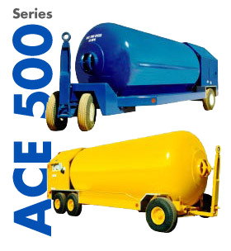

Equipment availability
TLD offers a complete range of Green, Clean and Energy Efficient GSE

Slide 36
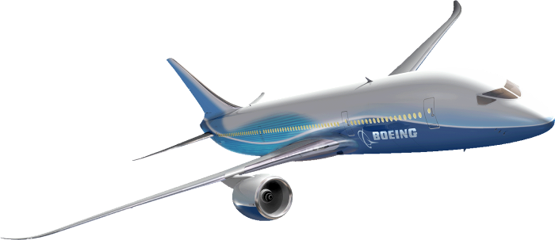
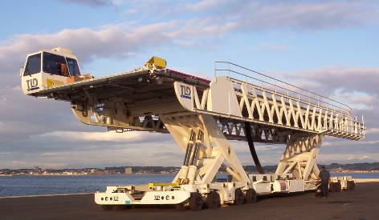
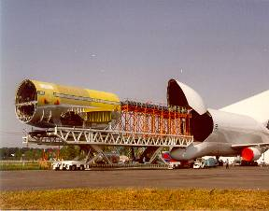
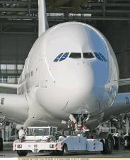
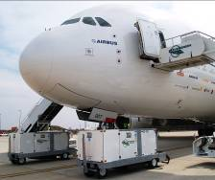


Ahead of our customers technical challenges

Slide 37










TLD has sold new equipment to more than 400 customers
during the past 3 years in more than 100 countries.
TLD top 10 Customer List for 2008
(confidential information)

Slide 38
What TLD can and wishes to offer
The strength of the leading GSE manufacturer, and the full involvement of a team which values reactivity and flexibility
A high level of customer service commitment with a strong support for parts and service
A very modern, reliable, green and cost efficient range of equipment, using the latest technologies and complying with the latest emission standards
A long term partnership with a global and multi cultural organization, which can support your expansion projects worldwide

Slide 39
Support
Quality
Technology
Our continuous common goals

