Slide 1



From: All of us at TLD
Attention: To our valued customer
Address: Some airport,
Somewhere

Slide 2

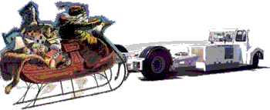
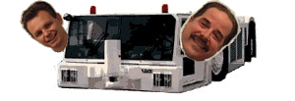
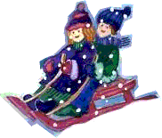
Wow, even Santa’s going towbarless!

Slide 3

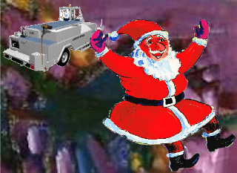
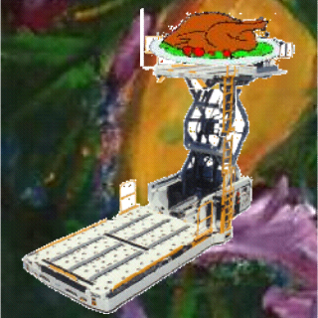
Boy, can this vacuum lav truck suck or what?
Our loaders move your cargo as well as your turkey!

Slide 4
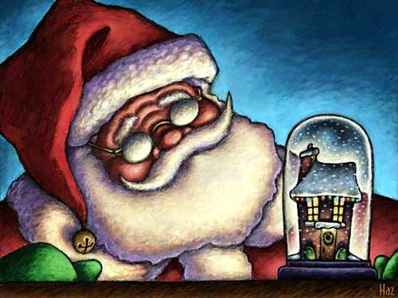

Santa plans his entrance with our Albret passenger stairs
You can also use them to board planes!

Slide 5

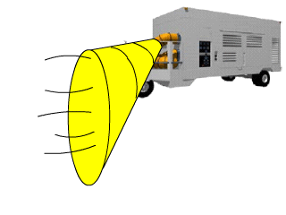
Our ACE Air conditioner is powerful enough to cool your aircraft too!

Slide 6
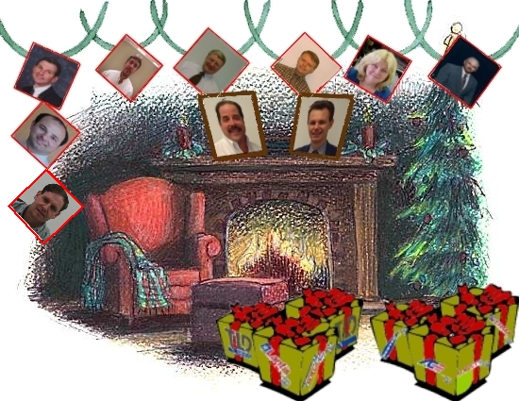
Merry Christmas and a Happy New Year from All of us at TLD

