Slide 1
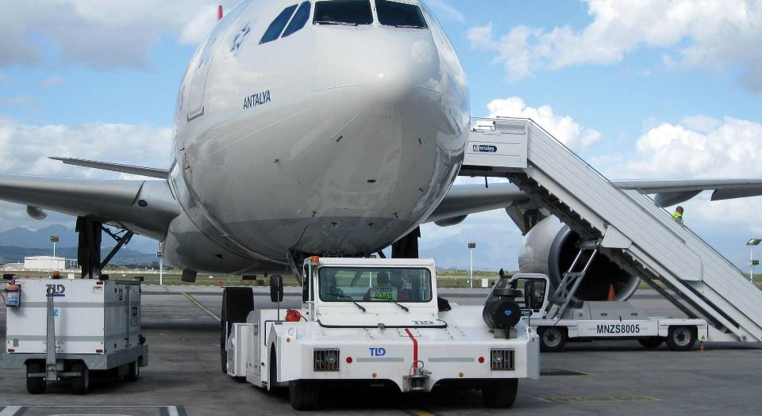


Cargo Transporters
Local Support,
Total Commitment
EXTRANET TLD WEB site
SPARE PARTS MODULE
LOCAL SUPPORT, TOTAL COMMITMENT
Last update Sept 17th 2012, Celine Tessier

Slide 2
Slide 2, 3 and 4 of present POWER POINT is internal TLD
Only the other slide can be sent to customer for info
COMMUNICATION

Slide 3
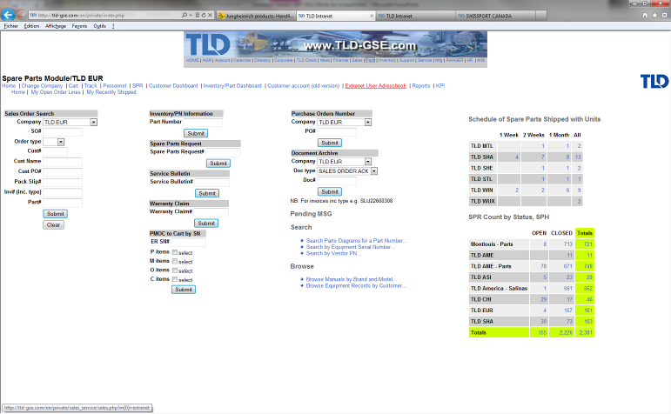
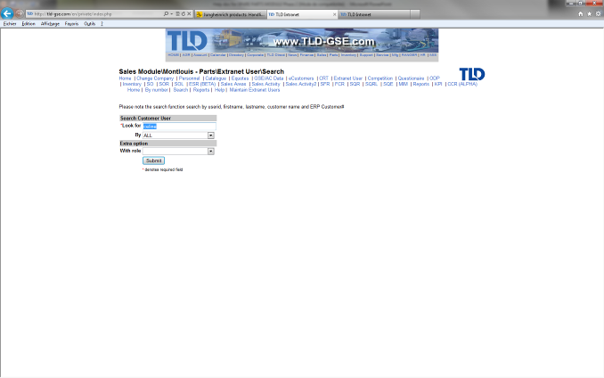
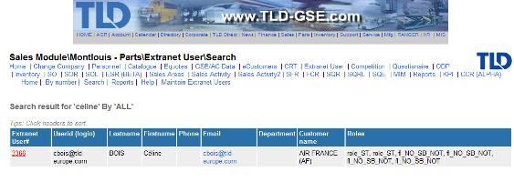
1) Go in Parts, then Extranet User Addressbook, then SEARCH
2) Search by name or company, click SUBMIT
3) Make your choice on the list and click on Extranet User #
Recover a customer ID & password

Slide 4
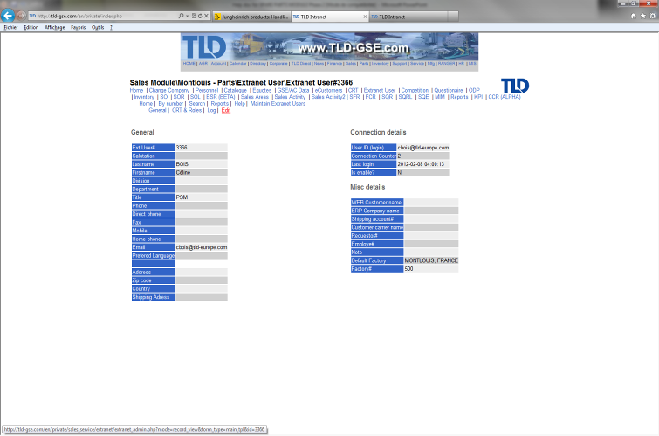
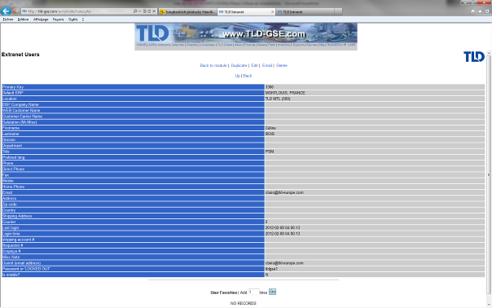
Find ID and password

Slide 5

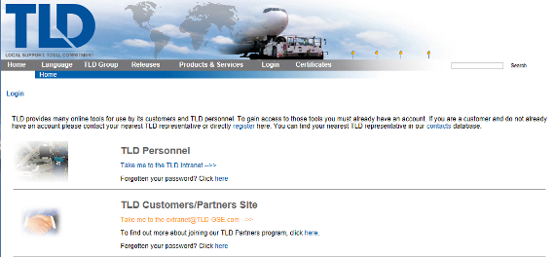
Go SPARE PARTS extranet

Slide 6
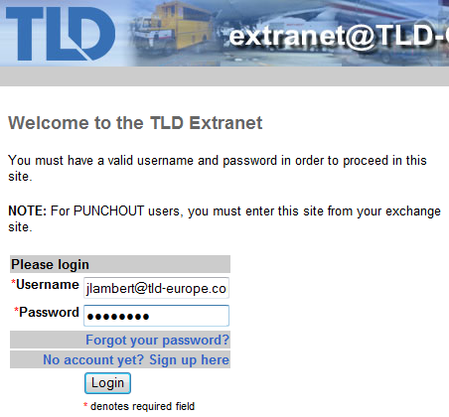
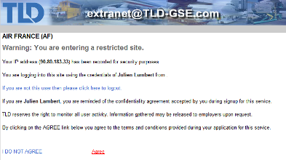
Fill out fields and login
Then Agree
Customer entry in extranet TLD web site

Slide 7
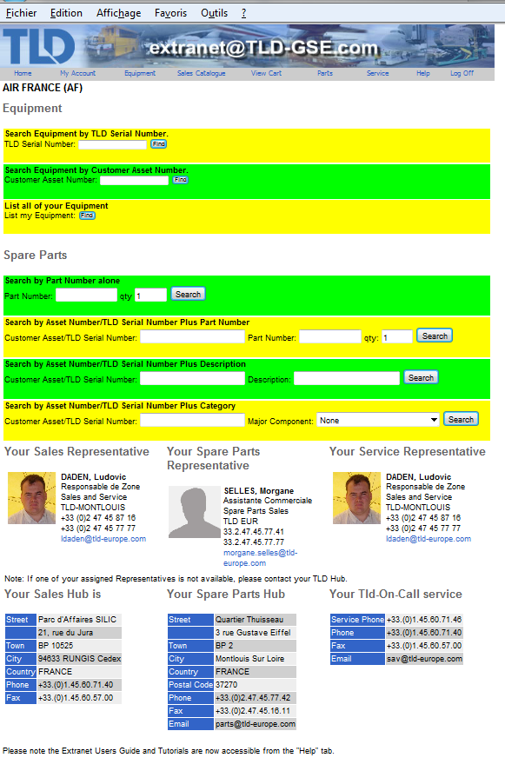
FYI: this poor design was made for FEDEX
We are currently asking for change to have a clean and design HOME PAGE.
Céline T (sept 2012)
Customer relation team
EXTRANET home page

Slide 8
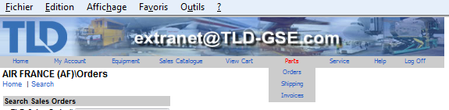

Customer name
Extranet PARTS ACCESS

Slide 9
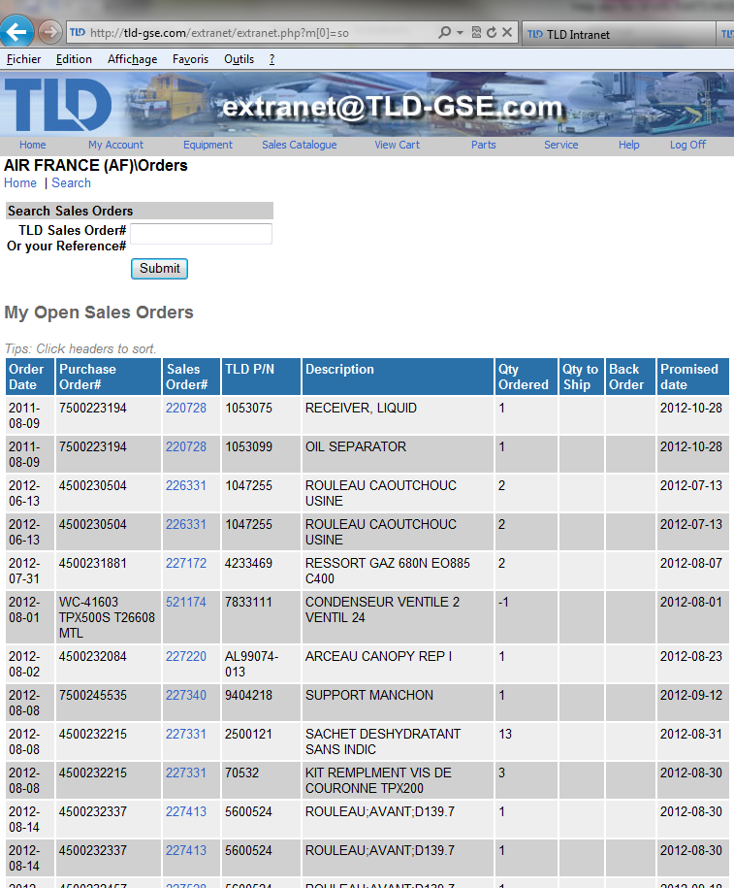
Search field on PO# or SO#
Sort by a click on header column
Extranet PARTS open orders

Slide 10
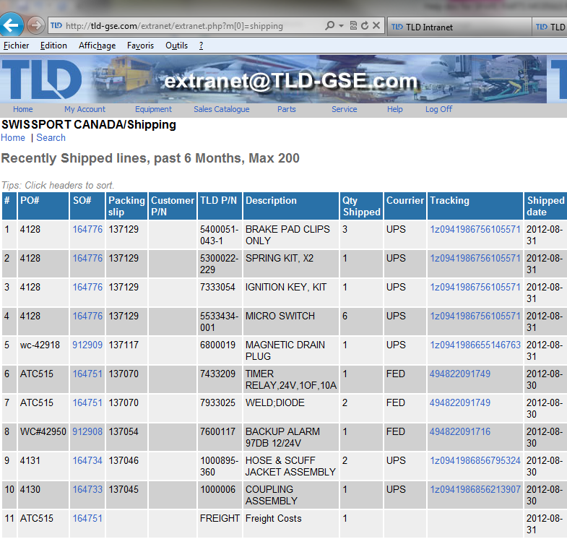
Only 6 months view
Or
200 lines maximum
Tracking will lead to the carrier web site for transportation status
Extranet PARTS recently shipped items

Slide 11
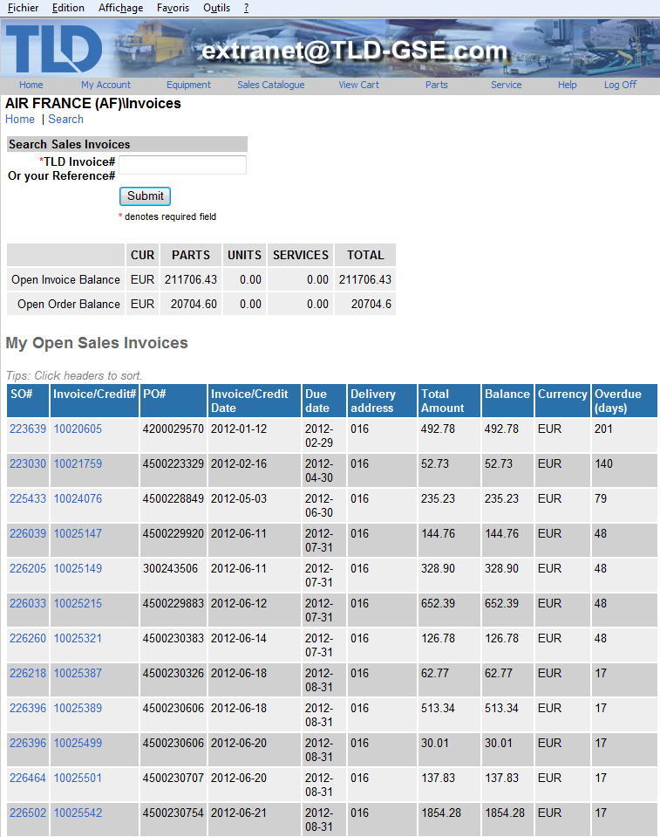

Summary of customer open situation in terms of money
Overdue visibility in days
NOTE: no access to PDF invoice up to now. No possibility for the moment due to security reason on TLD Server. Issue is to give access to customer only to invoices related to him.
Extranet PARTS invoicing info

Slide 12
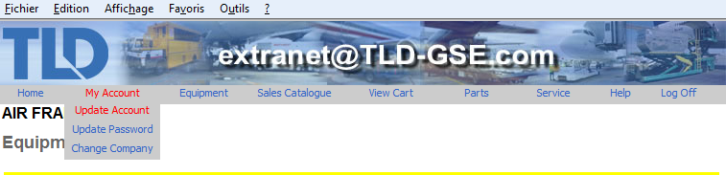

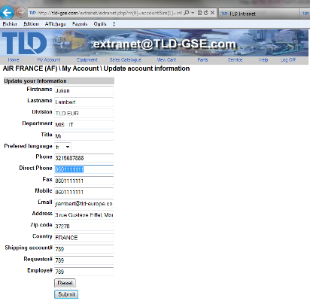
Customer can update his account
It will automatically update TLD Used Adressbook
Extranet : update account

Slide 13

Log Off

