Slide 1
Trimester Report
TLD-ACE
4/7/2004

Slide 2
Agenda
TLD-ACE YTD financial performance
Recent Key Wins
Potential Opportunities
TLD-ACE Reorganization
TLD Group info
New Development Status
ISO 9001 Project Status
Conclusion

Slide 3
TLD-ACE
YTD financial performance
$4.2M 1st Qtr sales against a budget of $4.4M
Slow start and low end product mix mean unprofitable 1st qtr
302 are meeting budget margins
GPU margins improving each month but still below budget
Military product will help next qtr
We need to play catch-up

Slide 4
Recent Key Wins
Jet Blue
  302, 600-180, GPU
Mesa Airlines
  16 ACE 302s
Southwest Airlines
  10 GPUs
UPS
  8 600-270 JetStarters
Delta GPUs

Slide 5
Potential Opportunities
Globe Ground
  Jet starters and GPUs
Indian Airlines 802s
Delta 802s
MAS 808s
Continental HGEU90s
FedEx 600-270s
United Airlines 600-270s

Slide 6
Reorganization
Materials and Logistics Manager appointed
  More than ever the flow of our shop is dependent on the performance our suppliers
  Material Management must become our primary concern from the point of on-time delivery, quality, cost and inventory control
  Russ Sniffin will leave the Production Manager position to take on this challenging role which requires:
    Excellent Product Knowledge
    ERP Expertise
    Strong Leadership
With Russ in this new role we are putting the “necessary horsepower and talent” in place to succeed

Slide 7
Reorganization
New Production Manager appointed
  Duane Douglas will arrive on April 13 to fill this position
  Duane has 15 years of Production Leadership as well as Engineering and Materials experience
  His experience and training in shop efficiency techniques will be of great value as we start our modernization of the facility.
  Obviously his first task will be to learn the existing products and processes.
Duane’s motivation and experience combined with proven leadership skills will be an asset to our organization.

Slide 8
Reorganization
Mark Garlasco
Chief Operating Officer
Simon Su
Engineering Manager
Sue Reis
Quality Manager
Russ Sniffin
Materials and Logistics Manager
Gary Robinson
Strategic Purchasing
Duane Douglas
Production manager
Chad Yergeau Product support
Manager

Slide 9
New Faces/Positions
Alex Krasnoshek has gone from temporary to full time in the Engineering Department reporting to Simon
Jason Kulikowski has joined the Engineering Department reporting to Simon
Les Kimbal has moved to the Materials Handling Group reporting to Edwin. Thanks Les for many years of service in the Fabrication department

Slide 10
TLD Group info
RANGER programs Progressing
  Group Sourcing Manager in place
  Mr. Hai Bin located in the Shanghai facility
  Providing access to mainland China products and manufacturing in order to lower our costs
  GPU offers opportunities for kits that can be used by Windsor and Shanghai.
  Hai is actively involved in Windsor Development programs via Gary Robinson
  Electronic access to Engineering vault allows efficient interaction between Engineering departments
The “Globality” of TLD is growing daily

Slide 11
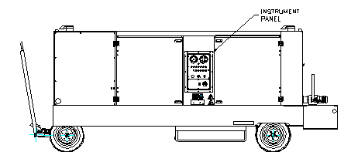
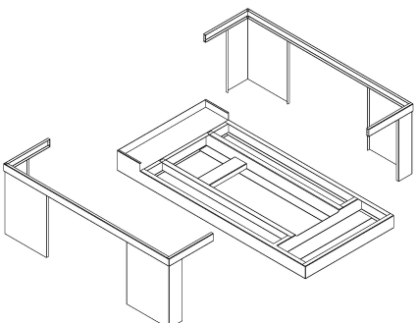
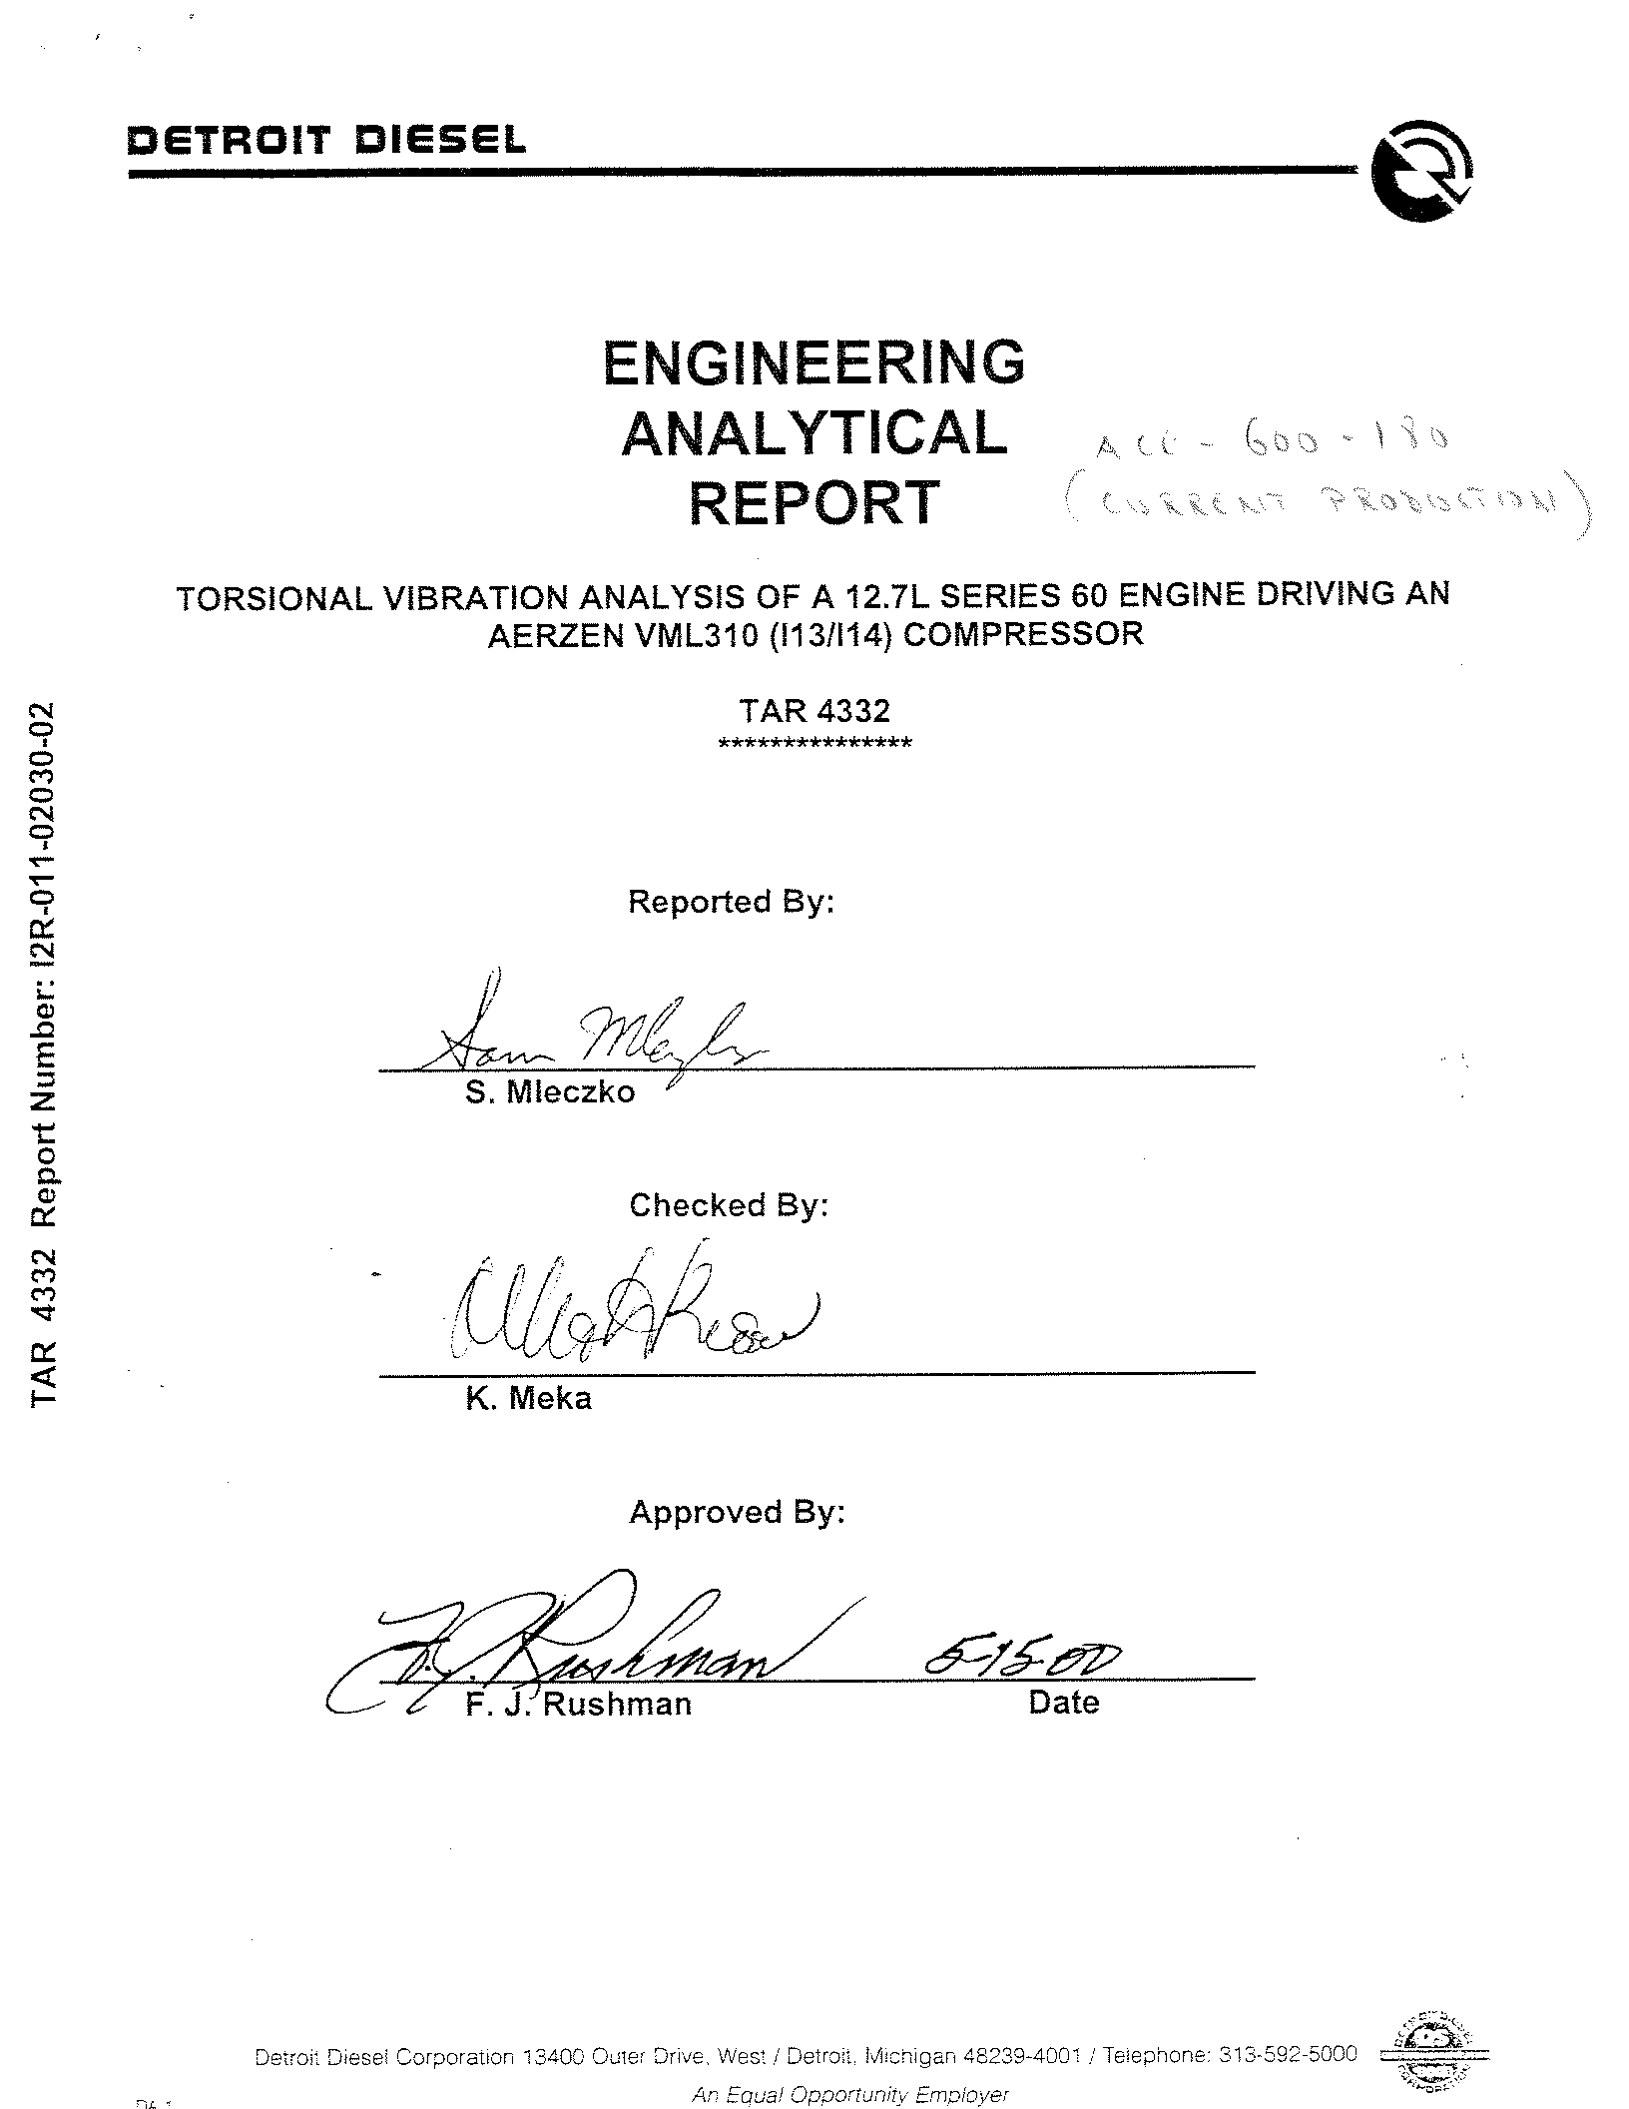
New Product Development Status
150 ppm Jet Starter
  Concept stage complete
  Detail design in process
  High commonality with GPU,302,600-100
  Will be displayed at GSE EXPO
Common Chassis 180,270,300 ppm jet starter
  In concept stage
  Challenging commonality driven design goals

Slide 12
ISO 9001 Program status
Implementation of ISOSOFT workflow software started
  Shared project with TLD-Canada
  Allows:
    Efficient collection and reporting of material and shop floor non conformances in order to better manage our suppliers and our processes
    Routing and approval of Engineering Changes
    Assigning and tracking of Field Issue tasks
    Control of Documents
    Management of Environmental and Safety tasks

Slide 13
Conclusion
1st QTR 2004 results are behind the plan
2nd QTR will be an improvement
  TLD-ACE is clearly winning market share
  However we need to continue to control costs and improve efficiency
  We need to continue to prepare for the resurgence of the market in 2005
The aim of our reorganization is to do both

