Slide 1

TLD-ACE
Trimester Review
6/03/02
Mark Garlasco
C.O.O. TLD-ACE

Slide 2
Agenda
TLD-ACE YTD financial performance
Market situation /6 Month Forecast
TLD Group info
New Product Status
Proposal Activity
ISO 9001 Project Status

Slide 3
Financial Summary
2002 budget is the planned loss the Shareholders have agreed to cover
TLD-ACE YTD financial performance is in line with the 2002 budget
However Market situation in the next 6 Month will not be as strong as anticipated in original 2002 budget
Without further changes we will miss our plan
  Requires additional emphasis on cost control
  Increased urgency to get improved margin products in production
  Close control of inventory levels
  Increased Productivity

Slide 4
Market Summary
Airlines are not increasing flights as fast as anticipated
All TLD competitors are suffering greatly
  One competitor is rumored out of business
  One key competitor is reduced to 1/3 original size
  Others will fall out over the next 6-12 months
  TLD-ACE Market position is improving relative to the competition
Military Work is coming-but not much this year
TLD-ACE must hold on for 6-9 months before consistent break even volume returns

Slide 5
Going Forward Plan
Continue to reduce costs in all areas
  Cost reduce key product components
  Cost reduce the facility costs
  Increase productivity
Deploy new products
  Cost effective GPU
  Point Of Use Aircon
  Cost effective 804
  Cost effective 302
Re-enter Military and Industrial markets
Prepare for increased production without adding overhead cost.

Slide 6
Productivity Improvement Projects
Pre-paint mode
First Article Inspection process
  Automated reminders for in house and outsource facility inspections
Small Parts Plating procedure
  Eliminate handling of small parts through paint shop
Automated Product Manuals
Automated Drawings to shop
Baan Customizations

Slide 7

TLD GROUP
TLD Canada Inc.
  Facility acquired in Sherbrooke, Quebec
  Approx 150,000 ft sq
  Taking advantage of the slow market to complete the move in May
  Some loaders being assembled now
  Production to start in July
  Opening ceremony in September
  West coast parts facility still located in Salinas

Slide 8
TLD GROUP
TLD corporate image and logo
  In order to increase TLD image recognition and reinforce the synergy of the all the entities, the TLD logo only will now be used by all.
  ACE brand name will not be shown on our equipment
  TLD-ACE company name will exist as a legal entity and be shown on our lettterhead
New TLD brochure will be available shortly

Slide 9
New TLD-ACE Products
ACE 4120-E-DUP
ACE 900
ACE 302 DUP
Hush kit for 302
Hush kit for 804

Slide 10
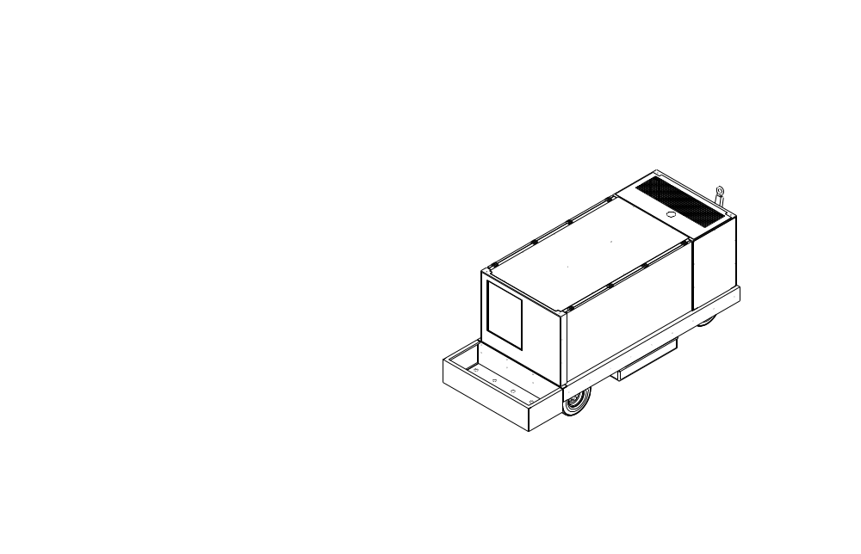
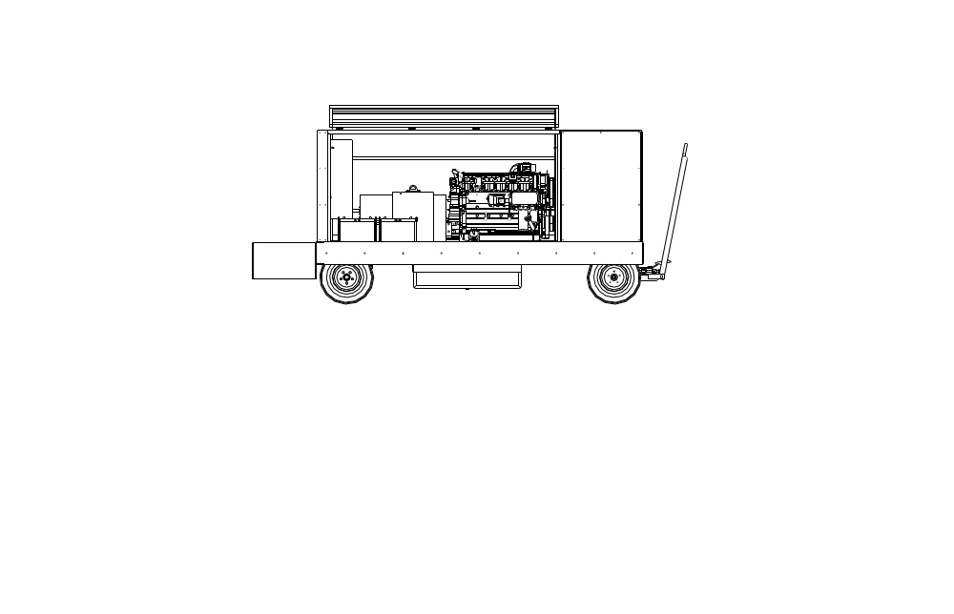
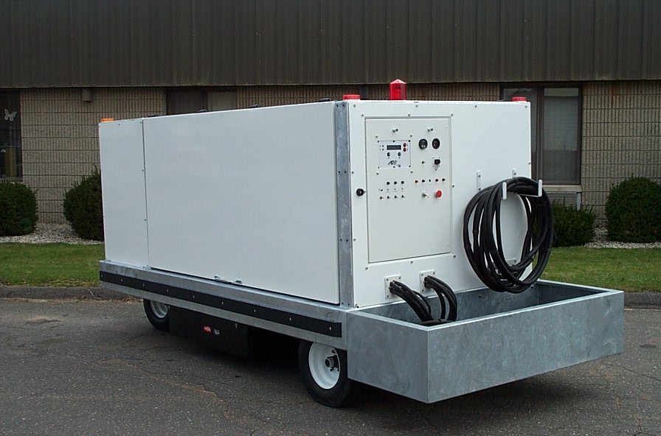
New Electronic GPU

Slide 11
Electronic GPU Goals
Current Production GPU not profitable/ competitive
Goal was to reduce material and labor costs by 25%:
  Simplified electrical box via TEK Module
  Common sheet metal for all models
  Common exhaust muffler,air filter and radiator.
  Common fuel tank with 302, 272, 600-100, 804
  Common cable tray with 100 ppm hose bin
  Galvanized frame , cable tray, towbar
  Powder coated sheet metal panels

Slide 12
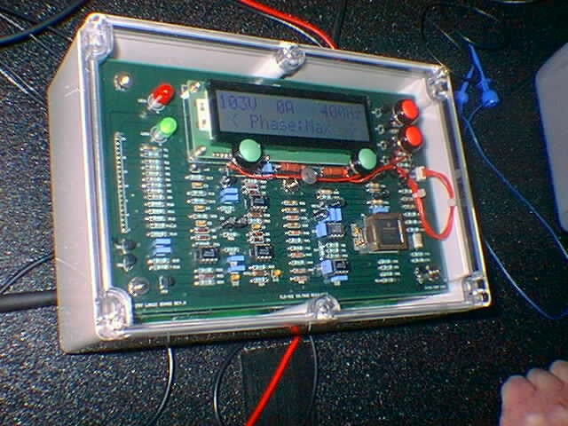
Close-up of TEK Module

Slide 13
GPU Prototype status
Module testing started Dec 15 2001
Field testing in process-60 hours to date
  Performing well at Signature Flight
  Collision test completed 5/30
Test mods to be incorporated by 6/21
Production units available August 2002

Slide 14
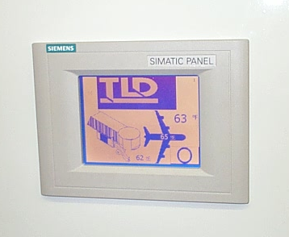
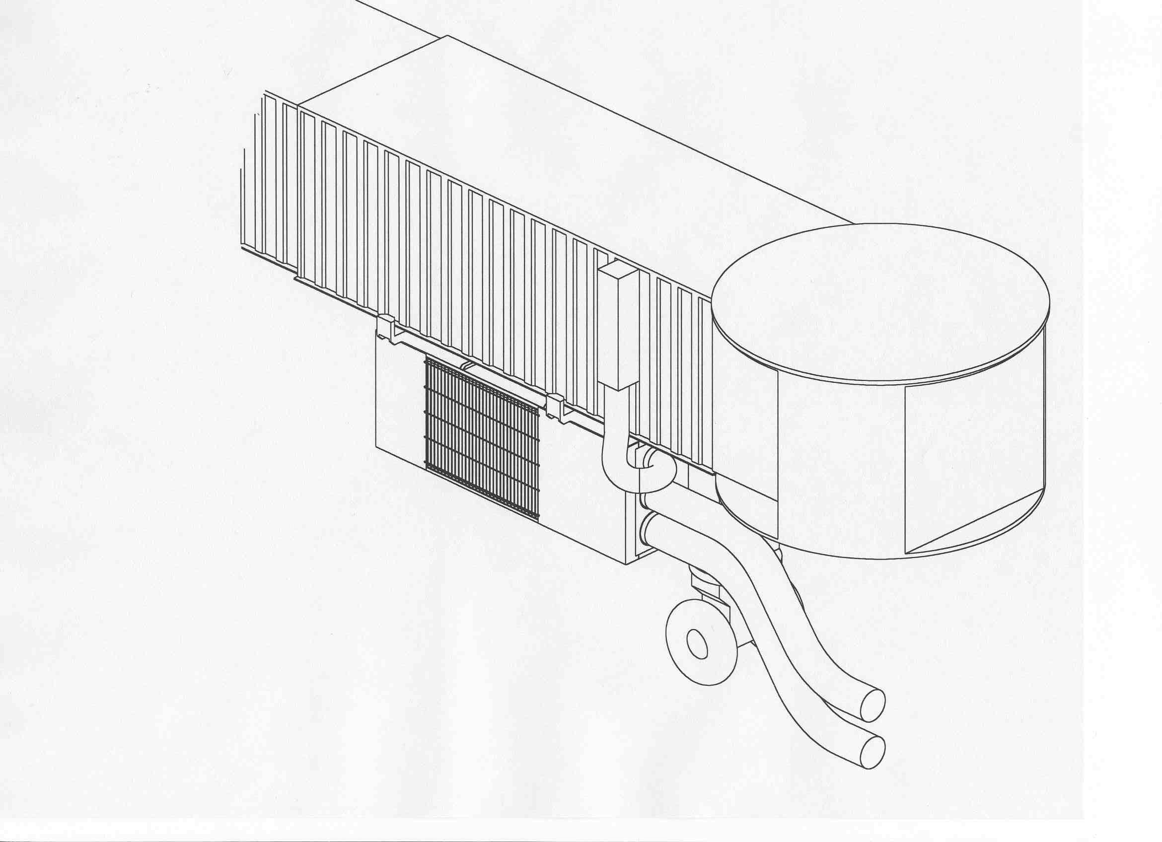
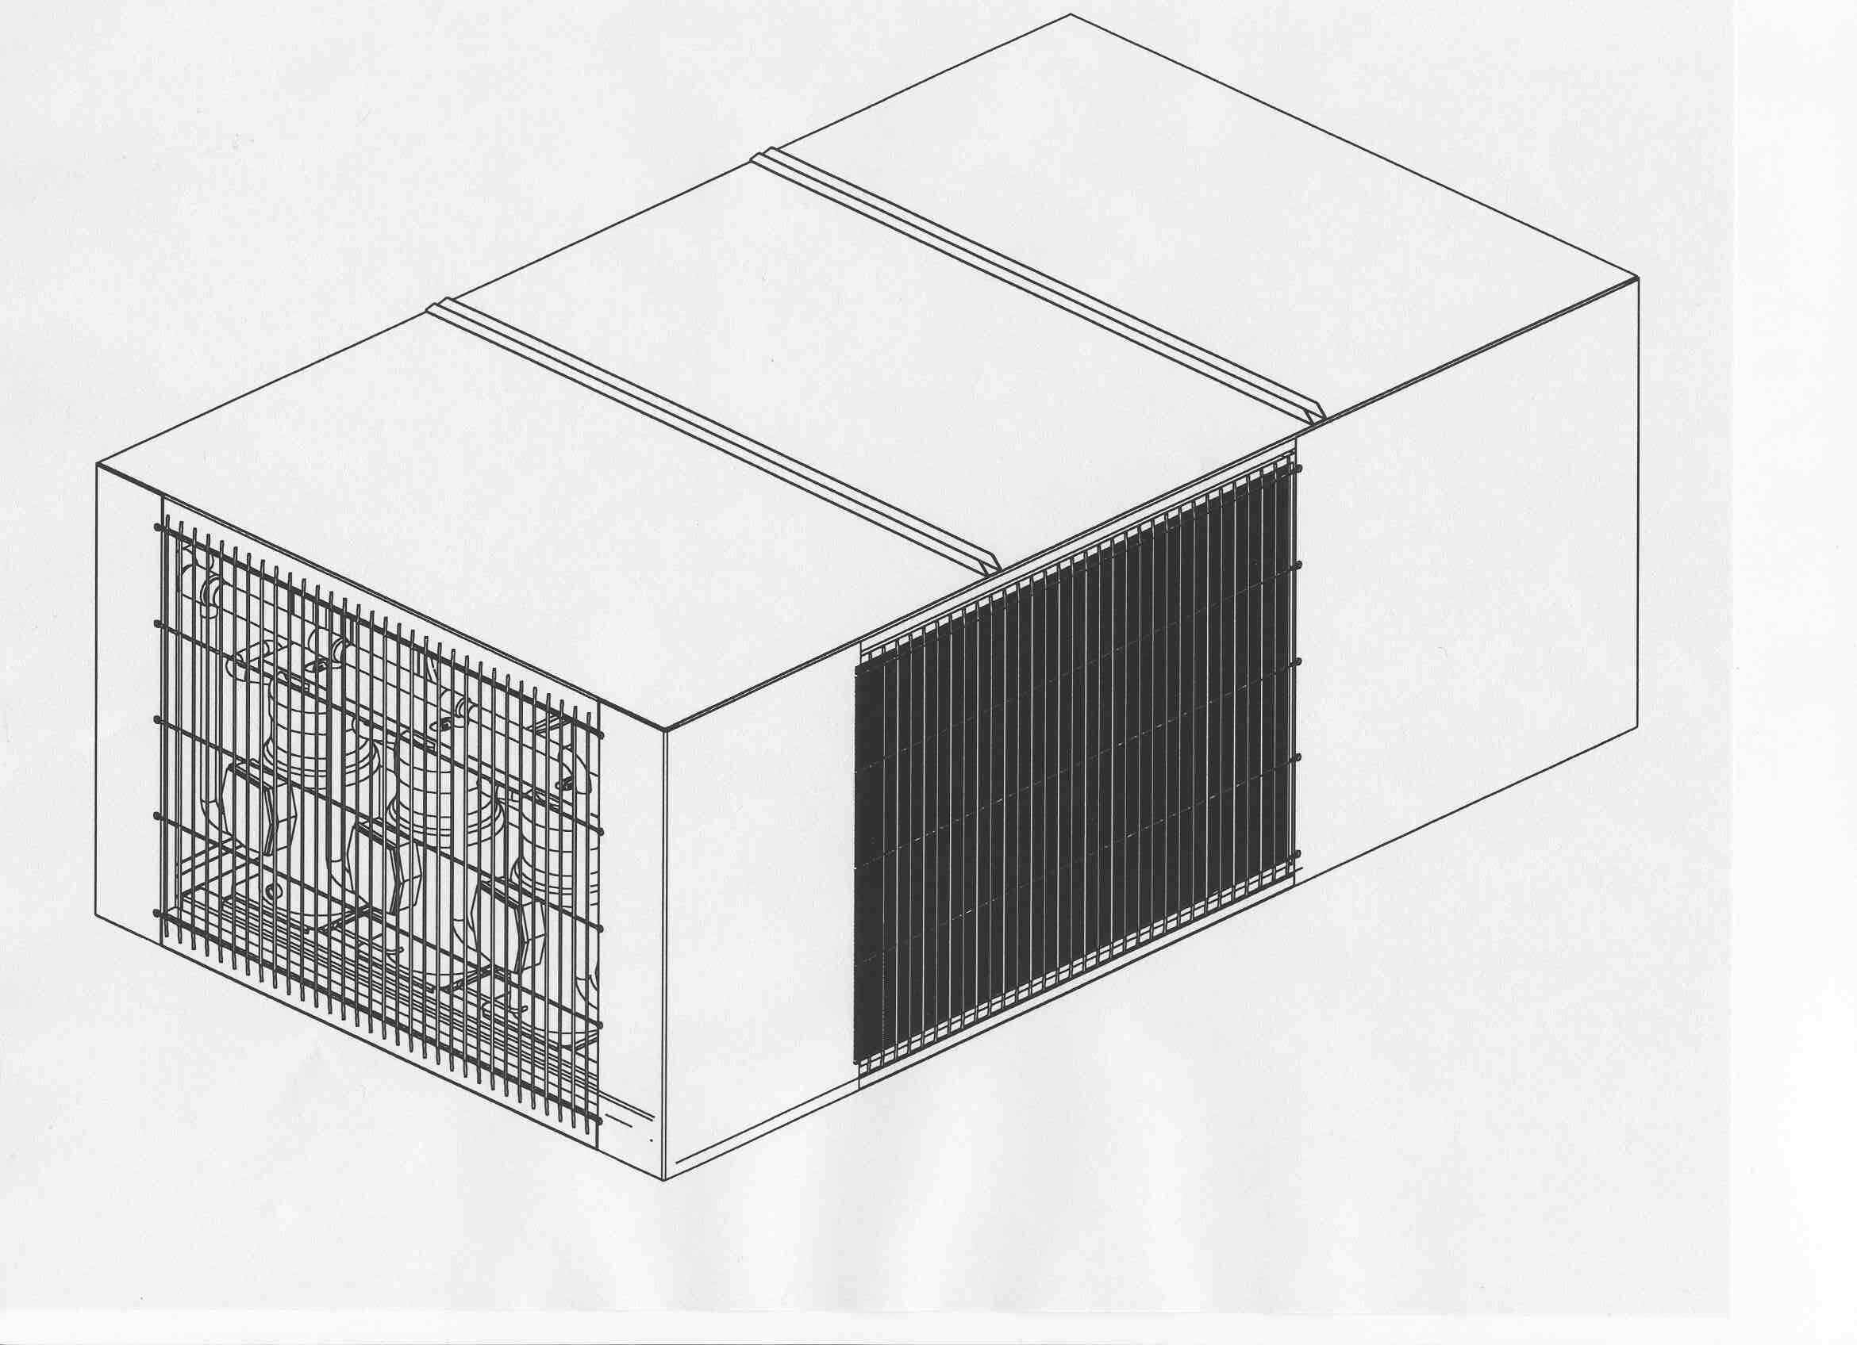
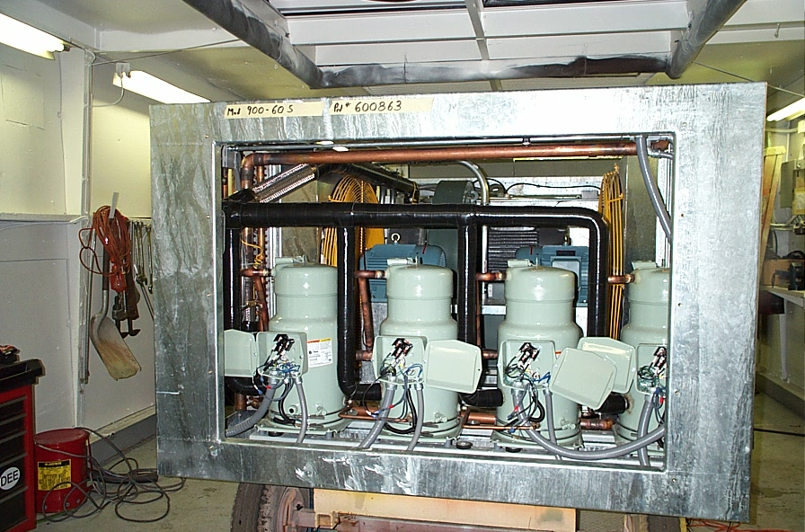
ACE-900-60 Prototype

Slide 15
Point Of Use Air-con Project
Goals
  Enter this market with most attractive cost
    Minimize the number of parts
    High commonality of parts with 302,804
    High Commonality between 45 and 60 ton
  Perform field testing with Delta
  Possibly supply a demo unit for McCarren Airport
    Get ready for next years bid

Slide 16
ACE 900-60 standard configuration

Slide 17
ACE 900-60 Installation

Slide 18
P.O.U. Project Milestones
Start Fabrication……………….3/7
Start Assembly…………………3/26
Start test………………………..5/10
Ship Unit to Field Test…………6/18

Slide 19
Other development news
Deutz powered 600-100 in production since November 2001
  Initial problems resolved, anticipating follow on orders
  Industrial version has interest
ACE 1410 E Electric Drive Lav vehicle finishing Demo at American Airlines. Will go to Delta next.
  Potential Fuel Cell powered projects in discussion
Deutz powered 302 went into production in April
  IPSCO generator set being offered as “drop in” alternate to the Cummins-Onan

Slide 20
Proposal Activity
Completed Military
  BAE Systems Multi Purpose GSE for F-16
  Israel Air Force 401/801 for F-16
  USAF RACM
Completed Commercial potential for 2003
  McCarren Airport POU
  FedEx 804, 600-270, GPU, 272
Other Opportunities for 2002
  USAF LCS,802-392
  Delta 600-200 ppm
  TCR 808
  Signature
  Jet Blue
  Qantas

Slide 21
ISO 9001 Project Status
Project Formally Kicked off Feb 6 2002
  Will force the completion of the good procedure writing already started
  Will identify clearly the “Gaps” in our system
  Will Bring back the formal definition of our quality System
  Will upgrade our existing system to a more modern approach

Slide 22
ISO 9001 Project Status
Goal to complete by year end
Sue Reis, QA Manager is Project Leader
Task team formed in February
  Representatives from each department
  2 person ACE team participated in Audit at Stanadyne Corp. in March
Master Schedule of Activity has been created
  First internal Audit planned for June
  Registrar Audit planned for October

