Slide 1

TLD-ACE
Trimester Review
6/13/03
Mark Garlasco
C.O.O. TLD-ACE

Slide 2
Agenda
TLD-ACE YTD financial performance
Going Forward Plan
Recent Key Wins
Potential Opportunities
TLD Group info
New Development Status
ISO 9001 Project Status
Conclusion

Slide 3
Financial Summary
TLD-ACE YTD financial performance is out of line with the 2003 budget
  Due to the low volume of production in 1st 3 months
  Product mix suffered from lower margin products
However YTD performance is better than 2002
Current production is approaching budget level
However Market situation for the Airline Industry is still very difficult and forecast visibility is only near term
We must continue to ramp up production near term to meet customer requirements without getting out beyond our forecast.

Slide 4
Recent key Wins
  PIA 802s (6)
  Boeing 302 (12)
  Boeing 4090-CUP (12)
  Boeing ACU 900-60 (4)
  Indian Airlines ACE 500 Bottle starter (9)
  IAF 302

Slide 5
Potential Opportunities
UPS Jet starter Demo evaluation near completion
Skywest 600-100 Demo in process
GLESCO 804 follow-on order
Indian Airlines Bottle follow-on order
Military 802 follow-on order
IAF follow-on order
Follow-on orders hinge on high quality and on-time delivery

Slide 6
Going Forward Plan
Increase production without adding overhead cost.
  Streamline the purchasing process
  Organize the parts movement process
Continue to reduce costs in all areas
  Increase productivity
  Close control of inventory levels
  Cost reduce key product components
Expand Outsourcing
  Most major components in place
  Quality is improving
  On track for completion by year end

Slide 7

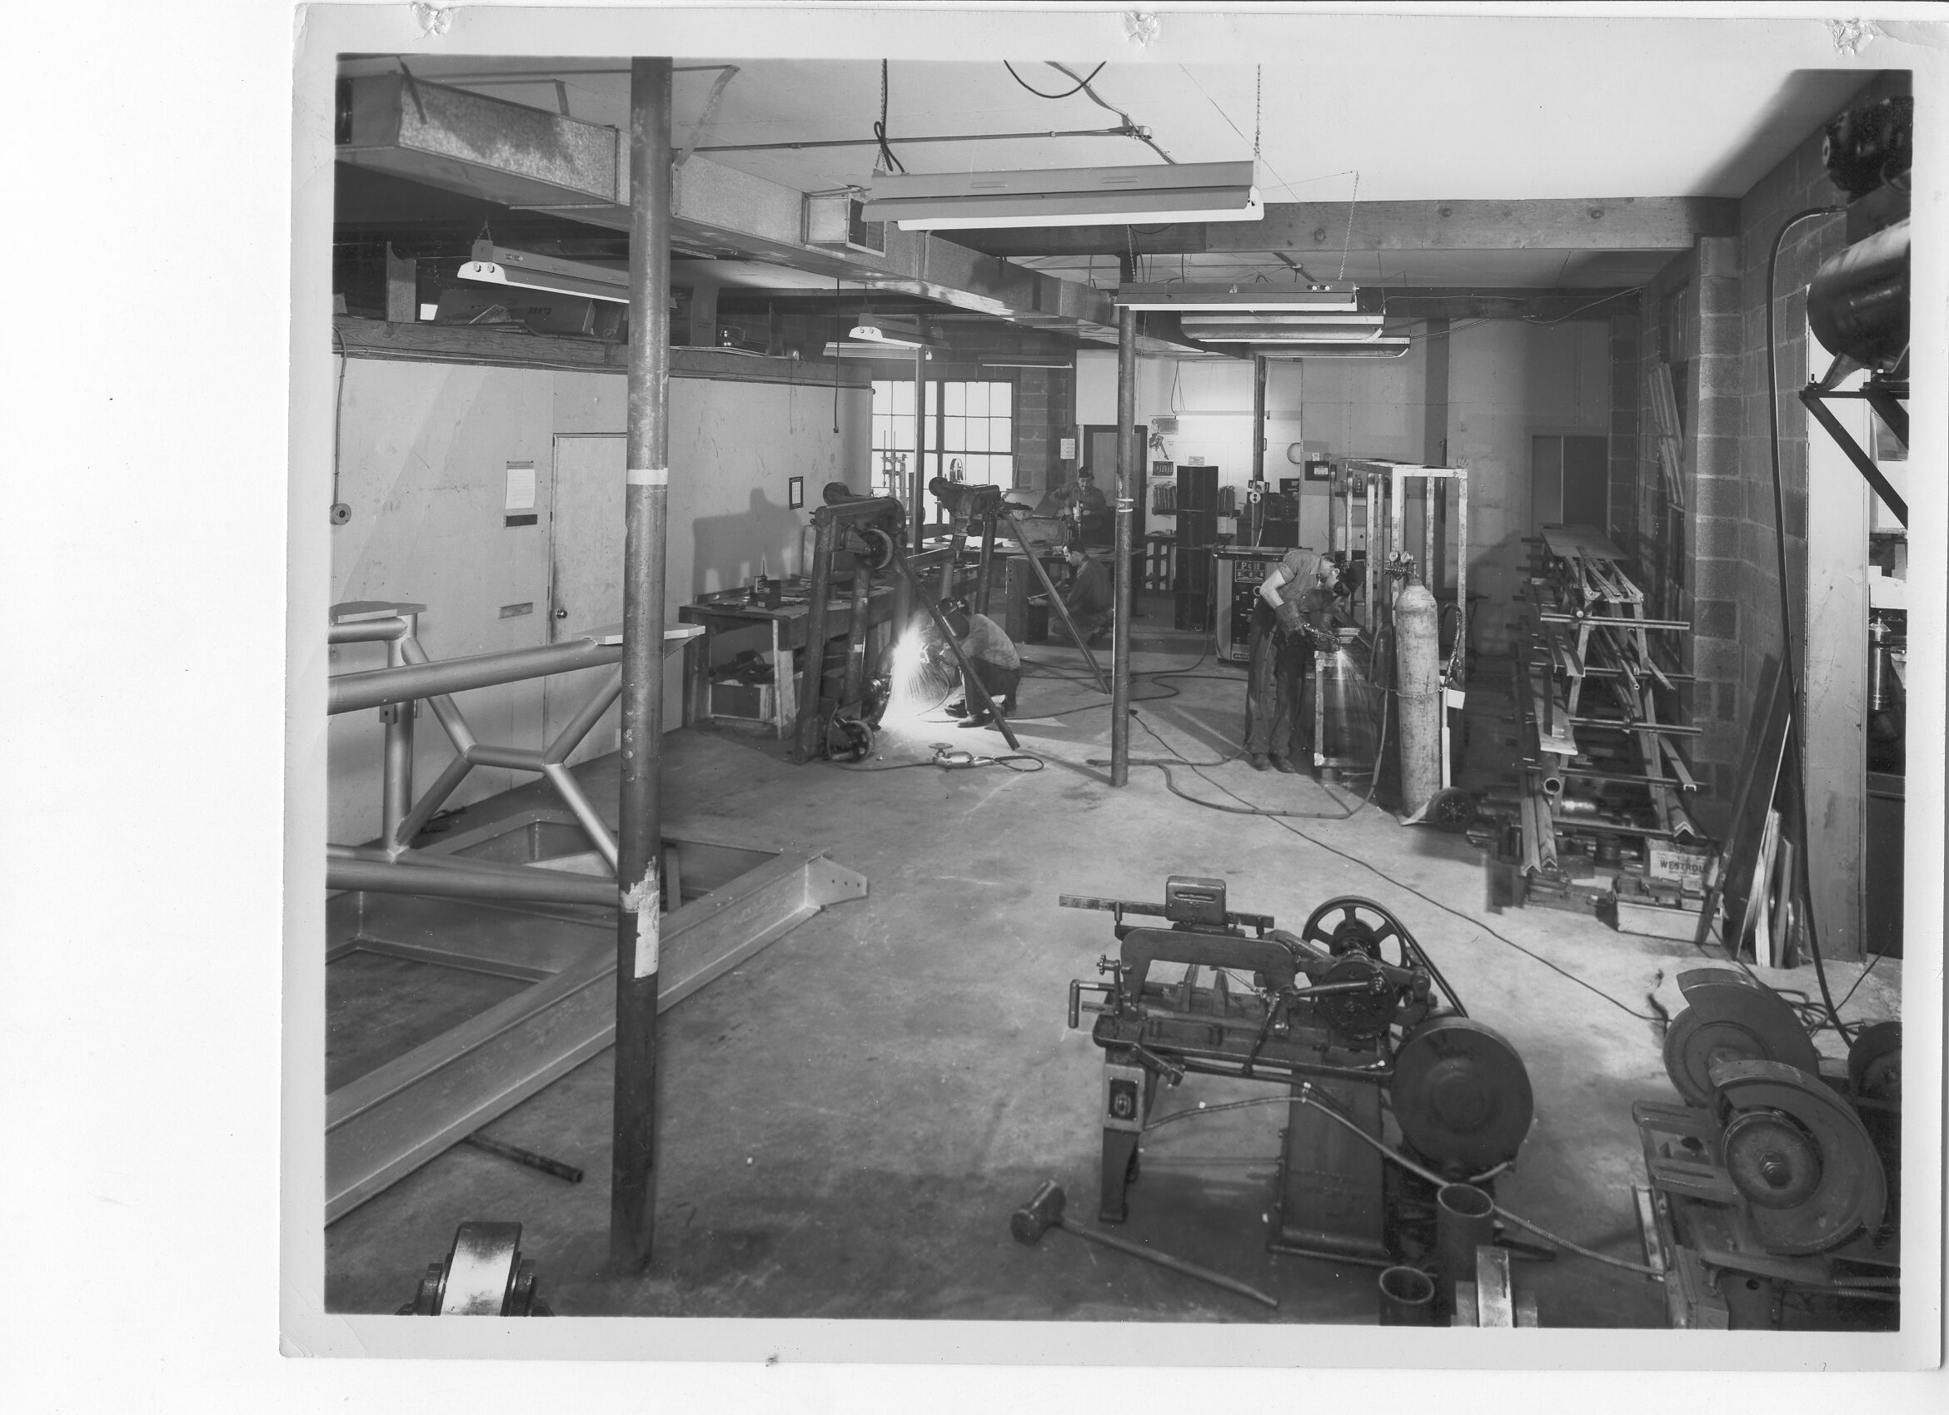
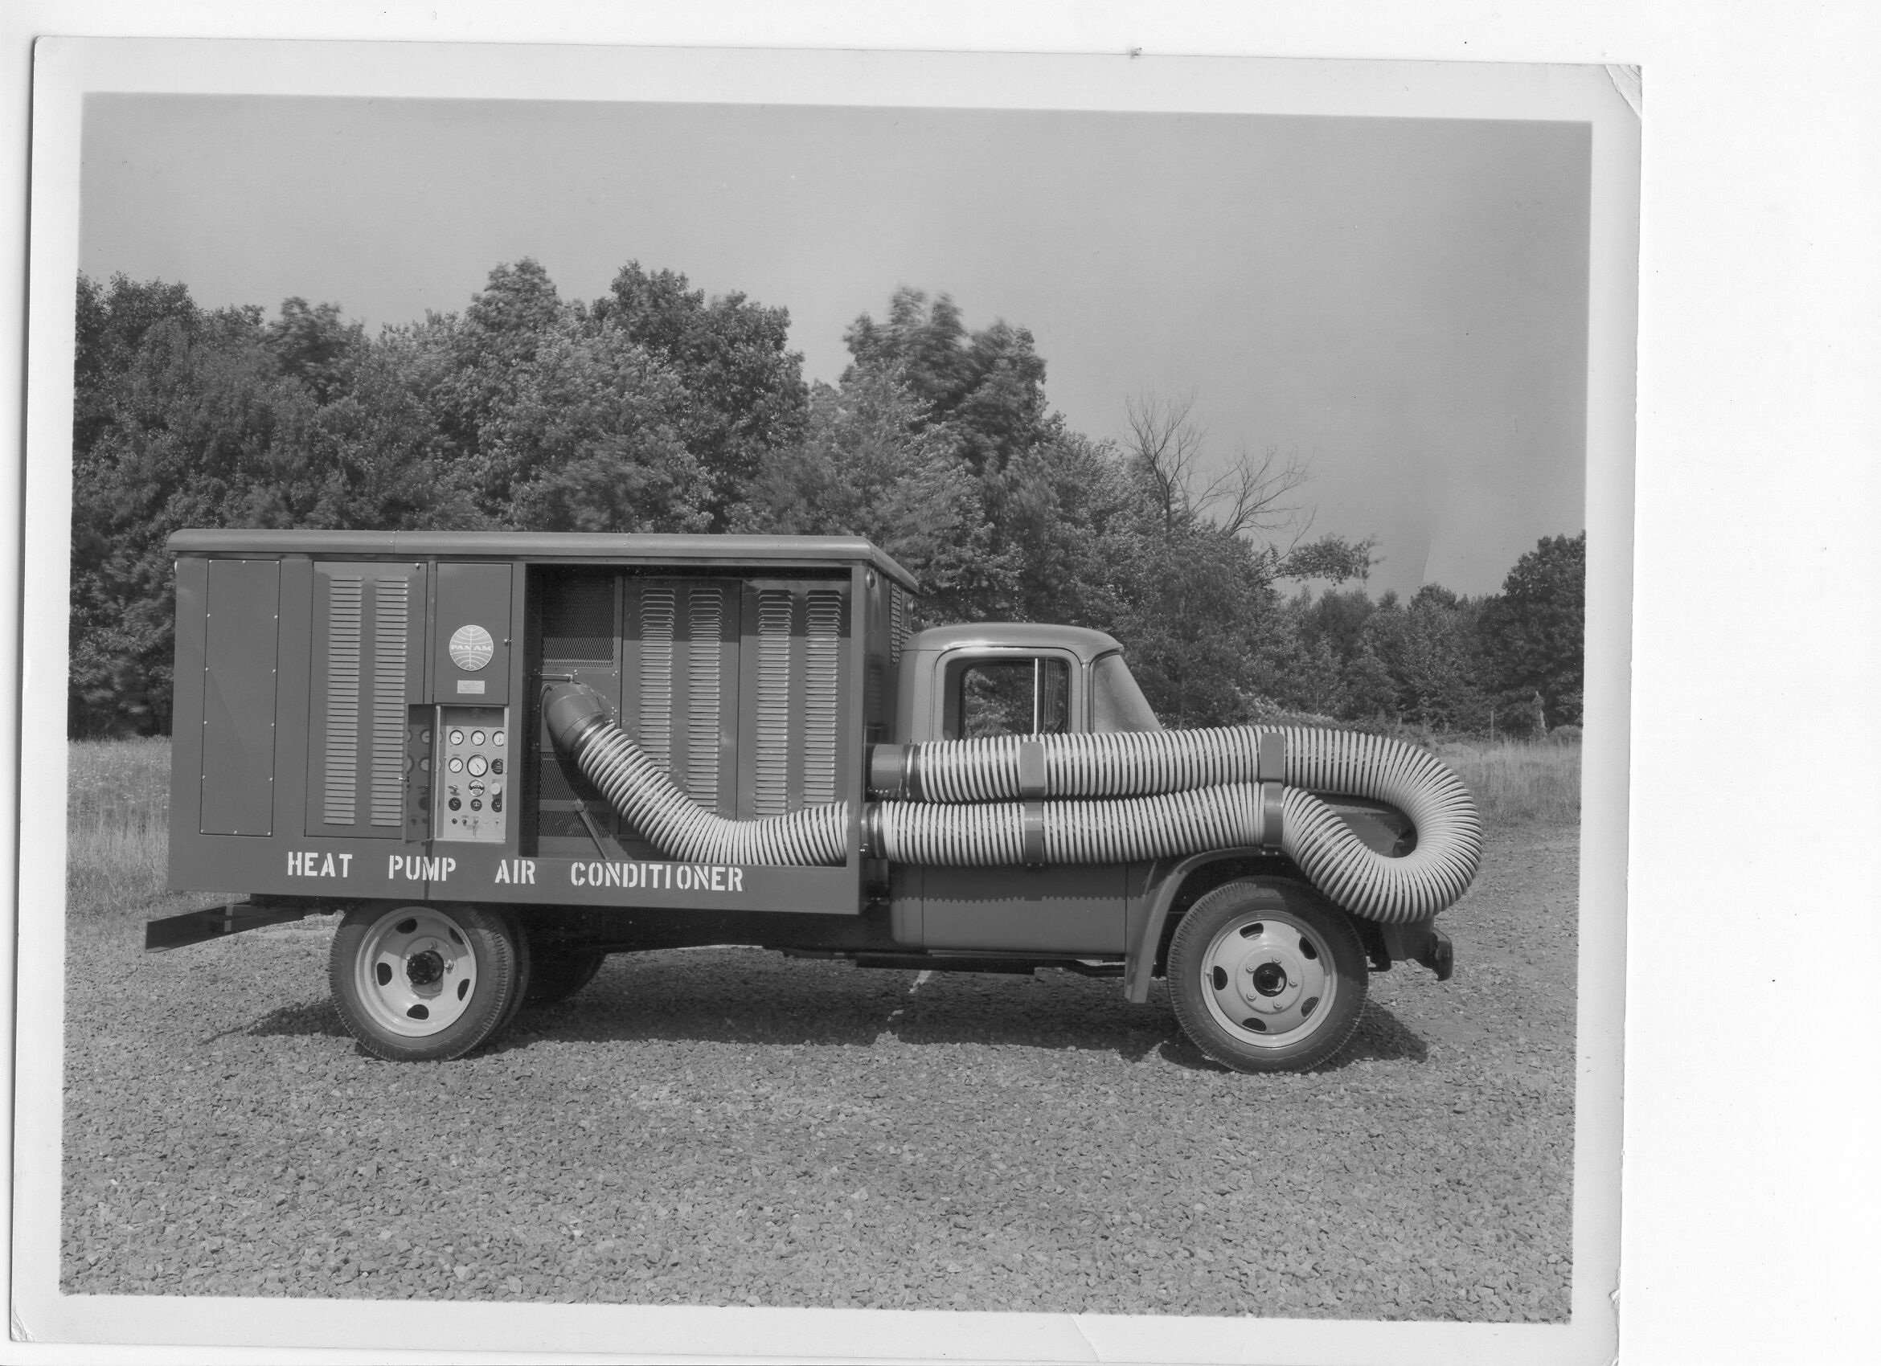
TLD GROUP
TLD-TRACMA and TLD-ACE are each celebrating their 50th year in GSE!
September Celebration planned

Slide 8
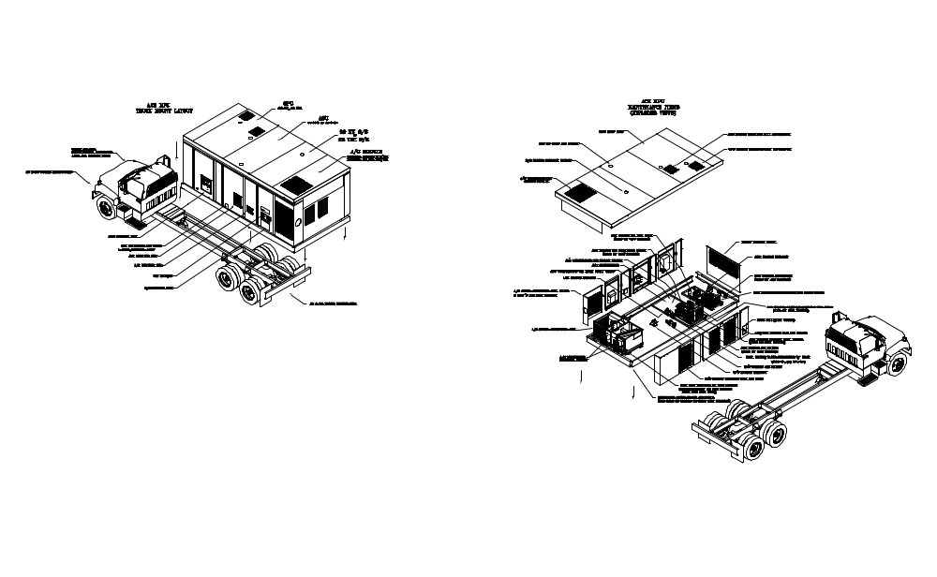
New TLD-ACE Developments
ACE-MPU
  Multi Purpose Unit that includes Aircon, Jetstart and Ground Power in one package
  High Profile Customer
  Challenging but exciting project that will solidify our relationship with a key customer

Slide 9
ISO 9001 Project Status
Registration Achieved December 2002
1st Surveillance Audit June 19 2002
  Be familiar with where to find the documents that define your job
Continual improvement is a tenant of ISO
  OSHA policies and procedures are being brought into our ISO system

Slide 10
Conclusion
TLD is clearly increasing market share in the current depressed Market
TLD philosophy of supporting the customer is recognized as first rate
We are positioning ourselves well to take advantage of a future revived market
We must continue to put all the necessary tools and controls in place before that time comes

