Slide 1
Trimester Report
TLD-Windsor
6/21/2007

Slide 2
Agenda
TLD-Windsor 2007 YTD financial performance
Actual Production vs Plan
Recent Wins
New Opportunities
New Product Development Status
LSP/WSP Program Transfer
TLD Group info
805 Building Extension
Conclusion

Slide 3
TLD-ACE 2007 YTD financial performance
$27.4M YTD May sales against a budget of $21.8M
2006 achieved $52 M YTD Sales
2007 will probably be over $60 M
Operating Profit is also ahead of the budget
Our Backlog still remains extremely high at $19M
  We must insure we keep up with our customers
  It means our production rate must remain high thru the summer

Slide 4
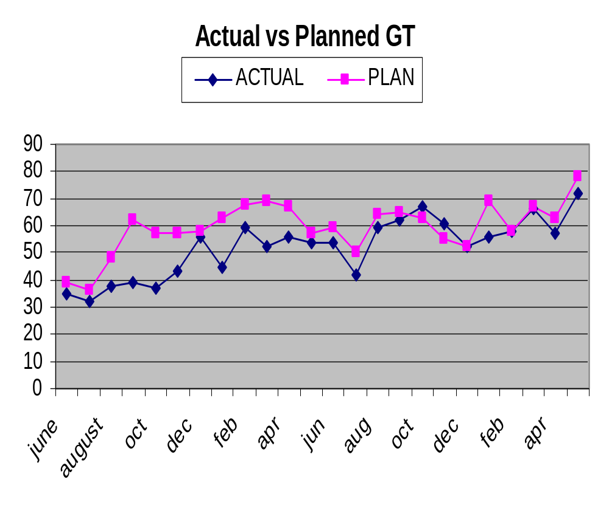

Slide 5
Improved Production Rate
Since mid last year we have gone from Green Tagging 55-60 units per month to 65-70.
3 Key Changes have enabled increasing production
Increased use of Galvanization:
  Currently ¾ of our Products are employing Galvanized frames and powder coated panels
  GPU
  ASU
  Now ACE 302
Common Chassis ASU design:
  1 sheetmetal package replaced 4 previous packages.
  Material flow increases
  Assembly process optimization possible E-Vendor System:
Increasing Procurement
  More Outsourced Electrical Sub-assembly
  Multiple sources of supply
  Increased use of our E-Vendor System:
    Electronic P.O. Process is allowing higher Purchasing department output.
We may soon need to reach 75-80 units per month
  To achieve this we must together find new production efficiencies

Slide 6
Recent Key Wins
Continental Airlines 802’s
Spanish Market still active
  Iberia
  Flight Care
DHL ASU
SouthWest ASU 150
Indian Market
  Menzies
  Globe Ground
  Jet Airways
  Air India
  Indian Airlines

Slide 7
Potential Opportunities
US Navy 60 ton aircon
  Similar to our 804
LMCO F-22 Combination ACU/LCU (22 units)
Northwest Airlines
  ASUs
  LSP
Disappointing losses
  8-10 USAF 802-329s
  Military business has become very competitive

Slide 8
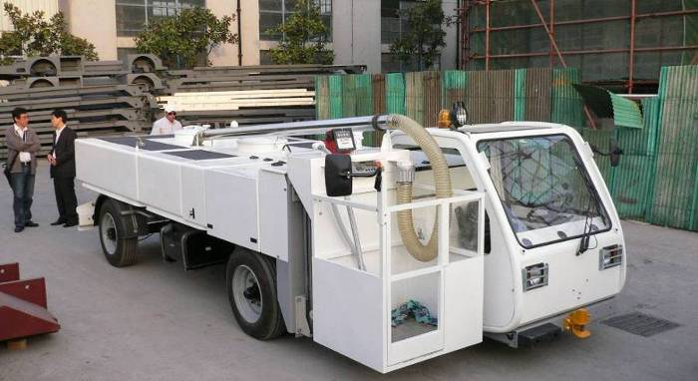
New Product Development
LSP, WSP
Northwest Airlines demo was successful
However, it has been decided to transfer this product line in 2007 to TLD-Canada for the following reasons:
  The Windsor work load is currently the largest in the group and we must be careful to keep resources focused on our existing products and not become too diluted.
  It is better to put this product into a factory that already has a product that shares many common parts with it.(NBL)
  TLD-Canada needs more product diversity to help fill in the gaps in the demand for the Loaders.
The Windsor effort to date has been key in getting a foothold for this RANGER product in the North American Market .
What helps the group helps each of us

Slide 9
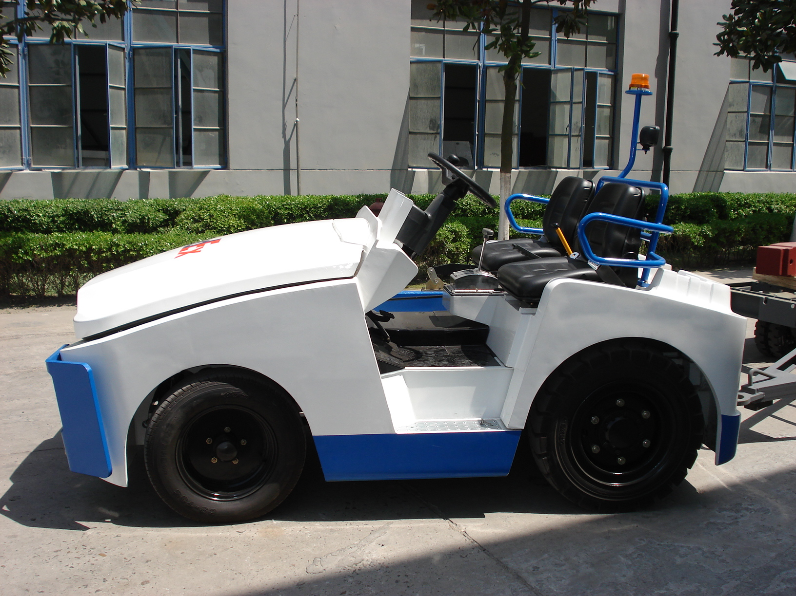
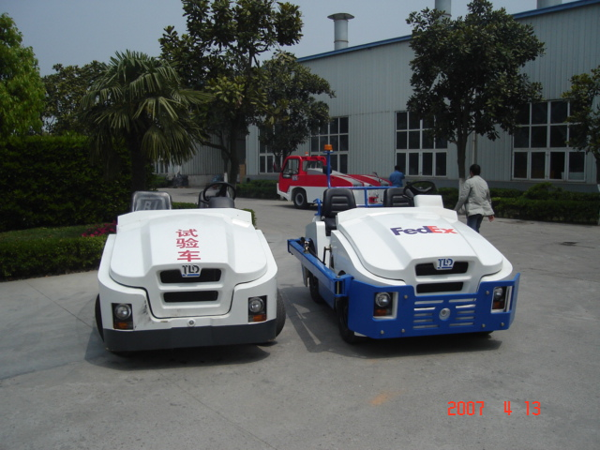
TLD Group Info
JST Tractor Project
  A Joint Venture between TLD and a Chinese Forklift company
  The goal is to attack the market with a very competitive product at a high production rate
  This volume will also bring new economic advantages to other TLD factories using common components such as engines and transmissions.

Slide 10
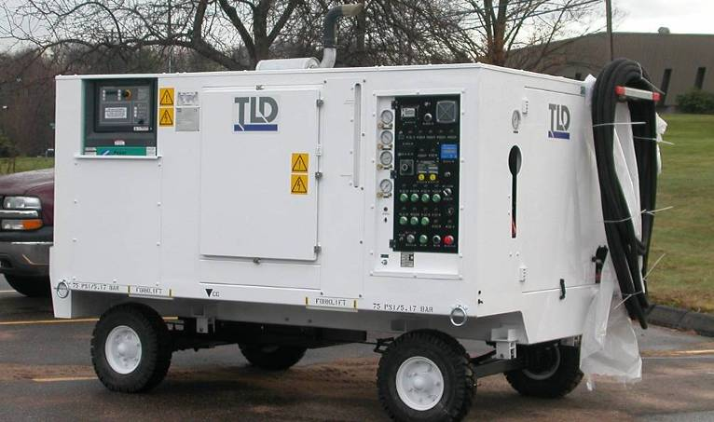
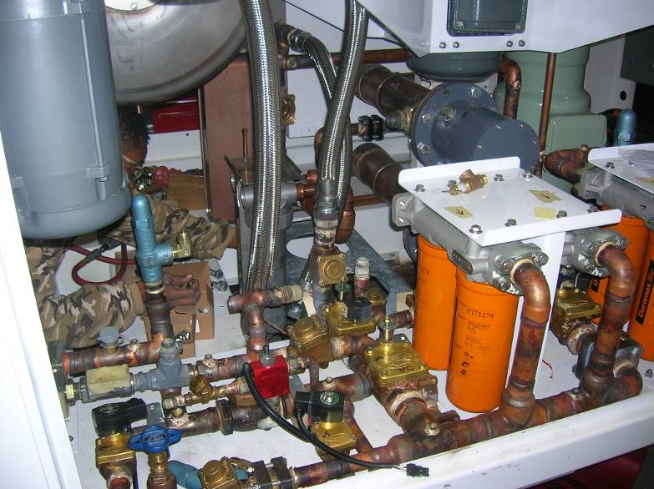
New Product Development
LCU-015-CUP
  Unit #2 finally completed
  Extensive increase in capacity and functionality over Unit #1
  Nearly 6 months overdue despite our best efforts
  We have learned from this experience
  A next phase of design will start in July where we will need to prove to LMCO that we can manage development better than before
  We continue to target LMCO as a key aerospace customer whose business we want to win for this and other Windsor products

Slide 11
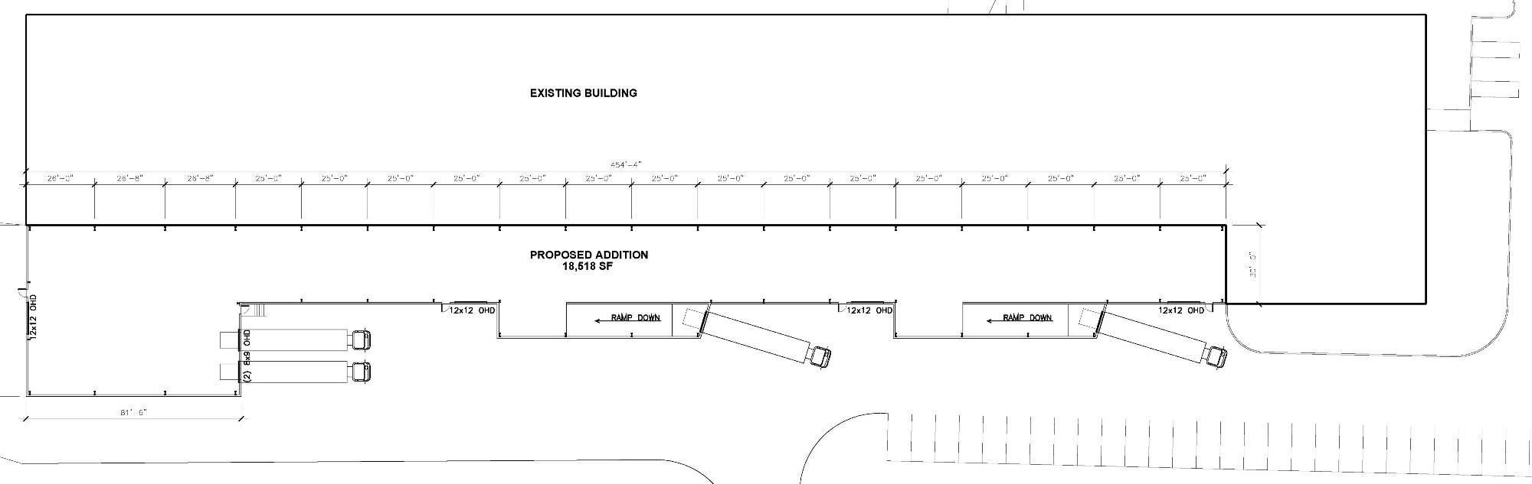
805 Building Extension
This project is starting in July
  Each Work Cell will receive material directly from suppliers
  A Bar code system will be used to transact material directly thru Baan
  Loading docks will be added to ease shipment of finished units
The Town of Windsor is asking us to improve our appearance and noise level which is our goal also
The addition will be operational by October 2007

Slide 12
Conclusion
The first half of 2007 has been very strong.
The second half of 2007 still appears to require a high Production rate in order to not lose customers
  We must face the challenges of working around construction
  We must plan well around vacations
  At the same time we must maintain Quality
We must continue to increase the efficiency of the shop and all other departments via…
  Focused projects to improve producibility
  E-tools
  Workflow modules
We must continue to “make hay while the sun shines”

