Slide 1
Trimester Report
TLD-ACE
6/26/2006

Slide 2
Agenda
TLD-ACE 2005 financial performance
TLD-ACE 2006 YTD financial performance
Our Production Challenge
Potential Opportunities
TLD Group info
New Product Development Status
Employee Incentive Plan
Conclusion

Slide 3
TLD-ACE 2005 financial performance
$34.5M YTD Dec sales against a budget of $27.4M
Operating Profit was also ahead of the budget
Year end results became a new record ,exceeding year 2000 results
The result is due to a generally improving Market but also a growing market share for TLD
Reduction of inventory and ramp up of production influenced the Windsor results positively

Slide 4
TLD-ACE 2006 YTD financial performance
$22M YTD May sales against a budget of $13.5M
Operating Profit is also ahead of the budget
May was a record month of sales at $5.4 M
  Effective Outsourcing, increased Commonality, Galvanizing, and Great Attitudes are among the things that got us there.
2006 will be a new record year
We are still at a high level of backlog
This is the good news…….

Slide 5
TLD-ACE
The Production Challenge
…Even though the production rate has clearly increased, We are still behind schedule with most of our customers
We are still at risk of losing orders or customers because we cant keep up.
  We must continue to Ramp up our production rate each week
  We must continue to streamline our processes
  We must focus on increasing number of green tags per day
We must meet our shipment promises

Slide 6
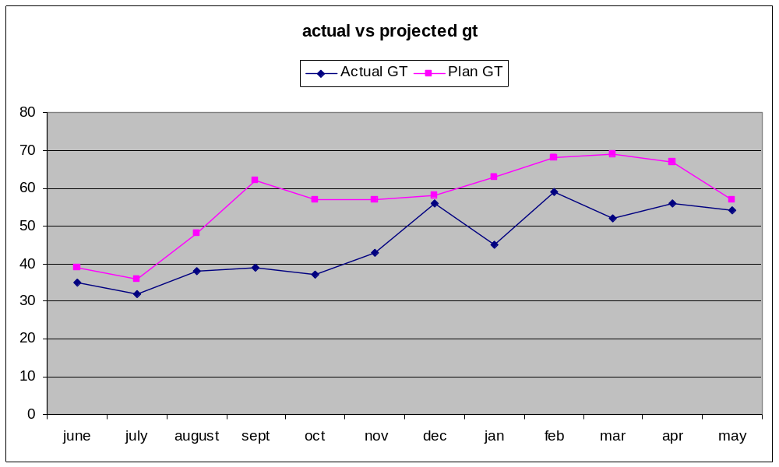
Actual Production vs Plan

Slide 7
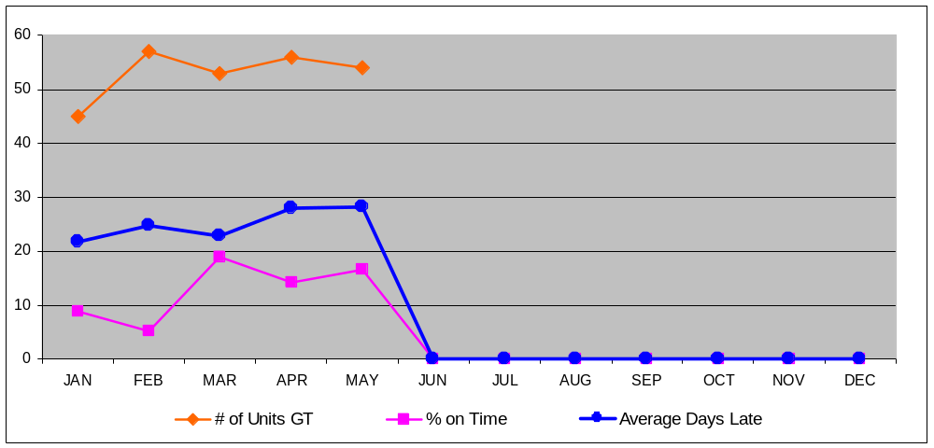
Average Days Late

Slide 8
Potential Opportunities
Our Commercial work continues to grow based on return orders from:
UPS
FEDEX
DELTA
JETBLUE
Continental Airlines may be a new key Customer
  Very impressed during their recent visit due to
    Our Product’s design and quality
    Our Shop’s organization and energy
    Our Web based tools such a Warrantee claim, on-line manuals and E-Vendor system
We must always consider our factory as a showroom for our product and processes.

Slide 9
Potential Opportunities
DAC 110 (USAF)
  Our 802-329
  Delayed by the USAF but now looking to be awarded
  Even chance of TLD winning
  Would result in 45 units requiring delivery of 5 per month starting Jan 07
With the current level of Commercial work we will need to put additional resources in place to handle this

Slide 10
TLD-Group Info
Change in Major Shareholder
MAAF has agreed to sell it’s shares of TLD to AXA Private Equity
  One Financial Investor selling to another Financial Investor
  MAAF included TLD Management in the selection of the buyer
  AXA is fully aware of the cyclical nature of this business
  AXA has studied the market and the TLD business plan and has great confidence in it and the TLD Management
Cash flow management will be a bigger focus for the new shareholder
  MAAF was not in position to take dividends while we reduced debt caused by lean years.
  AXA will expect to make cash
We just have to continue to improve the management of our Working Capital-but this is the TLD way

Slide 11
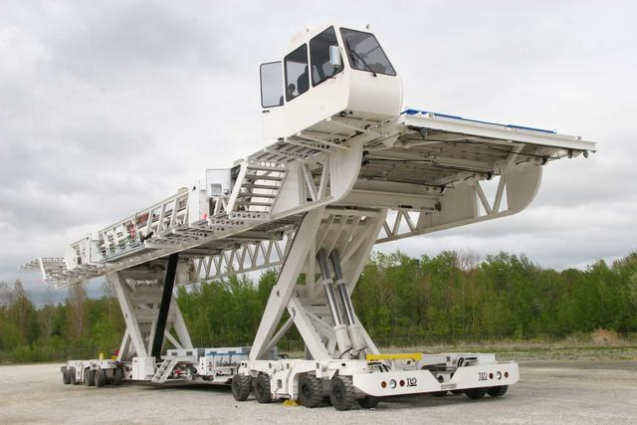
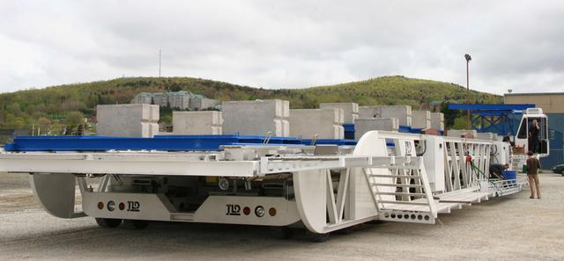
TLD-Group Info
DBL Project
A TLD Success story!
115 ft long
235,000 lbs weight
150,000 lbs payload

Slide 12
TLD-Group Info
DBL Project
First Delivery of the DBL Loader was achieved on time and on Budget
  Very Challenging since it was required to handle a heavier weight than the earlier Airbus Loader yet be it self lighter.
Will be used to load and offload the wings and Fuselage from a 747 modified (big belly)
Boeing devoted a full page on their website news describing this project.
  Boeing is making a documentary or the 787 Development to include footage from Sherbrooke
With this Boeing Project and the previous Airbus loader, TLD is clearly the leader in this niche

Slide 13
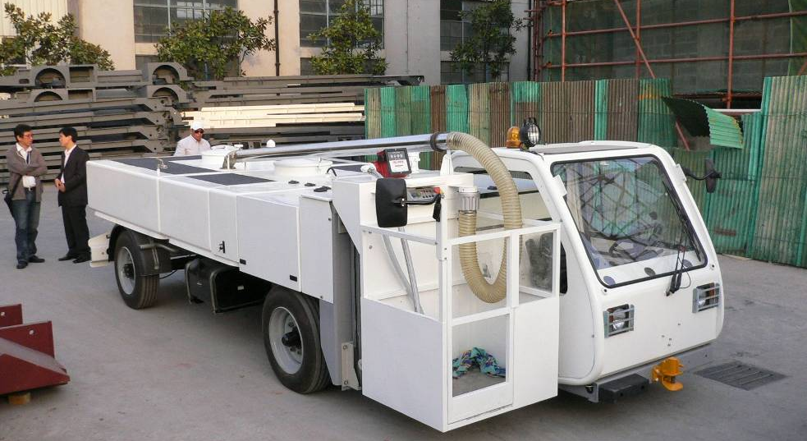
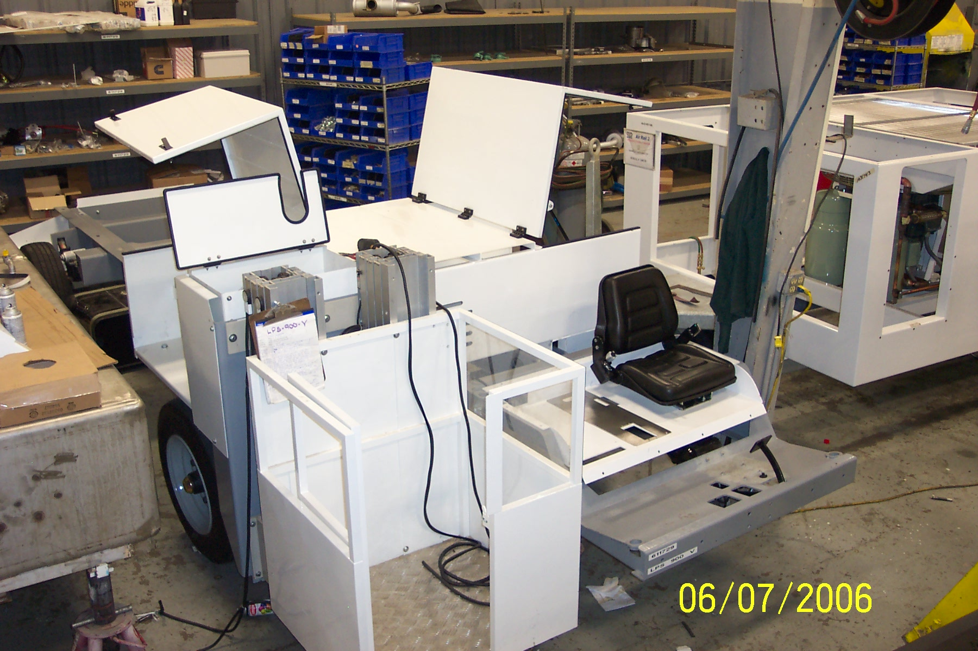
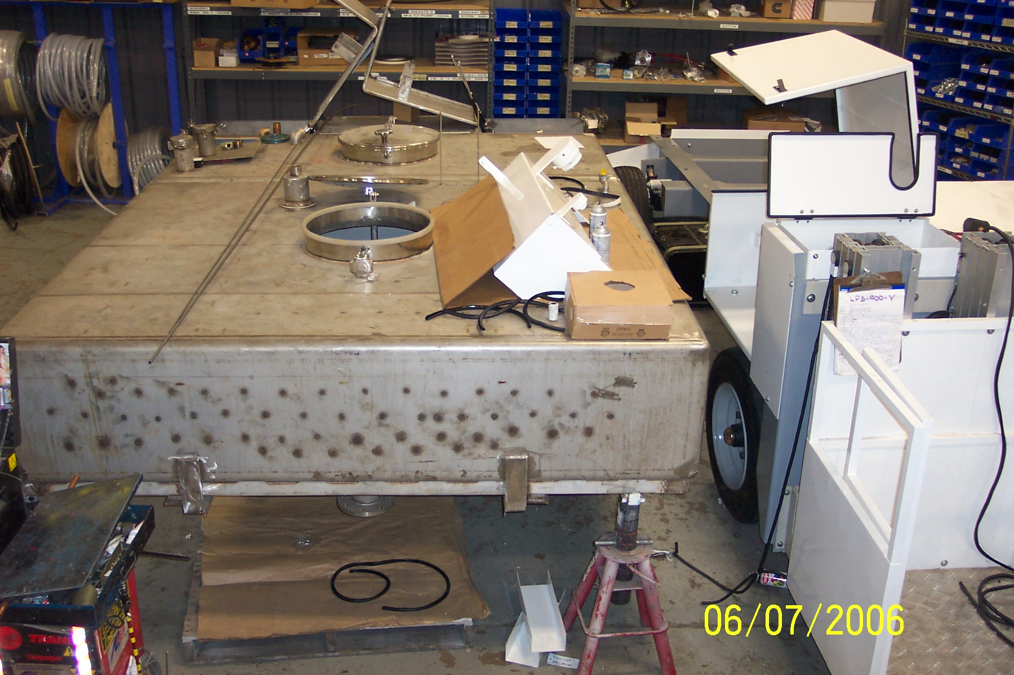
TLD Group Info –NLW Project
3 Prototypes in progress
LSP-900 in Shanghai
LSP-900 in St Lin
the LSP-900-V in Windsor
  Planned delivery to Air Seychelles End of June
Northwest Airlines demo need by end of September

Slide 14
TLD Group Info
The Workflow Modules
Several of our key Business Processes are being turned into paperless systems that improve the routing of assigned actions (definition of “Workflow”)
The goal is to increase the speed of these processes within the group and resulting responsiveness to our customers.
  Tasks and relevant info are posted on-line
  Reminders for follow up are automatically generated
  Responses and status are automatically routed to the initiator.
  Visibility, Tracking and Accountability are greatly improved
  These modules are linked together and to our ERP system (BAAN)
The development of these modules is the key to our future competitiveness

Slide 15
TLD Group Info
The Workflow Modules
For instance today a TLD Technician can define a field problem including attaching diagrams or photos and route it to our Product Support department
This action can be easily and quickly assigned internally.
The Managers can at any time review reports to determine how many Field issues are open and how long they have been open, who is responsible for closing them and what is their status.
A meeting is held on a regular basis to assure the progress of actions and the technician gets a report routed back to him of the status.
This type of rigor insures we complete actions in a timely fashion, thus providing real service to our customers

Slide 16
TLD Group Info
The Workflow Modules
There are several Workflow Modules underway
  PDC : Product Demerit Claims Module
    totally operational for months
  NCR : Non Conformance Reports Module
    Operational for two months already
  CPA : Corrective Preventive Action Module
    will be ready by mid June 06
  ECP: Engineering Change Procedure module :
    Target : August-September 06
We must use these systems in order to improve them
Everyone has a responsibility to help refine these modules

Slide 17
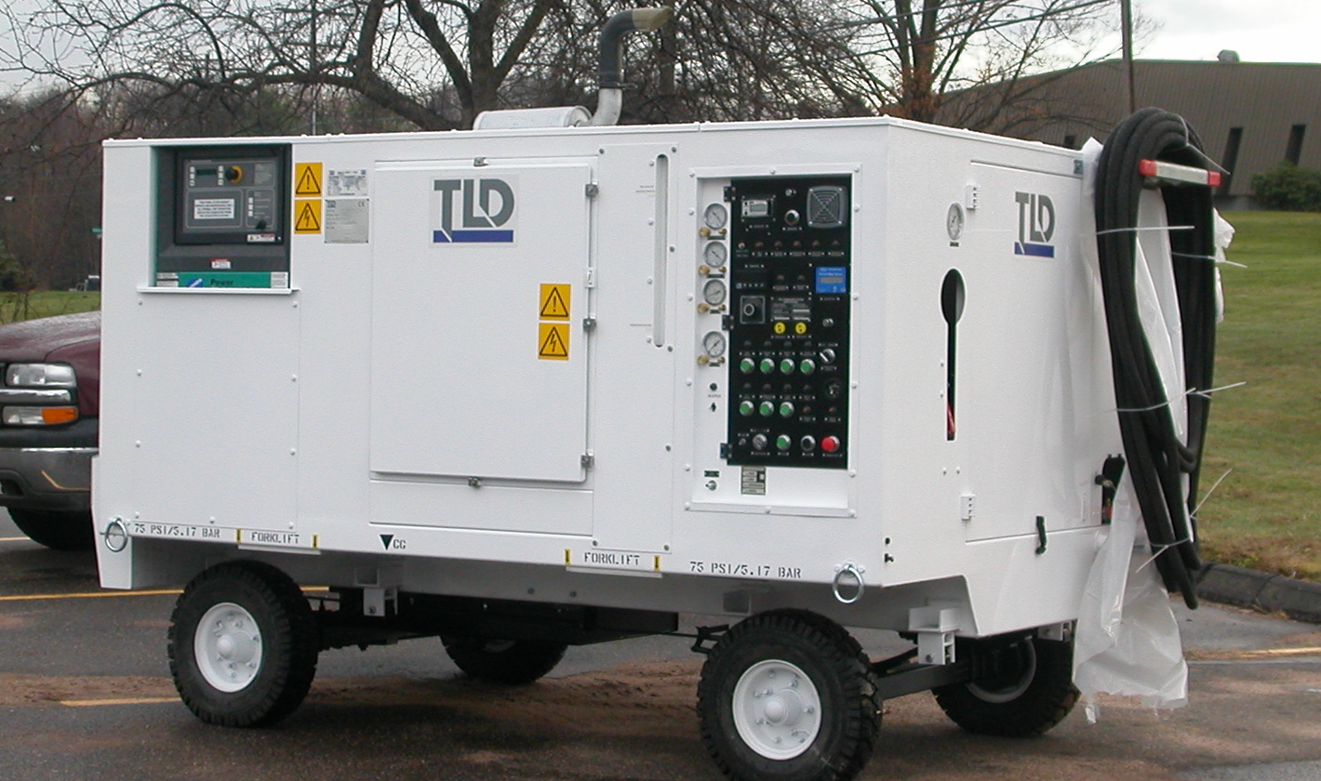
New Product Development
LCU-015-CUP
  LMCO has re-specified the performance requirements based on their testing of the JSF Aircraft
  An enhanced version of the LCU must be delivered by September 1
  EMI Testing required
  Our performance on this program has brought the attention of the F-22 Program Office
  During their April visit they requested us to propose a combination Chiller-Aircon for the F-22 Fighter
  A Job well done brings more opportunity

Slide 18
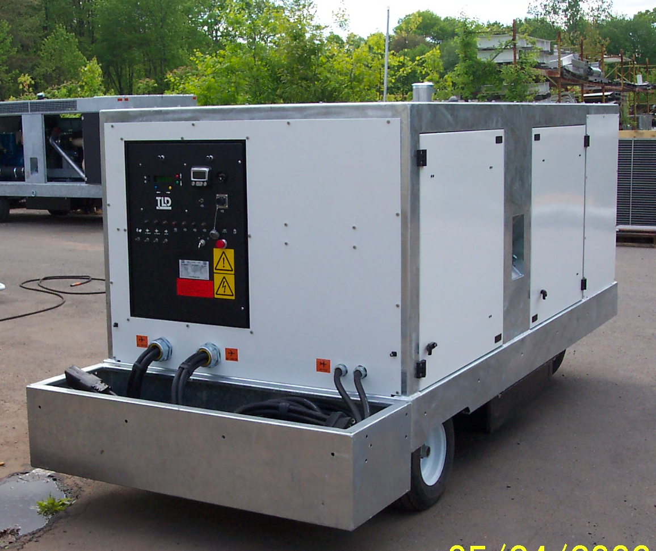
New Product Development
GPU-4180
Unit in test
  Intended for use on A-380 and 747
  Continental Airlines visit was successful
  Singapore Airlines interested
Testing on A-380 to begin July 10

Slide 19
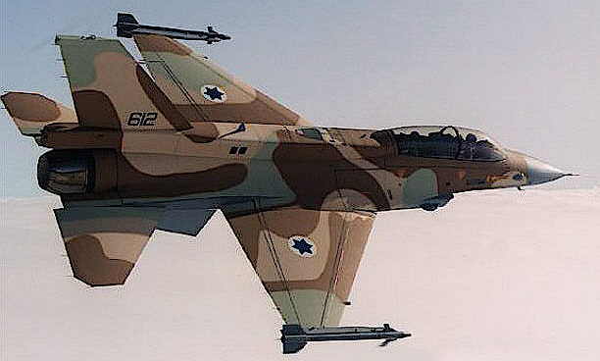
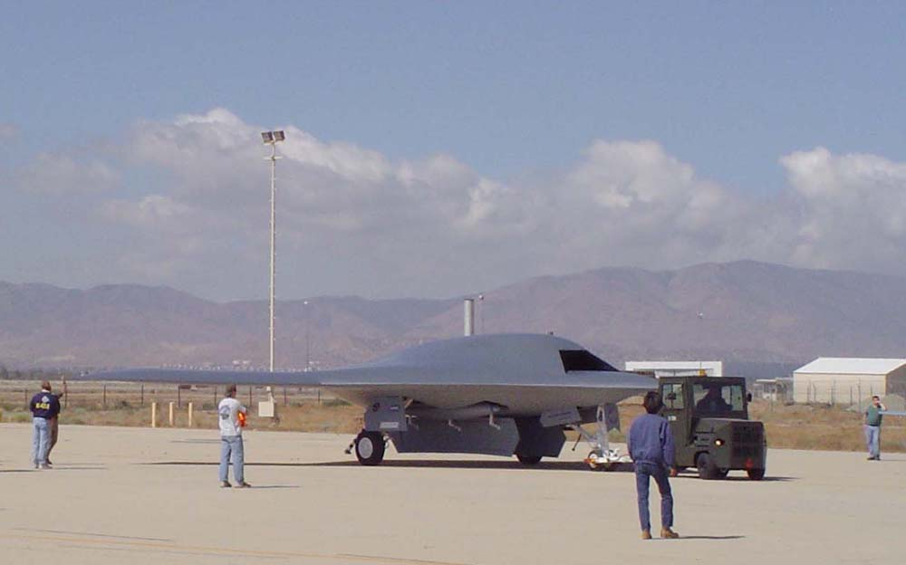
New Product Development
ACU-401
High Pressure Air-conditioning is required to cool Fighter aircraft and UAVs
We are designing a unit that can service all existing and up-coming fighters
Northrop Grumman is the launch customer.
  Factory Demo test 14 November 2006
  5.4 psig, 45DegF ,100 ppm at unit interface
Factory Demos planned also for
  USN, LMCO (JSF and F-22 programs)

Slide 20
Employee Incentive Plan
The next payout will be based on the results of 2006 and will be made at the end of this first QTR 2007
The program, entering it’s second year, will continue to ramp up from a partial level to a full potential level over 3 years.
  (1/3 potential first year, 2/3 second ,3/3 third year)
The payout is based on the companies performance as measured by our R.O.N.C.E.
  Currently at 47% year to date. (payout amount Cap is 25%)
  High volume is the leading reason for our stronger performance this year
The 2006 result to date are promising and if we keep on this track it can result in double last years payout
To do so we will need to:
  maintain a high level of production through summer and continue to improve efficiency
  Continue to control our costs
  Control our inventory very carefully

Slide 21
Conclusion
Our biggest challenge is to meet our production requirements in order to not lose customers
At the same time we must maintain Quality
We must continue to increase the efficiency of the shop and all other departments.
  E-tools
  Workflow modules
We must “make hay while the sun shines”

