Slide 1
Trimester Report
TLD-ACE
08/25/2005

Slide 2
Agenda
TLD-ACE YTD financial performance
Recent Key Wins
Potential Opportunities
TLD Group info
New Product Development Status
TLD-ACE Facility Improvements
Conclusion

Slide 3
TLD-ACE
YTD financial performance
$16.9M YTD July sales against a budget of $15.4M
Operating Profit is also ahead of the budget
  Cost reduction efforts are taking effect
  The Euro/Dollar exchange rate is improving
    This is always a balance between sales and cost advantages
The Sales situation has improved greatly since first quarter
We are now at a record level of backlog

Slide 4
TLD-ACE
The Production Challenge
Our problem now is to not lose our market advantage because we cant keep up.
  We must Ramp up our production rate to beyond where we have been before.
  At the same time we must still realize that we are in a fragile market where some of our biggest customers are on the verge of bankruptcy
    So we must still remain flexible and be able to react to changes in production rate
    We can not increase our expenses without careful consideration
    We must control inventory and cash as we ramp up
  We must “make hay while the sun shines”

Slide 5
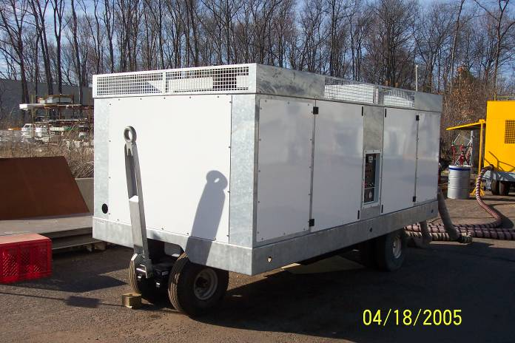
TLD-ACE
The Production Challenge
ASU-600 will be a major portion of our shipments through the end of the year
We will shift much of our shop activity in this direction
We still will produce a large number of GPUs each month
Total number of units per month will reach new records
To support this our shop and our suppliers manpower is increasing
We must all focus on productivity

Slide 6
Year end Production Plan
Product | Aug | Sep | Oct | Nov | Dec
Jet Starter | 6 | 7 | 15 | 22 | 13
Aircon | 18 | 15 | 12 | 5 | 2
GPU | 15 | 16 | 16 | 16 | 12
Heat Cart | 1 | 8 | 4 | 2 | 4
Others | 5 | 5 | 1 | 8 | 2
Total | 45 | 51 | 48 | 53 | 33

Slide 7
Recent Key Wins
Delta Jet starters
Fedex follow up jet start order
UPS follow up jet start order
American Airlines 802, 804 and ACU2000
Air Canada 802s
PIA follow-up 802 order
Boeing GPUs, 302s
Frontier 302s
Purolator GPUs

Slide 8
Potential Opportunities
TMAC Program (USAF)
  Similar to 302 but higher tonnage
  In proposal stage
  50% chance of winning
DAC 110 (USAF)
  Similar to 802-329 but higher tonnage
  In proposal stage
  Strong chance of winning
  Government is trying to control their costs through this competitive quote process

Slide 9
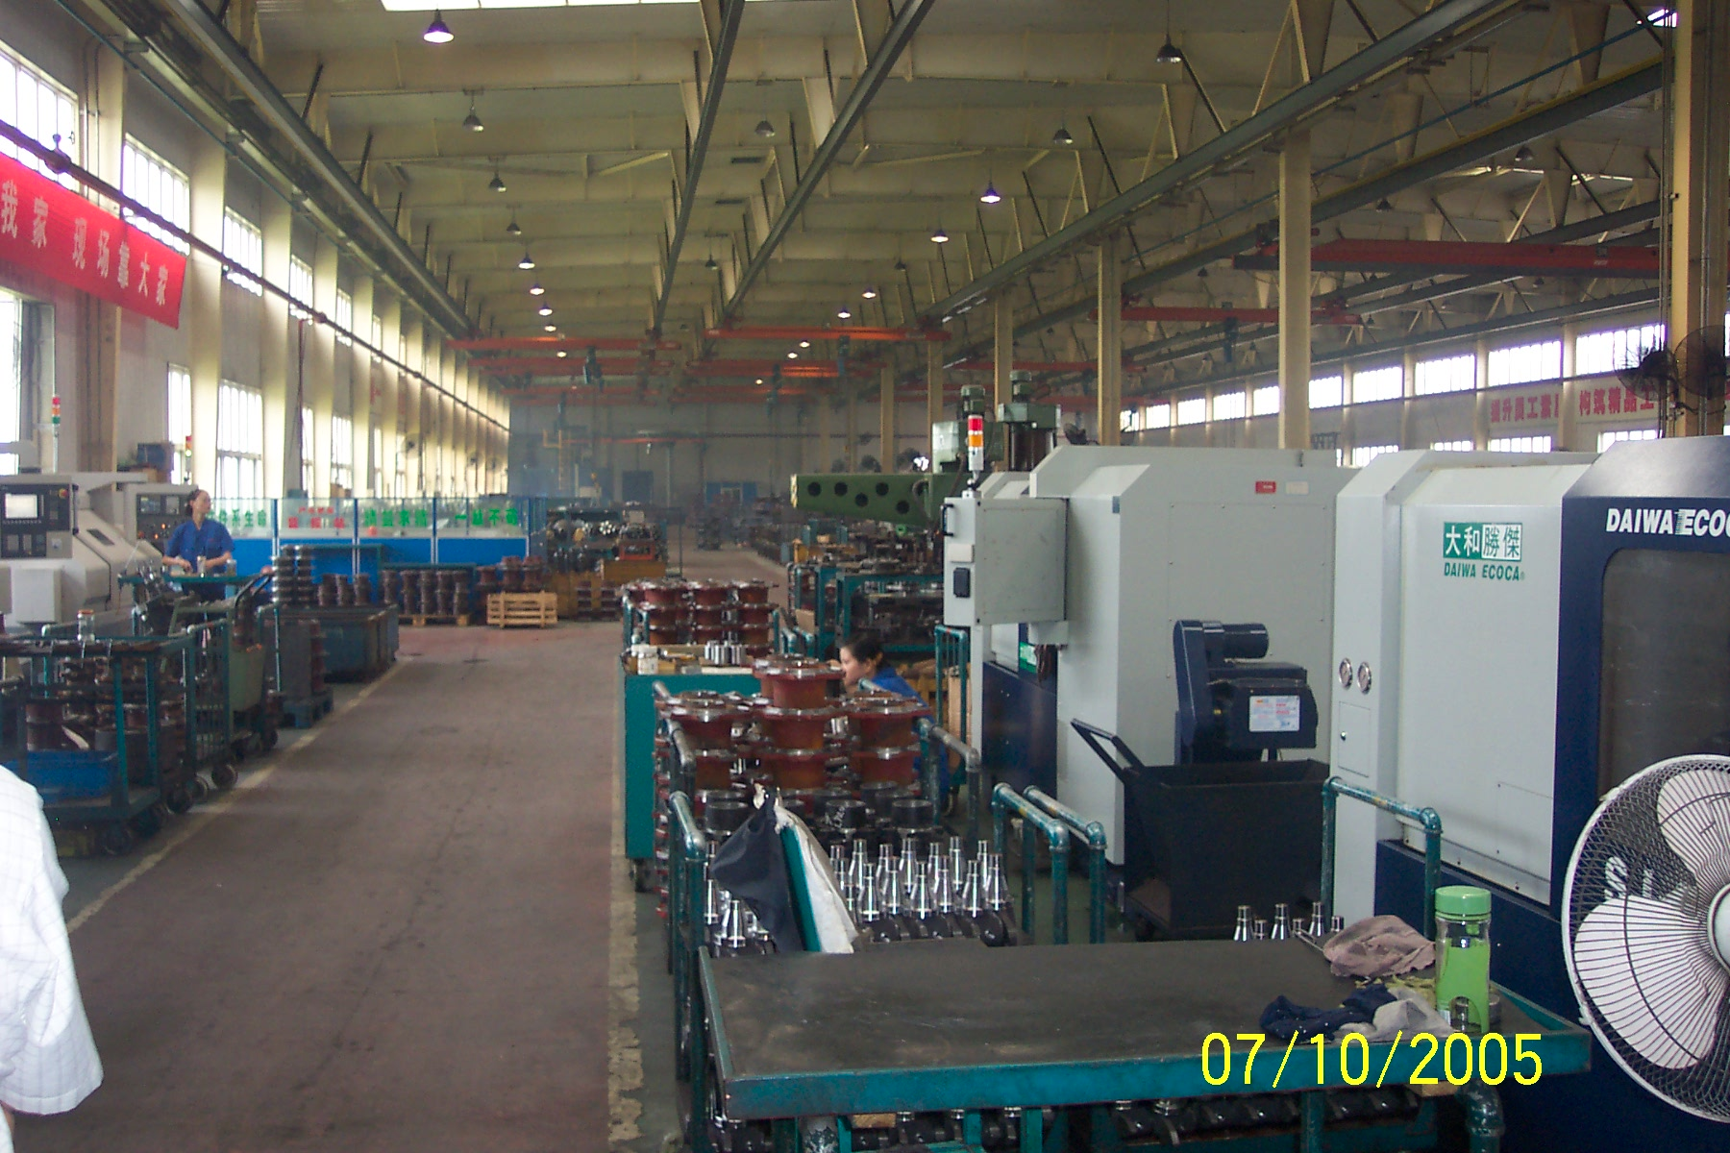
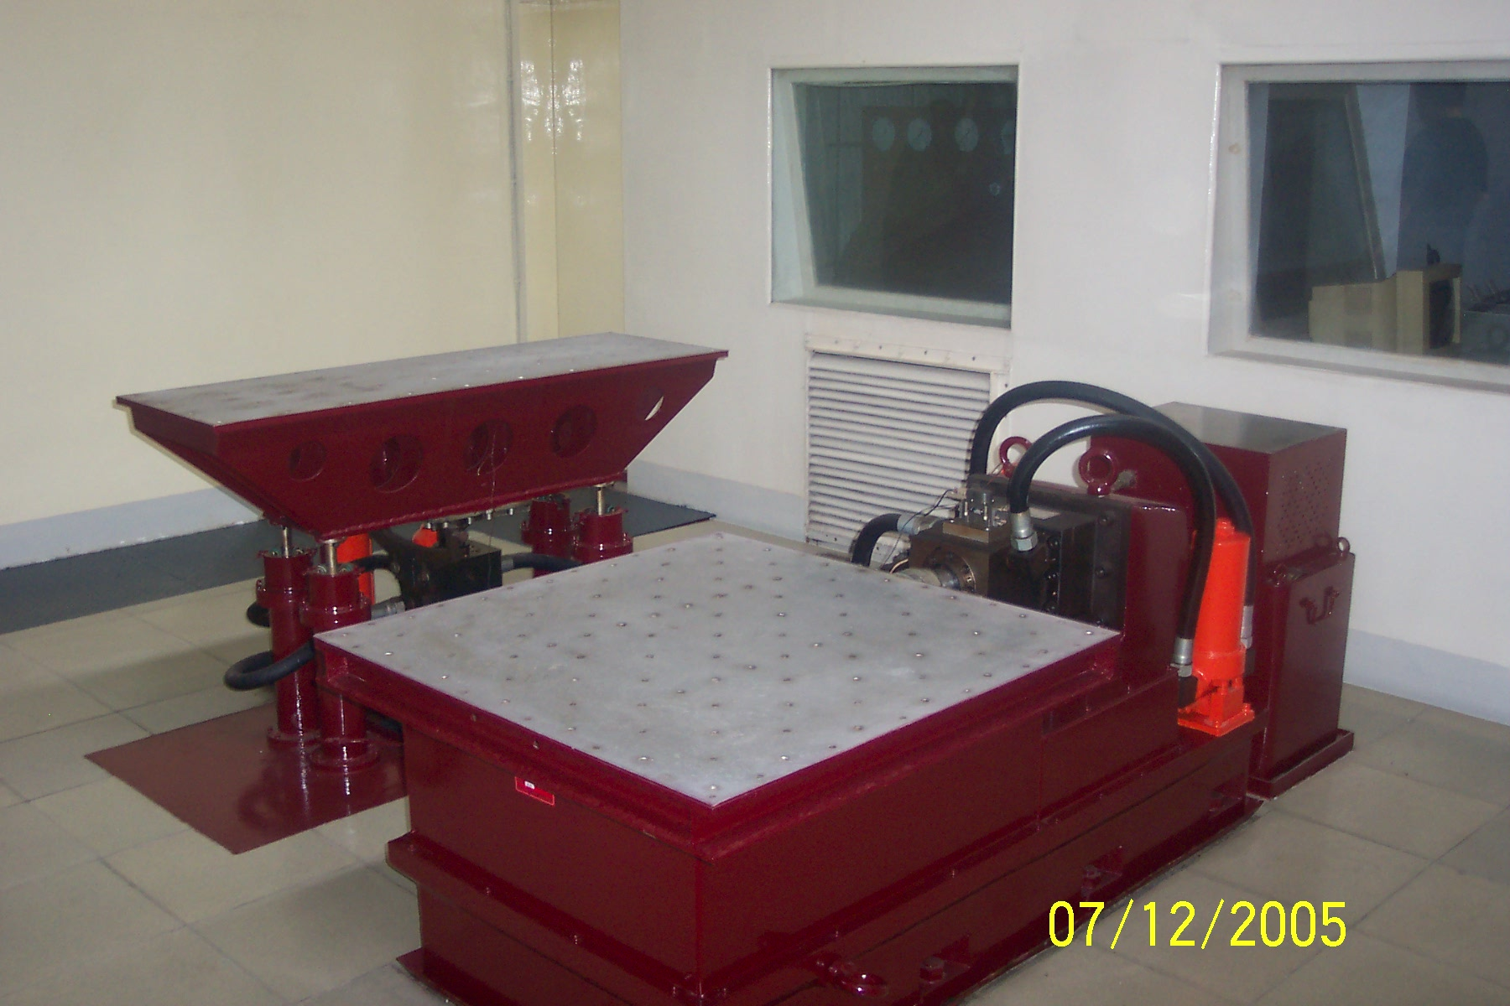
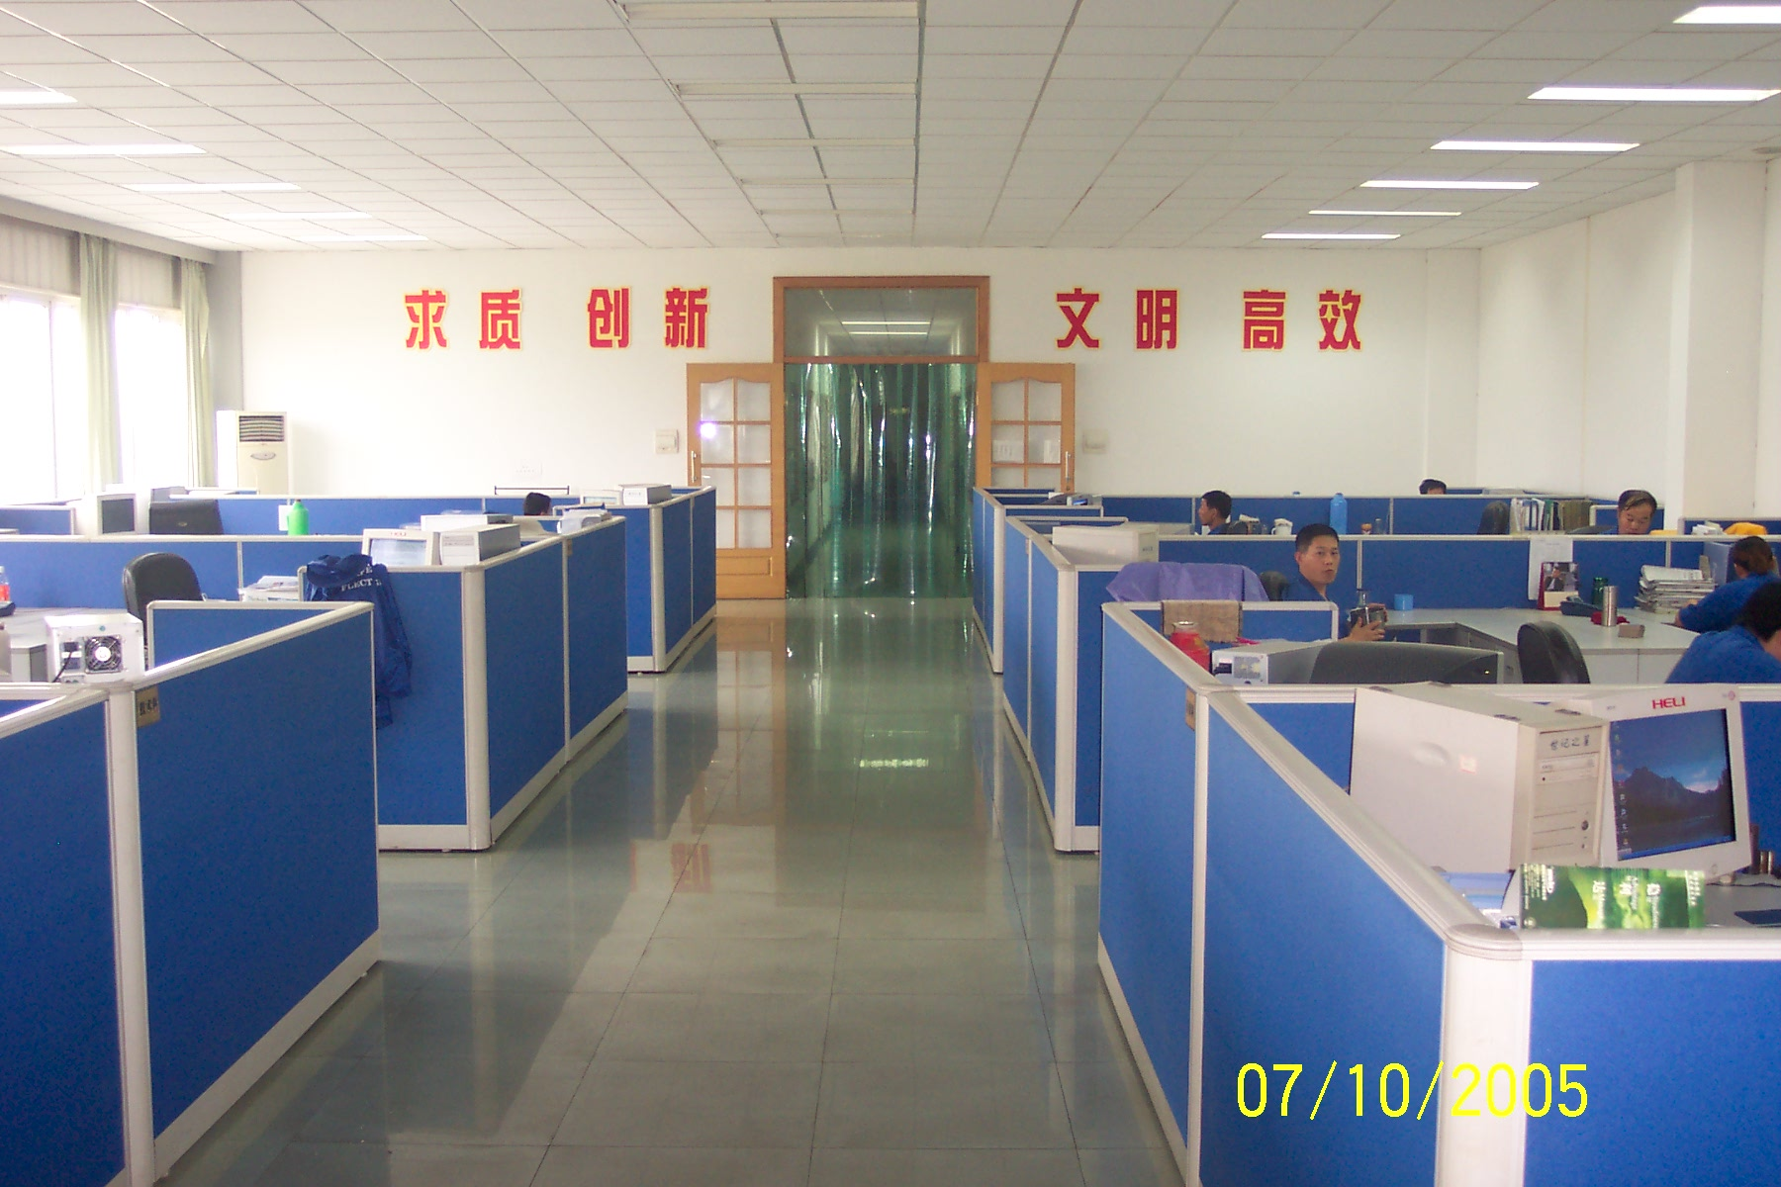
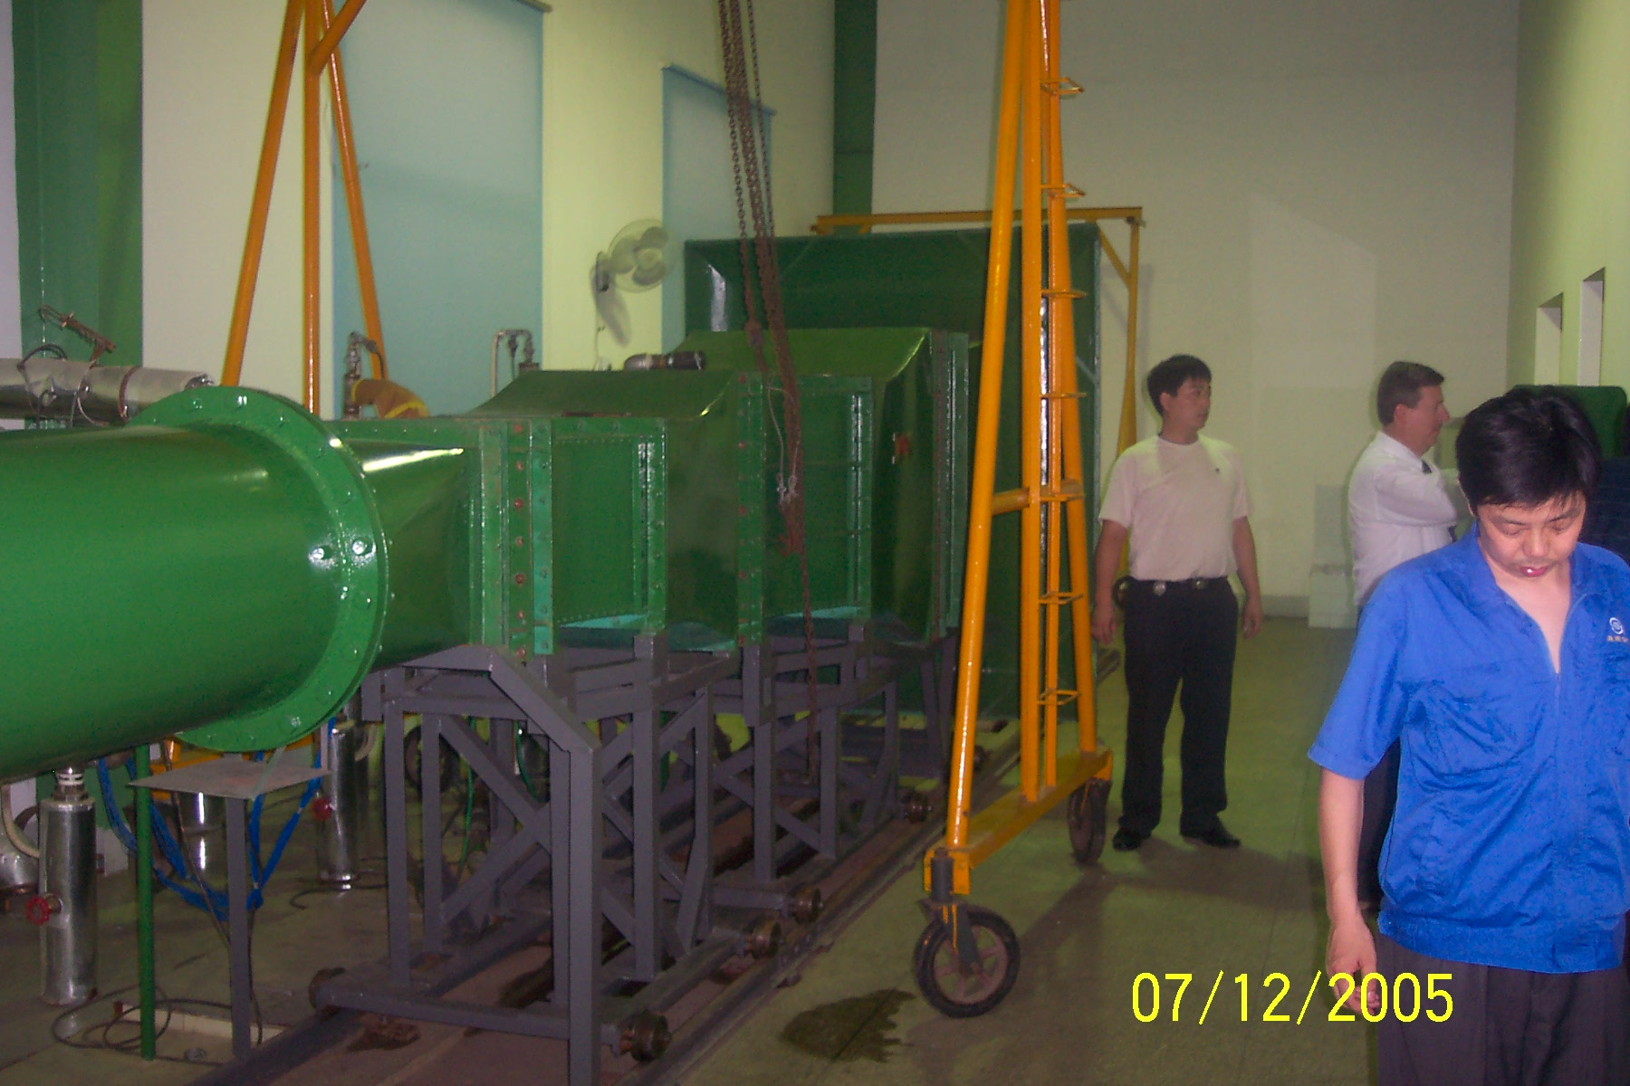
TLD Group info
Shanghai Sourcing team is working with us to improve our costs
TLD-ACE recently visited several Chinese suppliers for the purpose of evaluating their products and processes
Overall their quality level, cost and reactivity to changes was very good

Slide 10
New Faces/Positions
Alex Lys has returned to the Engineering Department and is working on the RANGER Lav program reporting to Simon
Richard Bacha has joined the Accounting department in the recent reorganization and is reporting to Steve Picano

Slide 11
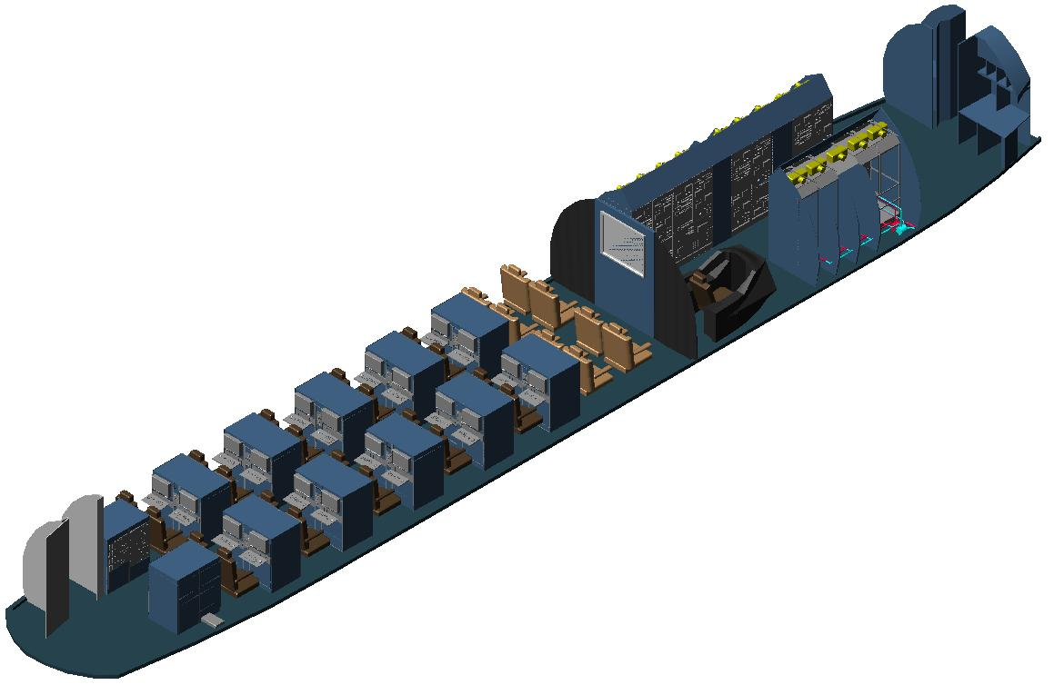

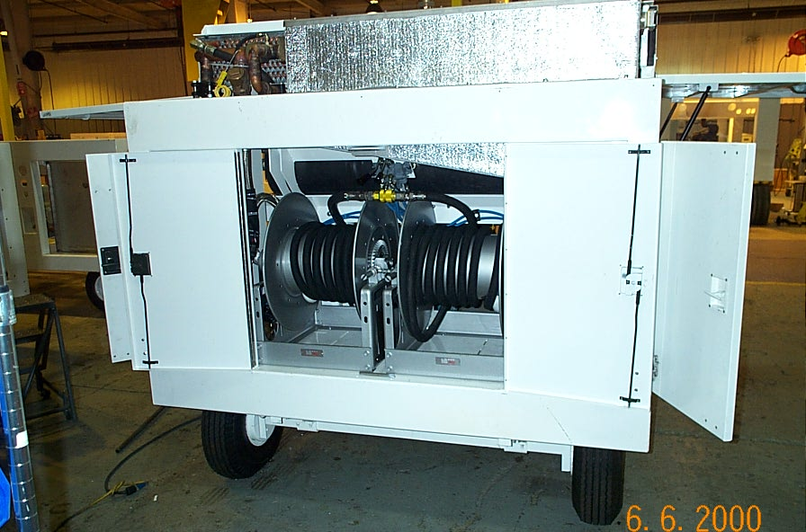
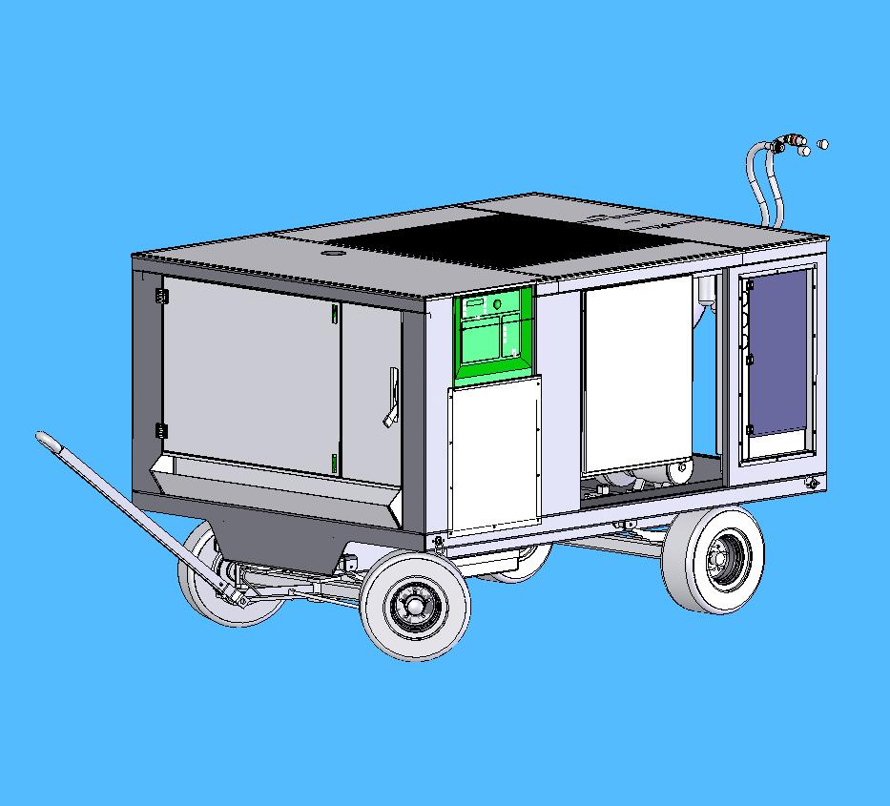
New Product Development Status
  814 944S Liquid Chiller has completed test
  LCU chiller for the JSF program will soon be on the floor
  Both of these programs support Lockheed Martin, a key Aerospace and Defense customer with potential to bring more work to TLD

Slide 12
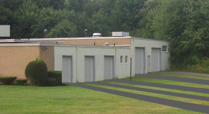
Facility improvements
Test Facility
  Is now up and running
  This investment is improving our productivity
  It will be a key improvement for this winter
Point of use Inventory
  This next project will enter the planning stage soon
  The objective is to reduce the amount of handling and movements of our parts and improve their proximity to the assembly cells

Slide 13
Conclusion
The simple TLD strategy of :
  Supporting the customer
  Value engineering our products
  Controlling our costs
Has won us a major market share
Our biggest challenge is to meet our production requirements in order to not lose this share
We must remember that for many years our shareholders supported us with millions of dollars
We must now bring that money back while we have a good Market opportunity
We must “make hay while the sun shines”

