Slide 1

TLD-ACE
Trimester Review
12/04/02
Mark Garlasco
C.O.O. TLD-ACE

Slide 2
Agenda
TLD-ACE YTD financial performance
Market Situation
Proposal status
Key Opportunities
Outsourcing plan
TLD Group info
New Product Status
ISO 9001 Project Status

Slide 3
Financial Summary
TLD-ACE YTD financial performance is out of line with the 2002 budget
  Due to the low volume of production
  Clearly good cost reduction efforts were made
Market situation in the next 16 Month will be better due to Military work in backlog for 2003
  Estimate a 50-75% increase in sales
Control of Cash flow will be key as we increase production rate

Slide 4
Market Situation
Airlines are continuing to down size
Power Generation business is also in a slump
It is clearly a “Buyers Market”
  We must react to stay competitive
TLD Focus is being applied to
  Low Cost Carriers
  Cargo Carriers
  Military Projects
Military Work has started in November
  Should continue through 2003
TLD Customer feed back is good
  It is clear that the TLD strategy to fully support customers through the crisis is paying off

Slide 5
Proposal Status/Recent key Wins
  L-3 communications Multi purpose GSE (2)
  L-3 communications GPU-4120-K-CUP (15)
  ASIG (Signature) 802 (2)
  802-392 (5) Boeing, Northrop, USAF
  802-329 (16) USAF
  Fedex did not choose ACE Jet starters
    Price was the issue
    We clearly made it a tough decision and we will get their business next time if we reduce our costs
  Israeli Air force did not chose ACE 401
    Higher than desired amp draw
    Future opportunities may still exist

Slide 6
Potential Opportunities
American Airlines APU Avoidance program may provide significant 804 sales (20-30)
Indian Airlines ACE 500
  May result in 9 in 2003, 27 total
RACM program still not awarded
UPS Jet starter Demo starting December

Slide 7
Going Forward Plan
Continue to reduce costs in all areas
  Increase productivity
  Close control of inventory levels
  Cost reduce key product components
Deploy new products
  Cost effective GPU
  Point Of Use Aircon
  Cost effective 804
Expand Military markets
Prepare for increased production without adding overhead cost.

Slide 8
Outsourcing Plan
Outsourcing fabrication will be a key goal of 2003
  TLD-ACE ability to grow is directly associated with increased Assembly capacity and efficiency. Our goal is to invest in modernizing the facility in these areas.
  TLD-ACE intent is to retain all current employees and utilize their expertise toward this outsourcing goal and increasing our Assembly efficiency
  First step is to develop suppliers that can fabricate a quality part, on time and at lower costs than we can and manage inventory costs for us.
  Re-training of some of our employees will be necessary
  This process will not happen overnight
  Every ones help is needed

Slide 9

TLD GROUP
TLD Canada Grand Opening was a success for TLD-ACE
  Sales organizations were very impressed with the 3 products ACE showed
    GPU
    ACE 900
    600-100
Direct feedback on our quality is now being provided by the sales organizations via « Report Card »
  Move towards galvanizing and corrosion resistance is key to our customers

Slide 10
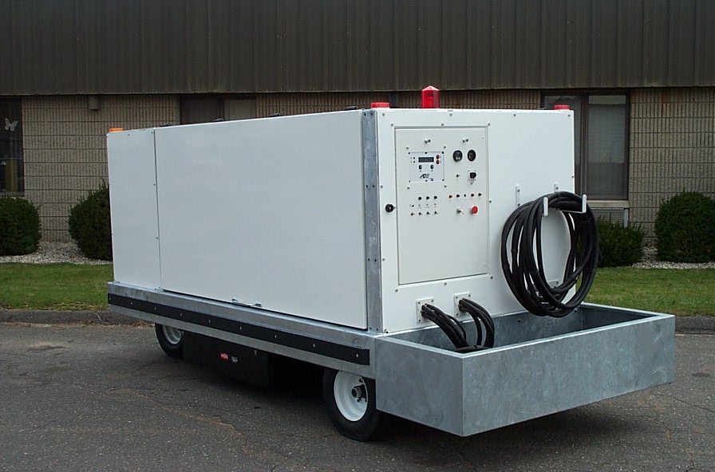
New TLD-ACE Products
ACE 4120-E-DUP
  Successful demo with signature completed
  Deutz requests we not use 2012 engine
  Production started in November (Deutz 1013)
  Working Cummins design next for L-3

Slide 11
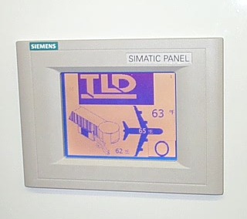
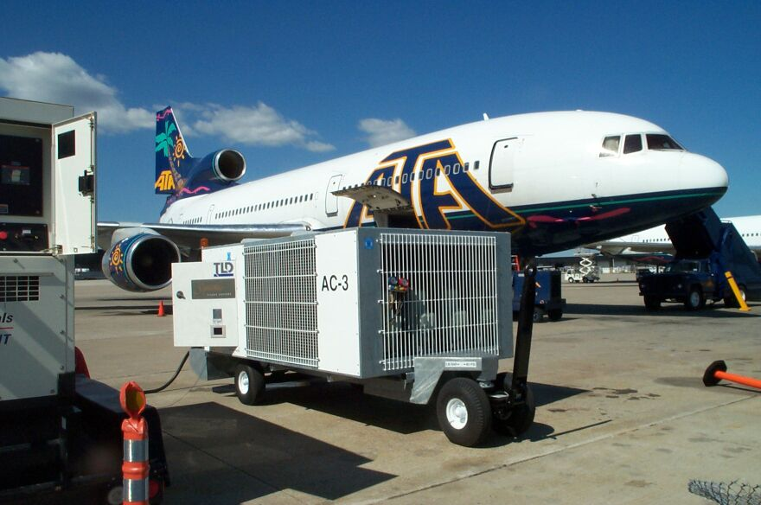
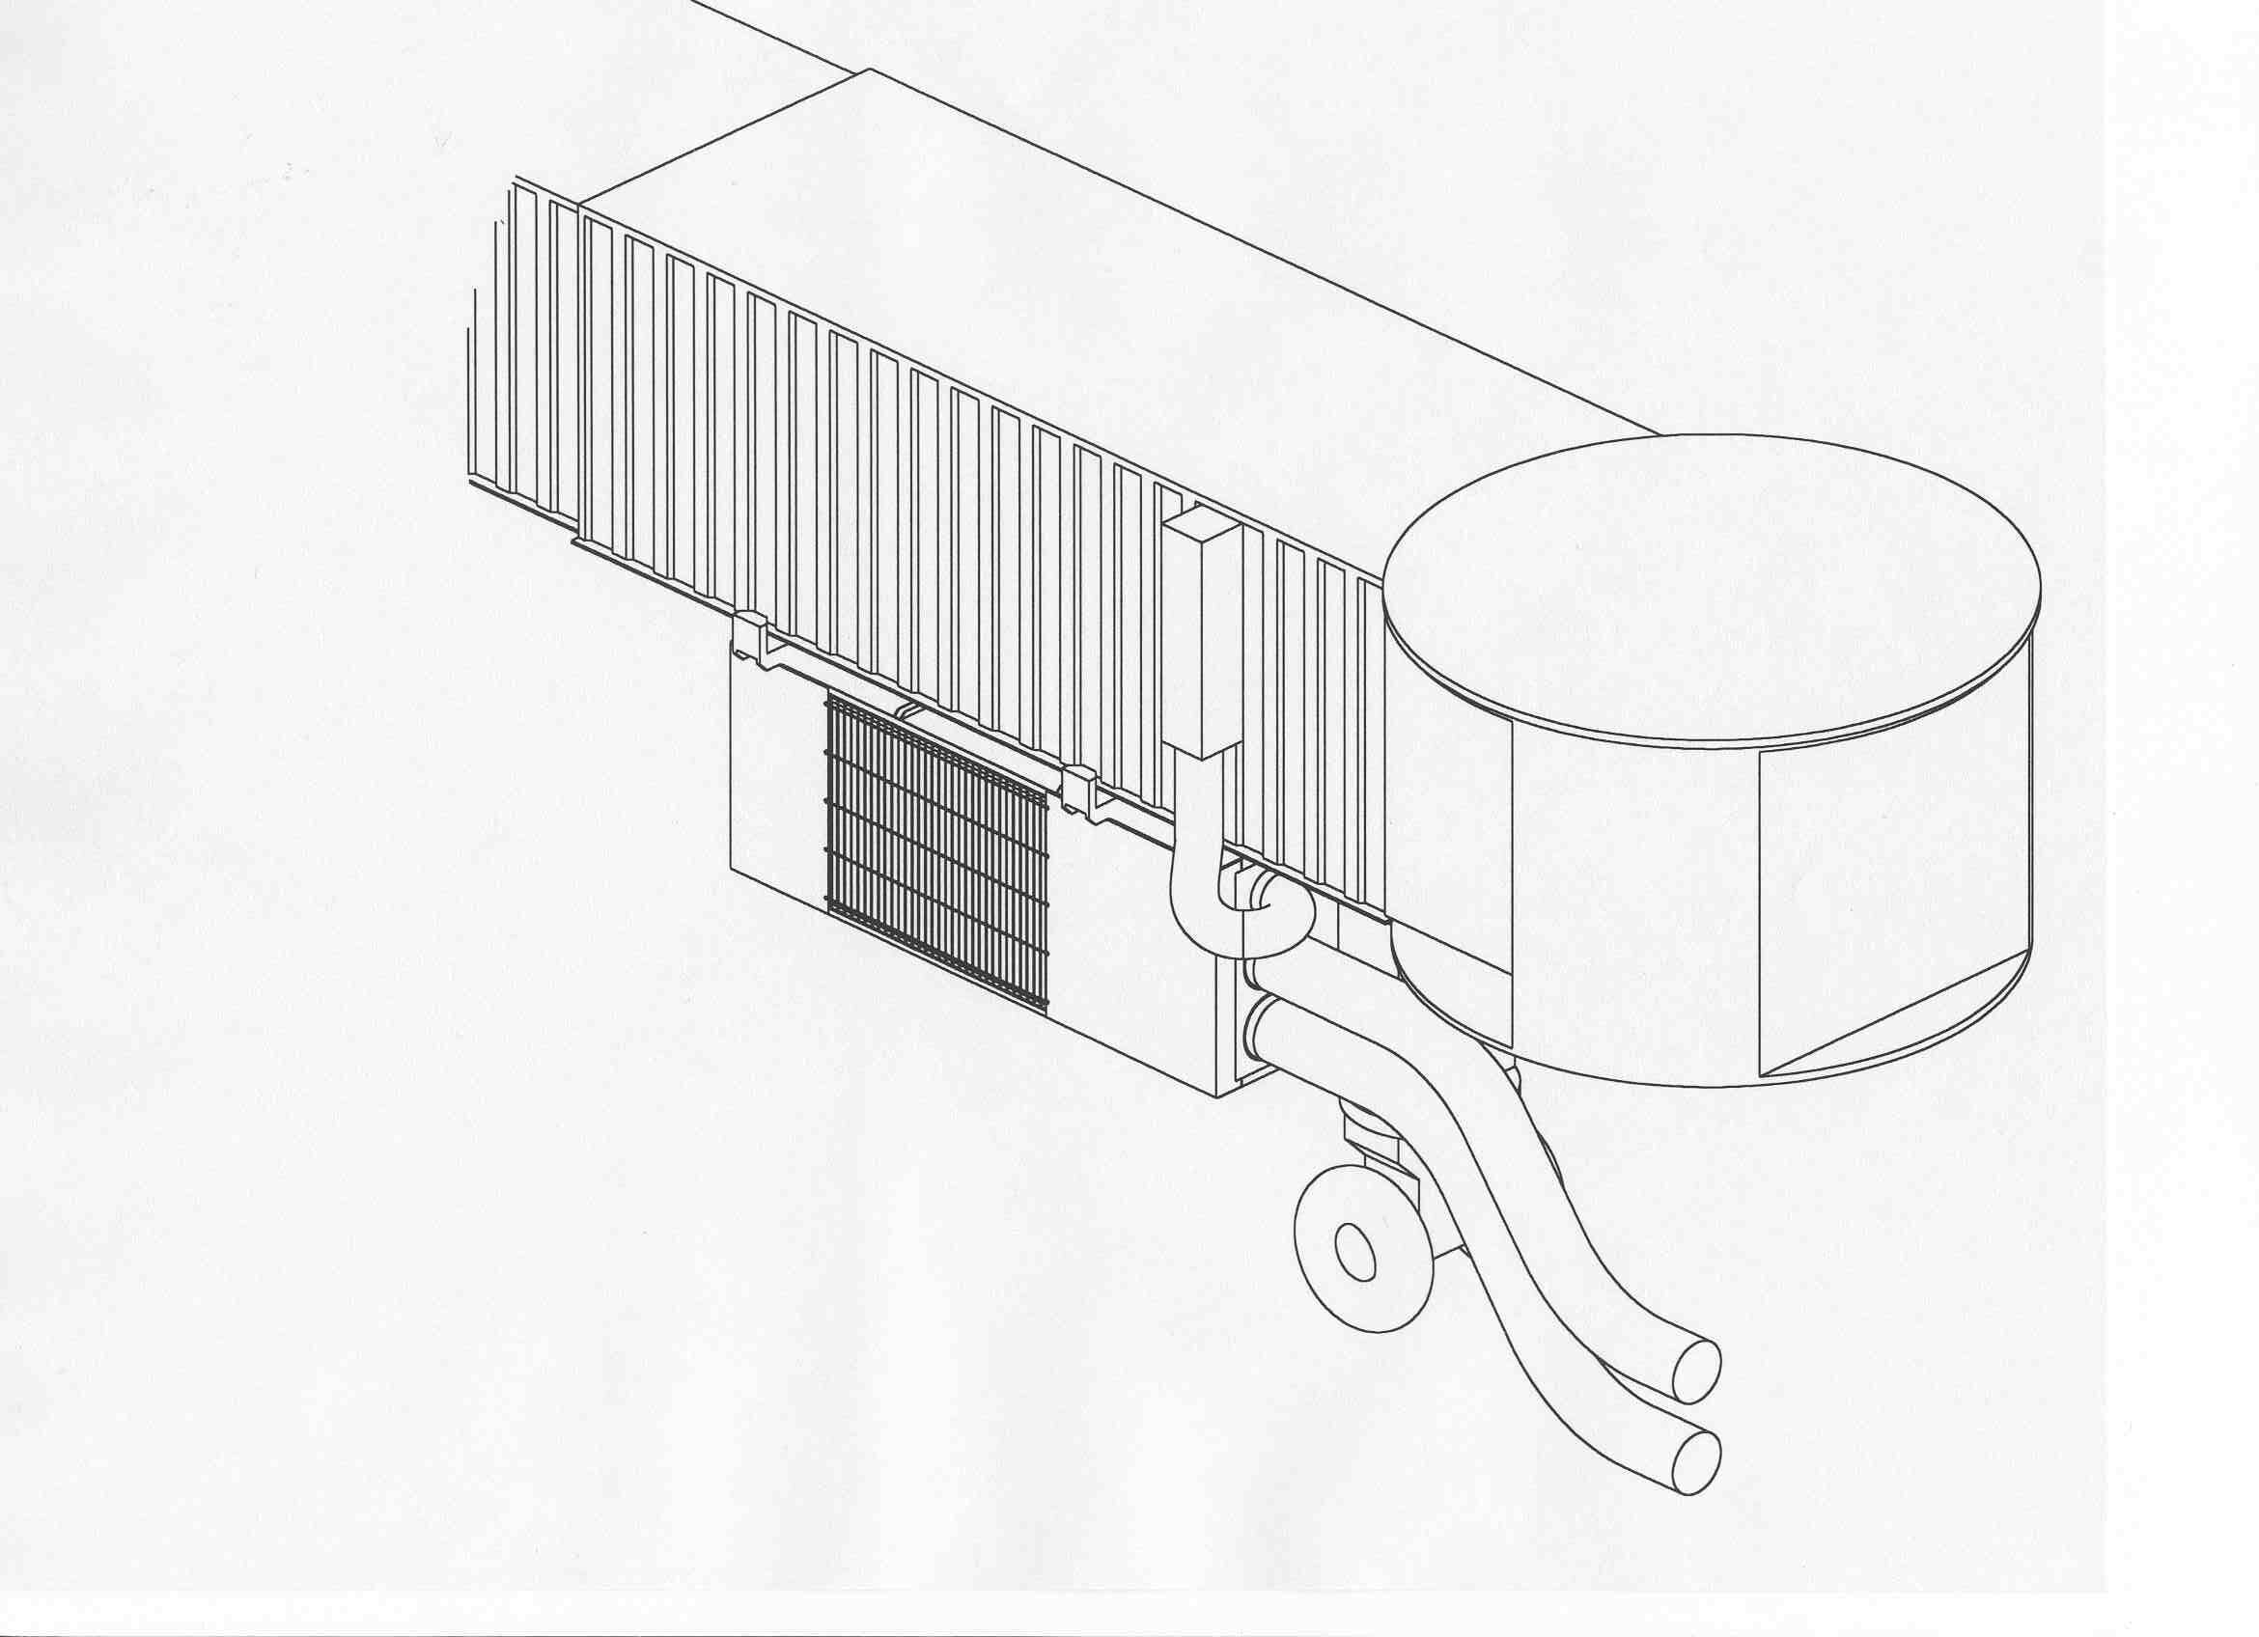
New TLD-ACE Products
ACE 900 Bridge mounted Air-conditioner
  Field Test completed at Signature (BWI)
  Basic performance is good
  Some control issues identified and resolved
  Bridge mounted demo being explored with American Airlines.
  TLD-Asia actively quoting

Slide 12

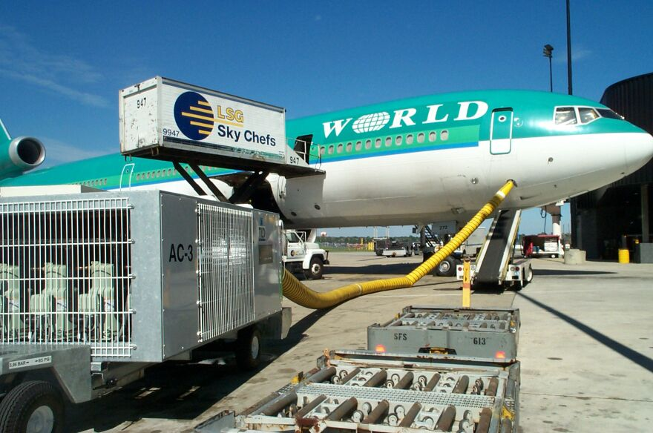
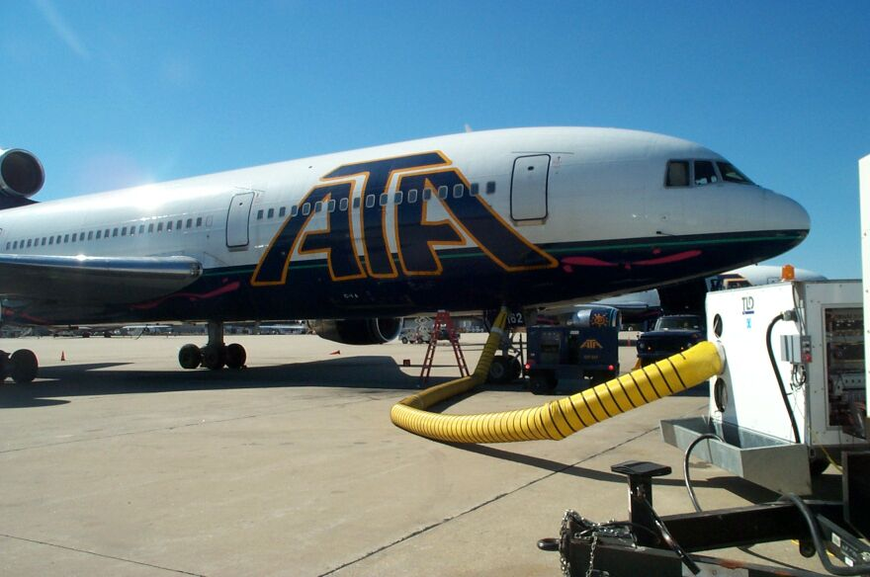
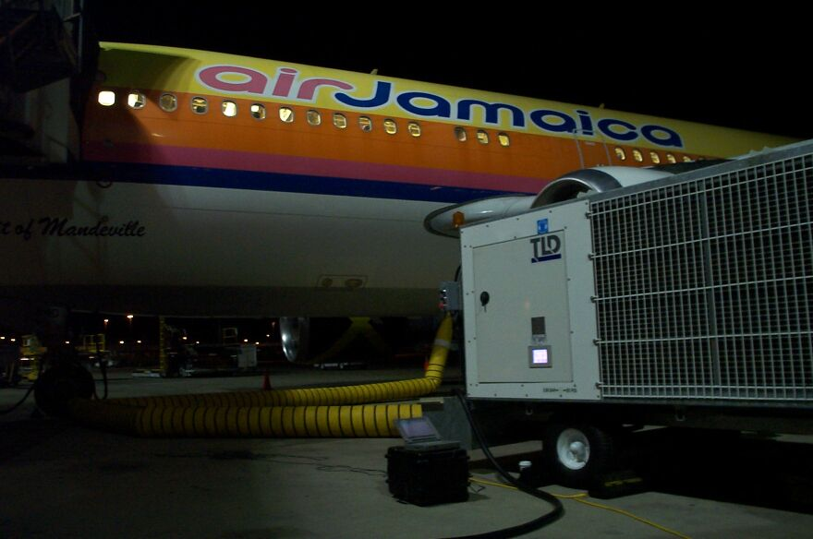
ACE 900 Field Test Program

Slide 13
ISO 9001 Project Status
Pre-assessment was held Nov 11 and 12
  Results were good
  No Major issues noted
  Improvements must continue to insure a successful registration audit
Registration Audit will be held Dec 12 and 13
  You have all worked hard towards this important goal
  Stay focused-It is achievable!

