Slide 1
Trimester Report
TLD-ACE
12/08/2005

Slide 2
Agenda
TLD-ACE YTD financial performance
Our Production Challenge
Potential Opportunities
TLD Group info
New Product Development Status
Conclusion

Slide 3
TLD-ACE
YTD financial performance
$24.5M YTD Oct sales against a budget of $21.4M
Operating Profit is also ahead of the budget
Year end results may become a new record ,exceeding year 2000 results
We are still at a record level of backlog
This is the good news…….

Slide 4
TLD-ACE
The Production Challenge
…We are not ramping up fast enough
We are at great risk of losing customers because we cant keep up.
  We must Ramp up our production rate each week
  We must continue to streamline our processes
  We must focus on increasing number of green tags per day

Slide 5
Year end Production Plan
Number of units | Aug | Sep | Oct | Nov | Dec | Jan | Feb
Planned August | 45 | 51 | 48 | 53 | 33
Actual to date | 38 | 35 | 43 | 49
Need going forward |  |  |  |  | 57 | 61 | 67

Slide 6
Potential Opportunities
DAC 110 (USAF)
  Our 802-329
  Strong chance of winning
  Will result in 45 units requiring delivery of 5 per month starting May 06
With the current level of Commercial work we will need to put additional resources in place to handle this

Slide 7
TLD Group info
TLD has completed planning to put in place an Employee Incentive Plan
The purpose is to give each employee incentive to improve productivity and profitability of the company and share in the results.
The first payout will be based on the results of this year and will be made at the end of the first QTR 06
The payout is based on the companies performance as measured by our R.O.N.C.E.
The program will ramp up from a partial level to a full potential level over 3 years.
  (1/3 potential first year,2/3 second ,3/3 third year)
The result can be as much as 4 weeks salary paid when the plan is fully in place and if we meet our goals

Slide 8
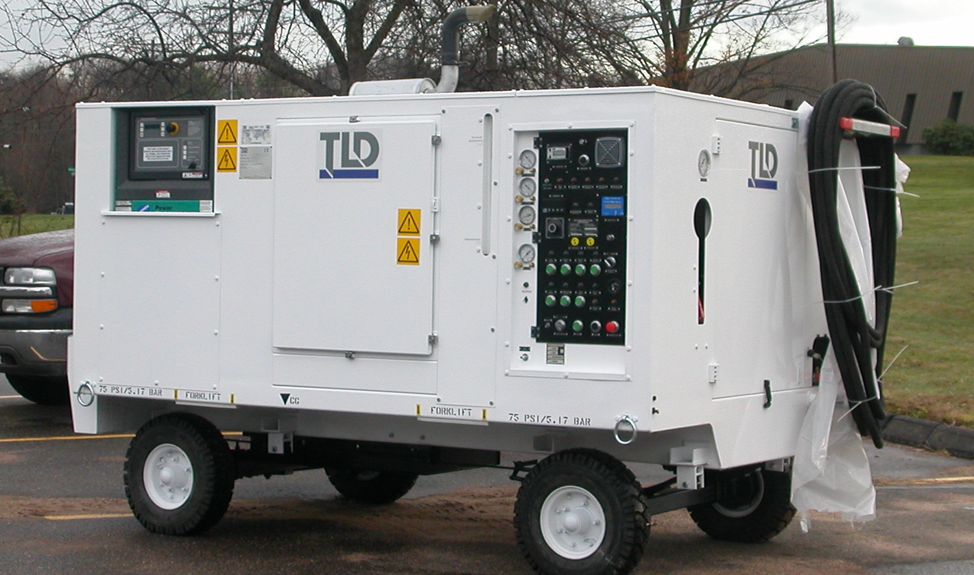
New Product Development
LCU-015-CUP
  After 1 year of development the LCU chiller for the JSF program was delivered on time
  Our performance on this program has put us in a good position to bring more work to TLD
  Many thanks to all for your outstanding efforts

Slide 9
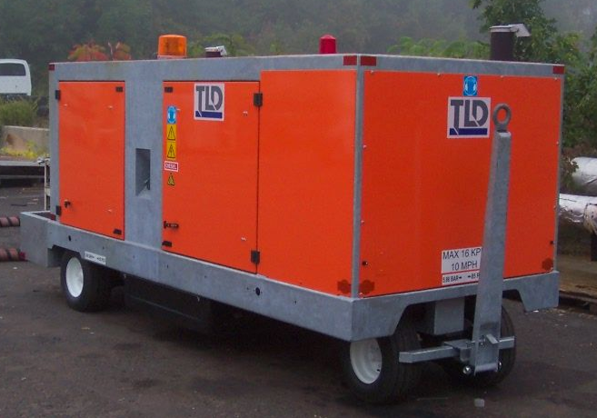
New Product Development
GPU-4180
Several potential customers have shown interest in this project
A concept has been defined
  1 engine type only -Cummins QSL
  1 Generator type –Marathon
  Base and structure nearly identical to 600-150
    3 inches taller and 12 inches longer than our current GPUs
55k Transfer Price Target
Prototype planned to be running in 1st QTR 06

Slide 10

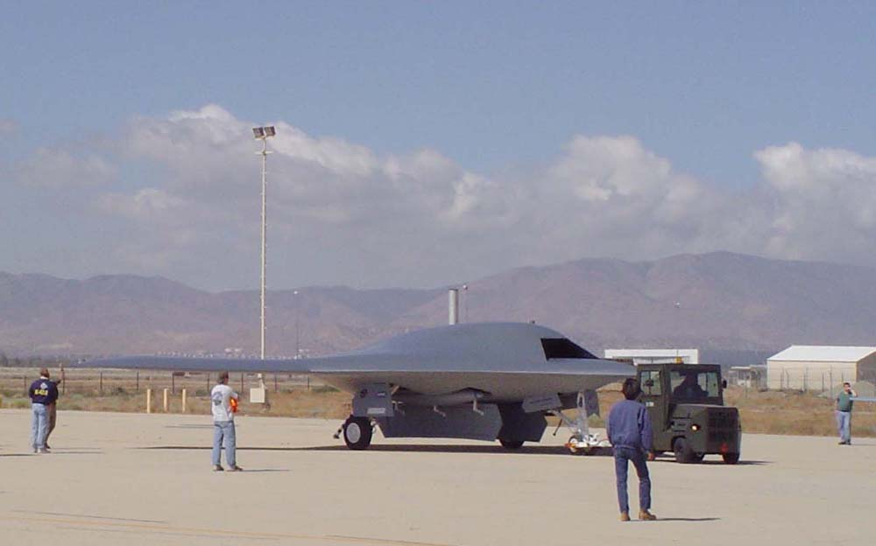
New Product Development
ACU-401
High Pressure Air-conditioning is required to cool Fighter aircraft and UAVs
It is intended to design a unit that can service all existing and up-coming fighters
Northrop Grumman will be the launch customer in late 2006

Slide 11
Conclusion
Our biggest challenge is to meet our production requirements in order to not lose customers
We must increase the efficiency of the shop and all other departments where ever possible
We must “make hay while the sun shines”

