Slide 1
Trimester Report
TLD-ACE
12/11/2003

Slide 2
Agenda
TLD-ACE YTD financial performance
Outlook for 2004/2005
Going Forward Plan
Recent Key Wins
Potential Opportunities
TLD Group info
New Development Status
ISO 9001 Project Status
Conclusion

Slide 3
TLD-ACE
YTD financial performance
$23M Year end projected sales against a budget of $26M
Up from $13M sales in 2002
Clearly ROS (Return On Sales) is moving in the right direction

Slide 4
Outlook for 2004/2005
2004 will be a similar level of sales as 2003
  Second half will be stronger with return of Military work
  Product mix will include more Jet starters than 2003
2005 is expected to be the start of recovery of the Airline Industry
We must continue to keep costs under control and prepare the factory for 2005

Slide 5
Going Forward Plan
Creation of an improved Test Facility will be the first step in factory improvements in 2004.
  Multiple test cells will be created
The completion of the Outsourcing Project in 2003 and fine tuning in 2004 will allow us to expand the assembly floor space in early 2005
  Point of use inventories will be added

Slide 6
Recent Key Wins
Glesco 804s
TASCO 804s
Lier Siegler 814s
USAF HGEU90s
ASIG 600-400
Air India 802
Indian Airlines 600-300
China Airlines 600-300 DU

Slide 7
Potential Opportunities
Mesa Airlines
  16 ACE 302s
Southwest Airlines
  10 GPUs
Skywest Airlines
  10 600-100 Jet starters
UPS
  600-270 JetStarters
Globe Ground
  Jet starters and GPUs

Slide 8
TLD Group info
Message from the October Executive meeting
  TLD is now recognized as a world wide company and among the top 2 GSE industry leaders
  TLD Strategy of support during the crisis has been effective.
    We are recognized as the market leader in Customer Support
  “Our facilities must be considered as our product showrooms” –A key sales tool
  “Group Wide Missions” are being developed

Slide 9
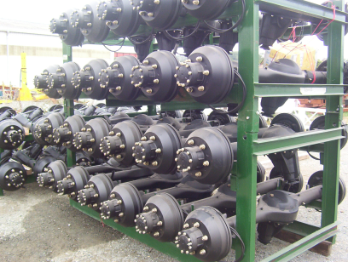
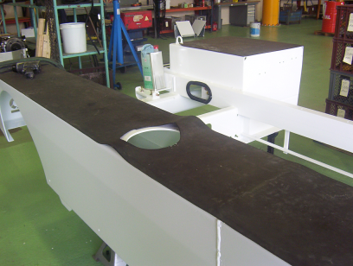
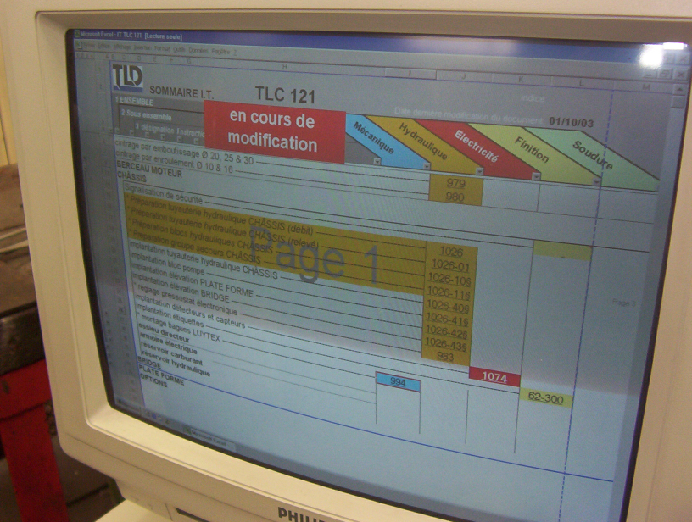
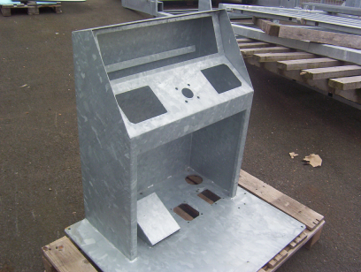
Group Wide missions
Common Procurement Plan
  Take advantage of the groups common parts to increase purchasing power with our suppliers.
  Take advantage of our presence in Shanghai to tap the manufacturing resources of mainland China
    -English speaking procurement manager to be in place by year end
Development of the “Ranger” Product approach to allow assembly in multiple locations
  Increase group market share thru reduced landed cost
Expand TLD On-line product manuals and E-purchasing of spare parts
The Factories must share their “best practices”

Slide 10
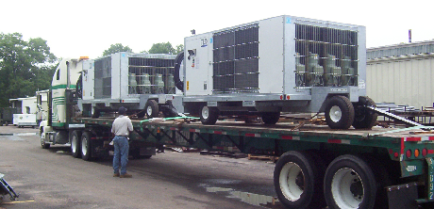
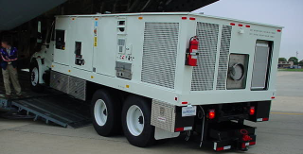
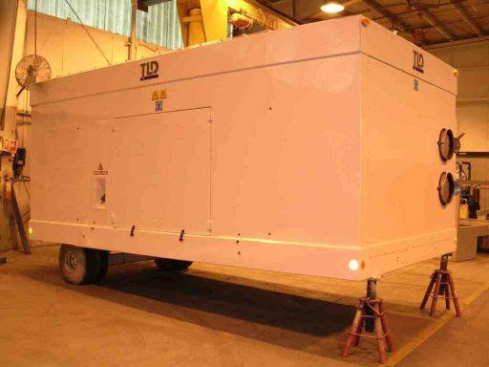
New Product Development Status
ACU-900
  4 units in service at Boeing
  Bridge mount opportunity exists
MPU
  ACU,GPU,ASU,28VDC,120VAC
  Engineering and Shop met the challenge
  Highly satisfied customer
  1st overseas mission completed
ACU-808
  Significantly reduced parts count
  Assembly process simplified
  Performance improved
  This Product is a world leader
Key Development projects for 2004
  150 ppm Jet Starter
  Common Chassis 180,270,300 ppm jet starter

Slide 11
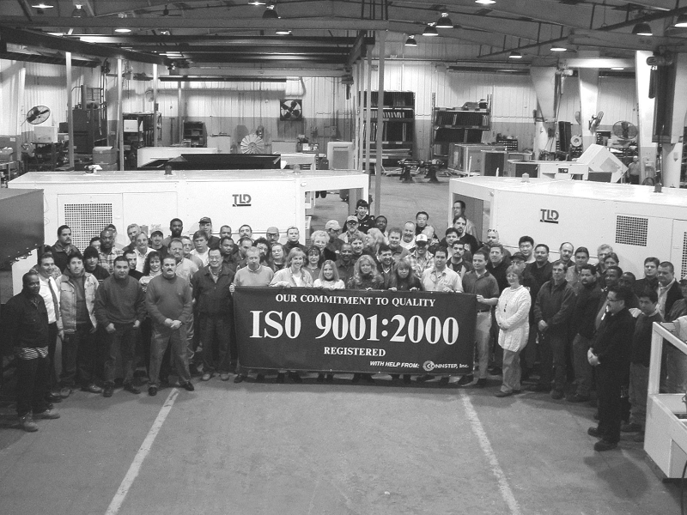
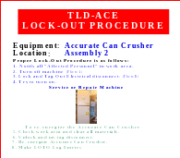
ISO 9001 Program status
1 year Audit Scheduled for Jan 19
Focusing on addition of OSHA processes to the audit schedule
This is a continuous improvement process that requires everyone’s involvement

Slide 12
Conclusion
2003 has been a year of recovery
  TLD has increased its reputation and market share during the Airline Industry Crisis
2004 will be a year of preparation
  We need to continue improve our cost structure and efficiency
We need to be ready for the resurgence of the market in 2005

