Slide 1
Trimester Report
TLD-Windsor
12/11/2007

Slide 2
Agenda
TLD-Windsor 2007 YTD financial performance
Recent Wins
New Opportunities
New Product Development Status
TLD Group info
805 Building Extension
Employee Incentive update
Conclusion

Slide 3
TLD-ACE 2006 YTD financial performance
$62M YTD Nov sales against a budget of $45M
This month we will reach $66 M YTD Sales
Operating Profit is also ahead of the budget
  We have increased our Production 25% above last year which was already a previous record
  Everyone in this company has made a contribution towards this success
Initial forecasts indicate that 2008 could be a little slower…..
However our Backlog still remains extremely high at $19M
  We must insure we keep up with our customers
  It means our production rate must remain high at least for the first half of 2008

Slide 4
Recent Key Wins
US Navy 60 ton aircon
  5 units and test program
  Fly-off type competition for 3 year contract
Philippines 808s
US Airways GPU, 302,
China Airlines GPU 4180
Northwest 802s
Indian Market and Spanish Market still strong

Slide 5
Potential Opportunities
LMCO F-22 Combination ACU/LCU (22 units)
Northwest Airlines 804s
RAAF 802,804
AMR Eagle 302/28VDC
Disappointing losses
  Northwest ASUs
  Turbine type starter are becoming more competitive

Slide 6


New Management Organization in Windsor
Peter Owitz has joined us as COO of TLD-Windsor
  Ex BAE,ABB
  Engineering and Operations background
  MBA
Mark Garlasco is now CEO of Windsor and Sherebrooke factories
This reorg allows Antoine Maguin to manage more effectively as the Group COO

Slide 7
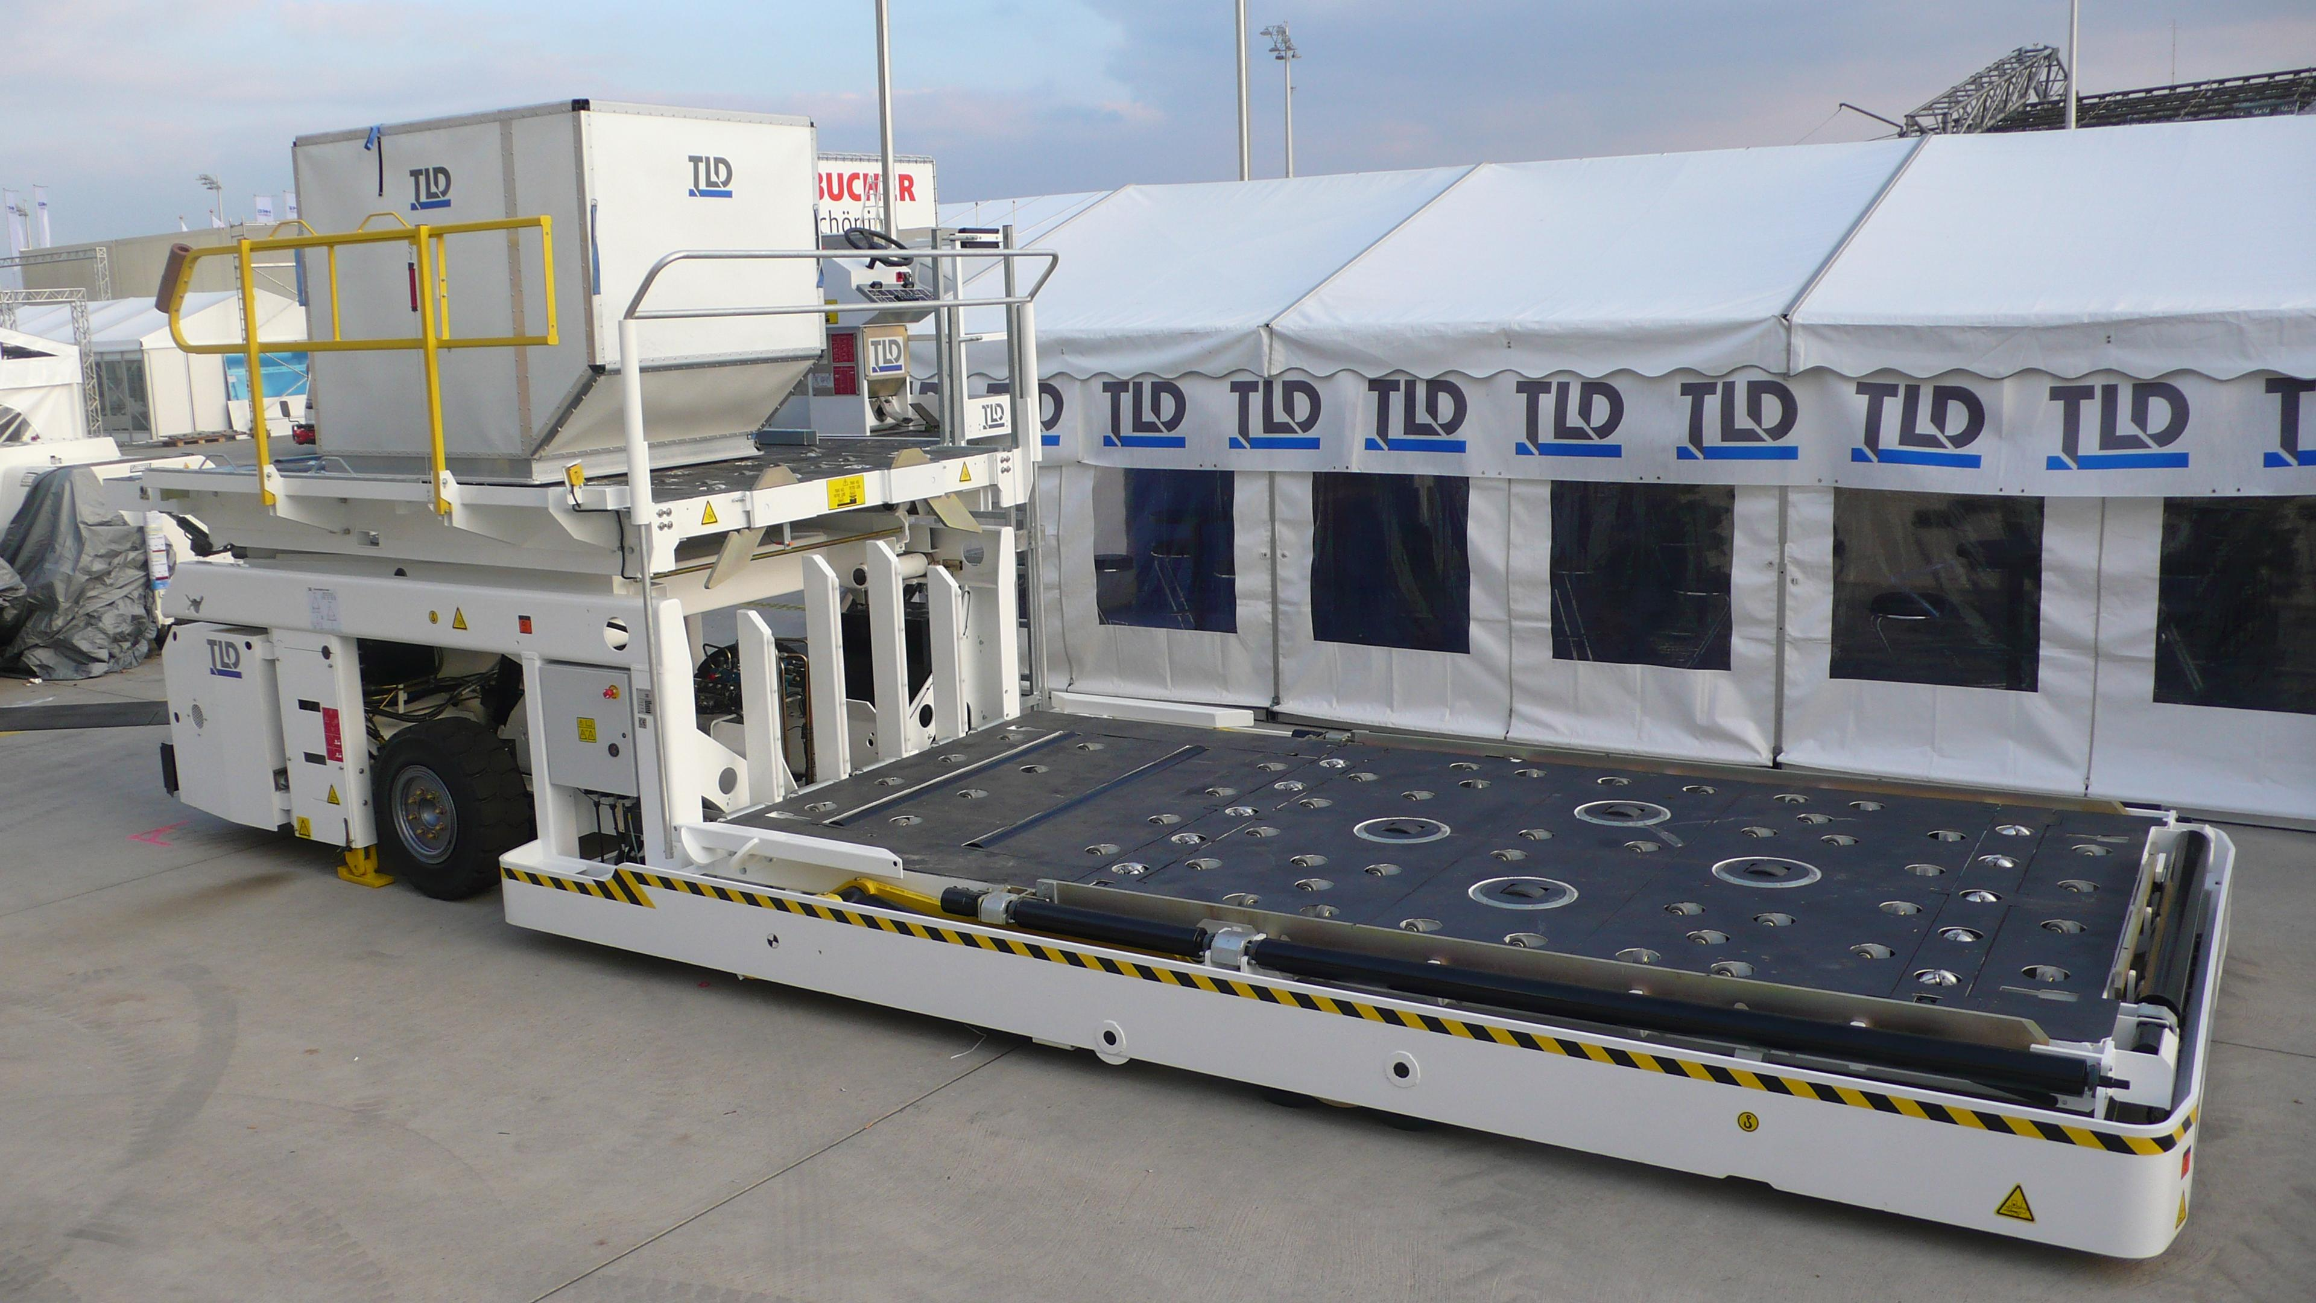
TLD Group Info
TLD-Canada 838 project
  The Sherebrooke team has created a new loader to meet the low cost market
  Simplification of the weldments to allow more competition from fabrication suppliers
  Can Bus technology to reduce electrical wiring and componentry
  Prototype will demo this month in Newark with ASIG
  Production is expected starting in April.
  This program is key to the success of TLD-Canada who are living in a very competitive market.

Slide 8
TLD Group Info
The challenge to stay number1
  The TLD Executive committee has recognized that TLD has achieved the goals set out 7 years ago to become a leader in GSE
  Now our challenge is to maintain and improve our support of the customer
  It was recognized that quality of our product and responsiveness to field issues were the two areas most effected by our rapid growth in sales and production
  It was decided to add 2 official positions in the TLD organization for each factory
    Reliability and Maintainability Engineer
    Vendor Quality Control Engineer
  This action is targeted at adding resources where they can make the biggest impact-the support of the customer

Slide 9
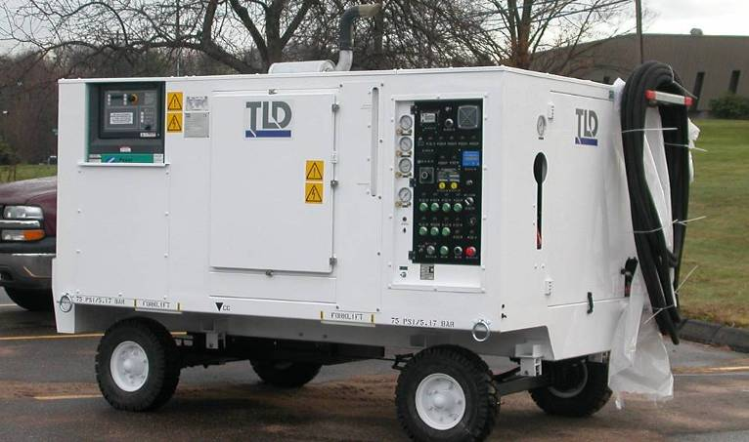
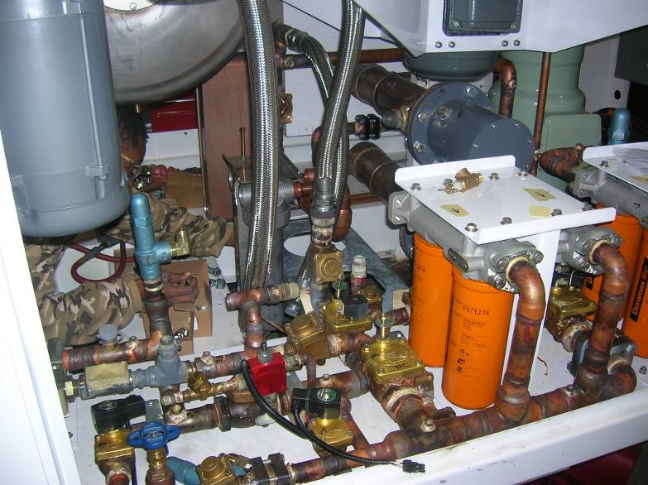
New Product Development
LCU-015-CUP
  Unit #3 is near completing test
  Much better schedule performance than unit #2
  Two more units planned for 2008 as well as refurb of units #1 and 2
  Joint Strike Fighter program is still planned to be the major Military Aircraft contract of the next decade
  It is important for us to continue to satisfy LMCO in order to win the production contract to support this program

Slide 10
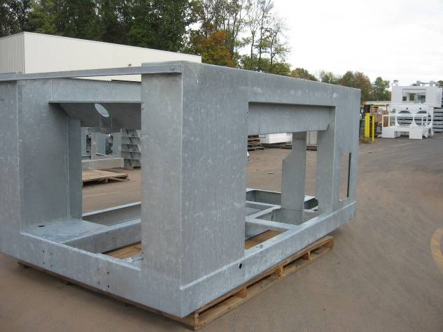
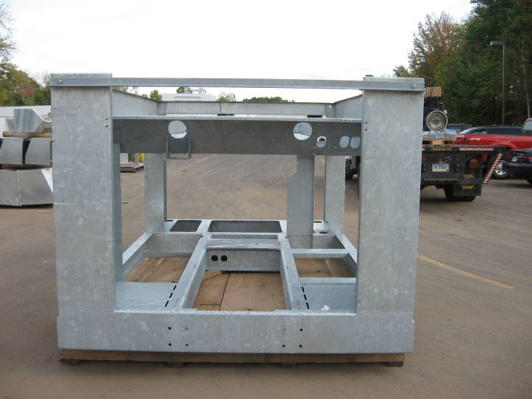
Increasing the use of galvanization
Our Large ACUs will soon have galvanized frames
  This will help our production rate by reducing the natural bottle neck of the painting process
  It will also provide a more durable product for your customer with a lower maintenance cost
  804 frame has been prototyped and production versions will be available early next year

Slide 11
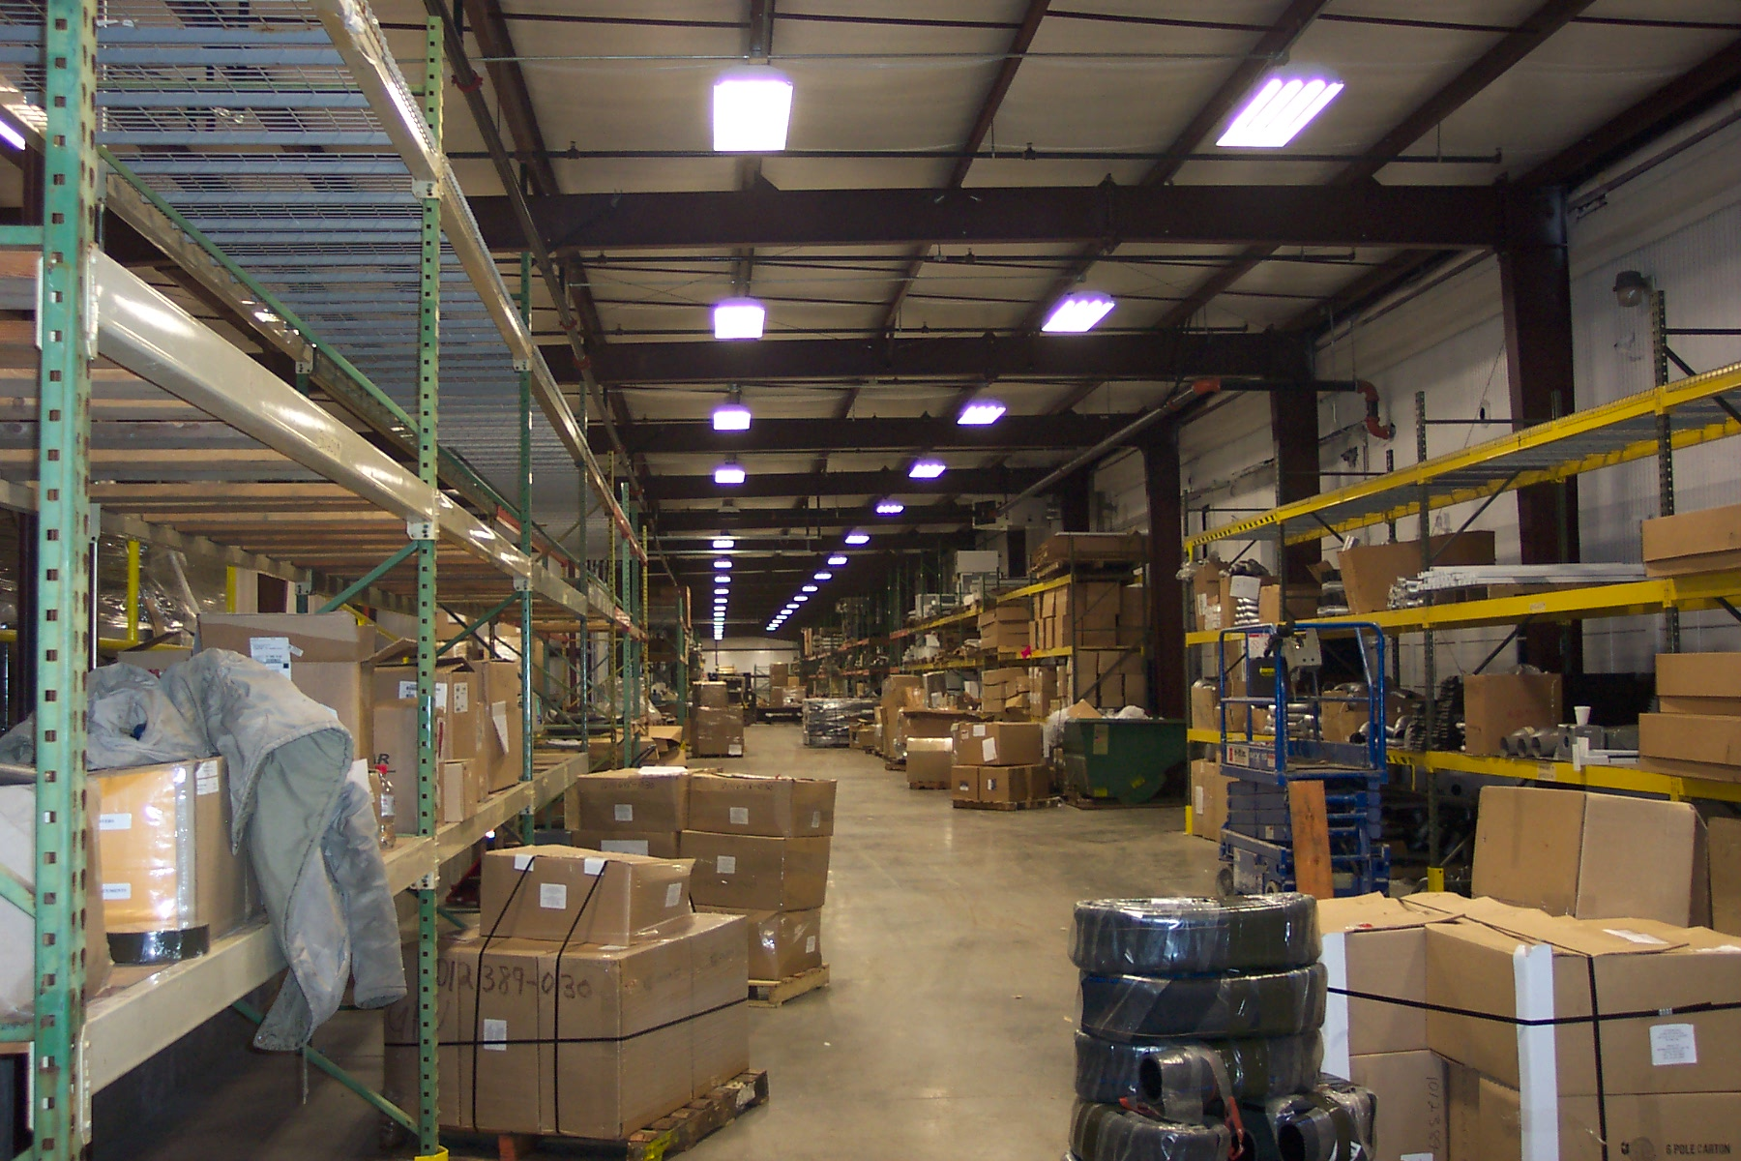
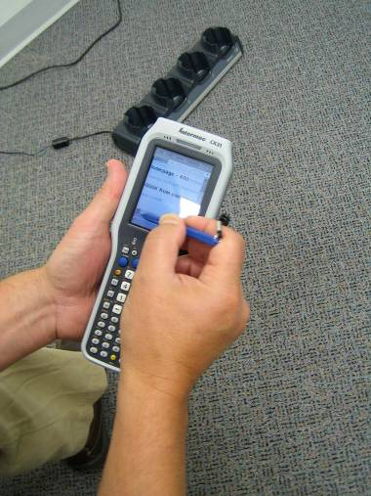
805 Building Extension
This project which started in July is nearing completion from a construction point of view.
Everyone has done an excellent job progressing the project as well as maintaining a strong production rate despite the difficult working conditions.
Now we must quickly put this addition to work for us.
  Remember we want to reduce the amount of time we spend handling material and thereby increase our productivity

Slide 12
Employee Incentive Plan
The next payout will be based on the results of 2007 and will be made at the end of this first QTR 2008
The payout is based on the companies performance as measured by our R.O.N.C.E. Currently at a very good rate well above our payout amount Cap of 25%.
The program, entering it’s third year, will continue to ramp up from a partial level to its full potential level.
As originally announced the rollout plan was 1/3 potential first year, 2/3 second ,3/3 third year
Last year, Management and Share Holders had recognized the extraordinary efforts made and the very good results and decided to advance the rollout of this plan from 2/3 (66%) to 80%.
This year the remaining 20% of the plan will be rolled out.

Slide 13
Conclusion
2007 has been very strong.
The first half of 2008 still appears to require a high Production rate in order to not lose customers
We must continue to increase the efficiency of the shop and all other departments via…
  Complete utilization of our POU inventory facility
  Focused projects to improve producibility
  E-tools
  Workflow modules
We must continue to “make hay while the sun shines”

