Slide 1
TLD ACE
Trimester Review Meeting
December 18, 2008

Slide 2
Agenda
2008 Performance
  2008 End of Year Estimates
2009 Forecast – Update from October Meeting
Actions for Slowing Business Conditions
Employee Incentive Program (RONCE)
Conclusion

Slide 3
2008 Performance
Eleven Months of exceptional Performance
  We continue to perform well despite Business Slowdown
    Profitability is good
    Return on Investment is good
    Operational indicators are good
2008 End of Year Forecast
  Sales through Nov 08 – $60.6M
    $5.5M/Month
  Forecast through Dec 08 - $62.9M (down $1.1M from October Forecast)
  We’ve been able to grab some extra business in November and December because of our ability to respond, otherwise our sales would be down even more

Slide 4
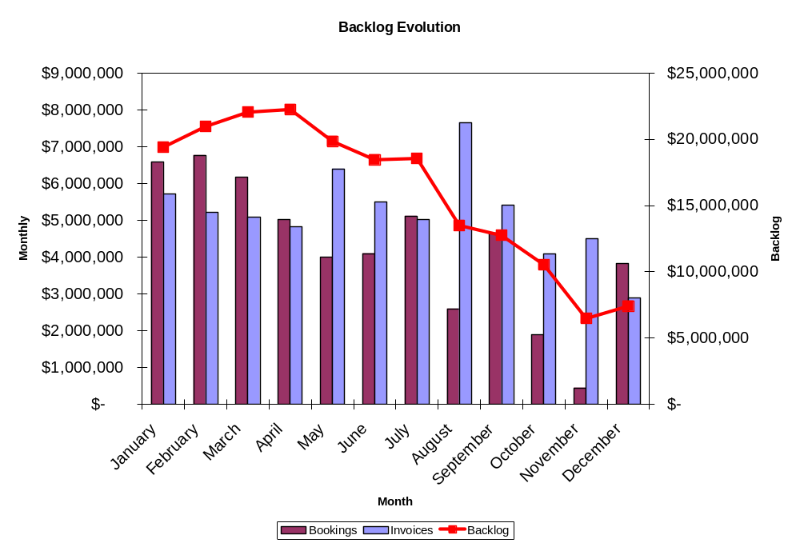
2008 Backlog Evolution

Slide 5

2009 Forecast
2009 Forecast
  Sales estimated to be 64% of 2008
  Units estimated to be 56% of 2008
  Profit estimated to be 54% of 2008
However
  First quarter substantially lower, $2.3M/Month, perhaps lower
  Recovery estimated in summer 2009
We are bidding aggressively to get business and keep the factory busy
  Recent win for 22 802s
  Bidding 3 400 PPM, and 4 802s for Qatar
  7 808’s for DNATA
  7 GPUs for American Airlines
  3 802s, 3 GPUs for Iraqui
– REMEMBER –
These are all estimates – no one can tell what the future holds

Slide 6
Actions for Slowing Business Conditions
We must take appropriate actions to ensure continued business health
  Tight Control of Costs
    Scrutinize every dollar spent – are we getting the required value out of the expenditure
  Perform Past-Due Maintenance
    Floors, cleaning, organizing
  Aggressive Product Improvement Plans
    Fuel Efficient GPU
    ACU Control Scheme Improvements
    ASU Control Scheme Improvements
    Electric ACU Development
We must take this slowdown as the opportunity to improve our business and our products.
  When the industry recovers we can be stronger than ever

Slide 7
Individual Actions
Every one of us can take actions every day to help us all during this downturn
  QUALITY – Attention to detail and high quality in our delivered products will help make us the supplier of choice
  PRODUCTIVITY – Ensuring we’re contributing every hour of every day is essential to keeping our costs down
  CONTINUOUS IMPROVEMENTS – When you have down time, focus on making your work easier, better, and more repeatable
  COMMUNICATION – When you have a suggestion, improvement idea, or opportunity for improvement, talk with someone about it
  CUSTOMER SERVICE – Listen to our customers, provide exceptional warranty support, deliver high quality products
Together, we can manage this slowdown effectively and be part of making this company stronger than ever

Slide 8
Employee Incentive Plan
RONCE – Return on Net Capital Employed
  Remember, in order to receive this ~8% bonus, we need to provide a competitive return on the money it takes to keep this business running
    Inventory – Less is better
    Costs – Less is Better
    Efficiency – Higher is Better
    Rework – Less is Better
    Defects – Less is Better
    Waste – Less is Better
2008 RONCE Incentive
  The TLD ACE factory has done an excellent job in 2008, we are exceeding the performance requirements for this incentive
  Even with the slowdown forecasted for the last quarter of 2008, today it appears that the RONCE incentives are safe for 2008
2009 - We can earn this incentive even in slow periods by improving our product quality, reducing our waste, inefficiency, inventory, and costs
– it is in our hands!

Slide 9
Conclusion
Our team has performed well in 2008, but global forces have created a business slowdown
We must manage this slowdown to make us stronger when the industry recovers
Continued focus on engineering, customer support, quality and costs are essential to our success
Each one of us has the ability to make this company the strongest GSE supplier in the industry

