Slide 1
Trimester Report
TLD-Windsor
12/21/2006

Slide 2
Agenda
TLD-Windsor 2006 YTD financial performance
Actual Production vs Plan
Recent Wins
New Opportunities
302 Six Sigma Project
New Product Development Status
LSP/WSP Program Transfer
TLD Group info
805 Building Extension
Employee Incentive Plan Status
Conclusion

Slide 3
TLD-ACE 2006 YTD financial performance
$49M YTD Nov sales against a budget of $32M
This month we will reach $52 M YTD Sales
Operating Profit is also ahead of the budget
  We have increased our Production 50% above last year which was already a previous record
  Everyone in this company has made a contribution towards this success
Our Backlog still remains extremely high at $19M
  We must insure we keep up with our customers
  It means our production rate must remain high

Slide 4
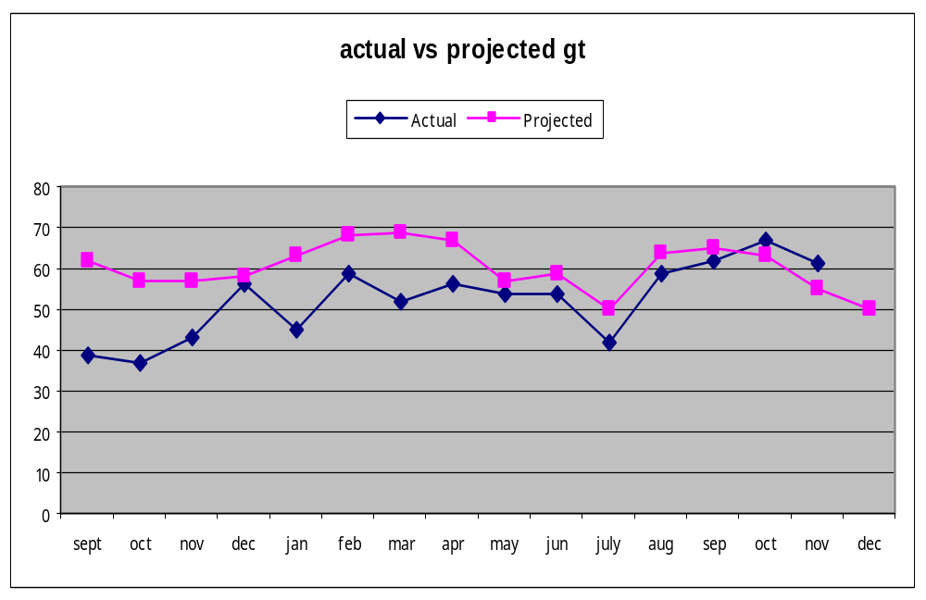
Actual Production vs Plan

Slide 5
Recent Wins
Continental Airlines (3) GPU 4180
Spanish Market still active
  Iberia (3) 802s, (12) ASU,
  Several other Spanish orders
UNASCO (5) ASU, (6) 802
LHAMS (2) 802 (2) ASU, (2) GPU
KES (3) 802, (2) ASU

Slide 6
Potential Opportunities
US Navy 60 ton aircon
  Similar to our 804
LMCO F-22 Combination ACU/LCU (22 units)
An additional 8 Lear Sigler 802-329s
8-10 USAF 802-329s
Swissport Pakistan (2)ASU, (1) 802, (8) GPU
DHL ASU
SouthWest ASUs

Slide 7
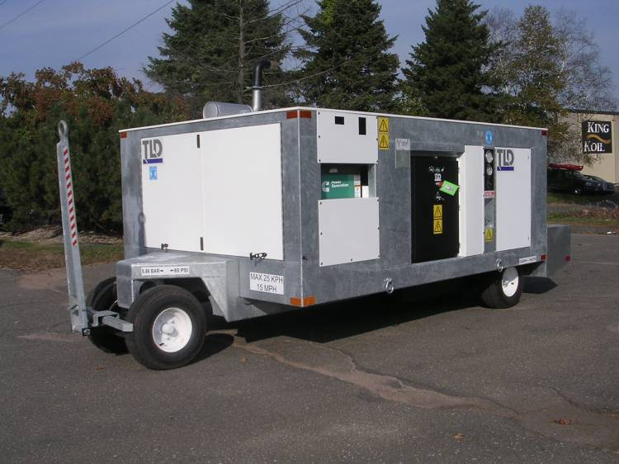
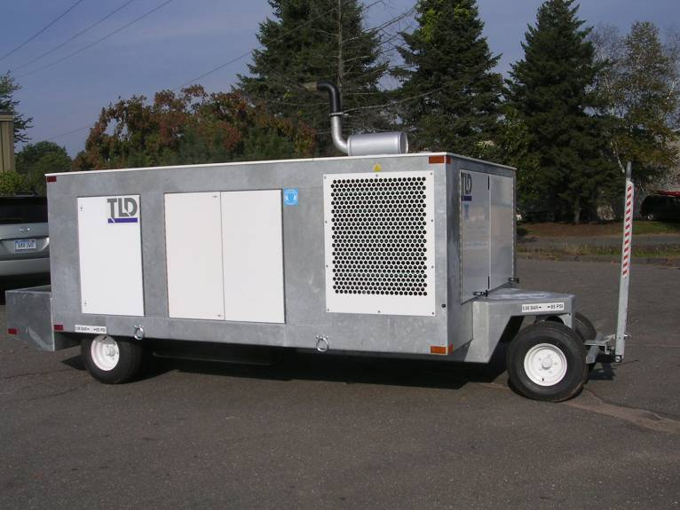
ACE-302 Six Sigma Project
The Six Sigma project is nearing completion
  The goal was to reduce labor hours by 10-15%
  Initial measurements indicate this will be surpassed.
Input from the Shop Team has been very good and was essential for the success of this project
There will be follow-up activity in January to insure all identified shop and product changes are incorporated.

Slide 8
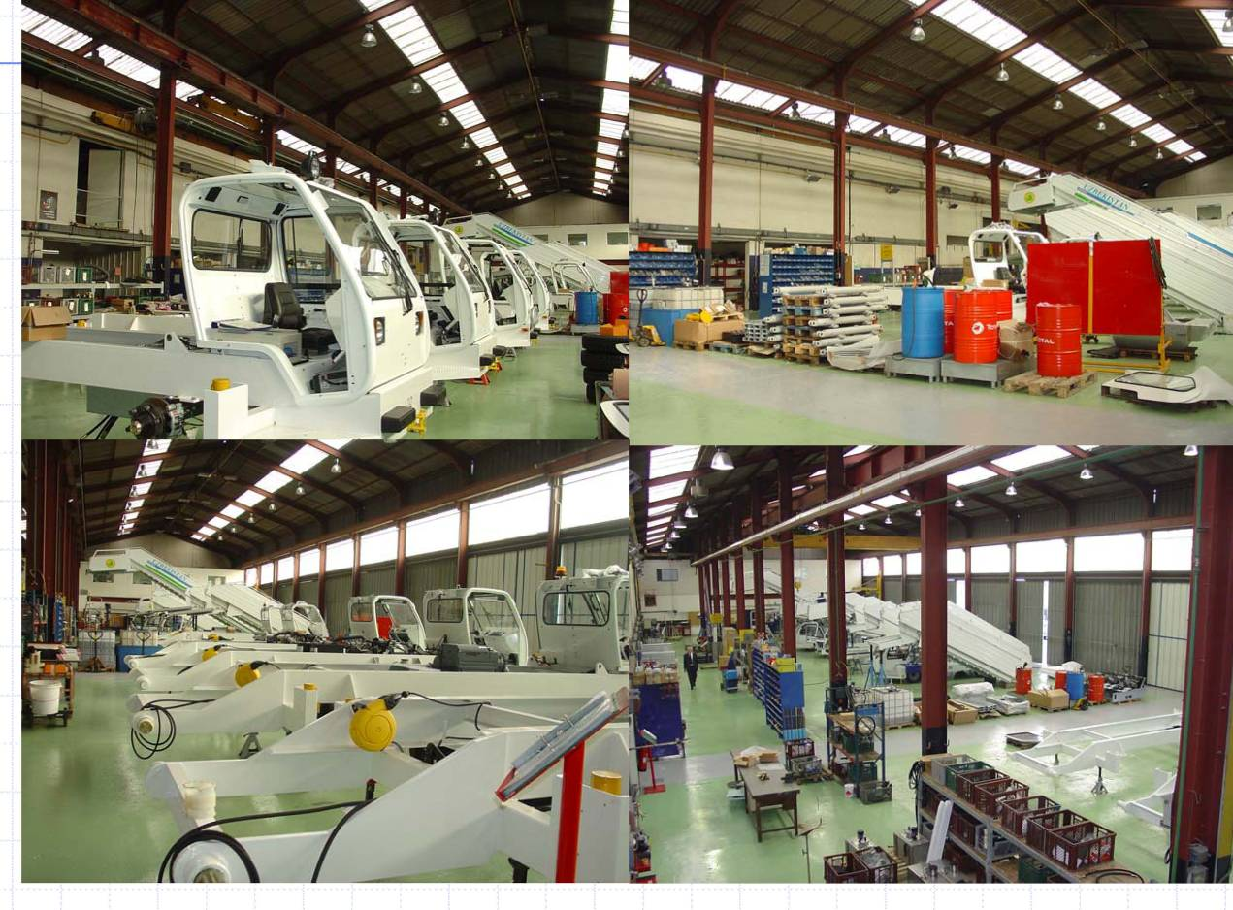
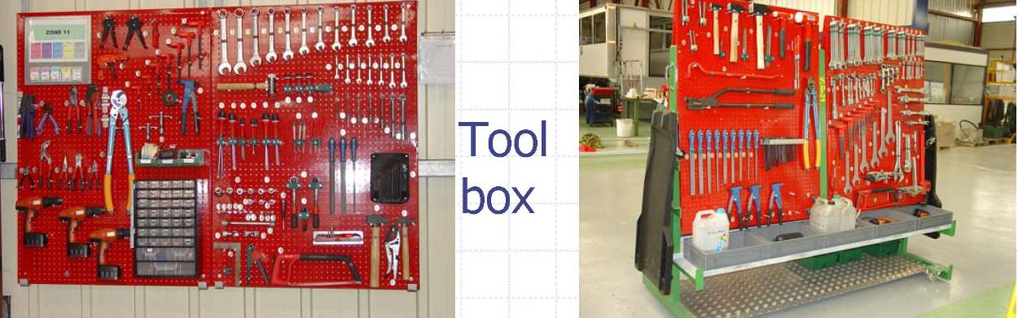
TLD-Group Info
St Lin Factory is rapidly evolving
  Incorporation and consolidation of product lines inherited from the closed TLD-Albret Factory is nearly complete
  All Shops areas have been re-organized and are extremely clean and efficient
  Production rate has increased dramatically
  We are sharing experiences in order to benefit both factories

Slide 9
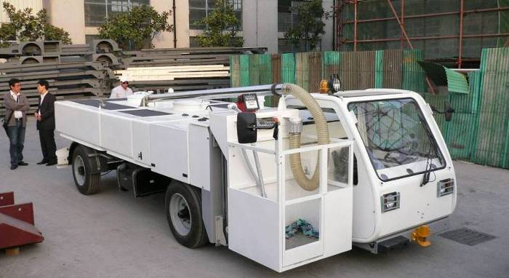
New Product Development
LSP, WSP
Northwest Airlines demo unit shipping this week
However, it has been decided to transfer this product line in 2007 to TLD-Canada for the following reasons:
  The Windsor work load is currently the largest in the group and we must be careful to keep resources focused on our existing products and not become too diluted.
  It is better to put this product into a factory that already has a product that shares many common parts with it.(NBL)
  TLD-Canada needs more product diversity to help fill in the gaps in the demand for the Loaders.
The Windsor effort to date has been key in getting a foothold for this RANGER product in the North American Market .
What helps the group helps each of us

Slide 10
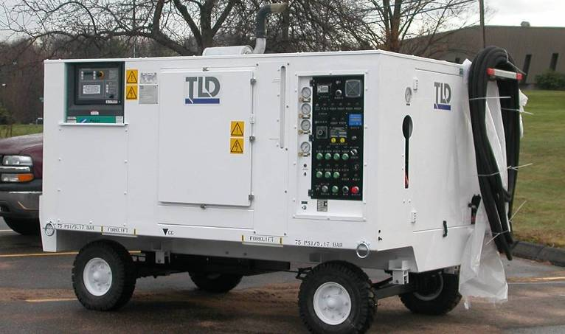
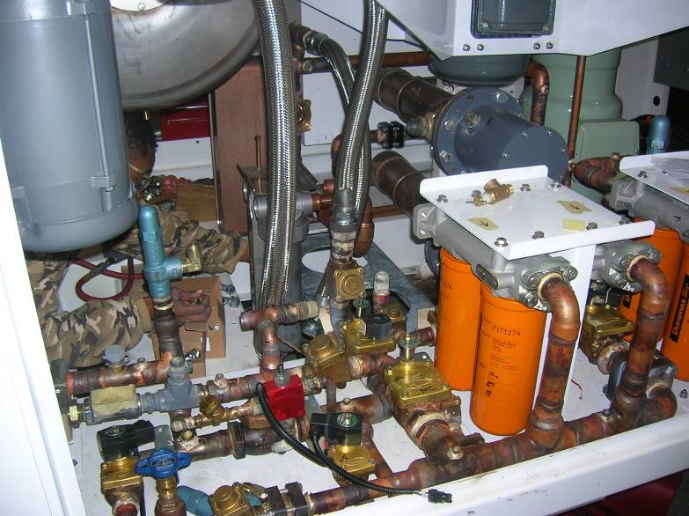
New Product Development
LCU-015-CUP
  Unit #2 Near completion
  Extensive increase in capacity and functionality over Unit #1
  EMI Testing Completed in October
  Final demonstration planned for January
  Unit #1 is supporting Joint Strike Fighter flight test aircraft.
  This successful program is causing LMCO to look at other TLD products like the 401 and 802

Slide 11
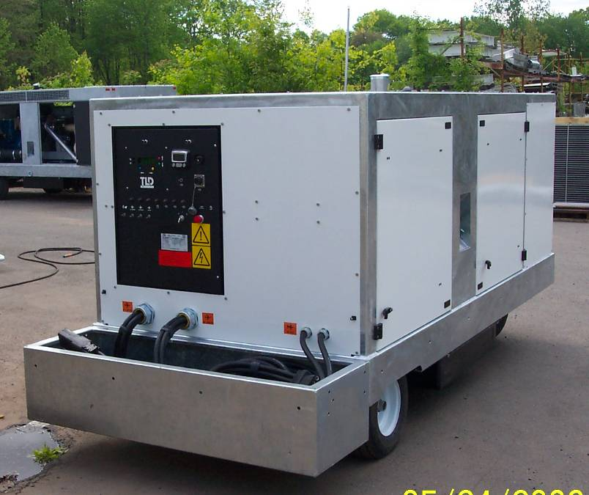
New Product Development
GPU-4180
Demo unit is currently with Continental Airlines and operating successfully
They have decided to purchase 3 units
Singapore Airlines also interested

Slide 12
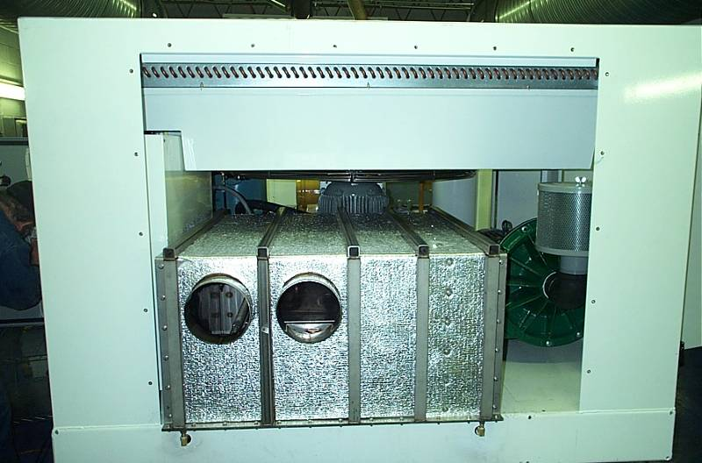
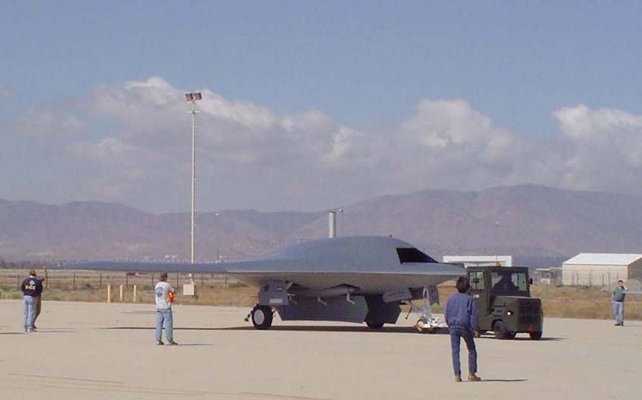
New Product Development
ACU-401
Successful Factory Demo test performed for Northrup Grumman during week of 11 December 2006
3 units to ship January
LMCO also reviewed the unit and are interested in it for F-22 Program

Slide 13
Employee Incentive Plan
The next payout will be based on the results of 2006 and will be made at the end of this first QTR 2007
The payout is based on the companies performance as measured by our R.O.N.C.E. Currently at a very good rate well above our payout amount Cap of 25%.
The program, entering it’s second year, will continue to ramp up from a partial level to a full potential level over 3 years.
As originally announced the rollout plan was 1/3 potential first year, 2/3 second ,3/3 third year
However the Management and Share Holders have recognized the extraordinary efforts made and the very good results this year…
It has been decided to advance the rollout of this plan from 2/3 (66%) to 80%. This results in 80% of a months pay as bonus or 2.4 times last years payout

Slide 14
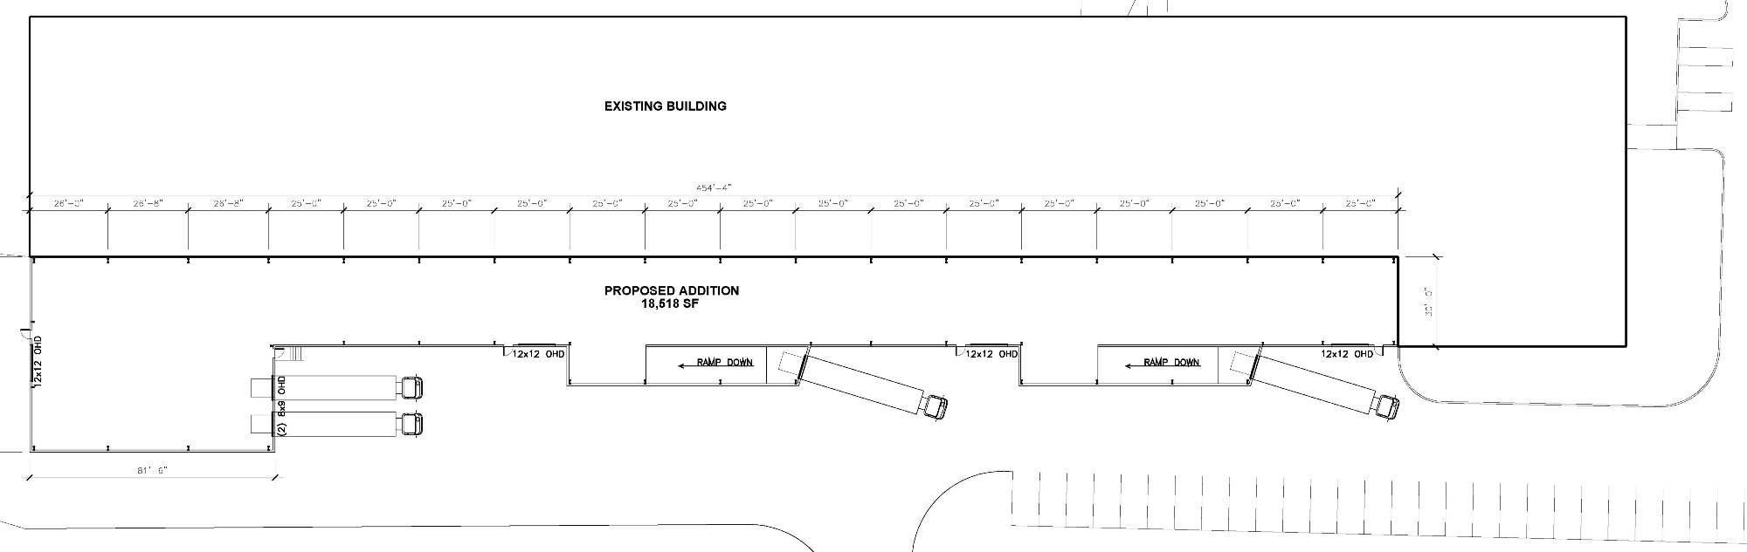
805 Building Extension
This key project is designed to improve the material movement to and from the shop
Each Work Cell will receive material directly from suppliers
A Bar code system will be used to transact material directly thru Baan
Loading docks will be added to ease shipment of finished units
The Plan is set to be operational by October 2007
Improving our efficiency is an investment in our future

Slide 15
Conclusion
2006 has been an extraordinary year….
  Not many people can claim they have worked for a company that increased its production rate 50% in a year!
  Be proud of your contribution, and thank you all for it.
The first half of 2007 still appears to require a high Production rate in order to not lose customers
  At the same time we must maintain Quality
We must continue to increase the efficiency of the shop and all other departments via…
  E-tools
  Workflow modules
We must continue to “make hay while the sun shines”

