Slide 1
Coursework
People and Computing

Slide 2
Section 1: Usability Testing
By taking the reference of commercially available mobile app or web application, prepare the report of usability test considering/including the following:
Major functionality present in the app/website
Analyze UI/UX on the basis of Nelsons Heuristic principle or Shneiderman’s 8 Golden Rules Of Interface Design
Usability Testing
Your analysis on Usability quality components including Learnability, Efficiency, Memorability, Errors and Satisfaction
Usability Questions design and response sheet
Participants Profile
Analysis of Usability testing conducted
Your proposed paper prototypes with identified additional recommendations

Slide 3
Selection of app/website
Identify a commercially available mobile app or website, eg
Foodmandu
Daraz
Connectips
Esewa
Dept of Transport Management

Slide 4
Major functionality present in the app/website
Background/general information of app/website
Hierarchical task analysis
Work breakdown structure
Software requirement specification

Slide 5
UI/UX analysis
Critically review the chosen app/website on each point of either one of the following guideline
Nelsons Heuristic principle
Shneiderman’s 8 Golden Rules Of Interface Design

Slide 6
Usability Testing
Learnability: How easy is it for users to accomplish basic tasks the first time they encounter the design?
Efficiency: Once users have learned the design, how quickly can they perform tasks?
Memorability: When users return to the design after a period of not using it, how easily can they reestablish proficiency?
Errors: How many errors do users make, how severe are these errors, and how easily can they recover from the errors?
Satisfaction: How pleasant is it to use the design?

Slide 7
Usability Questions design
Personal details of respondant
Quantitative, eg 1 to 10
Closed options, eg: yes/no, agree/disagree
Easiness to register new user
User Login
How fast is the application/website?
Easy to place new order
How are information displayed
Are all important functions easily available
User friendliness
Easy to navigate
Will you refer it to others?
Any specific feedback?

Slide 8
Usability Questions design
Is the registration process easy?
How was the interface?
How was your experience while using app?
How was overall design of the app?
How did you find the task?
Do you like the product?
Is the language displayed familiar to you?
Will you recommend the product to other?
Recommendation in UI change?

Slide 9
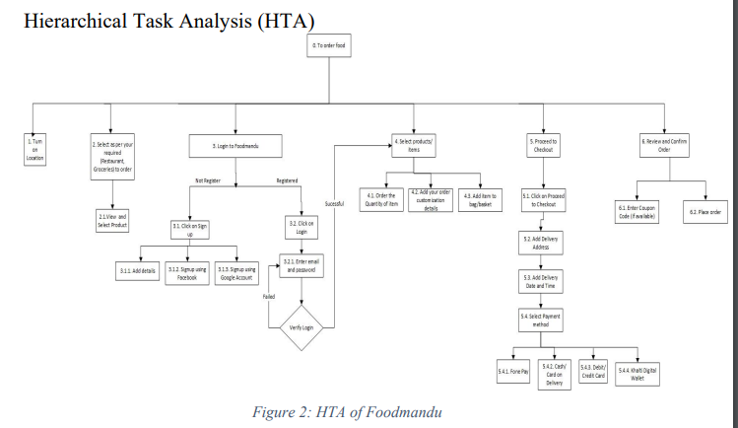
Hierarchical Task Analysis

Slide 10
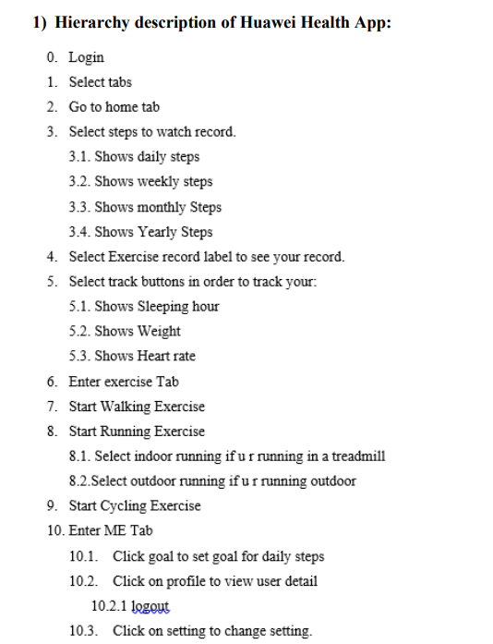
Hierarchical Task Analysis

Slide 11
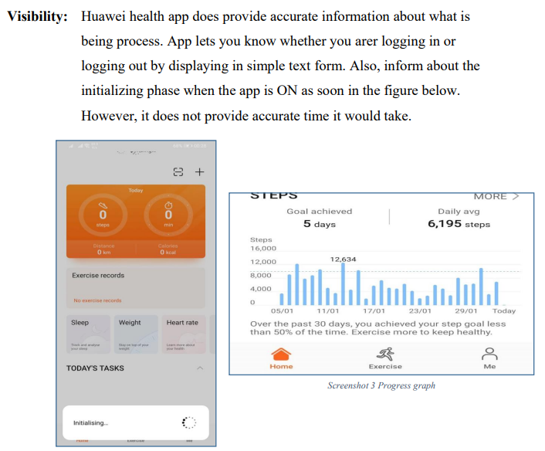
Nelsons’ Heuristic Evaluation

Slide 12
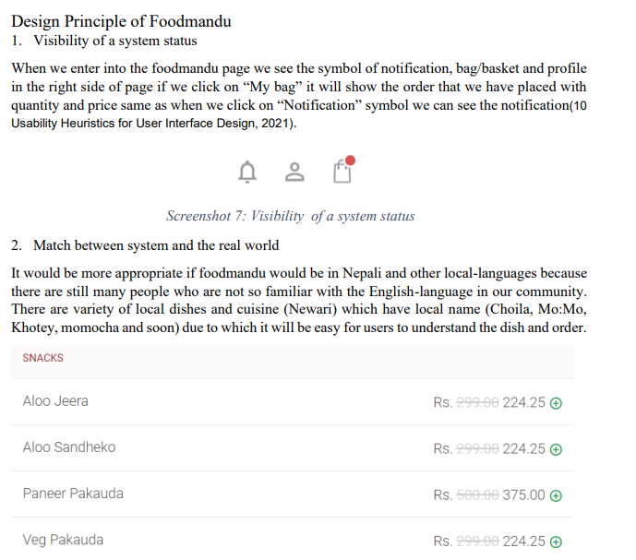
Nelsons’ Heuristic Evaluation

Slide 13
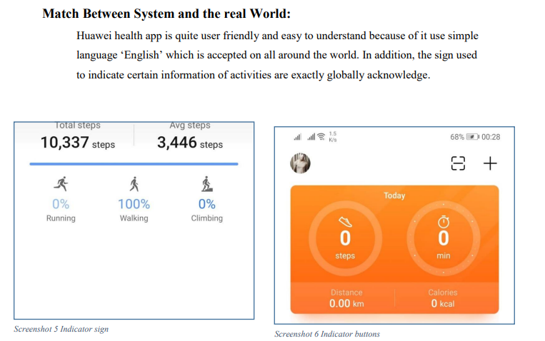

Slide 14
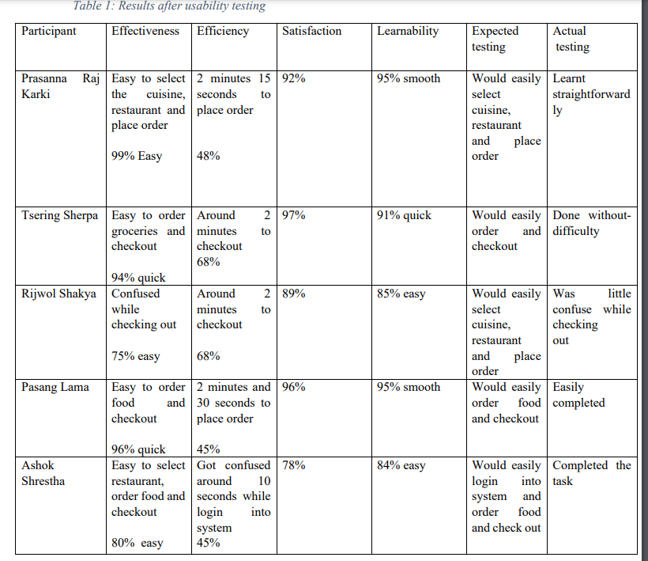
Analysis of Usability Testing

Slide 15
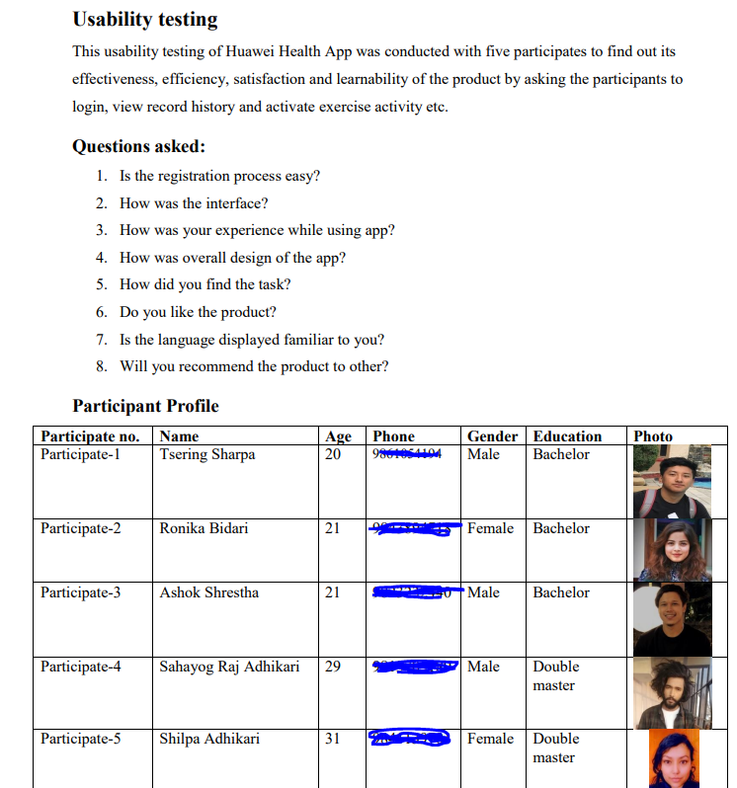
Participants Profile

Slide 16
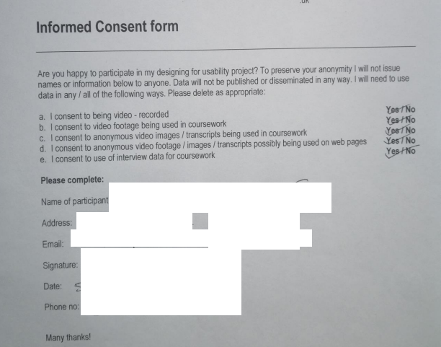
Informed Consent Form

Slide 17
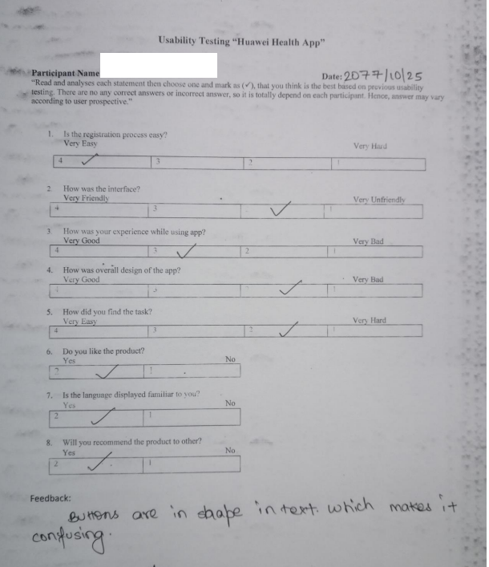
Question Design

Slide 18
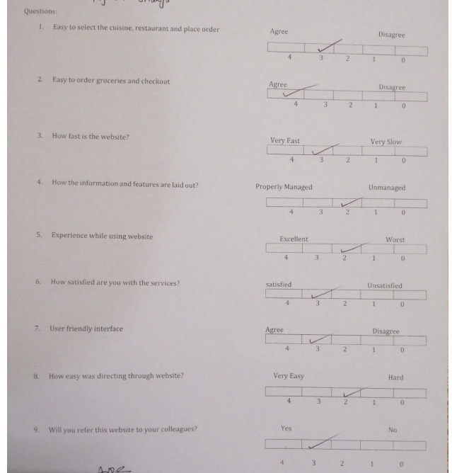
Question Design

Slide 19
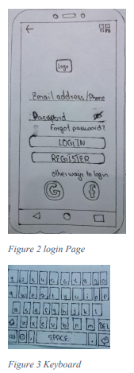
Paper Prototype

Slide 20
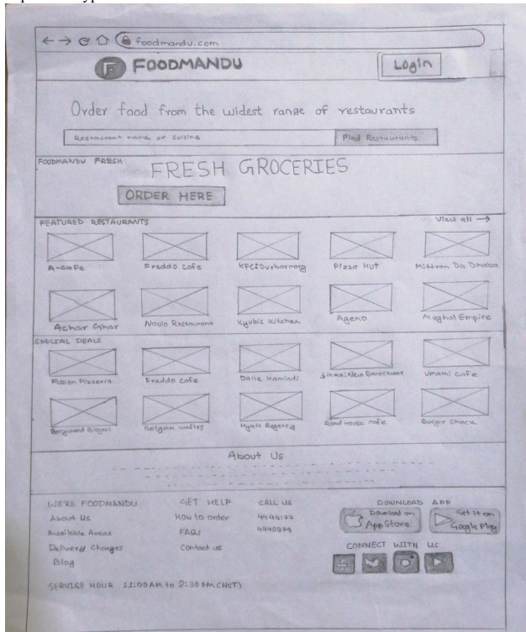
Paper Prototype

