Slide 1

﻿Supply chain Disruption worldwide due to covid 19 and Russian Ukraine war and its impact on world economy.
Puja Bhatta
Manisha Pandey
Kumari Katwal
Roshan Khatri
Anubhab Khatiwada
Chandan Singh
1

Slide 2
Supply Chain Disruption
An event that causes a disruption in the production, sale, or distribution of products. Supply chain disruptions can include events such as natural disasters, regional conflicts, and pandemics.
https://www.arenasolutions.com/resources/glossary/supply-chain-disruption/
2

Slide 3
According to Jabil's Special Report: Supply Chain Resilience in a Post-Pandemic World-
70% of supply chain decision makers said -COVID-19 is creating the biggest impact on the supply chain
3

Slide 4
Types Of Supply Chain Disruptions
1
2
Reduced Productivity
Sysco, a leading supplier for restaurants, furloughed 33%of its massive workforce by the end of March 2020.
3
Storage and Access Restrictions
Amazon closed an apparel returns warehouse in Kentucky due to the COVID-19 outbreak, forcing supply chain leaders to make substantial changes to storage and product handling.
Demand Drops
Eg: Airlines (demand drops by more than 95%)
4
Source :(Montgomery,2020)

Slide 5
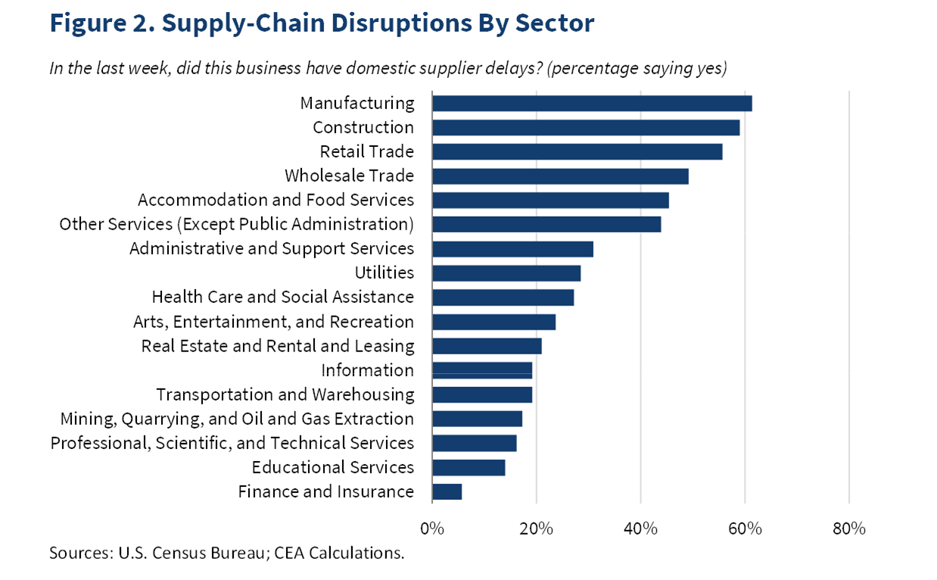
Supply Chain Disruption by Sector
5

Slide 6
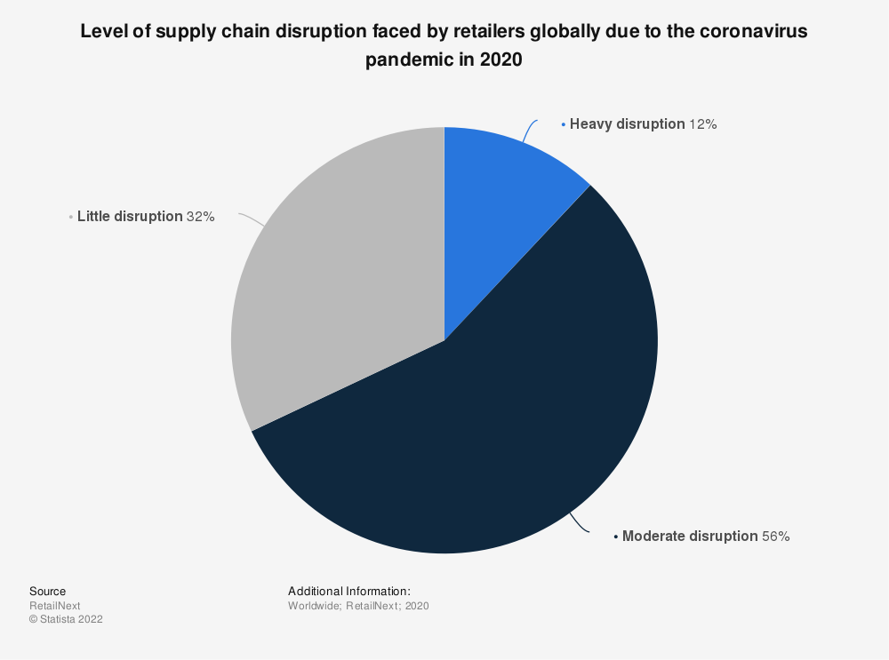
6

Slide 7
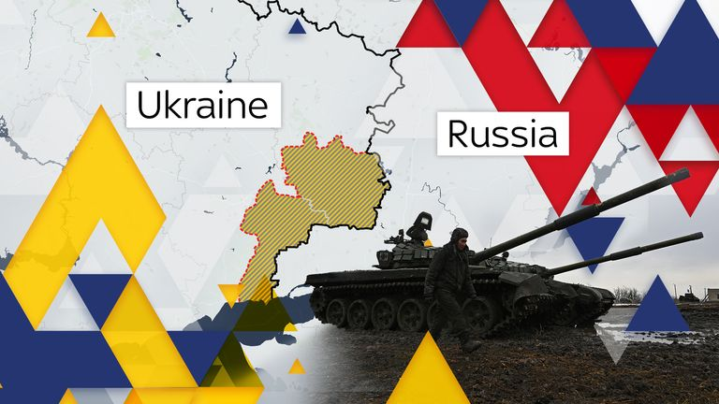
Russia Ukraine War and Impact on world economy
7

Slide 8
The conflict is a major blow to the global economy that will hurt growth and raise prices. (Source: IMF Blog, March 2022)
Global Economic Implications
Russia-Ukraine War
Channels Affected
Financial sanctions
Commodities prices
Supply-chain disruptions.
Ukraine and Russia make up 30 percent of global exports.
8

Slide 9
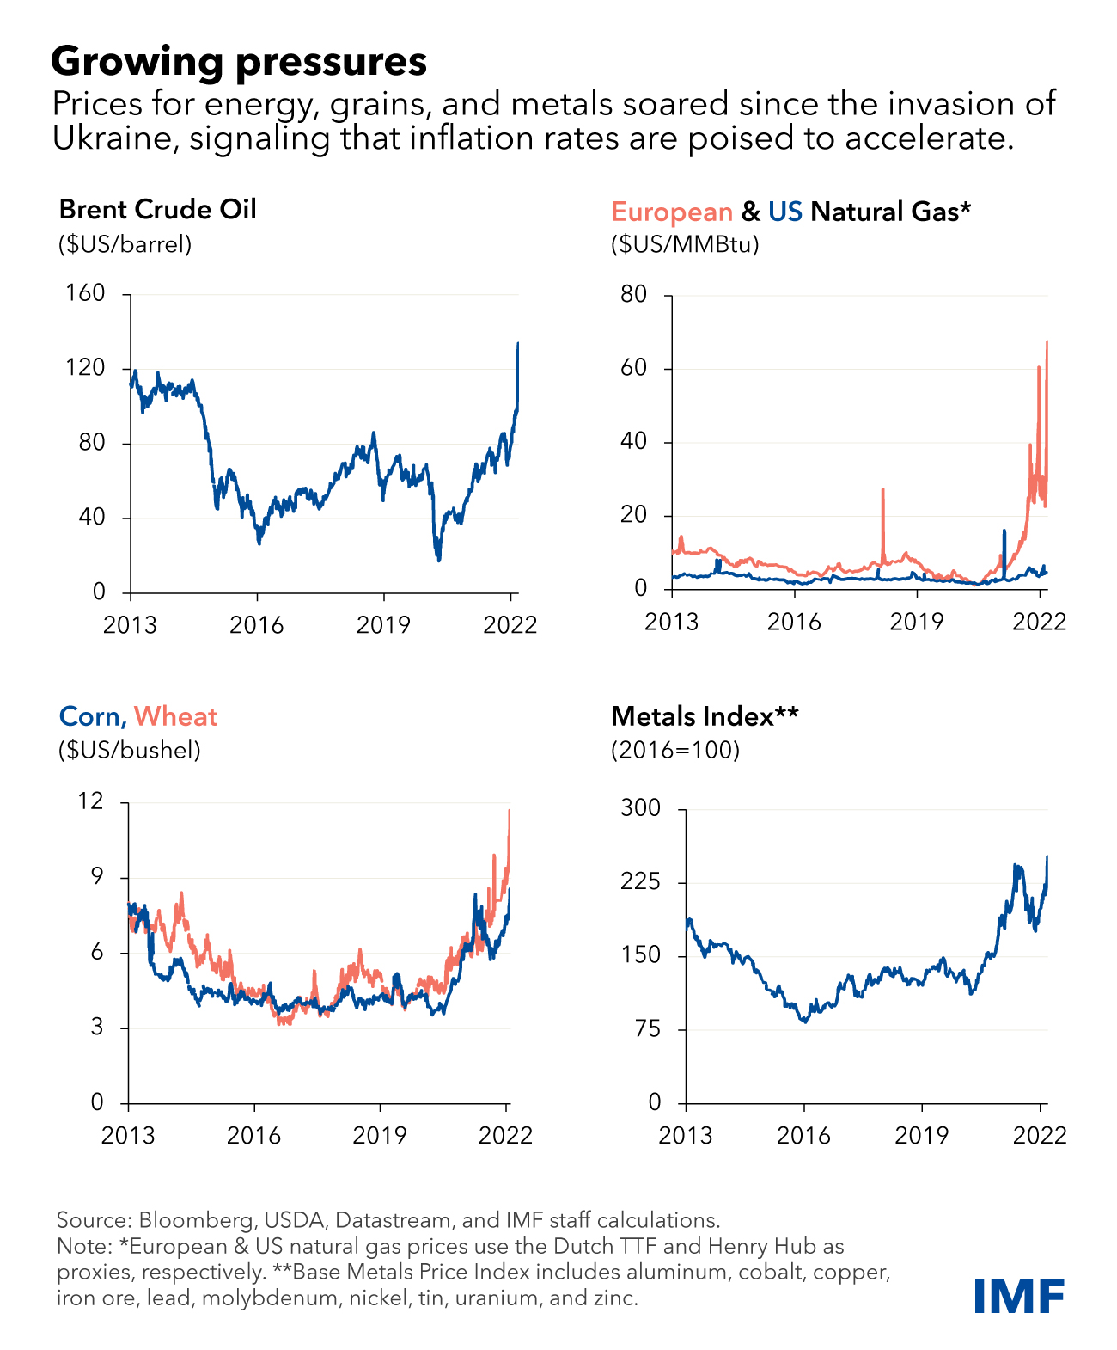
9

Slide 10
Supply chains is said to be disrupted -Difficulties affecting land-based routes -Restrictions on air link -Cancellation of sea freight routes from Ukraine
10
SOURCE: https://www.eiu.com/n/global-economic-implications-of-the-russia-ukraine-war/

Slide 11
In view of this situation (Anticipated)
EIU will be revising down the growth forecast for Europe in 2022, to about 2% from our previous projection of 3.9%.
Growth in the euro zone is now expected to stand at 3.7% this year, from EIU’s previous forecast of 4%.
Downward revisions to Europe’s growth outlook will also prompt a revision of the global growth forecast by 0.5 percentage points to about 3.4%, from 3.9% previously”.
11
(Source: AGATHE DEMARAIS, GLOBAL FORECASTING DIRECTOR, EIU.)

Slide 12
Nepalese Context Linkage
12

Slide 13
Supply chain disruption due to Russian-Ukraine war in context of Nepal
Inflation
(Gold, Petroleum products, industrial raw material, LPG gas and edible oil)
Imported Products from Russia (Aircraft and helicopters, parts and other goods, gears and bearings for vehicles, lighting and visual instruments, aluminum
Disrupted Export
(tea and handicrafts , hand woven rugs including pashmina shawls
13
Source :The Kathmandu Post

Slide 14
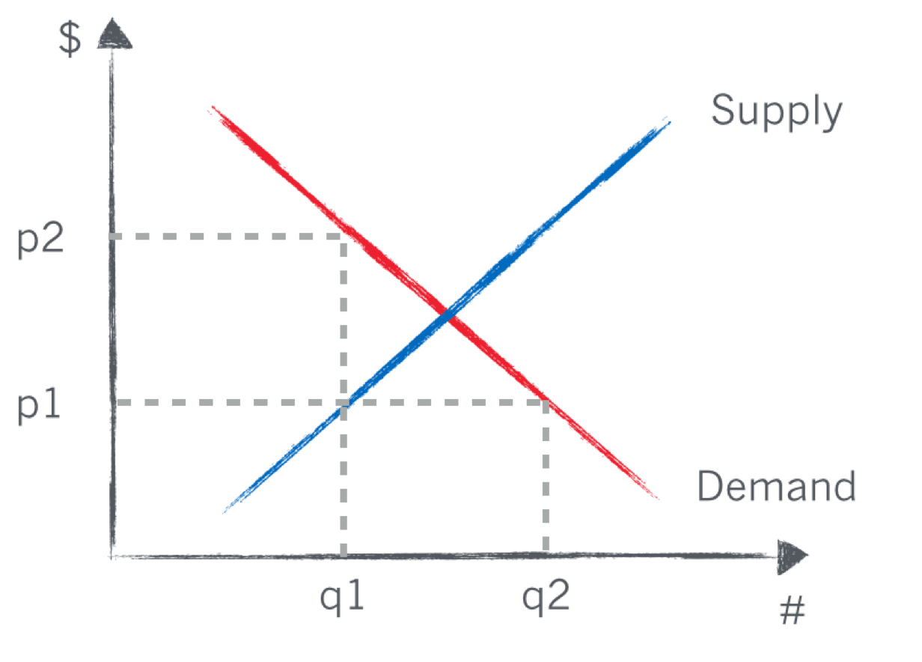
Supply chain disruption due to covid-19 in context of Nepal
Demand increase
Supply Decrease
Impacted the supply chain through staff shortages, restrictions in market/delivery routes .
The supply-chain disruptions have also impacted manufacturing, retail and construction.
14
Source :The Kathmandu Post

Slide 15
Thank You ☺
15

