Slide 1
SENTIMENT ANALYSIS OF TWITTER DATA
GROUP : 5
SAYLI AKARSHE(3105190)
YAMINIVARSHA NAMEPALLY(3105061)
CHAITANYA MALPURE(3105038)
KAUSHAL DABHI(3105065)

Slide 2
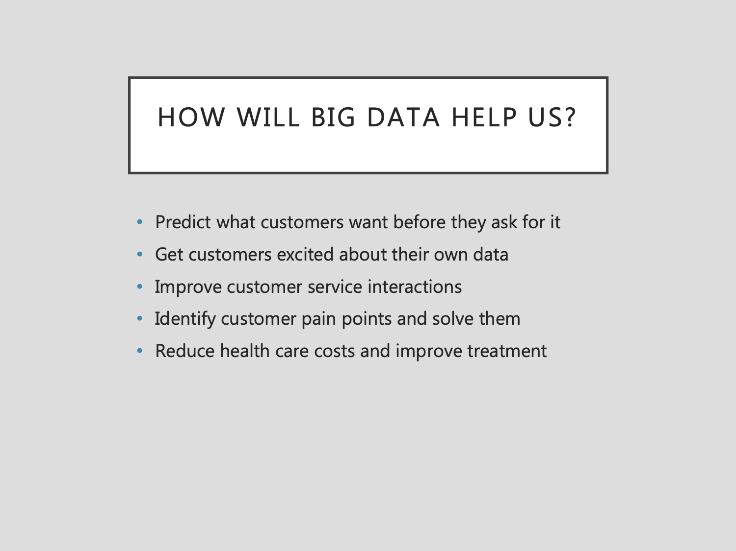
BIG DATA
Big Data, denotes storage and usage of vast amount of data .
Either structured or unstructured, on the cloud.
It includes capturing data, data storage, data analysis, search, transfer, visualization, updating, privacy and data source.

Slide 3
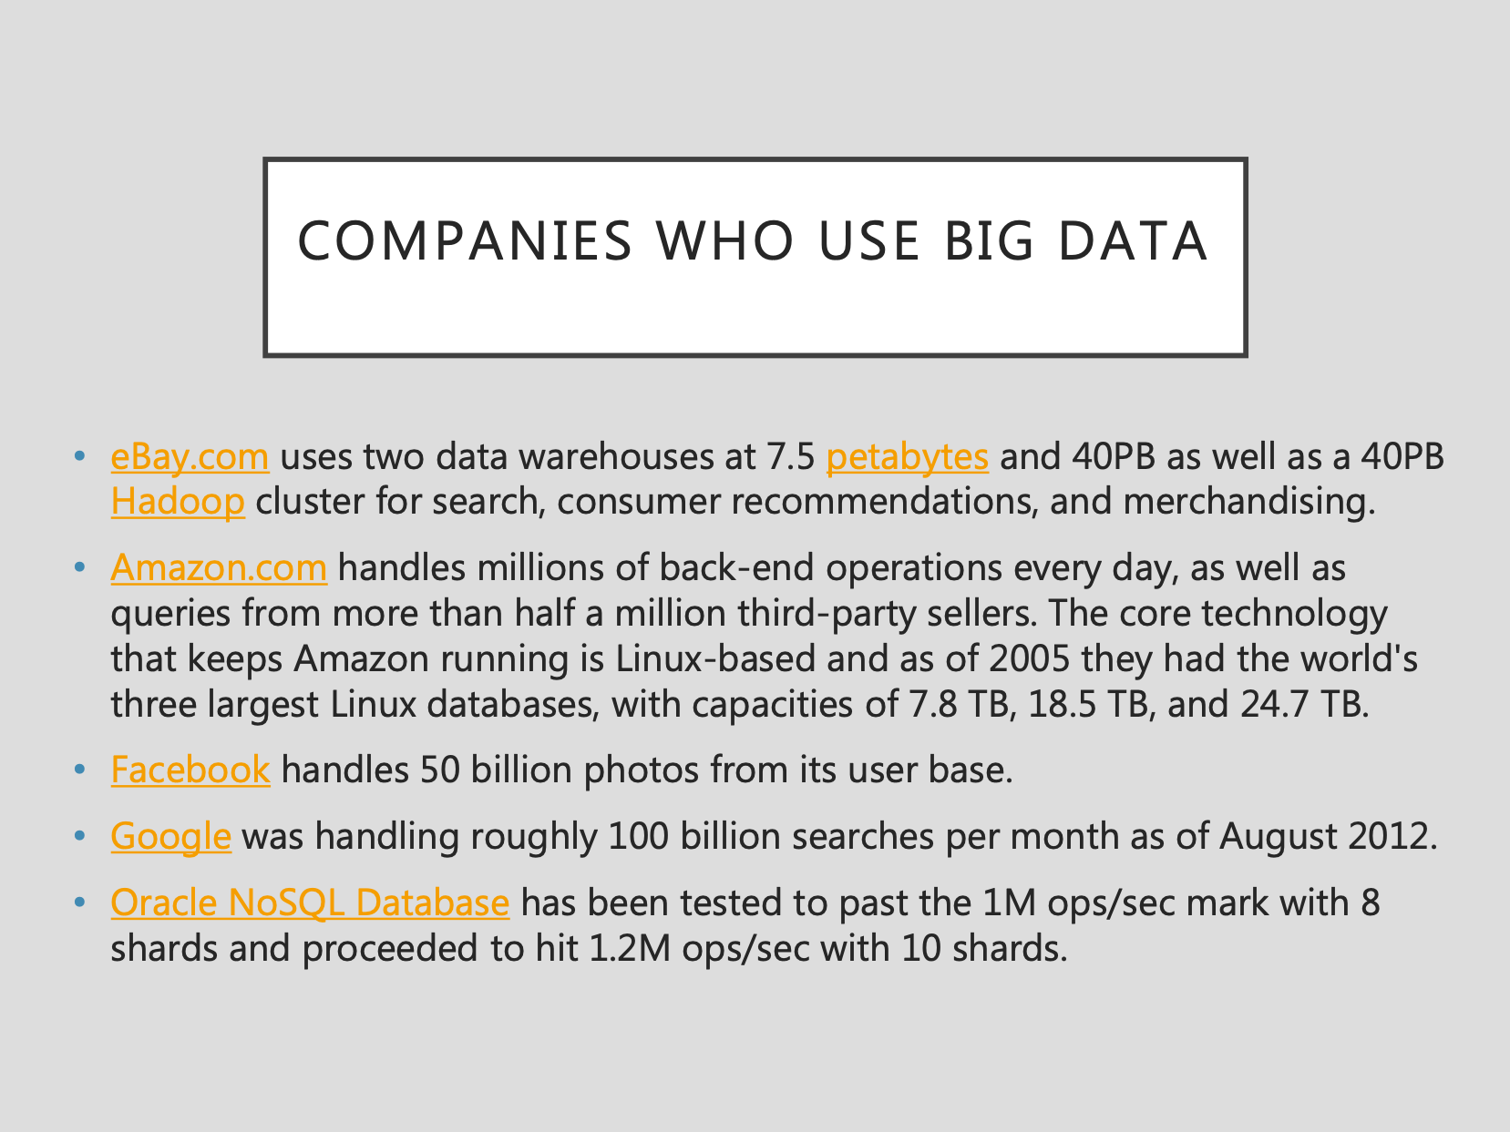

Slide 4
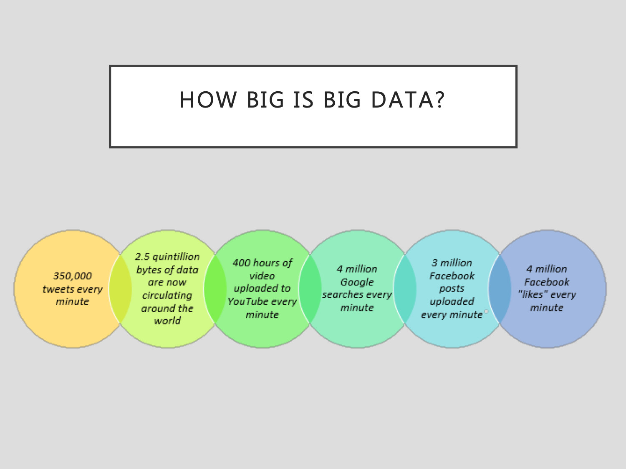

Slide 5
NATURAL LANGUAGE PROCESSING
Enables interaction between computers and humans through natural languages.
The branch of information science that deals with natural language information
Natural Language understanding – enabling computers to derive meaning from human input.
Natural Language Generation

Slide 6
NATURAL LANGUAGE PROCESSING
DEFINITION:
Natural language processing is theoretically motivated range of computational techniques for analyzing and presenting naturally occuring text or speech at one or more level of linguistic analysis for the purpose of achieving human like language processing for a range of tasks or applications.

Slide 7
NLP is everywhere
Google Translate
Google ads
Google search
Siri Question / Answering
Chatbots
Spam Generation / Spam Filtering
Gene and Protein Detection
Surveillance / Marketing

Slide 8
NLTK
•The Natural Language Toolkit, or more commonly NLTK, is a suite of libraries and programs for symbolic and statistical natural language processing(NLP) for English written in the Python.
•NLTK is intended to support research and teaching in NLP or closely related areas, including empirical linguistics ,cognitive science ,artificial intelligence , information retrieval, and machine learning
•NLTK has been used successfully as a teaching tool, as an individual study tool, and as a platform for prototyping and building research systems.

Slide 9
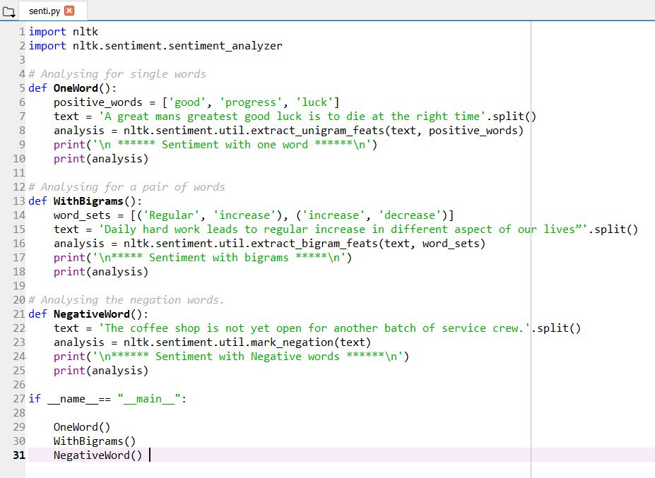

Slide 10
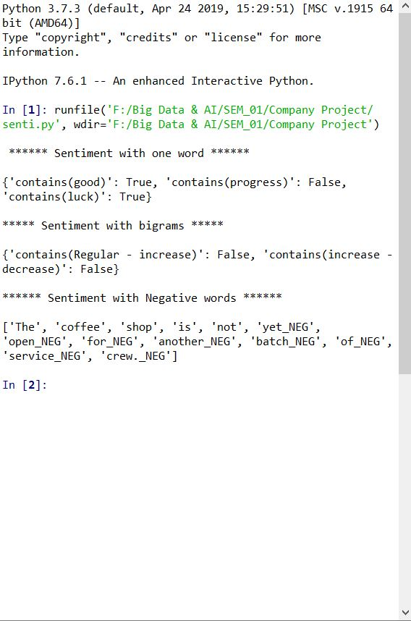

Slide 11

Sentiment Analysis
Its software for automatically extracting options,emotions and sentiments in text
It allows us to track attitudes and feelings on the web. People write blog posts, reviews, comments and tweets about all sorts on different topics.
We can track products , brands and people for example and determine whether they are viewed positively or negatively on the web.

Slide 12
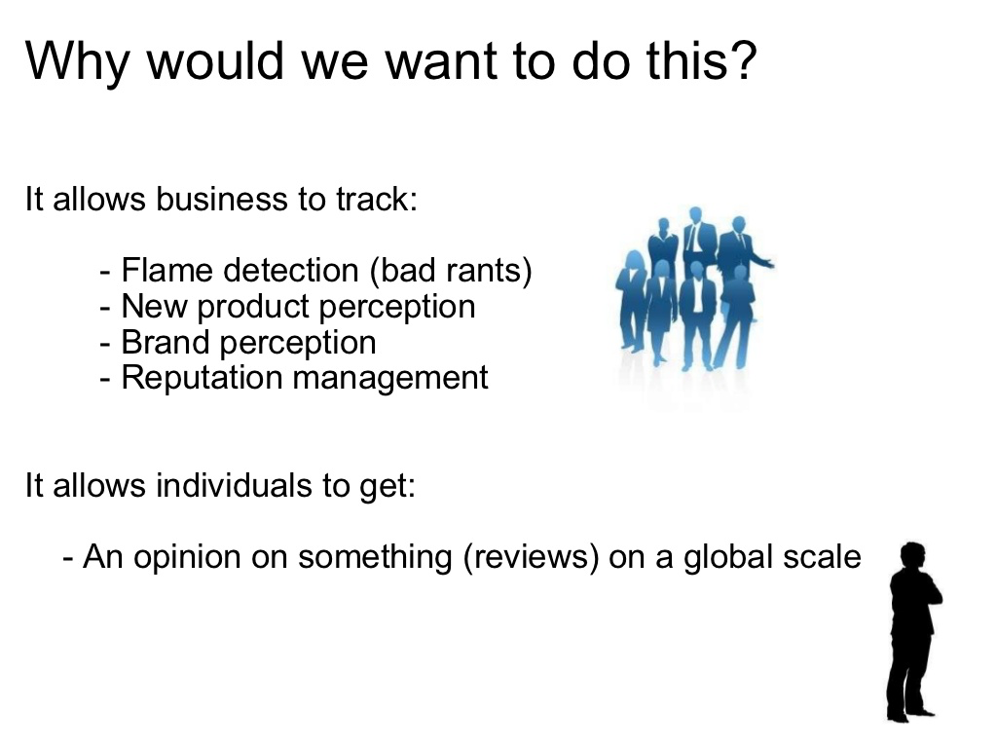

Slide 13
Why Twitter Data:
Has better approximation of public reviews compared to the conventional internet reviews or blogs.
Plays a role in predicting the stock market value of a firm.
Plays a role is determining the success rate of a product of a particular firm, also to know which areas of the market the product was a hit.
Predicting popularity of a political party.

Slide 14
Features used to Classify data:
Formal Language Based and Informal blogging.
Formal Language deals with formal linguistics, prior sentiment polarity, parts of speech the sentence is written.
Prior sentiment polarity: some words have tendency to express a particular and specific sentiment.
Example: “Excellent” - a strong positive word, “Evil” a strong negative word.
If a sentence has the word excellent, then chances are that the entire sentence has a positive sentiment.

Slide 15
Features used to Classify data:
Twitter data is more informal.
Because tweets relate to how people express their sentiments.
also, the sentiments are expressed n a limited 280 characters, that a tweet supports.
These 280 characters may contain hashtags, emoticons, word lengthening, URL’s, shorthand, word capitalization, etc.

Slide 16
Classification Techniques:
Supervised and Unsupervised Techniques.
Supervised: Data samples are pre-labeled that are used to train. The pre-labeled data samples are used to extract features, patterns, which are used to classify unlabeled data samples.
Unsupervised: There are no pre-labeled data samples.

Slide 17
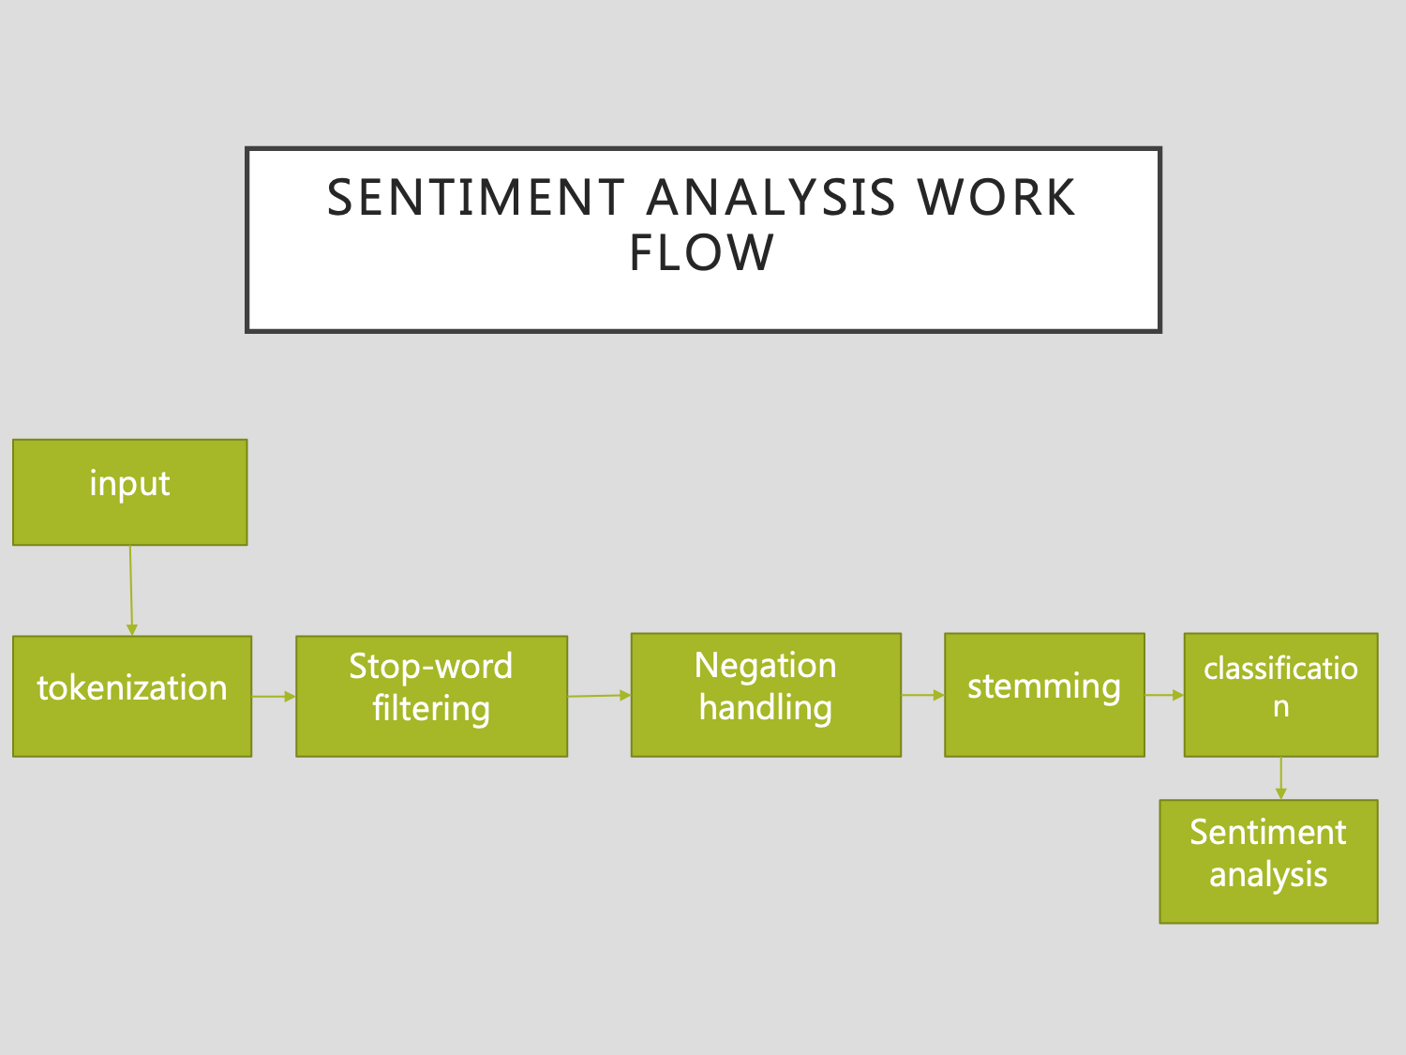

Slide 18
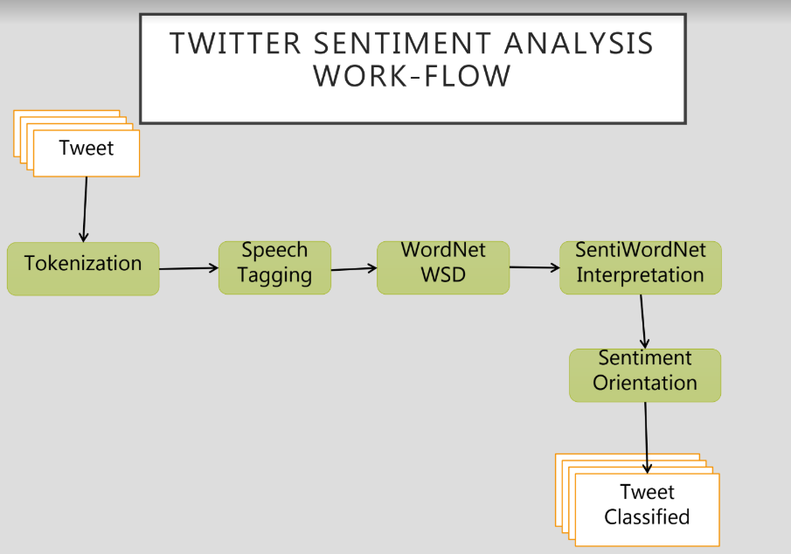

Slide 19
PREPROCESSING
Removing non english tweets
Remove URL, Target Mentions, Hashtags, Numbers
Replace seq of repeated characters eg: ‘cooool’ by ‘cool’
Remove Nouns and Prepositions

Slide 20
PREPROCESSING
CONVERT TEXT TO LOWERCASE
INPUT
input_str = ”The 5 biggest countries by population in 2017 are China, India, United States, Indonesia, and Brazil.”
input_str = input_str.lower()
print(input_str)
OUTPUT
the 5 biggest countries by population in 2017 are china, india, united states, indonesia, and brazil.

Slide 21
PREPROCESSING
REMOVE NUMBERS
INPUT
import re
input_str = ’Box A contains 3 red and 5 white balls, while Box B contains 4 red and 2 blue balls.’
result = re.sub(r’\d+’, ‘’, input_str)
print(result)
OUTPUT
Box A contains red and white balls, while Box B contains red and blue balls.

Slide 22
PREPROCESSING
REMOVE PUNCTUATIONS
INPUT
import string
input_str = “This &is [an] example? {of} string. with.? punctuation!!!!” # Sample string
result = input_str.translate(string.maketrans(“”,””), string.punctuation)
print(result)
OUTPUT
This is an example of string with punctuation

Slide 23
Tokenization:
The word tokenization is the process of splitting statement into words.
It is a concept of natural language processing which breaks statements into smaller chunks.
Analyzing, classifying and counting these word chunks, one can determine sentiments.
There is also a method, sent_tokenize which breaks down paragraphs into sentences.
TOKENIZATION can be achieved by nltk,textblob,spacy.

Slide 24
Tokenization:
from nltk.tokenize import word_tokenize
text = "God is Great! I won a lottery."
print(word_tokenize(text))
Output: ['God', 'is', 'Great', '!', 'I', 'won', 'a', 'lottery', '.']

Slide 25
Stop-Word Filtering:
To make the data machine understandable, it needs to be pre-processed, which includes removing of useless words, which are referred as Stop-Words.
Stop-word is a word that a search engine is programmed to ignore both when indexing entries for searching and resulting them in the search enquiry.
Examples: the, a, an, in, etc.,

Slide 26
Stop-Word Filtering:
input_str = “NLTK is a leading platform for building Python programs to work with human language data.”
stop_words = set(stopwords.words(‘english’))
from nltk.tokenize import word_tokenize
tokens = word_tokenize(input_str)
result = [i for i in tokens if not i in stop_words]
print (result)
OUTPUT :
[‘NLTK’, ‘leading’, ‘platform’, ‘building’, ‘Python’, ‘programs’, ‘work’, ‘human’, ‘language’, ‘data’, ‘.’]
sci-kit learn:
from sklearn.feature_extraction.stop_words import ENGLISH_STOP_WORDS
Spacy : from spacy.lang.en.stop_words import STOP_WORDS

Slide 27
Negation Handling:
The scope of negation may be limited only to the next word after a negation or may be extended up to other words following negation.
Example: The Climate is not good; Machine doesn’t function properly.
These examples show that the scope of negation is not fixed and varies based on different linguistics features such as conjunctions, punctuation marks and part of speech (POS) of negation etc.
Negation handling is an automatic way of determining the scope of negation and inverting the polarities of opinionated words that are actually affected by a negation. The portion of the sentence that negation affects is called the vicinity or scope of negation.

Slide 28
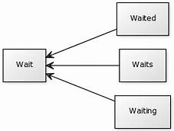
Stemming
A process of reducing a word to its word stem.
Is important in Natural Language Understanding and Natural Language Processing.
It actually means going back to the origin of the word.

Slide 29
Stemming
from nltk.stem import PorterStemmer
from nltk.tokenize import word_tokenize
stemmer= PorterStemmer()
input_str=”There are several types of stemming algorithms.”
input_str=word_tokenize(input_str)
for word in input_str:
print(stemmer.stem(word))
OUTPUT :
There are sever type of stem algorithm.

Slide 30
Speech Tagging
Automatic assignment of descriptors to the given tokens is called Tagging.
The descriptor is called tag. The tag may indicate one of the parts-of-speech, semantic information, and so on. So tagging a kind of classification.
Parts of speech tagging simply refers to assigning parts of speech to individual words in a sentence, which means that, unlike phrase matching, which is performed at the sentence or multi-word level, parts of speech tagging is performed at the token level.

Slide 31
Speech Tagging
input_str=”Parts of speech examples: an article, to write, interesting, easily, and, of”
from textblob import TextBlob
result = TextBlob(input_str)
print(result.tags)
OUTPUT:
[(‘Parts’, u’NNS’), (‘of’, u’IN’), (‘speech’, u’NN’), (‘examples’, u’NNS’), (‘an’, u’DT’), (‘article’, u’NN’), (‘to’, u’TO’), (‘write’, u’VB’), (‘interesting’, u’VBG’), (‘easily’, u’RB’), (‘and’, u’CC’), (‘of’, u’IN’)]

Slide 32
Tools:
Apache Nutch : Web Crawler
Elastic Search Database : Speeding up the process
Apache Hadoop: Map Reduce algorithm for stream processing
Apache Spark: Big Data processing ,SQL, ML and Graph processing
Apache Cassandra : Scalability and high availability without compromising performance

Slide 33
WORDNET:
Is a dictionary-like database of English which has all the words and their synonyms.

Slide 34
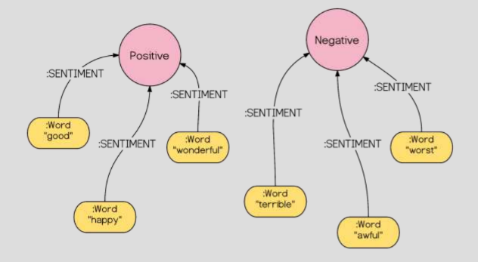
SENTIWORDNET:
Is an extended version of wordnet which has the sentiment of each word written.

Slide 35
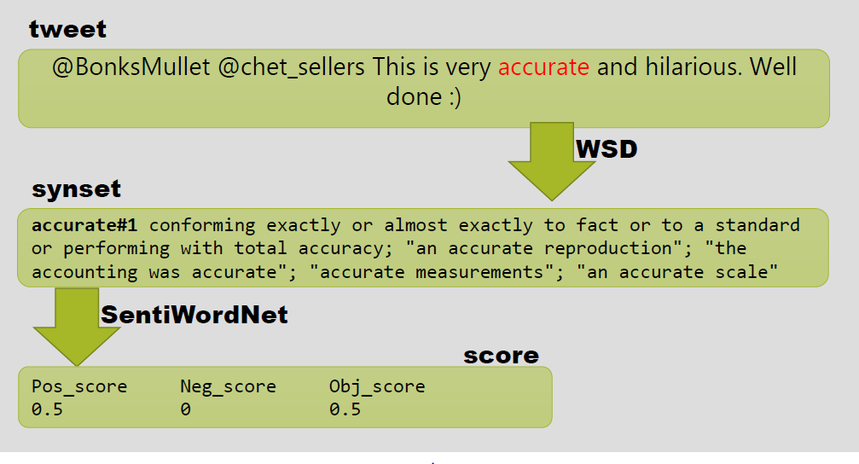
EXAMPLE OF TWITTER SENTIMENT ANALYSIS

Slide 36
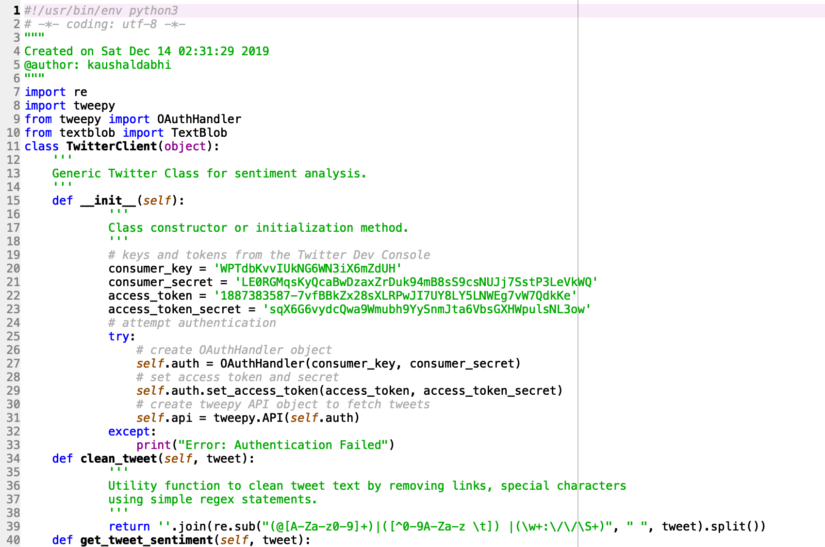

Slide 37
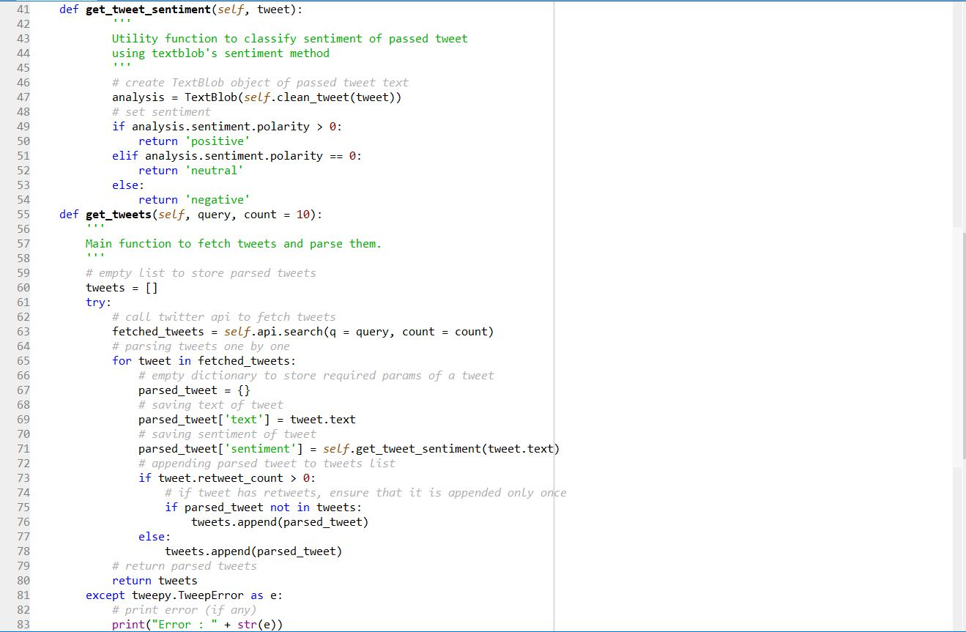

Slide 38
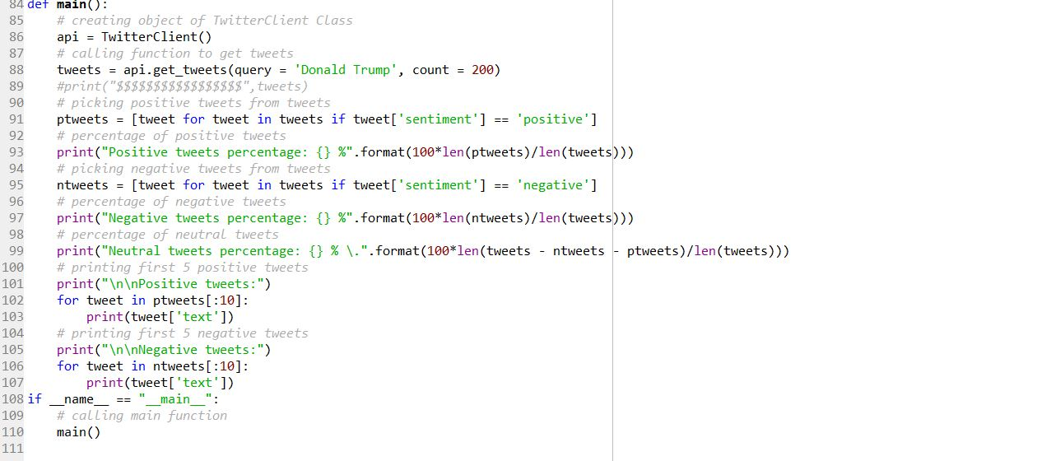

Slide 39
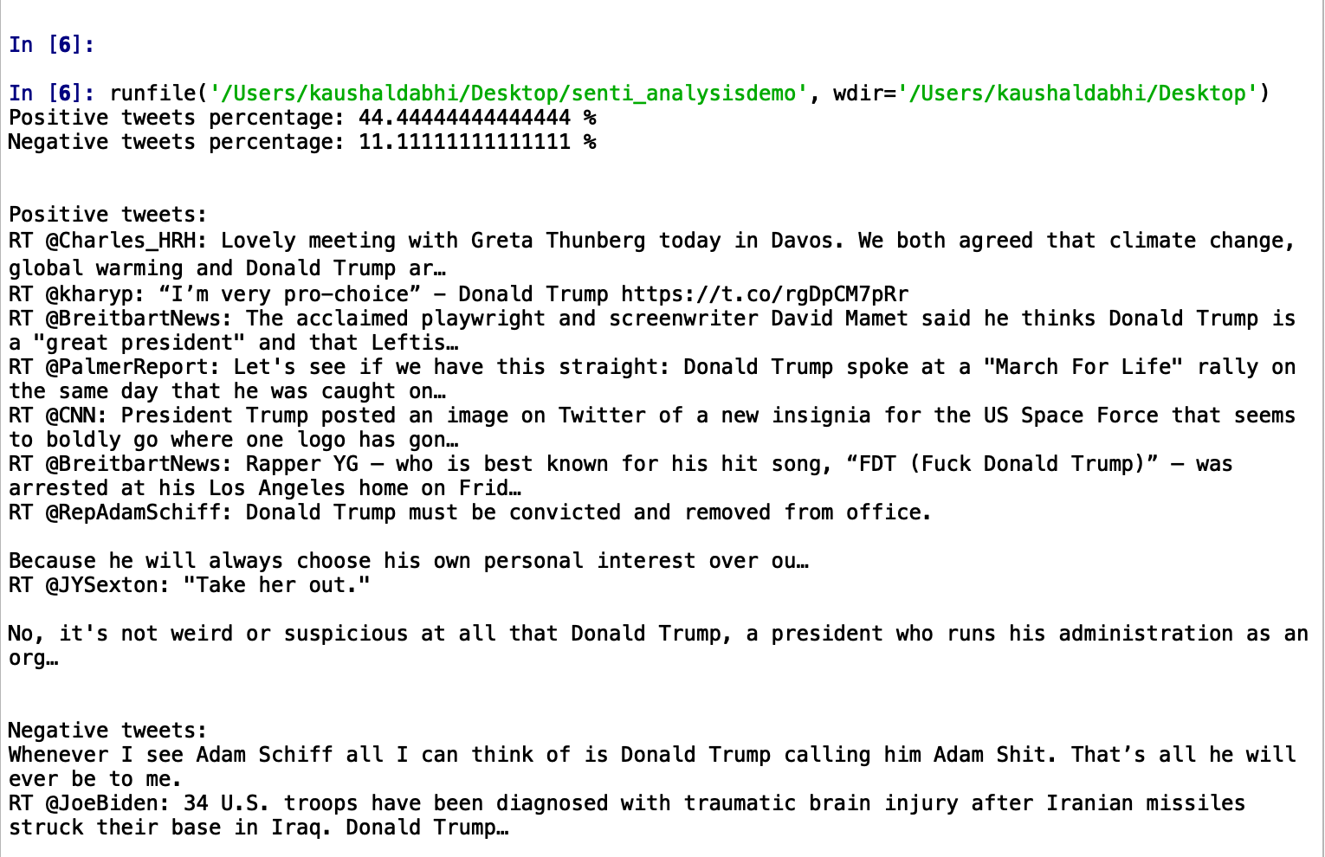

Slide 40
References
https://www.geeksforgeeks.org/twitter-sentiment-analysis-using-python/
https://towardsdatascience.com/sentiment-analysis-on-swachh-bharat-using-twitter-216369cfa534
https://www.tandfonline.com/doi/full/10.1080/23311916.2018.1534519
http://www2.imm.dtu.dk/pubdb/views/publication_det ails.php?id=6010
http://www.academia.edu/1336655/Reviews_Classificat ion_Using_SentiWordNet_Lexicon
http://www.jeremyellman.com/jeremy_unn/pdfs/1_____ Chalothorn_Ellman_SKIMA_2012.pdf
http://www.aaai.org/ocs/index.php/ICWSM/ICWSM10/ paper/viewFile/1536/1842
https://arxiv.org/ftp/arxiv/papers/1509/1509.04219.pdf
https://www.tutorialspoint.com/python_text_processing/python_sentiment_analysis.htm

