Slide 1
React JS
Submitted To- Submitted By-
Dr. Lalit Purohit Kaushal Patel IT-38
Kishan Tapadia IT-41
Muskan Gupta IT-53

Slide 2

What is React?
React is a JavaScript framework. React was created to serve large-scale user interfaces like Facebook and Instagram scale interfaces React is a JavaScript-based UI development library. React was created by Jordan Walke, a software engineer at Meta in year 2011. Although React is a library rather than a language, it is widely used in web development. The library first appeared in May 2013 and is now one of the most commonly used frontend libraries for web development.

Slide 3
It employs Webpack to automatically compile React, JSX, and ES6 code while handling CSS file prefixes. Following are the features that make react a preference over other frontend frameworks:
1)Easy creation of dynamic applications: React makes it easier to create dynamic web applications because it requires less coding and offers more functionality
2)Improved performance: React uses Virtual DOM, thereby creating web applications faster. Virtual DOM compares the components’ previous states and updates only the items in the Real DOM that were changed, instead of updating all of the components again, as conventional web applications do.

Slide 4
3)Reusable components: Components are the building blocks of any React application, and a single app usually consists of multiple components. These components have their logic and controls, and they can be reused throughout the application, which in turn dramatically reduces the application’s development time.
4)Unidirectional data flow: React follows a unidirectional data flow. This means that when designing a React app, developers often nest child components within parent components. Since the data flows in a single direction, it becomes easier to debug errors and know where a problem occurs in an application at the moment

Slide 5
Prerequisites for learning React.js
1. Knowledge of HTML & CSS
2. Knowledge of JavaScript and ES6 standards
3. Some knowledge about the DOM
4.Some knowledge about Node & npm (and installation)

Slide 6
Installation steps of React
In windows:
Install Node.js and npm:
Download and install Node.js from nodejs.org.
Follow the installation instructions and ensure that the "npm package manager" option is selected during installation.
Open Command Prompt or PowerShell:
Open the Command Prompt or PowerShell on your Windows machine. Run the following command to install the create-react-app globally using npm and Install create-react-app

Slide 7
In Mac:
Install Node.js and npm:
Download and install Node.js from nodejs.org.
Follow the installation instructions and ensure that the "npm package manager" option is selected during installation.
Open Terminal: Run the following command to install the create-react-app globally using npm- npm install -g create-react-app

Slide 8
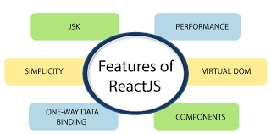
5)It can be used for the development of both web and mobile apps: We already know that React is used for the development of web applications, but that’s not all it can do. There is a framework called React Native, derived from React itself, that is used for creating beautiful mobile applications.

Slide 9
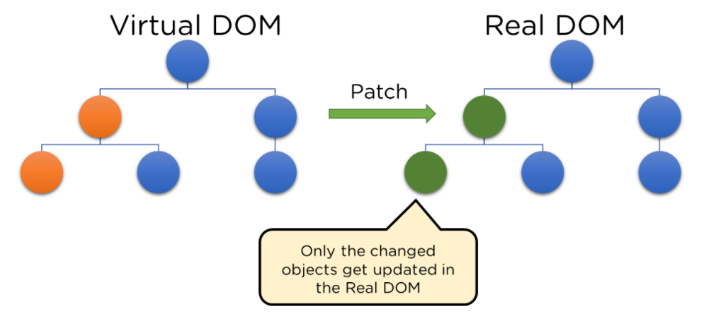
Vdom- Virtual Document Object Model
The Virtual DOM is React's lightweight version of the Real DOM. Real DOM manipulation is substantially slower than virtual DOM manipulation.

Slide 10
DOM (Document Object Model) is a programming interface for web documents and represents the structure of a document as a tree of objects.DoM treats an XML or HTML document as a tree structure in which each node is an object representing a part of the document.
The Virtual DOM is a concept used by React to improve the performance of updating the user interface. Instead of directly manipulating the actual browser DOM every time there is a change in the application state, React uses a virtual representation of the DOM in memory.When an object's state changes, Virtual DOM updates only that object in the real DOM rather than all of them.

Slide 11
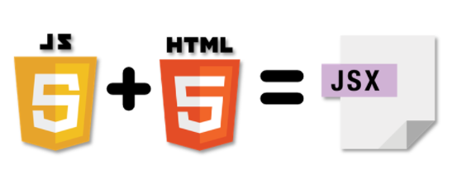
JSX- JavaScript XML
JSX (JavaScript XML) is a syntax extension for JavaScript that looks similar to XML or HTML. It's a syntax used in React to describe what the UI should look like. JSX allows you to write HTML elements and components in a syntax that looks similar to XML or HTML, but it gets transpiled into JavaScript code that React can understand. It is neither a string nor HTML. Instead, it embeds HTML into JavaScript code.

Slide 12
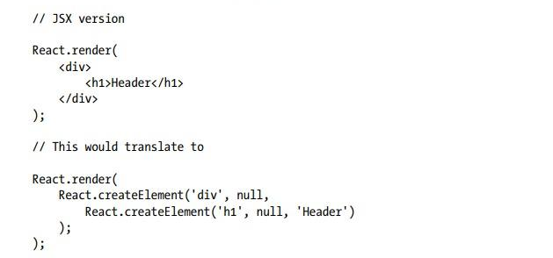

Slide 13
Framework vs Library
Provides ready to use tools, standards, templates, and policies for fast application development
The framework controls calling of libraries for our code
To leverage the benefit of a framework, a fresh application can be developed following the framework's guideline
Easy to create and deploy an application
Helps us to develop a software application quickly
Intent of a framework is to reduce the complexity of the software development process
Provides reusable function for our code
Our code controls when and where to call a library
Library can be added to augment the features of an existing application
Facilitates program binding
Helps us to reuse a software function
Intent of a library is to provide reusable software functionality

Slide 14
cdfvdfsd
ECMAScript 6 (ES6)
ECMAScript 6 (ES6) is a version of the ECMAScript standard, which is the scripting language specification that JavaScript is based on. ES6 introduced several new features and improvements to JavaScript, and these features are commonly used in React.js development.

Slide 15
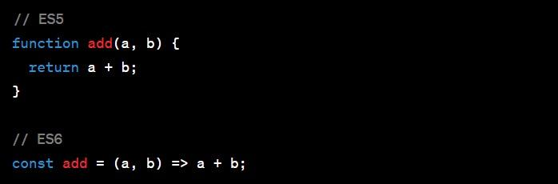
Features of ES6 are:
1.Arrow functions are concise and lexically scoped, making them a popular choice for defining functions in React components.

Slide 16
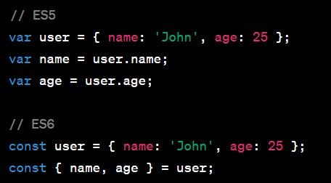
Features of ES6 are:
2.Destructuring assignment simplifies the process of extracting values from objects and arrays.

Slide 17
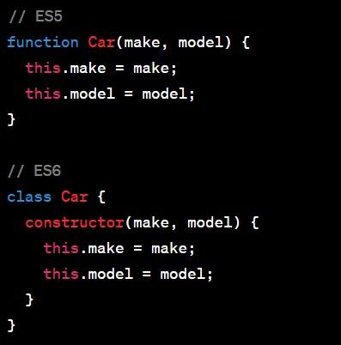
Features of ES6 are:
3.Constructor Functions can be created, making it more intuitive for developers familiar with object-oriented programming.

Slide 18
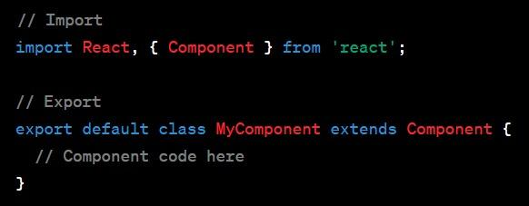
Features of ES6 are:
4.ES6 allows developers to Import and Export modules easily.

Slide 19
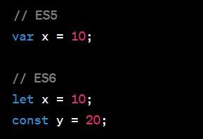
Features of ES6 are:
5.ES6 introduced a more controlled way of Declaring variables and constants.

Slide 20
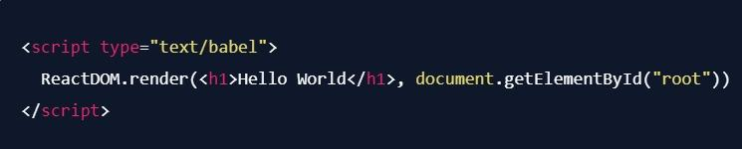
ReactDOM.Render
ReactDOM.render() is a React method to render a React app to the web page.
ReactDOM.render() takes at least 2 parameters:
1.element (what we want to render)
2.container (where we want to render)

Slide 21
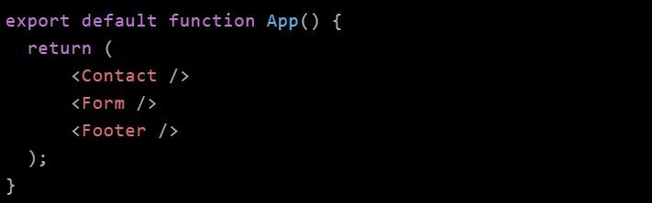
Multiple Elements Rendering
Here below, we are trying to render multiple components.
Problem is that they are not wrapped in one container, so React is going to throw an error.
render() function must return only one React element.

Slide 22
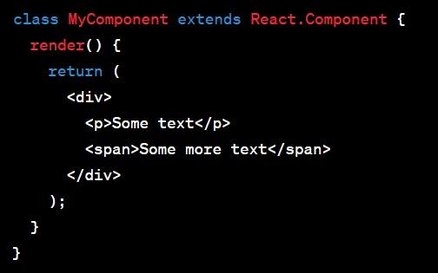
Div Method:
The easy solution to above problem is to wrap all these components with one <div> element.In JSX, when you have multiple adjacent elements, you need to wrap them in a parent element (commonly a <div>), like below:
But using div like this, however, can introduce unnecessary divs to the DOM, especially when you don't need an extra wrapping element. React Fragments help you avoid this.

Slide 23
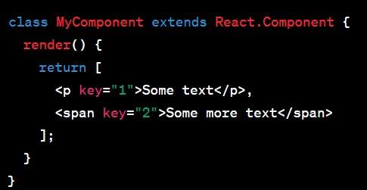
Array Method:
A possible solution can be using an array here using square brackets which can be seen below but it is also not the best one.

Slide 24
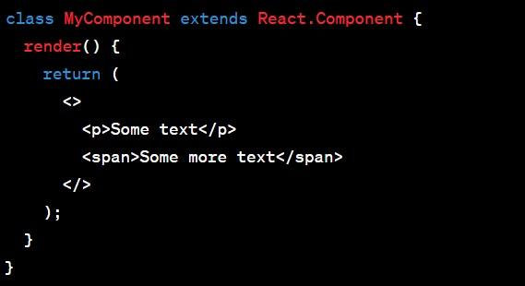
React Fragments
In React, a fragment is a lightweight syntax to group multiple elements concisely without introducing an additional DOM node.It is better than 1.Array Method which requires more keys.
2.Div method which introduces an extra DOM node.

Slide 25
React Components
Components are independent and reusable bits of code. They serve the same purpose as JavaScript functions, but work in isolation and return HTML.
React components can be broadly classified into two main types: Each type has its own syntax and use cases.
1.Functional Components
2.Class Components

Slide 26
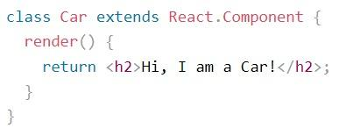
Class Component
A class component is a stateful component which must extend React.Component statement. This statement creates an inheritance to React.Component, and gives your component access to React.Component's functions like updating and mounting.
The component also requires a render() method which returns HTML.

Slide 27

Functional Component
Functional component is a stateless component or a presentational component. It is defined as a JavaScript function that take props (short for properties) as an argument and return React elements.They are preferred for simple UI elements.

Slide 28
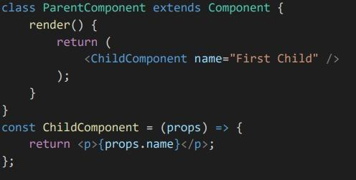
Props In React.js
Props (short for properties) are a fundamental concept in React.js. They allow you to pass data from a parent component to a child component.In React, components can receive data through props as function parameters, and this mechanism facilitates the communication of information throughout the component tree.

Slide 29
Prop Drilling
Prop drilling refers to the situation where you pass props down through multiple layers of components, even if some of the intermediate components don't directly use those props. It can occur in a deeply nested component hierarchy when data needs to be transmitted from a top-level parent to a deeply nested child component.
In the above example, the Grandparent Component passes data to Parent Component, and ParentComponent passes the same data to Child Component, even though ParentComponent itself might not directly use that data. This is prop drilling.
Prop Drilling makes code less maintainable.

Slide 30
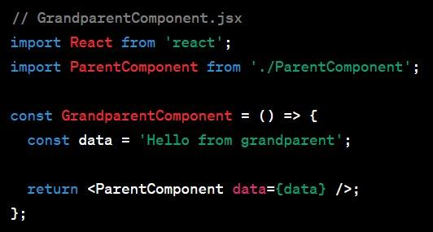
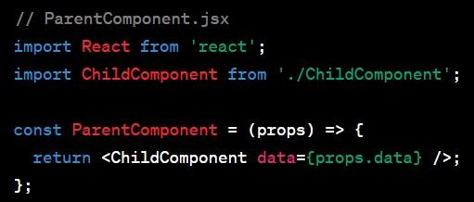
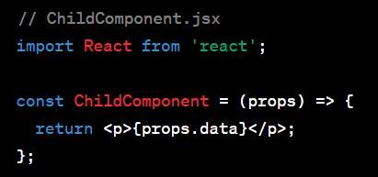

Slide 31
React Hooks
React Hooks are functions that allow functional components to manage state, lifecycle methods.Hooks don’t work inside classes ,they let you you use react without classes.
Hooks are JS functions,they have two rules:
1.Only call Hooks at the top level.Don’t try to call them inside nested functions,loops or conditions.
2.Only call Hooks from react function components.Don’t try to call them from regular JS functions.
Examples of some built-in hooks are:
1.useState()
2.useEffect()
3.useContext()

Slide 32
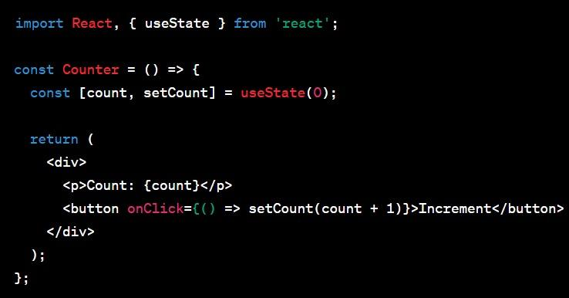
useState() Hook:
It allows functional components to manage state. It returns an array with two elements: the current state value and a function that lets you update it.
const[someState,updateState]=useState(initialState)

Slide 33
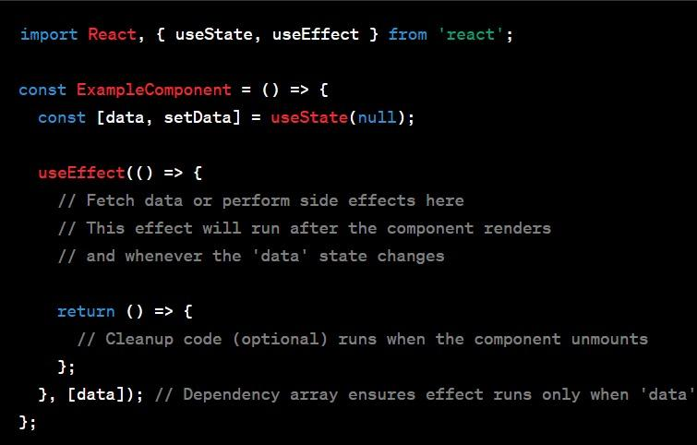
useEffect() Hook:
useEffect is used for handling side effects in functional components. It is similar to componentDidMount and componentDidUpdate lifecycle methods in class components.

Slide 34
useContext() Hook:
The useContext hook in React is a hook that allows functional components to consume values from a React context. It is used to access the current value of a context directly, without the need for a Context.Consumer wrapper.
useContext simplifies context consumption,avoids prop drilling and simplifies way of handling dynamic updates.
Here in the below example,useContext is used inside ChildComponent to access the value from MyContext .It returns the current context value, and any updates to the context will trigger a re-render of the component.

Slide 35
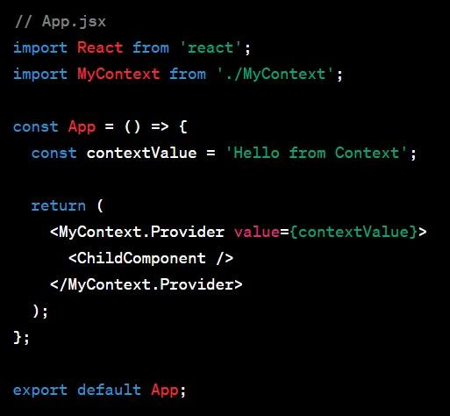
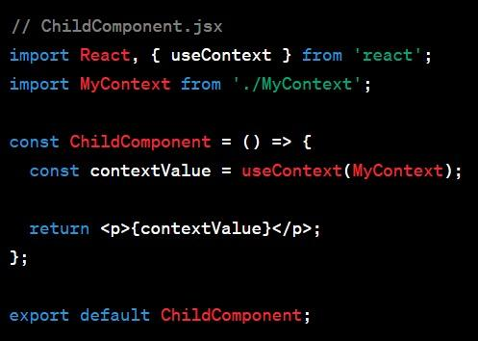
useContext will read the value provided in App.jsx and use it in ChildComponent.jsx

Slide 36
1.Fetch API:The Fetch API is a native JavaScript API for making HTTP requests. It is built into modern browsers and provides a simple and clean interface for making network requests.You don't need to add Fetch in our project, it's already built into your browser.Fetch does not have built-in support for interceptors, but you can achieve similar functionality with middleware.
JS libraries for making HTTP Requests
2.Axios Library:Axios is like a helper friend for your web application that helps you talk to other websites or services on the internet.Axios is a third-party library for making HTTP requests. It is known for its simplicity, ease of use, and additional features such as request and response interceptors,it’s not inbuilt we have to add it to use in our project.Axios has broader browser compatibility, including support for older browsers.

Slide 37
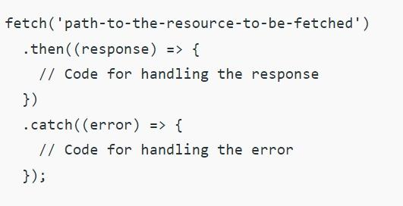
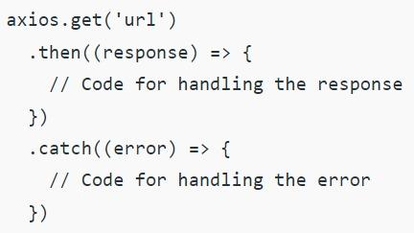
As you can see below,Fetch has no url in request object while it is needed in axios to have a request object.

Slide 38
React Redux
Redux is a predictable state container for JavaScript applications, and it is commonly used with React.js to manage the state of applications in a more organized and scalable way
Redux Key Concepts:
1.Store:The Redux store is a single, centralized place that holds the entire state of the application.
2.Actions:Actions are plain JavaScript objects that describe the intention to change the state.
3.Reducers:Reducers are functions that specify how the state changes in response to actions.
4.Dispatch:The dispatch function is used to send actions to the Redux store.

Slide 39
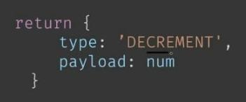
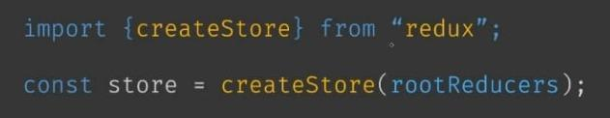
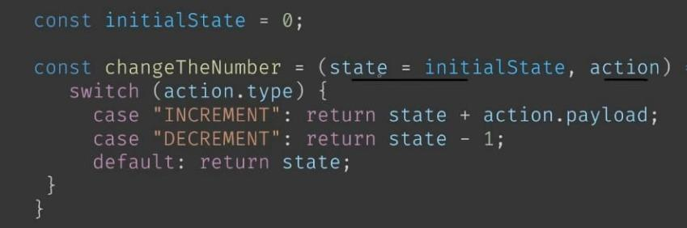
Action
Store
Reducer

