Slide 1
Applied Architectural Technology 2
TIA 1800
Introduction to Estimating and Costing
Dr Kaushal Keraminiyage
PhD, PgCert, FHEA
Queen’s Street Studios
University of Huddersfield

Slide 2
This Week….
Client’s priorities
The design and construction process
Forecasting costs
Cost planning

Slide 3
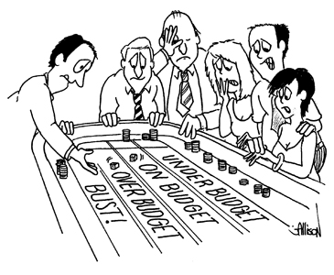
http://costplanner.com.au/wp-content/uploads/2011/11/home-cartoon.jpg

Slide 4
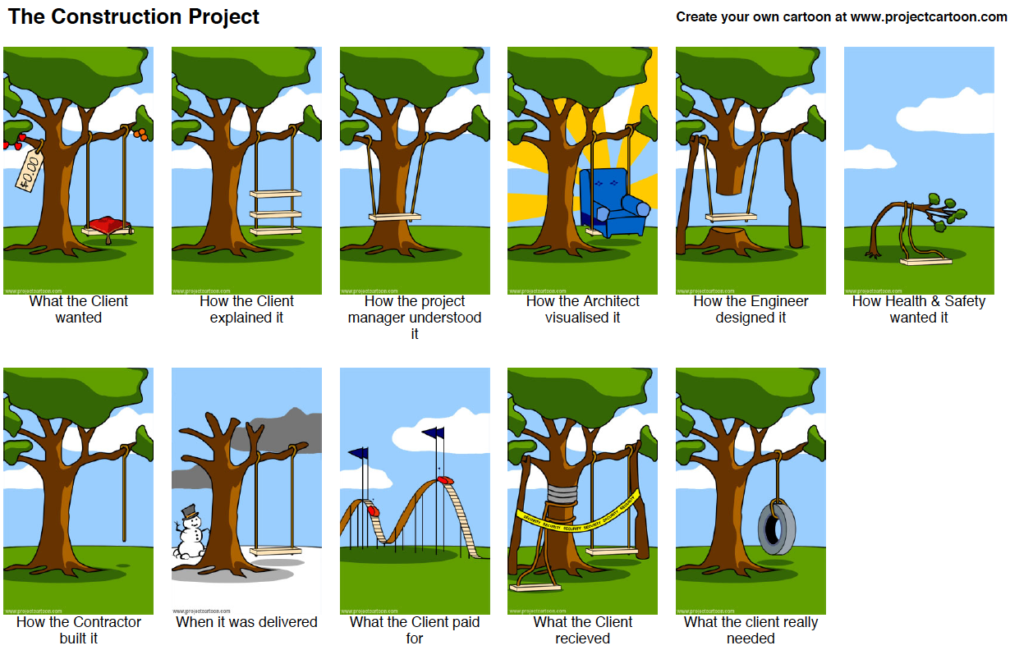
Client’s priorities

Slide 5
The design and construction process : importance of cost management
Different procurement systems
Separated systems
Integrated systems
Construction process management
RIBA plan of work
OGC gateway
Process protocol

Slide 6
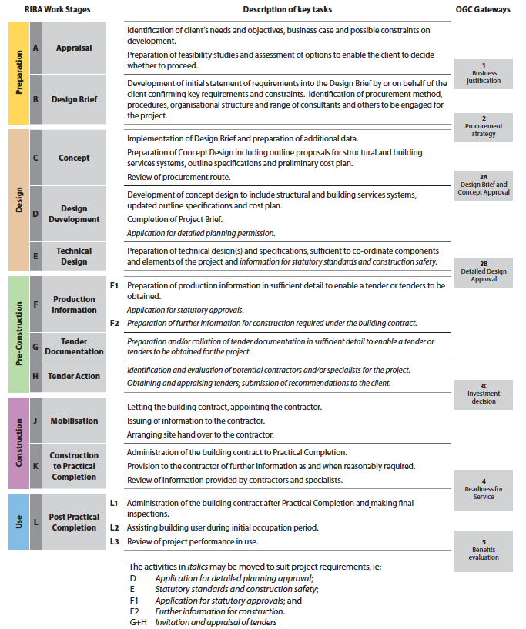
RIBA plan of work in detail
(RIBA, 2007)

Slide 7
Cost management
Cost of construction needs to be managed properly both within the design phase and the construction phase.
“Cost management” is a function of “cost planning” and “cost controlling” processes
Like in many management systems, what is measured will get managed
Cost planning is generally the process of establishing cost targets
Cost controlling is the process of controlling the project costs within the established target costs
Cost analysis is a record of how cost has been distributed over the elements of the building (prepared after receiving the tender information)

Slide 8
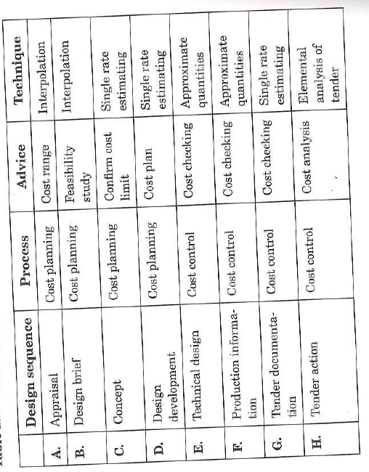
Pre contract cost management
(Cartlidge, 2009)

Slide 9
Cost Planning
Came to prominence during 70’s as a result of the demand for a rigorous and accurate pre-contract costing process
Introduced in 1972, Building Bulletin (4), Department of Education and Science
Often follow the standard list of elements developed by BCIS (currently in transition to NRM)

Slide 10
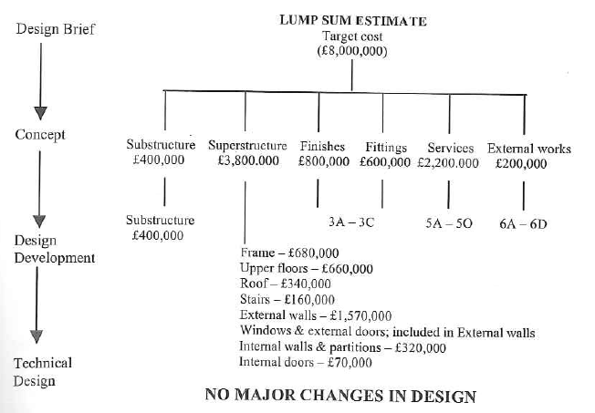
Cost Planning
(Cartlidge, 2009)

Slide 11
Cost Significant Elements
BICS standard list – 7 groups of elements and 34 individual elements
Some elements are cost significant elements (e.g. External walls – about 12-20%, Services 15-30%)
More attention to be given to cost significant elements
Do a cross check with cost analysis of similar buildings to check if cost target for each element is in acceptable range.
(Cartlidge, 2009)

Slide 12
Methods of Preliminary Estimating
Unit Method
Approximate Quantities
Storey Enclosure Unit Method
Elemental Estimating
Superficial Area Method
Parametric Cost Analysis

Slide 13
Unit Method
Used at very early stages of design
Can be used when purpose or function of building is known
No drawings or specifications
Use published information or experience
Cost per Unit
Cost per car -Car Parks
Cost per bed -Hospitals
Cost per students -Schools

Slide 14
Unit Method -Advantages & Disadvantages
Very quick and mathematical process is very simple
Easy to understand and remember
Useful method for estimating the initial cost limit or budget
A cost yardstick which can be used by an architect
Difficult to adjust costs for such factors as shape, size, constructional methods, material, finishing etc.

Slide 15
Superficial Area Method
Cost per m²
Measured to internal face of external walls
Measured over stair wells, internal partitions, columns and the like
Special items should be excluded & added to overall cost calculated

Slide 16
Advantages
Rapid
Directly related to accommodation
Allows comparison of different designs
Easy to understand and remember
Allows comparison between buildings that differ in size and shape
A cost yardstick - can be used by an architect

Slide 17
Approximate Quantities
Uses composite items
Composite rates are achieved by combining similar items of an element
Fairly detailed
Depending on the type of building, purpose of estimate, degree of accuracy required level of detail in measurement varies
More accurate but require more details
Require greater levels of calculation
Requires special estimating paper

Slide 18
Elemental Estimating
Estimate based on a previous elemental analysis of costs
Estimate derived from modifying and updating the costs of the analysis
Adjustments are for variations in Quantity, Quality and Price
Key method of estimating for CP
Estimate forms the basis for a Cost Plan
Requires much time

Slide 19
Next Week…
More on various estimation techniques

