Slide 1
HEALTH ASSISTOR
KAUSHAL ATTALURI
GOVIND CHANDAK

Slide 2
TABLE OF CONTENTS
01
02
03
INTRODUCTION
FLOW CHARTS AND USERCASE DIAGARAMS
THANK YOU

Slide 3
INTRODUCTION
INTRODUCTION
“ Health assistor “ as the name suggests is your health assistance which helps you achieve your fitness goals. we have used authenticate data from verified sources. this application will allow you to reach your daily goals and have a healthy lifestyle.

Slide 4
ACTOR WISE USER CASES:
USER:
REGISTER
LOGIN
CHOOSES THE PROBLEM
CHECKS THE SOLUTION
WORKS ON THE SOLUTION
FACILITIES:
FACILITES FROM THE BEST SOURCES
DIRECT HEALTH CARE FROM THE BEST DOCTORS.

Slide 5
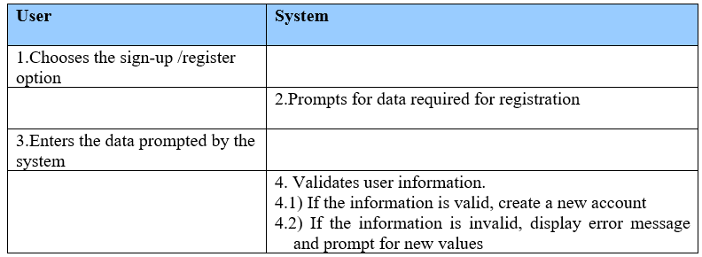
USER CASE DIAGARAM 1
Use Case ID: UC01
Name: Register
Actors: User
Description: Allows new user to register for an account
Pre-conditions: None
Post-conditions: An account is created for the user
Main Flow

Slide 6
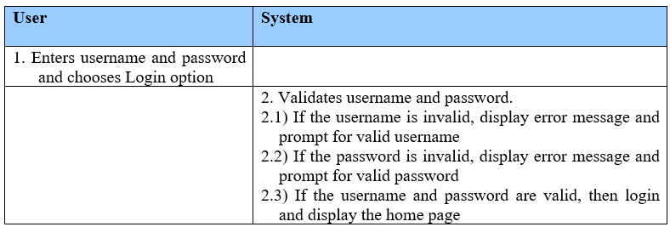
USER CASE DIAGARAM 2
Use Case ID: UC02
Name: Login
Actors: User
Description: Allows registered users to Login
Pre-conditions: user should be registered with the system
Post-conditions: User logs in and all the options are displayed on the screen
Main Flow

Slide 7
USER CASE DIAGARAM 3
Use Case ID: UC03
Name: Showing problems
Actors: User
Description: Allows registered users to choose their problem
Pre-conditions: user should be registered with the program.
Post-conditions: User gets infromation on this problem directly from world’s best medical references.
USER | SYSTEM
1) Chooses the problem
 | 2) Validates the problems chosen by the user and goes to the next command and then displays the solution for the problem.

Slide 8
USER CASE DIAGARAM 4
Use Case ID: UC04
Name: File
Actors: User
Description: Shows the solution.
Pre-conditions: user should be logged in and chose the problem
Post-conditions: The user can also directly contact with the best doctors in town if he wants to. and
USER | SYSTEM
1)Sees the solution
 | 2) Gives the daily goal and plan as chosen by the user and this plan is stored in a file.

Slide 9

USER CASE REFERENCE:
SIGNING UP FOR NEW USER
PROGRAM IS COMPILED
CHOOSING THE PROBLEM
SHOWING REGISTER AND LOGIN
CHOOSING APPROPRIATE PLAN FOR YOU
SHOWING HUNDEREDS OF MEDICAL PROBLEMS FOR THE USER TO CHOOSE
GETTING THE INFO FROM THE MEDICAL REFERENCES
CONNECTING WITH THE WORLD’S BEST MEDICAL REFERENCES
USER
SYSTEM
FOLLOWING THE PLAN AND INFO
ALSO CONNECTING WITH THE BEST DOCTORS NEAR YOU
GETTING THE RESULTS AND STAYING HEALTHY
EXIT.

Slide 10


USER DIAGARAM
CHOOSING THE PROBLEM
GET SOLUTION FROM BEST WEBSITES AND DOCTORS IN NO TIME
REGISTER
LOGIN
GENERAL USER
LOGGED IN USER
PROBLEM CHOOSEN
HEALTHY USER.

Slide 11
FLOW CHART on SOCKET.
socket
setsockopt
connect
Blind
Send/recv
Accept

Slide 12
FLOW CHART
Register
Problem
User
Login
PLAN AND INFO
Save

Slide 13
THANKS STAY HEALTHY!

