Slide 1
Scalable Performance Tuning of Hadoop MapReduce: A Noisy Gradient Approach
Sandeep Kumar, Sindhu Padakandla, Chandrashekar L, Priyank Parihar, Gopinath K and Shalabh Bhatnagar
Presented By: Sandeep Kumar
Department of Computer Science and Automation
Indian Institute of Science
Bangalore, India

Slide 2




Big Data Processing
Source: https://upload.wikimedia.org/wikipedia/commons/thumb/1/1d/AmazonWebservices_Logo.svg/2000px-AmazonWebservices_Logo.svg.png
Humongous amount of Data is being generated everyday.
These data can provide crucial insights in there domain.
For example, it helps decision making process in industry, predicting disaster and epidemic control so that necessary measure can be taken.
Tools like, Hadoop, Spark, Presto etc. is used to process this huge amount of data.
Most of these times these tools is deployed on a cloud service like AWS (Amazon web services), Microsoft’s Azure, Google Cloud Platform etc.
These tools can be configured according to cluster configuration and workload to get the optimal configuration.
We focus on automatic configuration of Hadoop given a particular workload.
Source: https://www.seeklogo.net/wp-content/uploads/2015/08/microsoft-azure-logo.png
Source: https://gigaom.com/wp-content/uploads/sites/1/2014/01/gcplogo.jpg
Source: https://upload.wikimedia.org/wikipedia/commons/thumb/0/0e/Hadoop_logo.svg/2000px-Hadoop_logo.svg.png
Notes:
We are living in an era where huge amount of data is being generated every day. Be it from social media, medical domain or environment domain. These data can be used to predict a lot of things including epidemic outbreaks, potential disaster like flood or earthquakes. However, because of there size processing these data is not simple. Many tools are present today which helps in processing these data. Such as, Hadoop, Spark Presto etc. These all are distributed tools which means they use a lot of machines to process the data. Most of the times these tools are deployed on cloud services like AWS, Azure, Google Cloud computing etc. These workloads are very complex and along with cluster setting configuring them is not an easy task. We focus on automating this configuration part of the job. We use Hadoop for our experiments but theoretically it can be deployed to any framework with charactertics.

Slide 3
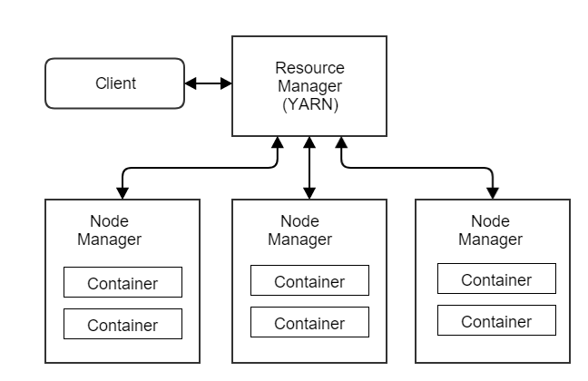
Hadoop brief overview
One of the node act as a Master and handles the communication
Hadoop is an open-source implementation of MapReduce.
Commodity hardware.
<Key, Value> pair
It uses <Key, Value> pair for its operation and is ideal for processing of Humongous amount of data.
Resistant to node failures.
Tasks are just restarted on different node if it fails.
Speculative execution starts multiple copies of tasks (id resource allows) and use the result of the task which finishes first.
HDFS
Hadoop Architecture
Worker nodes where the processing is done and the data is stored.
Notes:
Just a brief overview of Hadoop. Hadoop is a distributed framework which employs a master slave kind of design. One of the node in the cluster act as the master and most of the communication of the client goes through this master node. Rest of the node is responsible for storing the data and running the map and reduce task as per required.
Hadoop can run on commodity hardware which makes it very attractive to use as there is not need for specialised hardware. Hadoop use <key, value> pair for most of its operation. It also has capability to handle node failures, which will be a frequent event in a large cluster. Hadoop employs speculative execution. Which means that, if resource allows, it starts multiple copies of the map or reduce tasks and take the result from whichever finishes first and discards the other.

Slide 4
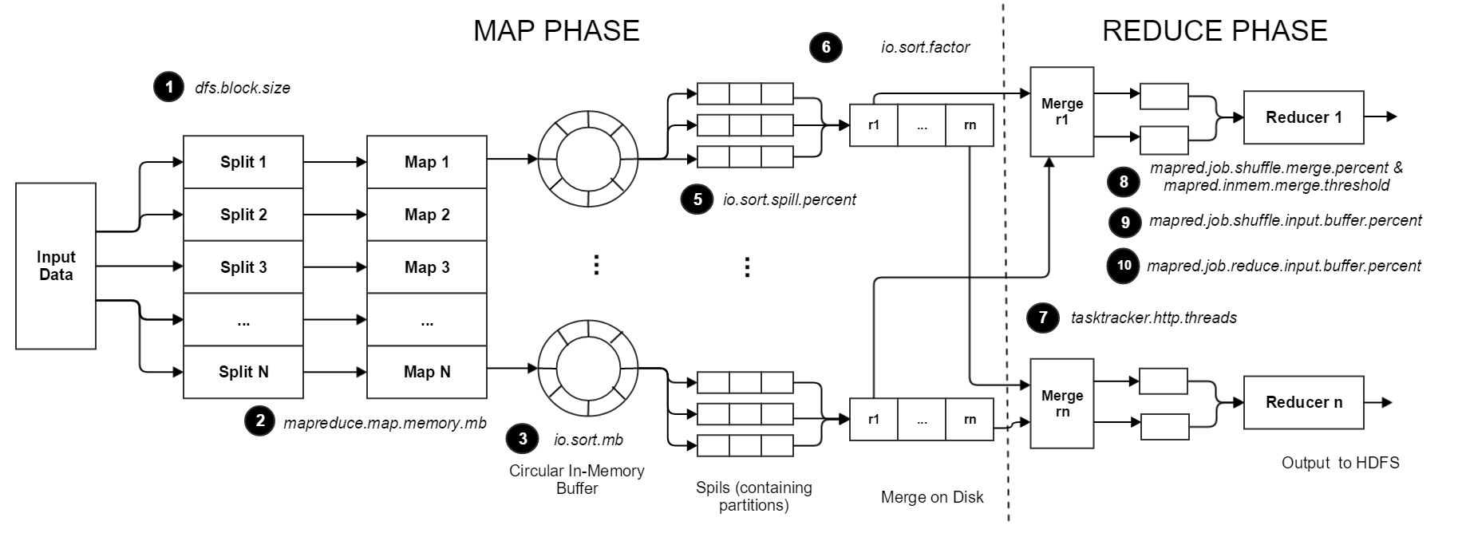
Hadoop Internals: Parameters
Similarly on the reducer side similar parameters are present.
Once reached, a thread will begin to spill the contents to disk in the background.
The number of streams to merge at once while sorting files.
Input data is split based on block size and one map task is started for each split
Number of threads on the reducer side to fetch the map data.
Memory given to each of the Map task
How much memory is reserved for sorting.
A brief overview of working of Hadoop. There are a number of inter dependent parameters which can be tuned

Slide 5
Hadoop Performance
Default Settings
Hadoop comes with default values for these parameters which works OK in most of the cases (except for the number of reducers).
Parameter Values
To optimize the Hadoop performance, these parameters needs to be tweaked according to the workload.
Setting the “correct” values of these parameters requires an in-depth knowledge of Hadoop working and the workload characteristics.

Slide 6
Why manual tuning is not possible.
Huge Sample
Hadoop has lots of parameters and brute forcing through all of them is not feasible.
Also most of the settings in the sample space will not be valid.
Inter-dependency among parameters
The parameters are dependent on value of other parameters.
Most of the parameters are percentage and the actual value depends on the other parameter values (Eg. mapreduce.map.memory, io.sort.mb).
Complex workloads
Hadoop is mostly used with a base layer with Hive, HBase or Mahout like application on top of it.
Workload characteristics of these workloads is quite complex.

Slide 7



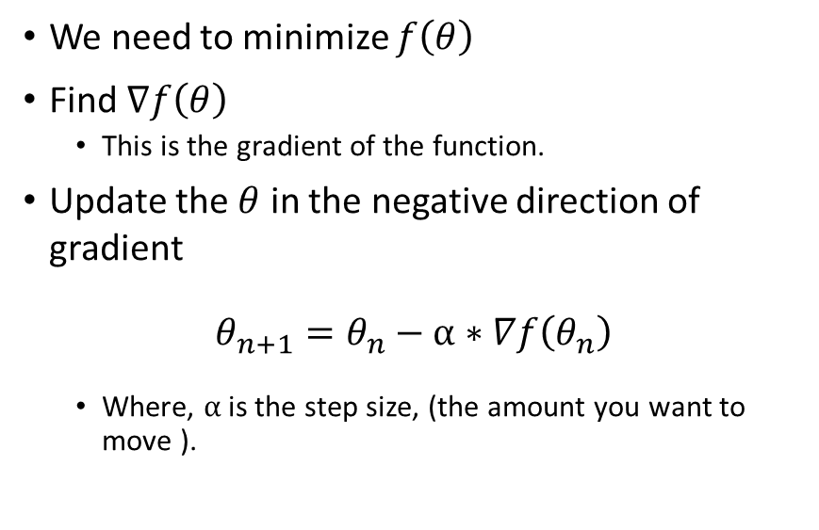



Gradient Descent like algorithm
We need to minimize $f\left(θ\right)$
Find $∇f\left(θ\right)$
This is the gradient of the function.
Update the $θ$ in the negative direction of gradient
$$θ_{n+1}=θ_{n}−α∗∇f\left(θ_{n}\right)$$
Where, $α$ is the step size, (the amount you want to move ).
$$f\left(θ\right)$$
$$f\left(θ1\right)$$
$$f\left(θ1\right)$$
$θ$*
$$−α∗∇f\left(θ_{n}\right)$$
$$−α∗(−∇f\left(θ_{n}\right))$$
Gradient Search

Slide 8

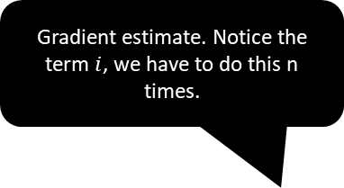
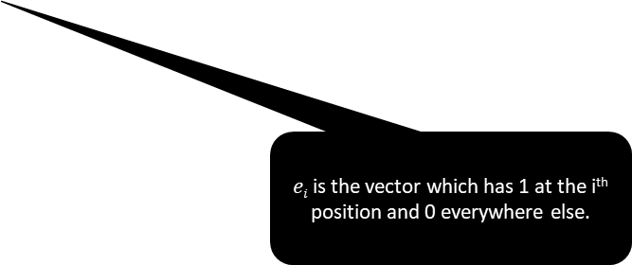
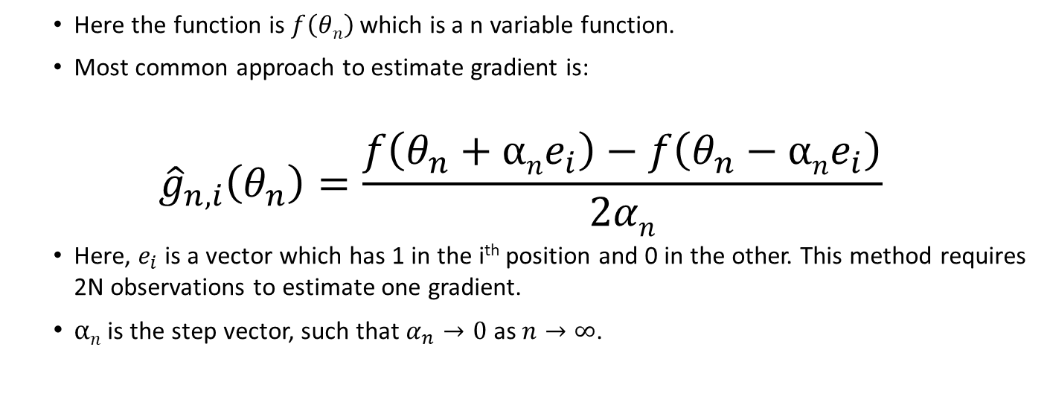
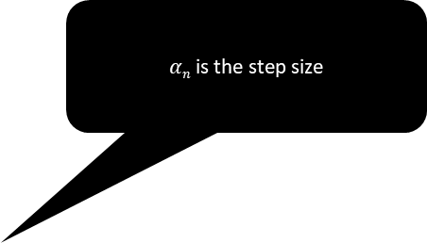
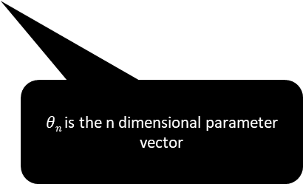
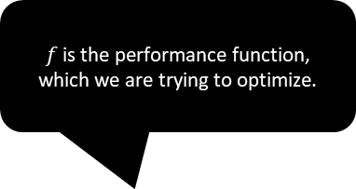
Gradient of partial derivative
$αn$ is the step size
$f$ is the performance function, which we are trying to optimize.
Gradient estimate. Notice the term $i$, we have to do this n times.
Here the function is $f\left(θn\right)$ which is a n variable function.
Most common approach to estimate gradient is:
$${\hat{g}}_{n,i}\left(θ_{n}\right)=\frac{f\left(θ_{n}+αne_{i}\right)−f\left(θ_{n}−αne_{i}\right)}{2αn}$$
Here, $e_{i}$ is a vector which has 1 in the i^{th} position and 0 in the other. This method requires 2N observations to estimate one gradient.
$αn$ is the step vector, such that $α_{n}→0$ as $n→∞$.
+ $noise$
$θn$ is the n dimensional parameter vector
$ei$is the vector which has 1 at the i^{th} position and 0 everywhere else.

Slide 9
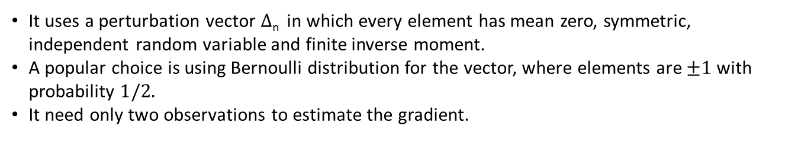
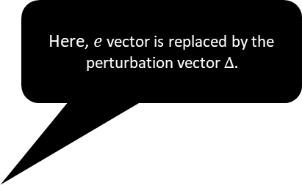
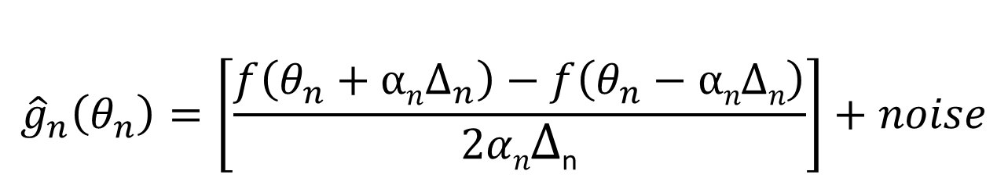
SPSA: Simultaneous Pertubation Stochastic Approximation
Here, $e$ vector is replaced by the perturbation vector $Δ.$
Gradient Estimation
In uses the direct noisy, measurement from the system to estimate the gradient of the performance vector of the system.
$${\hat{g}}_{n}\left(θ_{n}\right)=\left[\frac{f\left(θ_{n}+αnΔ_{n}\right)−f\left(θ_{n}−αnΔn\right)}{2αnΔ\text{n}}\right]+noise$$
It uses a perturbation vector $Δ$_{n} in which every element has mean zero, symmetric, independent random variable and finite inverse moment.
A popular choice is using Bernoulli distribution for the vector, where elements are $±1$ with probability $1/2.$
It need only two observations to estimate the gradient.
SPSA “walk” from Initial guess to Optimal value.

Slide 10




SPSA Working
Simulation Optimization
$\text{θ}$_{n}= h(f(θ₁),…, f(θ_{n-1}))
$$\text{Parameters} \text{θn}\text{+1}$$
$$\text{Performance} f\left(θ_{n}\right)$$
System/ Simulator (Hadoop)
Default Settings $θ$
SPSA with Hadoop

Slide 11
SPSA with Hadoop
SPSA converges in about 15-20 iterations.
Each iteration runs Hadoop job twice, which is about 30 -40 runs.
Data size is usually in petabytes and running it for 30 iterations will take time
Typical job run will have map tasks followed by reduce operations.
Single wave of map tasks is total map task that can be run in the parallel on the cluster.
Map Waves
Reduce operations and result
Actual Data
Map Operations

Slide 12
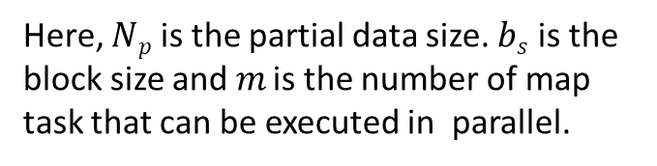
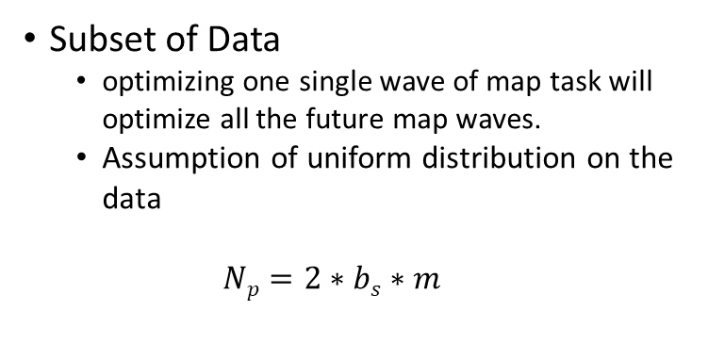
Subset of Data
Subset of Data
optimizing one single wave of map task will optimize all the future map waves.
Assumption of uniform distribution on the data
$$Np=2∗bs∗m$$
Less number of map waves.
Reduce operations and result
Subset of Data
Here, $Np$ is the partial data size. $bs$ is the block size and $m$ is the number of map task that can be executed in parallel.
Map Operations

Slide 13
Experiments
Cluster Configuration
25 node cluster, each has 8 core Intel Xeon E3 2.50GHz processor, 3.5TB HDD, 16GB of memory and Gigabit connectivity.
SPSA training
We use the default Hadoop settings as the starting point.
We use a subset of the workload size for training purpose.
Benchmarks
For Hadoop we have used standard benchmarks, Terasort, Grep, Bigram, Inverted Index.
For Hive (on top of Hadoop) we use TPCDS benchmark.

Slide 14
SPSA Training
Converges with in 10 -15 iterations and takes approx. 30 mins to 4 hours to train depending on workload type and size of subset data
SPSA Training for Hadoop and Hive Benchmarks.

Slide 15
Results: Starfish
An improvement of factor 4 when compared with default and 2 Starfish.
An improvement of factor 12 when compared with default and 1.8 Starfish.
An improvement of factor 8 when compared with default and Starfish.
Comparison of SPSA based method with Starfish and Default Setting (Hadoop v1). Average of 10 runs

Slide 16
Results: PPABS Profiling and Performance Analysis-based System
An improvement of factor 5 when compared with default and about 1.2 with PPABS.
An improvement of factor 7 when compared with default and of 3 with PPABS.
Comparison of SPSA based method with PPBAS and Default Setting (Hadoop v2).
Average of 10 runs
Notes:
For Terasort with default we see a improvement of factor 7 and a factor 3 when compared to Starfish.
Inverted index about 5 with default and 1.5 with starfish.
Bigram default 4, starfish about 1.7
Word default 3, 1.2 with starfish

Slide 17
Results: Hive
An improvement of factor 5 when compared TPCDS init settings
Comparison of SPSA based method v s TPCDS Default Setting (Hadoop v2).
Average of 10 runs
Notes:
TPCDS provides a scripts which configures the Hive and does not use the default setting out of the box.

Slide 18
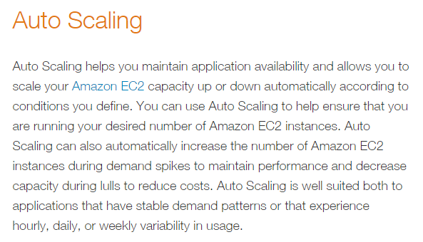
Change in Cluster Configuration
Most of the Hadoop cluster are run on cloud services like AWS, Azure or Google Cloud Computing
All of them provide option to scale up or down the cluster based on requirement.
The value of the parameters trained on a different cluster configuration will work on the new cluster as long as the machine configuration is kept same.
Source: https://aws.amazon.com/autoscaling/

Slide 19
Scaling up or down the cluster
Map waves for a particular workload in initial cluster configuration.
Reduce operations and result
Actual Data
Scaling the cluster down will increase the number of map waves.
Scaling the cluster up will decrease the number of map waves.
Map Operations
Initial Cluster Configuration
Reduce operations and result
Reduce operations and result
Actual Data
Actual Data
Map Operations
Map Operations
Scaling up the cluster
Scaling down the cluster

Slide 20
Results: Cluster Change
Comparison of SPSA based method v s Default Setting (Hadoop v2).
Average of 10 runs

Slide 21
Results Discussion
io.sort.mb is increase in all of the case.
Parameter Name | Default | Tera sort | Grep | Bigram | Inverted Index | Word Co-occurrence
io.sort.mb | 100 | 524 | 291 | 779 | 202 | 912
io.sort.spill.percent | .80 | 0.89 | 0.88 | 0.53 | 0.68 | 0.47
io.sort.factor | 10 | 115 | 57 | 178 | 85 | 5
shuffle.input.buffer.percent | 0.7 | 0.87 | 0.78 | 0.43 | 0.58 | 0.37
shuffle.merge.percent | 0.66 | .083 | 0.74 | 0.39 | 0.54 | 0.33
inmem.merge.threshold | 1000 | 318 | 200 | 4201 | 948 | 200
mapred.reduce.tasks | 1 | 22 | 1 | 33 | 16 | 41
Default number of reducers is 1, which almost always results in slow performance during reduce phase.
Grep benchmark, based on the data and the phrase searched for may result in very less data after the map phase, and a single reducer will be enough to handle this.

Slide 22


Future Work
The method can be used for other platforms where there are parameters that can be tuned, such as SPARK.
A more deeper understanding about the decision that SPSA makes.
The training time of SPSA can be reduced if we can devise a machine learning model that can predict the running time fairly accurately. The job is only run when the confidence in this prediction is low.
Simulation Optimization
$\text{θ}$_{n}= h(f(θ₁),…, f(θ_{n-1}))
ML Model
$$\text{Parameters} \text{θn}\text{+1}$$
$$\text{Performance} f\left(θ_{n}\right)$$
System/ Simulator (Hadoop)
Default Settings $θ$
SPSA with Hadoop

Slide 23
Future Work
Use of Discrete SPSA. We are using Continuous version of SPSA which sometime results in very small update to the theta value.
Multi-tenant setting. In practise a cluster is usually shared along with other multiple services such as web server, email server etc.

Slide 24
Questions?

