Slide 1
Career Pathway in
Computer Science
How to build skills , internships and land your first job.
Name – Kaushal Kumar Gupta
Course – B.tech(CSE)

Slide 2
WHY CHOOSE CSE CORE ?
Strong Curriculum
CSE Core provides a comprehensive foundation in computer science principles, programming, algorithms, and systems.
Courses often include hands-on projects and real-world applications, enhancing practical skills.
Career Opportunities
Graduates from CSE Core programs are in high demand across various industries, including technology, finance, healthcare, and more.
The field offers diverse career paths, such as software development, data analysis, cybersecurity, and artificial intelligence.

Slide 3
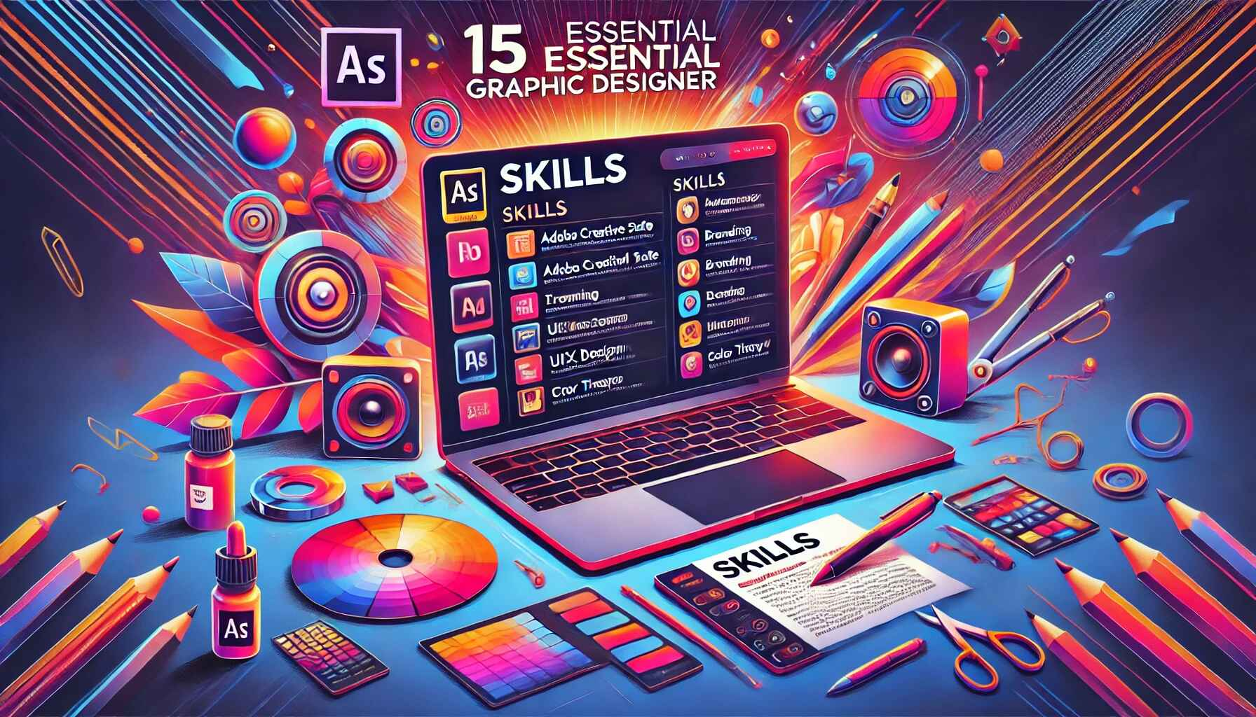
ESSENTIAL SKILLS TO BUILD ?
Technical Skills:
Programming Languages: Proficiency in languages such as Python, Java, C++, and JavaScript.
Soft Skills:
Problem-Solving: Ability to analyze problems and develop effective solutions.

Slide 4

HOW TO GAIN PRACTICAL EXPERIENCE ?
Internships
Apply for internships in tech companies to work on real-world projects
Projects
Engage in personal or group projects that solve real problems
Participate in hackathons to develop skills under time constraints.
Hackathons

Slide 5
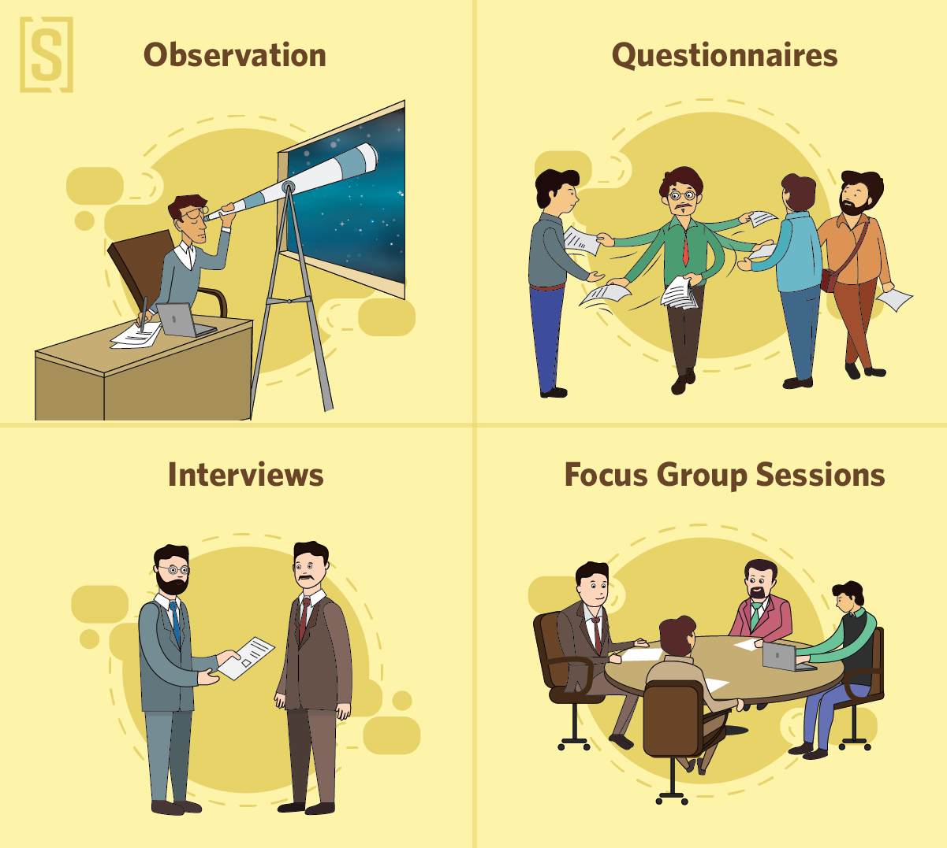
RESUME & INTERVIEW TIPS
Resume Tips for BTech CSE Core Students:
Highlight Technical Skills: Focus on programming languages (e.g., Java, C++, Python), tools (e.g., Git, Docker), and technologies (e.g., AI, machine learning).
Projects and Internships: Include relevant projects and internships that demonstrate practical experience and problem-solving abilities.
Education Details: Clearly state your degree, university, and any relevant coursework or certifications.
Interview Tips for BTech CSE Core Students:
Prepare for Technical Questions: Review core subjects and practice coding problems on platforms like LeetCode.
Behavioral Questions: Use the STAR method (Situation, Task, Action, Result) to structure responses to behavioral questions.
Mock Interviews: Conduct mock interviews with peers or mentors to build confidence and receive feedback.

Slide 6
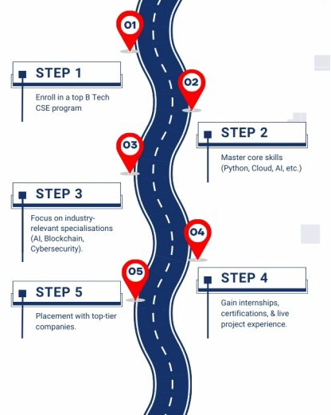
ROADMAP : 6 MONTH PLAN
Programming Fundamentals: Introduction to programming languages like C/C++ and Python, focusing on algorithms and data structures.
Mathematics: Courses often cover discrete mathematics, linear algebra, and calculus, essential for computer science concepts.
Computer Organization: Understanding computer architecture, hardware components, and basic operating systems.
Data Structures and Algorithms: In-depth study of data organization, manipulation, and algorithm efficiency.
Software Engineering: Basics of software development life cycles, methodologies, and project management.

Slide 7

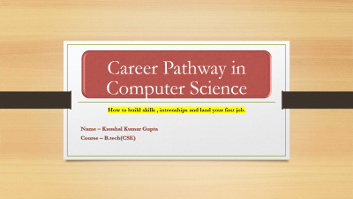
THANKYOU
“BUILD 1 POJECT THIS MONTH . PUSH CODE TO GITHUB.APPLY 5 INTENSHIPS”
CONTACT : KAUSHALGUPTA.KU78@GMAIL.COM |PHONE :7000541278

