Slide 1
Types of Digital Data

Slide 2
Learning Objectives and Learning Outcomes
Learning Objectives | Learning Outcomes
Introduction to digital data and its types Structured data: Sources of structured data, ease with structured data, etc. Semi-Structured data: Sources of semi-structured data, characteristics of semi- structured data. Unstructured data: Sources of unstructured data, issues with terminology, dealing with unstructured data. | To differentiate between structured, semi-structured and unstructured data. To understand the need to integrate structured, semi- structured and unstructured data.

Slide 3
Agenda
Types of Digital Data
◆ Structured
Sources of structured data
Ease with structured data
◆ Semi-Structured
Sources of semi-structured data
◆ Unstructured
Sources of unstructured data
Issues with terminology
Dealing with unstructured data

Slide 4
Classification of Digital Data
Digital data is classified into the following categories:
◆ Structured data
◆ Semi-structured data
◆ Unstructured data

Slide 5
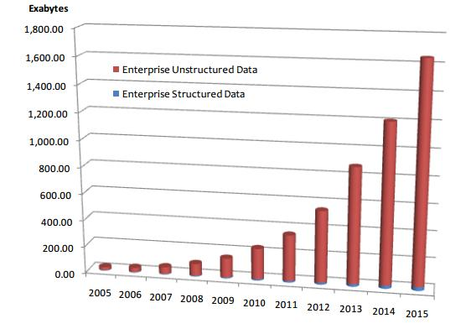
Approximate Distribution of Digital Data
Approximate percentage distribution of digital data

Slide 6
Structured Data

Slide 7
Structured Data
◆ This is the data which is in an organized form (e.g., in rows and columns) and can be easily used by a computer program.
◆ Relationships exist between their objects.
entities
of data,
such a classes and
◆ Data stored in databases is an example of structured data.

Slide 8
Sources of Structured Data
Databases such as Oracle, DB2, Teradata, MySql, PostgreSQL, etc
Structured data
Spreadsheets
OLTP Systems

Slide 9
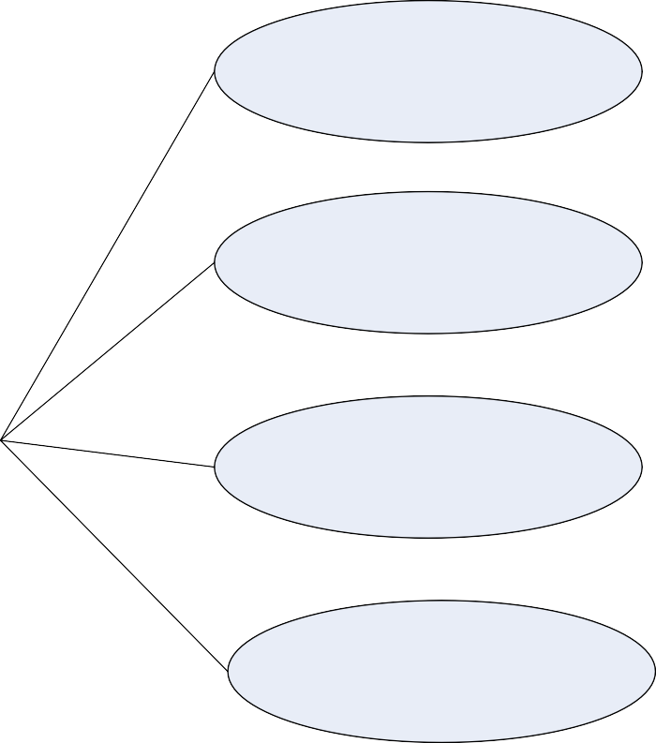
Ease with Structured Data
Input / Update / Delete
Security
Ease with Structured data
Indexing / Searching
Scalability
Transaction Processing

Slide 10
Semi-structured Data

Slide 11
Semi-structured Data
◆ This is the data which does not conform to a data model but has some structure. However, it is not in a form which can be used easily by a computer program.
◆ Example, emails, XML, markup languages like HTML, etc. Metadata for this data is available but is not sufficient.

Slide 12
Sources of Semi-structured Data
XML Extensible MarkUp Language
Other MarkUp Language
JSON(JavaScript Object Notation)
Semi-Structured Data

Slide 13
Characteristics of Semi-structured Data
Inconsistent Structure
Self-describing (lable/value pairs)
Semi-structured data
Often Schema information is blended with data values
Data objects may have different attributes not known beforehand

Slide 14
Unstructured Data

Slide 15
Unstructured Data
◆ This is the data which does not conform to a data model or is not in a form which can be used easily by a computer program.
◆ About 80–90% data of an organization is in this format.
◆ Example: memos, chat rooms, PowerPoint presentations, images, videos, letters, researches, white papers, body of an email, etc.

Slide 16
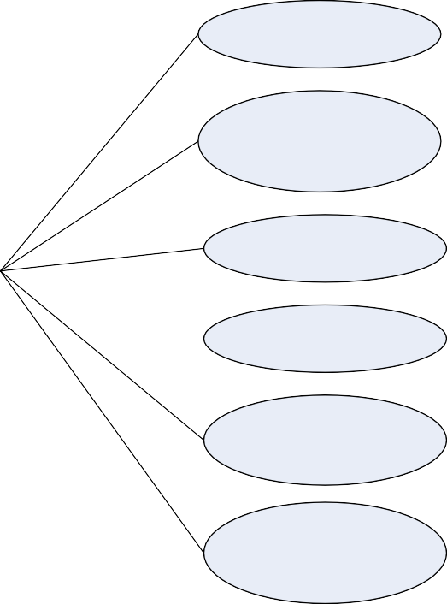
Sources of Unstructured Data
Web Pages
Images
Free-Form Text
Unstructured data
Audios
Videos
Body of Email
Text Messages
Chats Social
Media data
Word
Document

Slide 17
Issues with terminology – Unstructured Data
Structure can be implied despite not being formerly defined.
Issues with terminology
Data with some structure may still be labeled
unstructured if the structure doesn’t help with processing task at hand
Data may have some structure or may even be
highly structured in ways that are unanticipated or unannounced.

Slide 18
Dealing with Unstructured Data
Data Mining
Natural Language Processing (NLP)
Dealing with Unstructured Data
Text Analytics
Noisy Text Analytics

Slide 19
Answer a few quick questions …

Slide 20
Answer Me
◆ Which category (structured, semi-structured, or unstructured) will you place a Web Page in?
◆ Which category (structured, semi-structured, or unstructured) will you place
Word Document in?
◆ State a few examples of human generated and machine-generated data.

Slide 21
Summary please…
few participants of the learning program to summarize the lecture.

Slide 22
References …

Slide 23
Further Readings
◆ http://data-magnum.com/the-big-deal-about-big-data-whats-inside- structured-unstructured-and-semi-structured-data/
◆ http://www.webopedia.com/TERM/S/structured_data.html
◆ http://en.wikipedia.org/wiki/UIMA

Slide 24
Thank you

