Slide 1

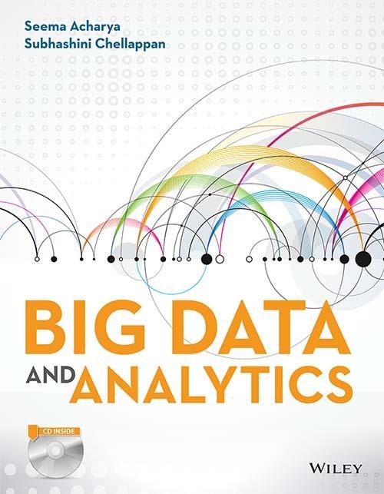

Big Data
^{And} Analytics
Seema Acharya
Subhashini Chellappan

Slide 2
Chapter 11
JasperReports using Jaspersoft

Slide 3
Learning Objectives and Learning Outcomes
Learning Objectives | Learning Outcomes
JasperReports using Jaspersoft Studio 1. To connect to NoSQL databases such as MongoDB and Cassandra to retrieve the data into a JasperReport using Jaspersoft Studio. | a) To be able to design JasperReports using Jaspersoft studio using data from NoSQL databases.

Slide 4
Session Plan
Lecture time
45 to 60 minutes
Q/A
15 minutes

Slide 5
Agenda
◆ Introduction to JasperReports, Jaspersoft Studio
JasperReports
Jaspersoft Studio
◆ Connecting to MongoDB NoSQL database
Syntax of Few MongoDB Query Language
Elements and Attributes
Creating Variables
Creating Report Parameters
◆ Connecting to Cassandra NoSQL Databases

Slide 6
Introduction to JasperReports

Slide 7
Introduction to JasperReports
Open-source reporting engine.
Helps to create page-oriented reports.
Completely written in Java.
Reports can be embedded in any Java Application.
Represents reports in various formats such as HTML, PDF, CSV, etc.

Slide 8
Introduction to Jaspersoft Studio

Slide 9
Introduction to Jaspersoft Studio
Eclipse based report designer.
Available in two flavors: Eclipse plugin and as a standalone application.
Data can be accessed from multiple sources such JDBC, XML, CSV, etc.
Supports big data components such as Mongo DB, Cassandra, Hive, etc.
5. Provides sophisticated
subreports, etc.
layouts
such
as charts,
crosstabs,
images,

Slide 10
Connecting to MongoDB NoSQL database

Slide 11
Connecting to MongoDB NoSQL database
Jaspersoft uses Jaspersoft MongoDB Query Language to query the MongoDB databases. Jaspersoft MongoDB Query Language is a declarative language. It is used for stating which data to retrieve from which database. Connector converts this MongoDB query into the appropriate API calls. Then it makes use of MongoDB Java connector to query the MongoDB instance.

Slide 12
MongoDB Query Language
The bare minimal syntax (MongoDB Query Language) to retrieve all fields from the collection, “students” (the collection exists in the database, “student”) is
{
‘collectionName’: ‘students’
}

Slide 13
Syntax of Few MongoDB Query Language
To return only StudRollNo, Grade and Suppress _id field:
{
‘collectionName’: ‘students’,
‘findFields’: { ‘StudRollNo’:1,
‘Grade’ : 1,
‘_id’: 0
}
}

Slide 14
Syntax of Few MongoDB Query Language
To select documents from a collection based on search criteria(s).
{
‘collectionName’: ‘students’,
‘findQuery’: { ‘StudRollNo’: { ‘$in’ : [ ‘S101’, ‘S102’, ‘S103’ ] } }
}

Slide 15
Connecting to Cassandra NoSQL Databases

Slide 16
Connecting to Cassandra NoSQL Databases
Jaspersoft studio uses Cassandra Query Language (CQL), which is similar to SQL, to retrieve data from Cassandra NoSQL database.

Slide 17
CQL (Cassandra Query Language)

Slide 18
CQL (Cassandra Query Language) query to retrieve data from the Cassandra database
Select * from student_info;

Slide 19
Answer a few quick questions …

Slide 20
Hands-on Assignment
Create a collection in MongoDB to store the details of students. Pull this data into a JasperReport using Jaspersoft Studio.

Slide 21
Hands-on Assignment
Create a column family in Cassandra to store the details of students. Pull this data into a JasperReport using Jaspersoft Studio.

Slide 22
Summary please…
Ask a few participants of the learning program to summarize the lecture.

Slide 23
References …

Slide 24
Further Readings
◆ https://community.jaspersoft.com/wiki/designing-report-jaspersoft-studio
◆ http://community.jaspersoft.com/wiki/jaspersoft-mongodb-query-language

Slide 25
Thank you

