Slide 1

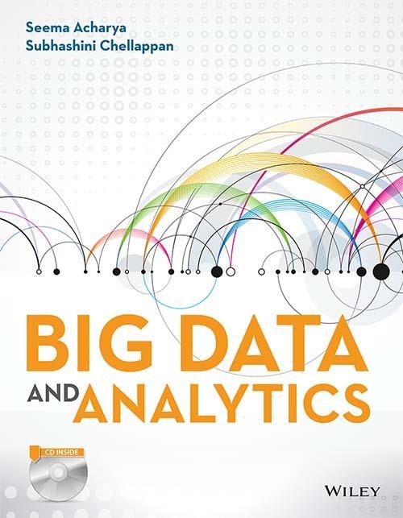
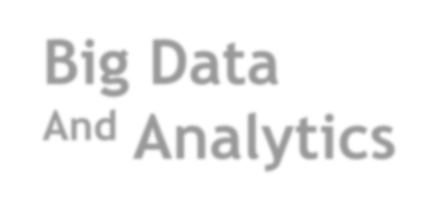
Big Data
^{And} Analytics
Seema Acharya
Subhashini Chellappan

Slide 2
Chapter 12
Introduction to Machine Learning

Slide 3
Learning Objectives and Learning Outcomes
Learning Objectives | Learning Outcomes
Introduction to Machine Learning To study the importance of Machine Learning. To learn supervised learning and unsupervised learning. To study Regression Model, K- Means, Decision tree, Association rule mining and Collaborative Filtering. | To comprehend the reasons behind the popularity of Machine Learning. To be able to work with various supervised and unsupervised learning. To be able to understand the classification and clustering problems.

Slide 4
Session Plan
Lecture time
120 minutes
Q/A
10 minutes

Slide 5
Agenda
◆ Introduction to Machine Learning
Machine Learning Definition
◆ Machine Learning Algorithms
Regression Model − Linear Regression
Methodology
◆ Clustering
K-Means
◆ Collaborative Filtering
Collaborative Filtering Algorithms
Euclidean Distance
Manhattan Distance
Pearson−Correlation Co-efficient
◆ Association Rule Mining
◆ Decision Tree

Slide 6
Introduction to Machine Learning

Slide 7
Machine Learning Definition
Arthur Samuel (1959), Machine Learning: It is a field of study computers the ability to learn without being explicitly programmed.
that
gives
Tom Mitchell (1998), Well-posed Learning Problem: A computer program is said to learn from experience E with respect to some task T and some performance measure P, if its performance on T, as measured by P, improves with experience E.
Example
Tom’s definition is the latest Machine Learning Definition. According to Tom’s definition, we will try to identify E, P, T in Email Spam Classification Problem. In this problem,
Task − Classifying email as spam or not.
Experience − Labeling the email as spam or not.
Performance − Number of emails correctly classified as spam or not.

Slide 8
Machine Learning Algorithms
Supervised Learning: In supervised learning, the classifier undergoes a process of training based on known classifications and through supervision it attempts to learn the information contained in the training dataset. Example: Predicting the selling price of the house based on pricing of other houses for sale in the neighborhood.
Unsupervised Learning: In unsupervised learning, the classifier tries to find some structure from the given data set without any known classification. That structure is known as Cluster. Example: Google News collects tens of thousands of news stories and automatically clusters them together. So that news stories that have the same content are displayed together.

Slide 9
Regression Model – Linear Regression

Slide 10
Regression Model
Regression Model is used to predict numbers. With the help of regression you can predict profit, sales, house values, etc. Regression Model serves as a good example for classification (supervised learning). Here, we will discuss Linear Regression.
Linear Regression is used to predict the relationship between two variables. The variable that needs to be predicted is known as the dependent variable and the variables that are used to predict the value of the dependent variable are known as independent variables.

Slide 11
Methodology
The general equation for Regression Model is as follows:
Y = a + b1x1 + b2x2 + … + bnxn
Here, Y is the dependent variable; x1, x2, x3 are the independent variables (these variables are used to predict the value of Y ); b1, b2, …, bn are the co- efficient of the respective independent variables (these values are determined from the input data); a is the intercept. Slope and intercept can be calculated using the below expression.
Slope (b) = [N Σ X Y − (ΣX) (ΣY )]/[N ΣX 2 − (Σ X )2]
Intercept (a) = [ΣY − b(ΣX )]/N

Slide 12
Clustering

Slide 13
Clustering
Clustering is the process of grouping similar objects together. Clustering is an example of unsupervised learning. One can use clustering algorithms to segment data as in classification algorithms. However, classification models are used to segment data based on previously defined classes that are mentioned in the target, whereas clustering models do not use any target.
Clustering can be used to group items in a supermarket. For example, butter, cheese and milk can be placed in the “dairy products” group.

Slide 14
Clustering
You can use clustering when you want to explore data. Clustering algorithms are mainly used for natural groupings. There are different categories of clustering.
Hierarchical: Hierarchical cluster identifies the cluster within the cluster. A news article group can further have other groups such as business, politics, and sports in which each group can still have subgroups. For example, inside sports news there could be news on baseball sport, news on basketball sport, and so on.
Partitional: Partitional creates a fixed number of clusters. The K-means clustering algorithm belongs to this category. Let us study the K-mean clustering algorithm in detail.

Slide 15
K-Means
The steps involved in K-means algorithm are as follows:
Choose the final required number of clusters.
Examine each element in the population and assign it to one of the clusters depending on the minimum distance.
Each time a new element is added to the cluster, the centroid’s position is recalculated. This process is performed until all the elements are grouped into the required number of clusters.
Centroid: It is a point whose parameter values are the mean of the parameter values of all the points in the cluster.

Slide 16
Collaborative Filtering

Slide 17
Collaborative Filtering
Collaborative filtering is a category of information filtering. It is nothing but predicting user preferences based on the preferences of a group of users. You can use collaborative filtering when information needs are more complex than keywords or topics. Collaborative filtering is concerned with quality and taste.
Collaborative filtering can be defined as Social Navigation. We say that human beings are social animals owing to their tendency to follow other people’s advice or judgment when looking for information or buying products. This is in a way similar to an ant looking for food trudging behind other ants.

Slide 18
Algorithms of Collaborative Filtering

Slide 19
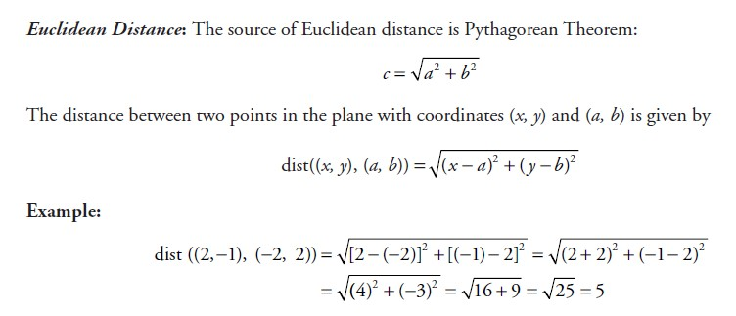
Euclidean Distance

Slide 20
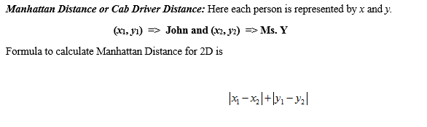
Manhattan Distance

Slide 21
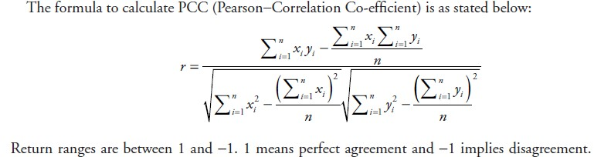
Pearson – Corelation - Coefficient

Slide 22
Association Rule Mining

Slide 23
Association Rule Mining
Association rule mining is also referred to as market basket analysis. Few also prefer to call it as affinity analysis. It is a data analysis and data mining technique. It is used to determine co-occurrence relationship among activities performed by individuals and groups.
Examples:
It is widely used in retail wherein the retailer seeks to understand the buying behavior of customer. This insight is then used to cross-sell or up-sell to the customers.
If you have ever bought a book from Amazon, this should sound familiar to you. The moment you are done selecting and placing the desired book in the shopping cart, pop comes the recommendation stating that customers who bought book “A” also bought book “B”.

Slide 24
Association Rule Mining
Who can forget the urban legend, the very famous beer and diapers example. The legend goes… there was a retail firm wherein it was observed that when diapers were purchased beer was purchased as well by the customer. The retailer cashed in on this opportunity by stocking beer coolers close to the shelves that housed the diaper. This just to make it convenient for the customers to easily pick both the products.
An association rule has two parts (a) an antecedent (if ) and (b) a consequent (then). An antecedent is an item found in the data. A consequent is an item that is found in combination with the antecedent.

Slide 25
Decision Tree

Slide 26
Decision Tree
A decision tree is a decision support tool. It uses a tree-like graph to depict decision and their consequences. The following are the three constituents of a decision tree:
Decision nodes: Commonly represented by squares
Chance nodes: Represented by circles
End nodes: Represented by triangles

Slide 27
Answer a few quick questions…

Slide 28
Fill in the blanks
1.
Decision tree is a ---------------------------- method.
2.
R is ----------------------------------- tool.
3.
---------------------------------is a user-based recommendation algorithm.
4.
K-mean splits dataset in to -----------------------------------------of Clusters.
5.
Regression Model deals with -------------------------------------.

Slide 29
Thank You

