Slide 1

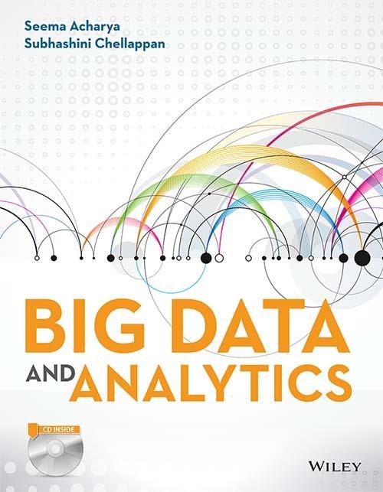
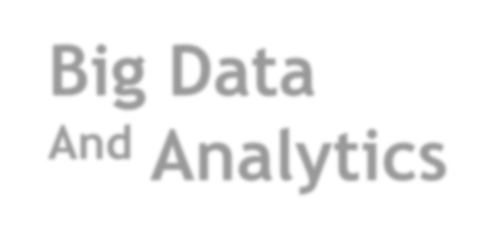
Big Data
^{And} Analytics
Seema Acharya
Subhashini Chellappan

Slide 2
Chapter 2
Introduction to Big Data

Slide 3
Learning Objectives and Learning Outcomes
Learning Objectives | Learning Outcomes
Introduction to big data Definition of big data. Challenges of big data. Why big data? Traditional Business Intelligence versus big data. | To understand the significance of big data. To understand the other characteristics of data that are not definitional characteristics of big data. To understand the challenges of big data and how to deal with the same. To understand what is new today.

Slide 4
Agenda
◆ Definition of Big Data
Volume
Velocity
Variety
◆ Challenges of Big Data
◆ Other Characteristics of Data Which are Not Definitional Traits of Big
Data
◆ Why Big Data?
◆ Traditional Business Intelligence (BI) versus Big Data
A Typical Data Warehouse Environment
A Typical Hadoop Environment
Coexistence of Big Data and Data Warehouse

Slide 6
Characteristics of Data
Composition
Condition
Context

Slide 8
Evolution of Big Data
Primitive and Structured
Complex and Relational
Complex and Unstructured

Slide 9
Definition of Big Data

Slide 10

Definition of Big Data
High-volume High-velocity High-variety
Big Data is high-volume, high- velocity, and high-variety information assets that demand cost effective, innovative forms of information processing for enhanced insight and decision making.
Source: Gartner IT Glossary
Cost-effective, innovative forms of information processing
Enhanced insight & decision making

Slide 11
Volume
- A Mountain of Data
1 Kilobyte (KB) = 1000 bytes
1 Megabyte (MB) = 1,000,000 bytes
1 Gigabyte (GB) = 1,000,000,000 bytes
1 Terabyte (TB) = 1,000,000,000,000 bytes
1 Petabyte (PB) = 1,000,000,000,000,000 bytes
1 Exabyte (EB) = 1,000,000,000,000,000,000 bytes
1 Zettabyte (ZB) = 1,000,000,000,000,000,000,000 bytes
1 Yottabyte (YB) = 1,000,000,000,000,000,000,000,000 bytes

Slide 12
Velocity
Batch → Periodic → Near real time → Real-time processing

Slide 13
Variety
◆ Structured data: example: traditional transaction processing systems and
RDBMS, etc.
◆ Semi-structured data: example: Hyper Text Markup Language (HTML), eXtensible Markup Language (XML).
◆ Unstructured data: example: unstructured text documents, audio, video,
email, photos, PDFs, social media, etc.

Slide 14
Other Characteristics of Data –
Which are not Definitional Traits of Big Data
Veracity and Validity-Veracity refers to biases, noises and abnormality in data.
Validity refers to the accuracy and correctness of the data.
Volatility-Deals with, how long is the data valid? And how long should it be stored?
Variability- Data flows can be highly inconsistent with periodic peaks.

Slide 15
Challenges with Big Data

Slide 16
Challenges with Big Data
Capture
Storage
Curation
Challenges with Big Data
Search
Analysis
Transfer
Visualization
Privacy
Violations

Slide 17
Sources of Big Data

Slide 18
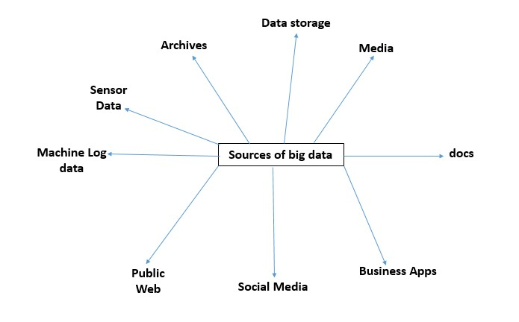
Sources of Big Data

Slide 19
Why Big Data?

Slide 20
Why Big Data?
More Data
More Accurate Analysis
More Confidence in decision making
Greater operational efficiencies, Cost reduction,
Time reduction, New product development, Optimized offerings, etc.

Slide 21
Traditional Business Intelligence (BI) versus Big Data

Slide 22
A Typical Data Warehouse Environment
ERP
Reporting / Dashboarding
CRM
OLAP
Legacy
Data Warehouse
Ad hoc querying
3rd party Apps
Modeling

Slide 23
A Typical Hadoop Environment
Web Logs
HDFS
Hadoop
Operational Systems
Images and Videos
Data Warehouse
Social Media
(Twitter, Facebook, etc.)
MapReduce
Data Marts
Docs & PDFs
ODS

Slide 24
Co-existence of Big Data and Data Warehouse
Web Logs
HDFS
Hadoop
Operational Systems
Images and Videos
Data Warehouse
Social Media
(Twitter, Facebook, etc.)
Data Warehouse
MapReduce
Data Marts
Docs & PDFs
ODS

Slide 25
What is challenging in the realms of Big data
Competitive Advantage
Decision Making
Value of Data

Slide 26
Answer a few quick questions …

Slide 27
Fill in the blanks
Big data is high-volume, high-velocity, and high-variety information assets that demand ---------------------, ------------------------- forms of information processing for enhanced ----------------------- and ---------
-------------------.

Slide 28
Answer Me
◆ Share your understanding of Big Data.
◆ How is traditional BI environment different from the Big Data environment?
◆ Share your experience as a customer on an e-commerce site. Comment on the
big data that gets created on a typical e-commerce site.

Slide 29
Summary please…
Ask a few participants of the learning program to summarize the lecture.

Slide 30
References …

Slide 31
Further Readings
◆ Big data for dummies - Judith Hurwitz, Alan Nugent, Fern Halper, Marcia Kaufman
◆ http://en.wikipedia.org/wiki/Big_data
◆ http://www.sas.com/en_us/insights/big-data/what-is-big-data.html
◆ https://www.oracle.com/bigdata/
◆ http://bigdatauniversity.com/

Slide 32
Thank you

