Slide 1

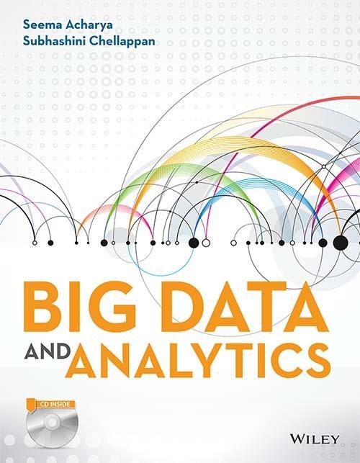
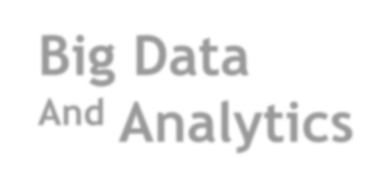
Big Data
^{And} Analytics
Seema Acharya
Subhashini Chellappan

Slide 2
Chapter 3
Big Data Analytics

Slide 3
Learning Objectives and Learning Outcomes
Learning Objectives | Learning Outcomes
Big Data Analytics What is big data analytics and what it isn’t? Why is big data analytics important? What is data Science? Getting familiar with the terminologies used in the big data environment. | To understand the significance of big data analytics. To understand the role of data scientist. To understand the various terminologies used in the big data environment.

Slide 4
Session Plan
Lecture time
45 to 60 minutes
Q/A
15 minutes

Slide 5
Agenda
◆ What is Big Data Analytics?
◆ What Big Data Analytics isn’t?
◆ Classification of Analytics
◆ Why is Big Data Analytics Important?
◆ Data Science
◆ Data Scientist … Your New Best Friend!!!
◆ Terminologies Used in Big Data Environment
◆ In Memory Analytics
◆ In Database Processing
◆ Massively Parallel Processing
◆ Difference between Parallel versus Distributed Systems
◆ Shared Nothing Architecture
◆ Consistency, Availability, Partition Tolerance (CAP): Theorem Explained
◆ Few Top Analytics Tools

Slide 6
What is Big Data Analytics?

Slide 7

What is Big Data Analytics?
Move code to data for greater speed and efficiency
Better, faster decisions in real time
Richer, deeper insights into customers, partners and the business
Working with data sets whose volume and variety is beyond the storage & processing capability of a typical Database Software
Big Data Analytics
Competitive Advantage
Technology enabled analytics
IT’s collaboration with business users & data scientists
Time-sensitive decisions made in near real time by processing a steady stream of real-time data

Slide 8
What Big Data Analytics isn’t?

Slide 9
What Big Data Analytics isn’t?
“One-size fit all” traditional RDBMS built on shared disk & memory
Only about Volume
Big Data Analytics isn’t ...
Just about Technology
Only used by huge online companies like Google or Amazon
Meant to replace RDBMS
Meant to replace Data Warehouse

Slide 10
Classification of Analytics
First School of Thought
Second School of thought

Slide 11
First School of Thought
Basic analytics
Operationalized analytics
Advanced analytics
Monetized analytics

Slide 12
Second School of thought Analytics 1.0, 2.0 and 3.0 1.0→ 1950 to 2009 2.0→ 2005 to 2012 3.0→ 2012 to Present

Slide 13
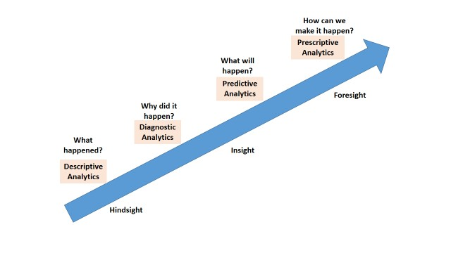
Analytics 1.0, 2.0 and 3.0

Slide 14
Top Challenges Facing Big Data 1. Scale 2.Security 3. Schema 4. Continuous availability 5. Consistency 6. Partition Tolerance 7. Data Quality

Slide 15
Data Science

Slide 16
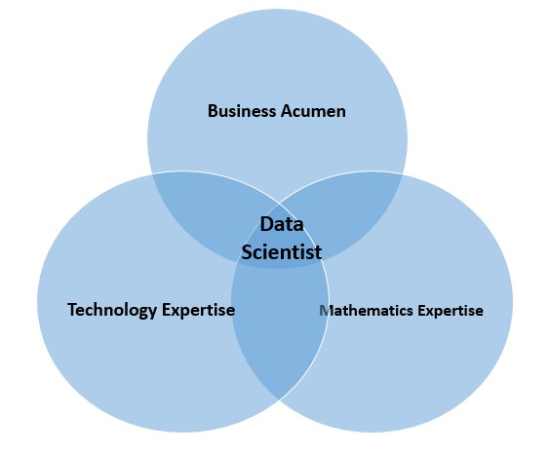
Data Scientist

Slide 17
Terminologies Used in Big data Environments
In-Memory Analytics
The relevant data is stored in RAM or primary storage thus eliminating the need to access data from hard disk.
In-Database Processing
Fusing data warehouses with analytical systems.
Symmetric Multiprocessor System
Massively Parallel Processing – Coordinated processing of programs by a number of processors working in parallel.
Difference between Parallel System and Distributed system
Distributed System
Shared Nothing Architecture

Slide 18
CAP Theorem

Slide 19
Brewer’s CAP
Consistency
CAP
Availability
Partition tolerance

Slide 20
Few Top Analytical Tools

Slide 21
Few Top Analytical Tools
MS Excel
https://support.office.microsoft.com/en-in/article/Whats-new-in-Excel-2013- 1cbc42cd-bfaf-43d7-9031-5688ef1392fd?CorrelationId=1a2171cc-191f-47de-8a55- 08a5f2e9c739&ui=en-US&rs=en-IN&ad=IN
SAS
http://www.sas.com/en_us/home.html
IBM SPSS Modeler
http://www-01.ibm.com/software/analytics/spss/products/modeler/

Slide 22
Answer a few quick questions …

Slide 23
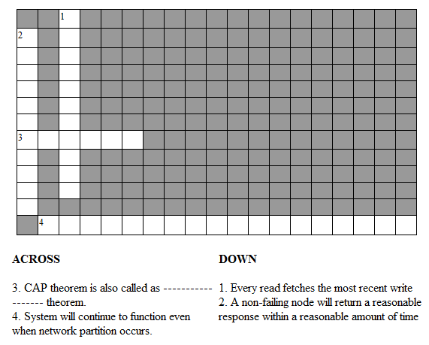
Crossword Puzzle on CAP theorem

Slide 24
Answer Me
◆ What are the key questions to be answered by all organizations stepping into analytics?
◆ What is predictive and prescriptive analytics?

Slide 25
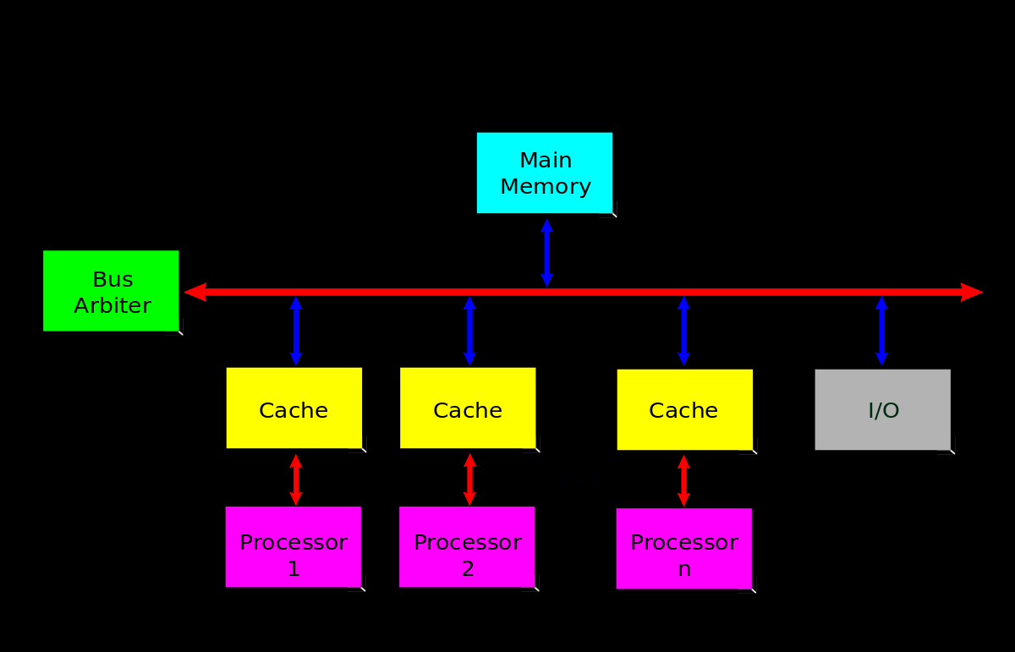
SMP

Slide 26
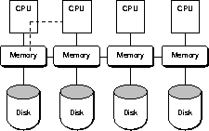
Parallel System

Slide 27
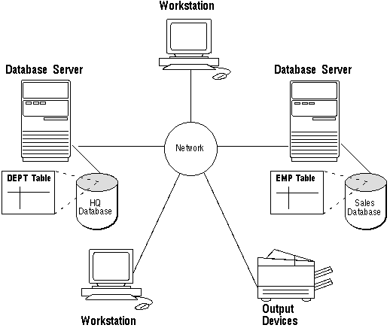
Distributed system

Slide 28
Summary please…
Ask a few participants of the learning program to summarize the lecture.

Slide 29
References …

Slide 30
Further Readings
◆ http://en.wikipedia.org/wiki/Data_science
◆ http://simplystatistics.org/2013/12/12/the-key-word-in-data-science-is-not- data-it-is-science/
◆ http://www.oralytics.com/2012/06/data-science-is-multidisciplinary.html

Slide 31
Thank you

