Slide 1



Big Data
^{And} Analytics
Seema Acharya
Subhashini Chellappan

Slide 2
Chapter 5
Introduction to Hadoop

Slide 3
Learning Objectives and Learning Outcomes
Learning Objectives | Learning Outcomes
Introduction to Hadoop To study the features of Hadoop. To learn the basic concepts of HDFS and MapReduce Programming. To study HDFS Architecture. To study MapReduce Programming Model To study Hadoop Ecosystem. | To comprehend the reasons behind the popularity of Hadoop. To be able to perform HDFS operations. To comprehend MapReduce framework. To understand the read and write in HDFS. To be able to understand Hadoop Ecosystem.

Slide 4
Session Plan
Lecture time
120 to 150 minutes
Q/A
15 minutes

Slide 5
Agenda
◆ Hadoop - An Introduction
◆ RDBMS versus Hadoop
◆ Distributed Computing Challenges
◆ History of Hadoop
◆ Hadoop Overview
Key Aspects of Hadoop
Hadoop Components
High Level Architecture of Hadoop
◆ Use case for Hadoop
ClickStream Data
◆ Hadoop Distributors
◆ HDFS
HDFS Daemons
Anatomy of File Read
Anatomy of File Write
Replica Placement Strategy
Working with HDFS commands
Special Features of HDFS

Slide 6
Agenda
◆ Processing Data with Hadoop
What is MapReduce Programming?
How does MapReduce Works?
MapReduce Word Count Example
◆ Managing Resources and Application with Hadoop YARN
Limitations of Hadoop 1.0 Architecture
Hadoop 2 YARN: Taking Hadoop Beyond Batch
◆ Hadoop Ecosystem
Pig
Hive
Sqoop
HBase

Slide 7
Hadoop – An Introduction

Slide 8
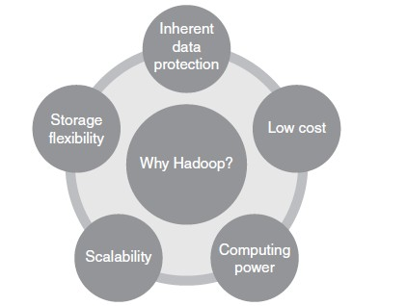
What is Hadoop
Hadoop is:
Ever wondered why Hadoop has been and is one of the most wanted technologies!!
The key consideration (the rationale behind its huge popularity) is:
Its capability to handle massive am
categories of data – fairly quickly.
The other considerations are :
ounts of data, different

Slide 9
RDBMS versus HADOOP

Slide 10
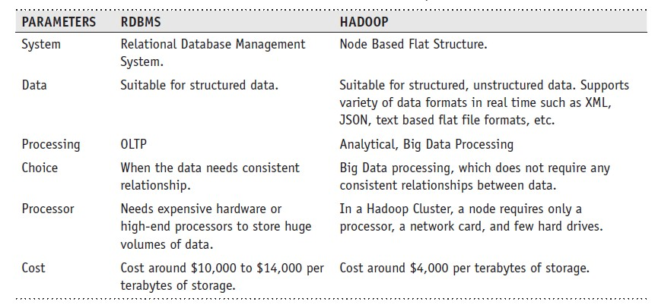
RDBMS versus HADOOP

Slide 11
Distributed Computing Challenges

Slide 12
Distributed Computing Challenges
Hardware Failure
How to Process This Gigantic Store of Data?

Slide 13
History of Hadoop

Slide 14
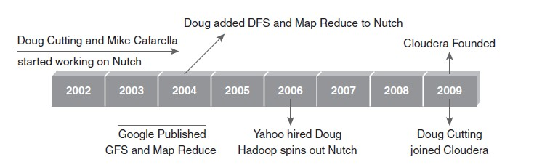
History of Hadoop

Slide 15
Hadoop Overview

Slide 16
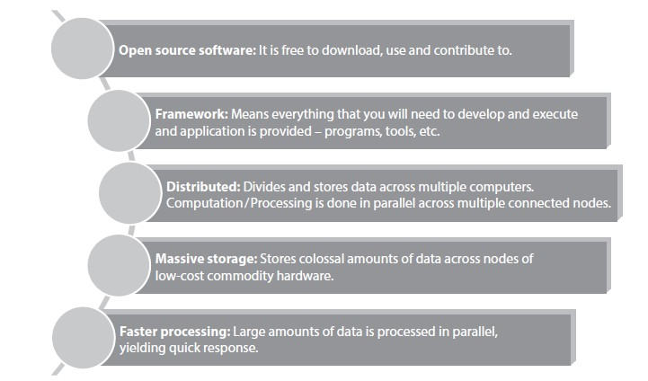
Key Aspects of Hadoop

Slide 17
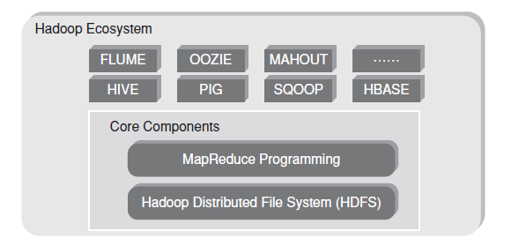
Hadoop Components

Slide 18
Hadoop Components
Hadoop Core Components:
HDFS:
Storage component.
Distributes data across several nodes.
Natively redundant.
MapReduce:
Computational framework.
Splits a task across multiple nodes.
Processes data in parallel.

Slide 19
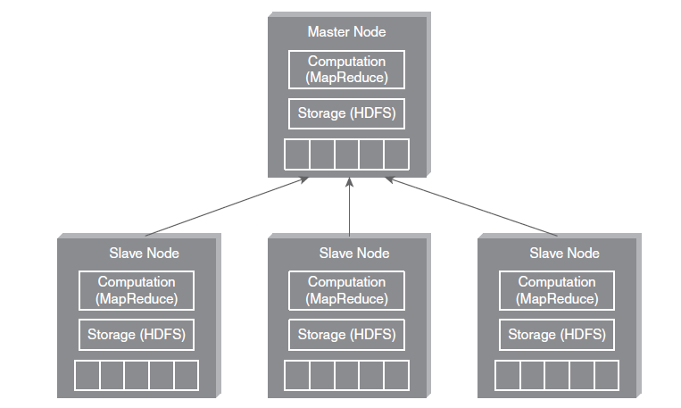
Hadoop High Level Architecture

Slide 20
Use case for Hadoop

Slide 21
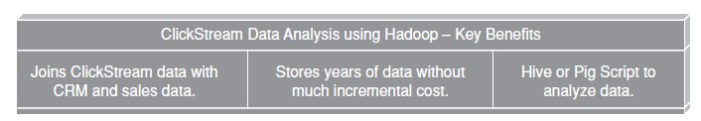
ClickStream Data Analysis
ClickStream data (mouse clicks) helps you to understand the purchasing behavior of customers. ClickStream analysis helps online marketers to optimize their product web pages, promotional content, etc. to improve their business.

Slide 22
Hadoop Distributors

Slide 23
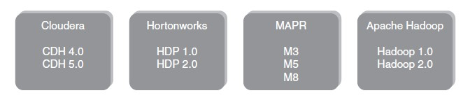
Hadoop Distributors

Slide 24
HDFS
(HADOOP DISTRIBUTED FILE SYSTEM)

Slide 25
Hadoop Distributed File System
1. Storage component of Hadoop.
Distributed File System.
Modeled after Google File System.
Optimized for high throughput (HDFS leverages large block size and
moves computation where data is stored).
You can replicate a file for a configured number of times, which is tolerant in terms of both software and hardware.
Re-replicates data blocks automatically on nodes that have failed.
You can realize the power of HDFS when you perform read or write on large files (gigabytes and larger).
Sits on top of native file system such as ext3 and ext4, which is described

Slide 26
HDFS Daemons
NameNode:
Single NameNode per cluster.
Keeps the metadata details
DataNode:
Multiple DataNode per cluster
Read/Write operations
SecondaryNameNode:
Housekeeping Daemon

Slide 27
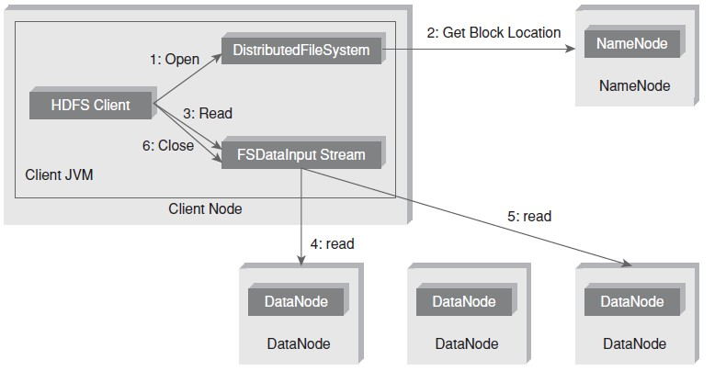
Anatomy of File Read

Slide 28
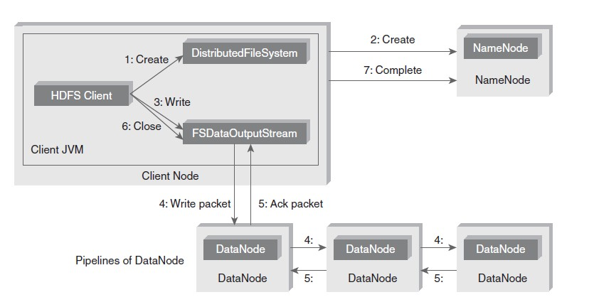
Anatomy of File Write

Slide 29
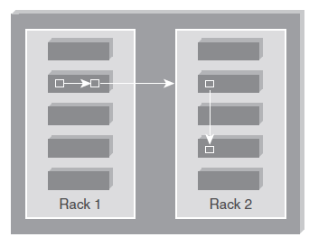
Replica Placement Strategy
As per the Hadoop Replica Placement Strategy, first replica is placed on the same node as the client. Then it places second replica on a node that is present on different rack. It places the third replica on the same rack as second, but on a different node in the rack. Once replica locations have been set, a pipeline is built. This strategy provides good reliability.

Slide 30
Working with HDFS Commands
Objective: To create a directory (say, sample) in HDFS.
Act:
hadoop fs -mkdir /sample
Objective: To copy a file from local file system to HDFS.
Act:
hadoop fs -put /root/sample/test.txt /sample/test.txt Objective: To copy a file from HDFS to local file system. Act:
hadoop fs -get /sample/test.txt /root/sample/testsample.txt

Slide 31
Special Features of HDFS
Data Replication: There is absolutely no need for a client application to track all blocks. It directs the client to the nearest replica to ensure high performance.
Data Pipeline: A client application writes a block to the first DataNode in the pipeline. Then this DataNode takes over and forwards the data to the next node in the pipeline. This process continues for all the data blocks, and subsequently all the replicas are written to the disk.

Slide 32
Processing with Hadoop

Slide 33
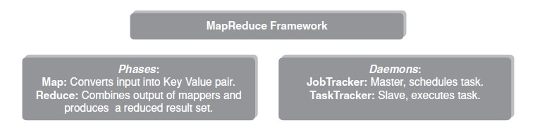
What is MapReduce Programming?
MapReduce Programming is a software framework. MapReduce Programming helps you to process massive amounts of data in parallel.

Slide 34
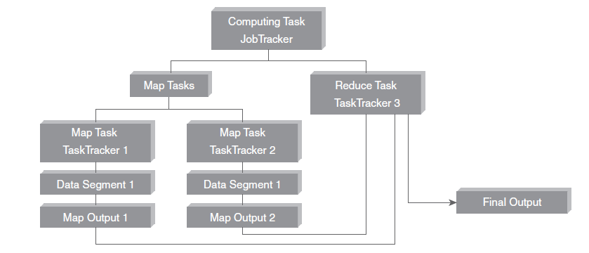
How MapReduce Programming Works

Slide 35
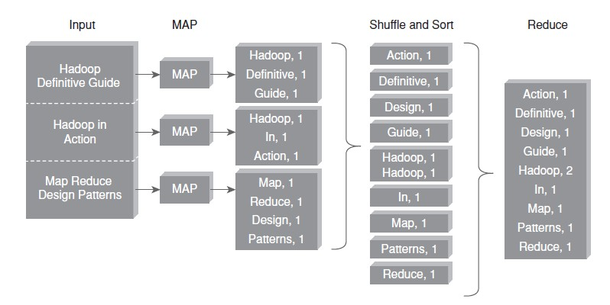
MapReduce – Word Count Example

Slide 36
MANAGING RESOURCES AND APPLICATIONS WITH HADOOP - YARN
(YET ANOTHER RESOURCE NEGOTIATOR)

Slide 37
Limitations of Hadoop 1.0 Architecture
Single NameNode is responsible for managing entire namespace for Hadoop Cluster.
It has a restricted processing model which is suitable for batch-oriented
MapReduce jobs.
Hadoop MapReduce is not suitable for interactive analysis.
Hadoop 1.0 is not suitable for machine learning algorithms, graphs, and other memory intensive algorithms.
5. MapReduce is responsible for cluster resource management and data
processing.

Slide 38
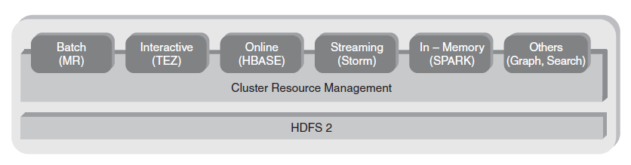
Hadoop 2 YARN: Taking Hadoop beyond Batch

Slide 39
Hadoop 2 YARN: Taking Hadoop beyond Batch
The fundamental idea behind this architecture is splitting the JobTracker responsibility of resource management and Job Scheduling/Monitoring into separate daemons. Daemons that are part of YARN Architecture are described below.
A Global ResourceManager: Its main responsibility is to distribute resources among various applications in the system. It has two main components:
NodeManager: This is a per-machine slave daemon. NodeManager responsibility is launching the application containers for application execution. NodeManager monitors the resource usage such as memory, CPU, disk, network, etc. It then reports the usage of resources to the global ResourceManager.
Per-application ApplicationMaster: This is an application-specific entity. Its responsibility is to negotiate required resources for execution from the ResourceManager. It works along with the NodeManager for executing and monitoring component tasks.

Slide 40
Interacting with Hadoop Ecosystem

Slide 41
Interacting with Hadoop Ecosytem
Pig : Pig is a data flow system for Hadoop. It uses Pig Latin to specify data flow. Pig is an alternative to MapReduce Programming. It abstracts some details and allows you to focus on data processing.
Hive: Hive is a Data Warehousing Layer on top of Hadoop. Analysis and queries can be done using an SQL-like language. Hive can be used to do ad-hoc queries, summarization, and data analysis. Figure 5.31 depicts Hive in the Hadoop ecosystem.
Sqoop: Sqoop is a tool which helps to transfer data between Hadoop and Relational Databases. With the help of Sqoop, you can import data from RDBMS to HDFS and vice-versa. Figure 5.32 depicts the Sqoop in Hadoop ecosystem.
HBase: HBase is a NoSQL database for Hadoop. HBase is column-oriented NoSQL database. HBase is used to store billions of rows and millions of columns. HBase provides random read/write operation. It also supports record level updates which is not possible using HDFS. HBase sits on top of HDFS. Figure
5.33 depicts the HBase in Hadoop ecosystem.

Slide 42
Answer a few quick questions…

Slide 43
Match the columns
Column A
Column B
HDFS
MapReduce Programming Master node
Slave node
Hadoop Implementation
DataNode NameNode Processing Data
Google File System and MapReduce
Storage

Slide 44
Match the columns
Column A
Column B
JobTracker MapReduce TaskTracker
Job Configuration Map
Executes Task Schedules Task Programming Model
Converts input into Key Value pair Job Parameters

Slide 45
Thank You

