Slide 1



Big Data
^{And} Analytics
Seema Acharya
Subhashini Chellappan

Slide 2
Chapter 6
Introduction to MongoDB

Slide 3
Learning Objectives and Learning Outcomes
Learning Objectives | Learning Outcomes
Introduction to MongoDB To study the features of MongoDB. To learn how to perform CRUD operations. To study aggregation. To study the MapReduce Framework. To import from and export to CSV format. | To comprehend the reasons behind the popularity of NoSQL database. To be able to perform CRUD operations. To comprehend MapReduce framework. To understand the aggregation. To be able to successfully import from and export to CSV.

Slide 4
Session Plan
Lecture time
90 to 120 minutes
Q/A
15 minutes

Slide 5
Agenda
What is MongoDB?
Why MongoDB?
Using JSON
Creating or Generating a Unique Key
Support for Dynamic Queries
Storing Binary Data
Replication
Sharding
Terms used in RDBMS and MongoDB
Data Types in MongoDB
CRUD (Insert(), Update(), Save(), Remove(), Find())
MapReduce Functions
Aggregation
Java Scripting
MongoImport
MongoExport

Slide 6
MongoDB– An Introduction

Slide 7
What is MongoDB?
MongoDB is:
Cross-platform.
Open source.
Non-relational.
Distributed.
NoSQL.
Document-oriented data store.

Slide 8
Why MongoDB?

Slide 9
Why MongoDB?
Open Source
Distributed
Fast In-Place Updates
Replication
Full Index Support
Rich Query Language
Easy Scalability
Auto sharding

Slide 10
JSON

Slide 11
JSON (Java Script Object Notation)
Sample JSON Document
{
FirstName: John, LastName: Mathews,
ContactNo: [+123 4567 8900, +123 4444 5555]
}

Slide 12
Unique Identifier
Each JSON document should have a unique identifier. It is the _id key.
0 | 1 | 2 | 3 | 4 | 5 | 6 | 7 | 8 | 9 | 10 | 11
Timestamp |  |  |  | Machine ID |  |  | Process ID |  | Counter

Slide 13
Support for Dynamic Queries
MongoDB has extensive support for dynamic queries.
This is in keeping with traditional RDBMS wherein we have static data and dynamic queries.

Slide 14
Storing Binary Data
MongoDB provides GridFS to support the storage of binary data.
It can store up to 4 MB of data.

Slide 15





Replication in MongoDB
Client Application
Writes
Reads
Primary
Replication
Replication
Replication
Secondary
Secondary
Secondary

Slide 16


Sharding in MongoDB
Collection 1
1 TB database
Shard 1
Shard 2
Shard 3
Shard 4
(256 GB)
(256 GB) (256 GB)
Logical Database (Collection 1)
(256 GB)

Slide 17
Terms Used in RDBMS and MongoDB

Slide 18
Terms Used in RDBMS and MongoDB
RDBMS | MongoDB
Database | Database
Table | Collection
Record | Document
Columns | Fields / Key Value pairs
Index | Index
Joins | Embedded documents
Primary Key | Primary key (_id is a identifier)

Slide 19
Data Types in MongoDB

Slide 20
Data Types in MongoDB
String | Must be UTF-8 valid. Most commonly used data type.
Integer | Can be 32-bit or 64-bit (depends on the server).
Boolean | To store a true/false value.
Double | To store floating point (real values).
Min/Max keys | To compare a value against the lowest or highest BSON elements.
Arrays | To store arrays or list or multiple values into one key.
Timestamp | To record when a document has been modified or added.
Null | To store a NULL value. A NULL is a missing or unknown value.
Date | To store the current date or time in Unix time format. One can create object of date and pass day, month and year to it.
Object ID | To store the document’s id.
Binary data | To store binary data (images, binaries, etc.).
Code | To store javascript code into the document.
Regular expression | To store regular expression.

Slide 21
CRUD in MongoDB

Slide 22
Collections
To create a collection by the name “Person”. Let us take a look at the
collection list prior to the creation of the new collection “Person”.
db.createCollection(“Person”);

Slide 23
Collections
To drop a collection by the name “food”.
db.food.drop();

Slide 24
Insert Method
Create a collection by the name “Students” and store the following data in it.
db.Students.insert({_id:1, StudName:"Michelle Jacintha", Grade: "VII", Hobbies:
"Internet Surfing"});

Slide 25
Update Method
Insert the document for “Aryan David” into the Students collection only if it does not already exist in the collection. However, if it is already present in the collection, then update the document with new values. (Update his Hobbies from “Skating” to “Chess”.) Use “Update else insert” (if there is an existing document, it will attempt to update it, if there is no existing document then it will insert it).
db.Students.update({_id:3, StudName:"Aryan David", Grade: "VII"},{$set:{Hobbies: "Skating"}},{upsert:true});

Slide 26
Find Method
To search for documents from the “Students” collection based on certain search criteria.
db.Students.find({StudName:"Aryan David"});

Slide 27
Find Method
To display only the StudName and Grade from all the documents of the Students collection. The identifier _id should be suppressed and NOT displayed.
db.Students.find({},{StudName:1,Grade:1,_id:0});

Slide 28
Find Method
To find those documents where the Grade is set to ‘VII’
db.Students.find({Grade:{$eq:'VII'}}).pretty();

Slide 29
Find Method
To find those documents from the Students collection where the Hobbies is set to either ‘Chess’ or is set to ‘Skating’.
db.Students.find ({Hobbies :{ $in: ['Chess','Skating']}}).pretty ();

Slide 30
Find Method
To find documents from the Students collection where the StudName begins
with “M”.
db.Students.find({StudName:/^M/}).pretty();

Slide 31
Find Method
To find documents from the Students collection where the StudName has an “e”
in any position.
db.Students.find({StudName:/e/}).pretty();

Slide 32
Find Method
To find the number of documents in the Students collection.
db.Students.count();

Slide 33
Find Method
To sort the documents from the Students collection in the descending order of StudName.
db.Students.find().sort({StudName:-1}).pretty();

Slide 34
Aggregate Function

Slide 35
Aggregate Function
{ } | CustID: “C123”, AccBal: 500, AccType: “S”
{ } | CustID: “C123”, AccBal: 900, AccType: “S”
{
 | CustID: “C111”,
 |  | $match
 | AccBal: 1200,
 | AccType: “S”
}
{ } | CustID: “C123”, AccBal: 1500, AccType: “C”
{ } | CustID: “C123”, AccBal: 500, AccType: “S”
{
 | CustID: “C123”,
 | AccBal: 900,
 | AccType: “S”
 |  | $group
}
{ } | CustID: “C111”, AccBal: 1200, AccType: “S”
{
_id: “C123”,
TotAccBal: 1400
}
{
_id: “C111”,
TotAccBal: 1200
}
Customers

Slide 36
Aggregate Function
First filter on “AccType:S” and then group it on “CustID” and then compute the sum of “AccBal” and then filter those documents wherein the “TotAccBal” is greater than 1200, use the below syntax:
db.Customers.aggregate( { $match : {AccType : "S" } },
{ $group : { _id : "$CustID",TotAccBal : { $sum : "$AccBal" } } },
{ $match : {TotAccBal : { $gt : 1200 } }});

Slide 37
MapReduce Framework

Slide 38
MapReduce Framework
{ } | CustID: “C123”, AccBal: 500, AccType: “S”
{ } | CustID: “C123”, AccBal: 900, AccType: “S”
{
 | CustID: “C111”,
 |  | query
 | AccBal: 1200,
 | AccType: “S”
}
{ } | CustID: “C123”, AccBal: 1500, AccType: “C”
{ } | CustID: “C123”, AccBal: 500, AccType: “S”
{
 | CustID: “C123”,
 | AccBal: 900,
 | AccType: “S”
 |  | map
}
{ } | CustID: “C111”, AccBal: 1200, AccType: “S”
{
_id: “C123”,
value: 1400
{“C123”:[ 500,900 ]}
}
{“C111”: 1200 }
{
_id: “C111”,
value: 1200
}
Customer_Totals
Customers

Slide 39
Java Script Programming

Slide 40
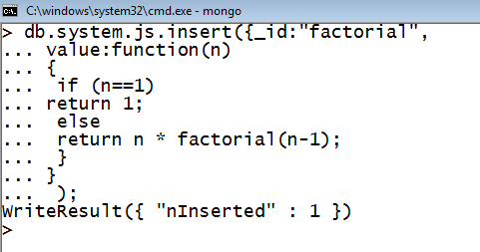

Java Script Programming
To compute the factorial of a given positive number. The user is required to create a function by the name “factorial” and insert it into the “system.js” collection.

Slide 41
MongoImport

Slide 42
Import data from a CSV file
Given a CSV file “sample.txt” in the D: drive, import the file into the MongoDB
collection, “SampleJSON”. The collection is in the database “test”.
Mongoimport --db test --collection SampleJSON --type csv --headerline --file d:\sample.txt

Slide 43
MongoExport

Slide 44
Export data to a CSV file
This command used at the command prompt exports MongoDB JSON documents from “Customers” collection in the “test” database into a CSV file “Output.txt” in the D: drive.
Mongoexport
d:\output.txt
--db test --collection Customers --csv --fieldFile
d:\fields.txt --out

Slide 45
Answer a few quick questions …

Slide 46
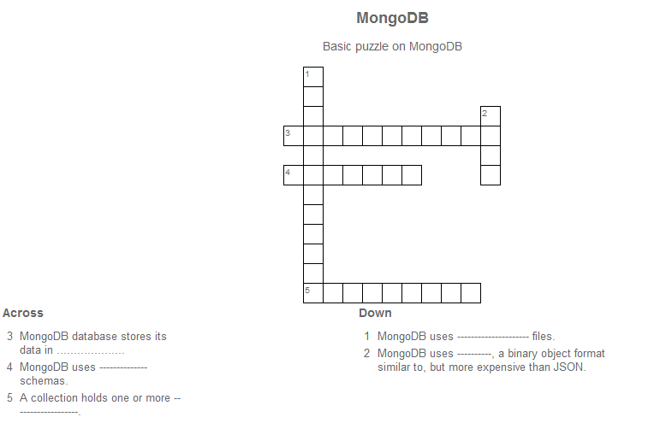
Crossword

Slide 47
Answer Me
◆ What is MongoDB?
◆ Comment on Auto-sharding in MongoDB.
◆ What are collections and documents?
◆ What is JSON?
◆ Explain your understanding of Update In-Place.

Slide 48
Summary please…
Ask a few participants of the learning program to summarize the lecture.

Slide 49
References …

Slide 50
Further Readings
http://www.mongodb.org/ https://university.mongodb.com/ http://www.tutorialspoint.com/mongodb/

Slide 51
Thank you

