Slide 1



Big Data
^{And} Analytics
Seema Acharya
Subhashini Chellappan

Slide 2
Chapter 8
Introduction to MapReduce Programming

Slide 3
Learning Objectives and Learning Outcomes
Learning Objectives | Learning Outcomes
Introduction to MapReduce Programming To study the optimization techniques of MapReduce Programming. To learn the combiner, partitioner technique. To study sorting, searching and compression. | To comprehend the reasons behind the popularity of MapReduce Programming. To be able to perform combiner and partitioner program. To comprehend searching, sorting and compression.

Slide 4
Session Plan
Lecture time
90 minutes
Q/A
5 minutes

Slide 5
Agenda
◆ Introduction
◆ Mapper
RecordReader
Map
Combiner
Partitioner
◆ Reducer
Shuffle
Sort
Reduce
Output Format
◆ Combiner
◆ Partitioner
◆ Searching
◆ Sorting
◆ Compression

Slide 6
Introduction

Slide 7
Introduction
In MapReduce Programming, Jobs (Applications) are split into a set of map tasks and reduce tasks. Then these tasks are executed in a distributed fashion on Hadoop cluster.
Each task processes small subset of data that has been assigned to it. This way, Hadoop distributes the load across the cluster.
MapReduce job takes a set of files that is stored in HDFS (Hadoop
Distributed File System) as input.

Slide 8
Mapper

Slide 9
Mapper
A mapper maps the input key−value pairs into a set of intermediate key–value pairs. Maps are individual tasks that have the responsibility of transforming input records into intermediate key–value pairs.
Mapper Consists of following phases:
RecordReader
Map
Combiner
Partitioner

Slide 10
Reducer

Slide 11
Reducer
The primary chore of the Reducer is to reduce a set of intermediate values (the ones that share a common key) to a smaller set of values.
The Reducer has three primary phases: Shuffle and Sort, Reduce, and
Output Format.

Slide 12
The chores of Mapper, Combiner, Partitioner, and Reducer

Slide 13
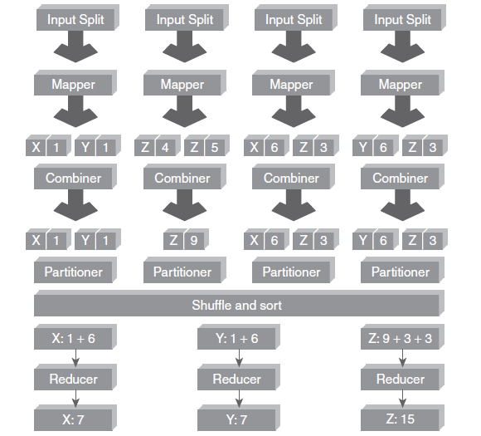
The chores of Mapper, Combiner, Partitioner, and Reducer

Slide 14
Combiner

Slide 15
Combiner
It is an optimization technique for MapReduce Job. Generally, the reducer class is set to be the combiner class. The difference between combiner class and reducer class is as follows:
Output generated by combiner is intermediate data and it is passed to the reducer.
Output of the reducer is passed to the output file on disk.

Slide 16
Partitioner

Slide 17
Partitioner
The partitioning phase happens after map phase and before reduce phase. Usually the number of partitions are equal to the number of reducers. The default partitioner is hash partitioner.

Slide 18
Searching and Sorting Demo

Slide 19
Compression
In MapReduce programming, you can compress Compression provides two benefits as follows:
the MapReduce
output
file.
Reduces the space to store files.
Speeds up data transfer across the network.
You can specify compression format in the Driver Program as shown below:
conf.setBoolean("mapred.output.compress",true); conf.setClass("mapred.output.compression.codec", GzipCodec.class,CompressionCodec.class);
Here, codec is the implementation of a compression and decompression algorithm.
GzipCodec is the compression algorithm for gzip. This compresses the output file.

Slide 20
Answer a few questions…

Slide 21
Fill in the blanks
1. Partitioner phase belongs ------------------------ to task.
2. Combiner is also known ---------------------------.
RecordReader converts byte-oriented view into --------------------------- view.
MapReduce sorts the intermediate value based on -------------------------- .
In MapReduce Programming, reduce function is applied ---------------- group at a time.

Slide 22
Thank You

