Slide 1
SQL v/s NoSQL v/s NewSQL
Prepared By
Group - 6

Slide 2
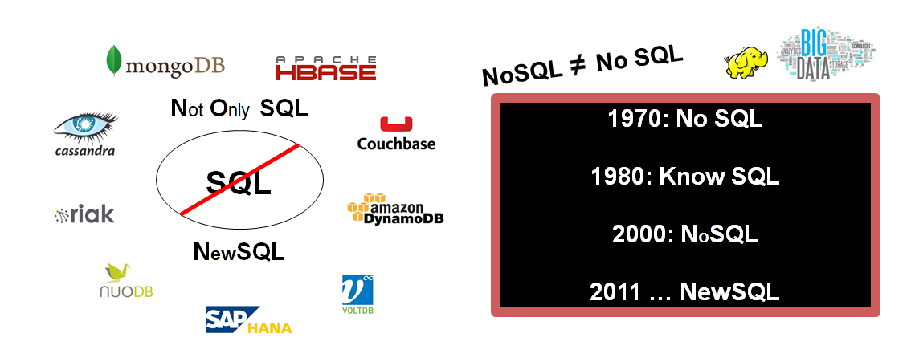
Introduction

Slide 3
SQL

Slide 4





Vendors
Early
Fixed schema
Data is normalized
Expensive storage
Client/Server model
SQL becomes a standard
SQL is a standard Interactive and
Programming language for getting information from and updating a database.
It is a relational model and obeys ACID properties.

Slide 5


SQL and its ACID Properties
Example: Banking Transaction
Transfer Money
ATOMICITY
All or nothing
Open Account of (Ram)
OldBalance=Ram.Balance
NewBalance=OldBalance-1000
Ram.Balance=NewBalance
Close
Open Account of (Ahmed)
OldBalance=Ahmed.Balance
NewBalance=OldBalance+1000
Ahmed.Balance=NewBalance
Close

Slide 6
SQL and its ACID Properties
Example: Banking Transaction
Transfer Money
CONSISTENCY
Transaction must leave database in consistent state even if it succeed or rollback.
Open Account of (Ram)
OldBal=Ram.Bal
NewBal=OldBal-1000
Ram.Bal=NewBal
Close
Open Account of (Ahmed)
OldBal=Ahmed.Bal
NewBal=OldBal+1000
Ahmed.Bal=NewBal
Close

Slide 7
SQL and its ACID Properties
Example: Banking Transaction
Transfer Money
ISOLATION
Two database transactions happening at same time should not affect each other and has consistent view of database.
Open Account of (Ram)
OldBal=Ram.Bal
NewBal=OldBal-1000
Ram.Bal=NewBal
Close
Open Account of (Ahmed)
OldBal=Ahmed.Bal
NewBal=OldBal+1000
Ahmed.Bal=NewBal
Close

Slide 8
SQL and its ACID Properties
Example: Banking Transaction
Transfer Money
DURABILITY
Data has to be persisted successfully in database once transaction completed successfully and it has to be saved from power outage or other threats.
Open Account of (Ram)
OldBal=Ram.Bal
NewBal=OldBal-1000
Ram.Bal=NewBal
Close
Open Account of (Ahmed)
OldBal=Ahmed.Bal
NewBal=OldBal+1000
Ahmed.Bal=NewBal
Close

Slide 9
NoSQL

Slide 10

Non relational- No pre-defined schema
Scalability
Collection of structures
No join operations
CAP theorem
Consistency, Availability and Partitioning (but not all three at once!).

Slide 11

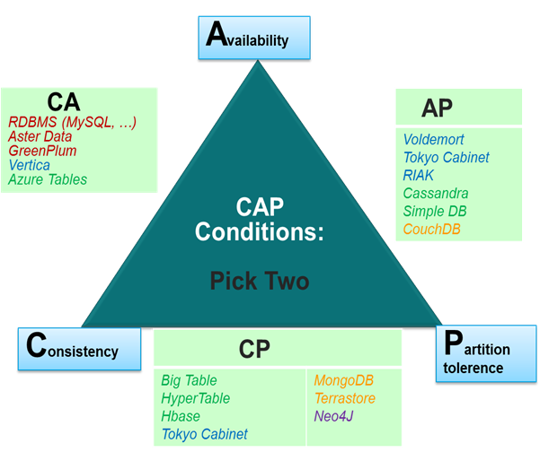



Slide 12
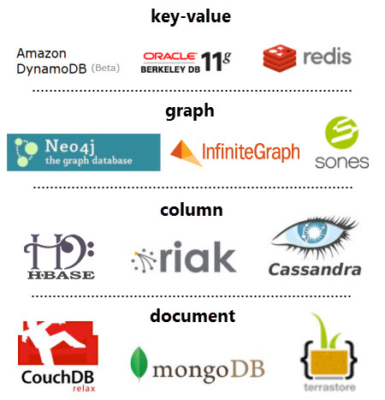
Types of NoSQL

Slide 13
Why NoSQL?
NoSQL databases first started out as in-house solutions to real problems:
Amazon’s Dynamo
Facebook’s Cassandra
The listed companies didn’t start of by rejecting relational technologies.
They tried them and found that they didn’t meet their requirements:
Huge concurrent transactions volume
Expectations of low-latency access to massive datasets
Expectations of nearly perfect service availability while operating in an unreliable environment

Slide 14
RDBMS vs NoSQL
RDBMSs enforce global ACID properties thus allowing multiple arbitrary operations in the context of a single transaction.
NoSQL databases enforce only local BASE properties
Basically Available (data is always perceived as available by the user)
Soft State (data at some node could change without any explicit user intervention. This follows from eventual consistency)
Eventually Consistent (NoSQL guarantees consistency only at some undefined future time)

Slide 15
Limitations of NoSQL
No standardized schema
No standard format of language for queries
Data is generally duplicated, potential for inconsistency
Depend on the application layer to enforce data integrity
No guarantee of support
Too many options, which one, or ones to pick

Slide 16
NewSQL

Slide 17
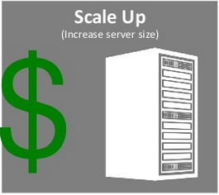

Properties of SQL and NoSQL
SQL
NoSQL
ACID Properties
Schema oriented
Tables and rows
CAP Theorem
Schema less
Document, Columnar, Graph.

Slide 18






Why scale out architecture is good?

Slide 19




Why scale out architecture is good?

Slide 20


What is NewSQL?
451 Group’s Definition
A DBMS that delivers the scalability and flexibility promised by NoSQL while retaining the support for SQL queries and/or ACID, or to improve performance for appropriate workloads.
Matt Aslett–“How Will The Database Incumbents Respond To NoSQLAnd NewSQL?”https://www.451research.com/report short?entityId=66963

Slide 21



NewSQL: Scale-out SQL
Transactions (OLTP)
Real-Time Analytics
High Availability
(production)
Geo-distributed OLTP
(production)
SAP
In-Memory
Real-Time Analytics
(Add-on to production)
In-memory OLTP
ETL for Analytics
(Add-on to production)

Slide 22
SQL v/s NoSQL
 | SQL | NoSQL
Data storage | Stored in a relational model, with rows and columns. | The main ones are: document, graph, key-value and columnar.
Schemas and Flexibility | Each record conforms to fixed schema. | Schemas are dynamic.
Scalability | Scaling is vertical | Scaling is horizontal, meaning across servers.
ACID Compliancy | The vast majority of relational databases are ACID compliant. | Sacrifice ACID compliancy for performance and scalability

Slide 23
SQL v/s NoSQL v/s NewSQL
Characteristic | RDBMS | NoSQL | NewSQL
ACID compliance (Data, Transaction integrity) | Yes | No | Yes
OLAP/OLTP | Yes | No | Yes
Data analysis (aggregate, transform, etc.) | Yes | No | Yes
Schema rigidity (Strict mapping of model) | Yes | No | Maybe
Data format flexibility | No | Yes | Maybe
Distributed computing | Yes | Yes | Yes
Scale up (vertical)/Scale out (horizontal) | Yes | Yes | Yes
Performance with growing data | Fast | Fast | Very Fast
Performance overhead | Huge | Moderate | Minimal
Popularity/community Support | Huge | Growing | Slowly growing

