Slide 1
Cassandra Architecture & Replication Factor Strategy
Cassandra is designed to handle big data. Cassandra’s main feature is to store data on multiple nodes with no single point of failure.
The reason for this kind of Cassandra’s architecture was that the hardware failure can occur at any time.
Any node can be down. In case of failure data stored in another node can be used. Hence, Cassandra is designed with its distributed architecture.
Cassandra stores data on different nodes with a peer to peer distributed fashion architecture.
All the nodes exchange information with each other using Gossip protocol.
Gossip is a protocol in Cassandra by which nodes can communicate with each other.

Slide 2
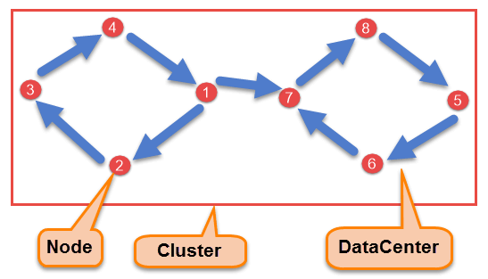
Components of Cassandra
There are following components in the Cassandra;

Slide 3
NodeNode is the place where data is stored. It is the basic component of Cassandra.
Data CenterA collection of nodes are called data center. Many nodes are categorized as a data center.
ClusterThe cluster is the collection of many data centers.
Commit LogEvery write operation is written to Commit Log. Commit log is used for crash recovery.
Mem-tableAfter data written in Commit log, data is written in Mem-table. Data is written in Mem-table temporarily.
SSTableWhen Mem-table reaches a certain threshold, data is flushed to an SSTable disk file.

Slide 4
Data Replication
As hardware problem can occur or link can be down at any time during data process, a solution is required to provide a backup when the problem has occurred.
So data is replicated for assuring no single point of failure.
Cassandra places replicas of data on different nodes based on these two factors.
Where to place next replica is determined by the Replication Strategy.
While the total number of replicas placed on different nodes is determined by the Replication Factor.
One Replication factor means that there is only a single copy of data while three replication factor means that there are three copies of the data on three different nodes.
For ensuring there is no single point of failure, replication factor must be three.
There are two kinds of replication strategies in Cassandra.

Slide 5
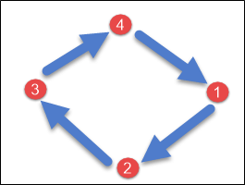
SimpleStrategy
SimpleStrategy is used when you have just one data center.
SimpleStrategy places the first replica on the node selected by the partitioner.
After that, remaining replicas are placed in clockwise direction in the Node ring.
Here is the pictorial representation of the SimpleStrategy.

Slide 6
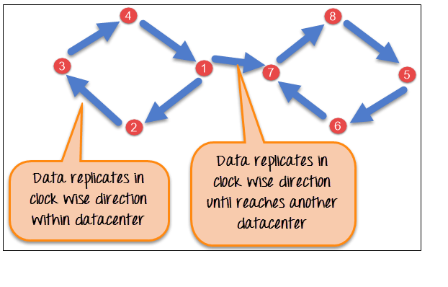
NetworkTopologyStrategy
NetworkTopologyStrategy is used when you have more than two data centers.
In NetworkTopologyStrategy, replicas are set for each data center separately.
NetworkTopologyStrategy places replicas in the clockwise direction in the ring until reaches the first node in another rack.
This strategy tries to place replicas on different racks in the same data center.
This is due to the reason that sometimes failure or problem can occur in the rack. Then replicas on other nodes can provide data.
Here is the pictorial representation of the Network topology strategy

Slide 7
Write Operation
The coordinator sends a write request to replicas. If all the replicas are up, they will receive write request regardless of their consistency level.
Consistency level determines how many nodes will respond back with the success acknowledgment.
The node will respond back with the success acknowledgment if data is written successfully to the commit log and memTable.
For example, in a single data center with replication factor equals to three, three replicas will receive write request.
If consistency level is one, only one replica will respond back with the success acknowledgment, and the remaining two will remain dormant.
Suppose if remaining two replicas lose data due to node downs or some other problem, Cassandra will make the row consistent by the built-in repair mechanism in Cassandra.

Slide 8
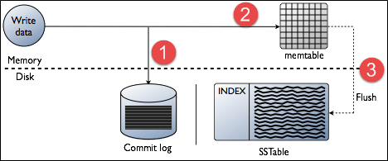
Here it is explained, how write process occurs in Cassandra
When write request comes to the node, first of all, it logs in the commit log.
Then Cassandra writes the data in the mem-table.
Data written in the mem-table on each write request also writes in commit log separately.
Mem-table is a temporarily stored data in the memory while Commit log logs the transaction records for back up purposes.
When mem-table is full, data is flushed to the SSTable data file.

Slide 9
There are three types of read requests that a coordinator sends to replicas.
Direct request
Digest request
Read repair request
The coordinator sends direct request to one of the replicas.
After that, the coordinator sends the digest request to the number of replicas specified by the consistency level and checks whether the returned data is an updated data.
After that, the coordinator sends digest request to all the remaining replicas.
If any node gives out of date value, a background read repair request will update that data. This process is called read repair mechanism.

Slide 10
https://www.guru99.com/cassandra-architecture.html#:~:text=There%20are%20two%20kinds%20of%20replication%20strategies%20in%20Cassandra.&text=SimpleStrategy%20is%20used%20when%20you,direction%20in%20the%20Node%20ring.

