Slide 1







ELASTIC THREATOPS
On-Prem
AWS Cloud
AD • Linux • Web • IDS
CloudTrail • S3 • SQS
Hybrid Enterprise SOC Lab
Cloud + On-Premise Security Monitoring, Detection and Threat Intelligence
SOC-Core
MISP
Elastic • Kafka • Logstash
Threat Intelligence
Group 10
Kaushal Kamde - 260240123025
Khem Kumar Rathore - 260240123026
Prajakta S. Patil - 260240123034
Guided by:
Kibana Security
Rules • Alerts • Dashboards
Mr. Raja Singh
ELASTIC THREATOPS PLATFORM
Hybrid Enterprise SOC Lab 1

Slide 2


Presentation Roadmap
OVERVIEW
A guided walkthrough from problem to validated security outcomes
01
Problem & objectives
Why a hybrid SOC was required
02
Architecture
Network, identity and log flow
03
Implementation
Elastic, AD, MISP, Suricata and AWS
04
Detection validation
Rules, alerts and evidence
05
Troubleshooting
Issues, root causes and fixes
06
Future scope
Hardening, automation and scale
ELASTIC THREATOPS PLATFORM
Hybrid Enterprise SOC Lab 1

Slide 3










Problem Statement
PROBLEM
The operational gap the project addresses
Fragmented visibility
Logs were generated across cloud, Linux, Windows, web applications and network sensors, but there was no unified monitoring layer.
Hybrid connectivity constraints
On-premise systems and AWS resources had to communicate securely despite enterprise firewall restrictions on standard VPN traffic.
Manual threat analysis
Raw events lacked consistent parsing, enrichment, correlation and alerting, making investigations slow and error-prone.
Core requirement
Design a cost-conscious, production-inspired SOC platform that securely collects hybrid telemetry, enriches it with threat intelligence, stores it reliably, and generates actionable alerts in Kibana.
Cloud
Network
Endpoint
Identity
Threat Intel
Detection
ELASTIC THREATOPS PLATFORM
Hybrid Enterprise SOC Lab 1

Slide 4

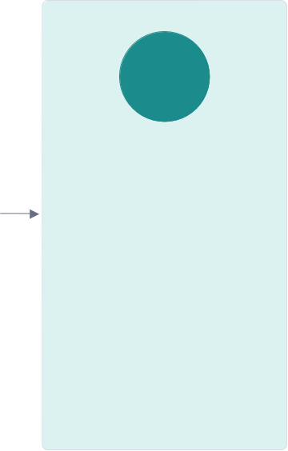
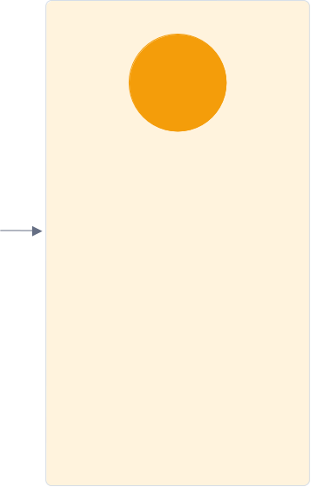
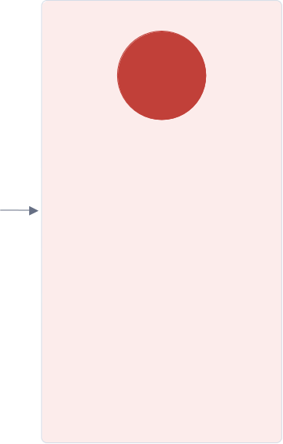
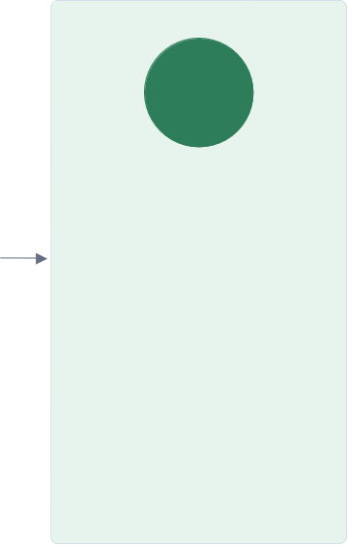
Proposed Solution
SOLUTION
A layered security architecture with clear ownership at every stage
1
2
3
4
5
Connect
Collect
Buffer & process
Enrich
Detect & investigate
AWS-hosted WireGuard gateway with NAT/routing and TCP 443 tunnelling support
Filebeat, Winlogbeat, Auditbeat and Suricata collect cloud, endpoint, identity and network telemetry
Logstash ingest pipeline normalizes events, Kafka buffers them, indexer routes to SOC indices
MISP IOC lookups add threat.indicator.matched fields to relevant events
Kibana detection rules create alerts and support Discover-based triage
Design principle: decouple collection, processing, storage and detection so each layer can be tested independently.
ELASTIC THREATOPS PLATFORM
Hybrid Enterprise SOC Lab 1

Slide 5
















Hybrid SOC Architecture
ARCHITECTURE
Editable topology based on the implemented lab
ON-PREMISE / LAB
AWS CLOUD TELEMETRY
Internet / Elastic IP
SOC-Core
192.168.150.20
MISP
192.168.150.10
CloudTrail
Management events
S3
Log storage
SQS
Events
AWS VPN Gateway
IDS
192.168.150.30
AD-DS
192.168.150.40
WireGuard + NAT + Routing wstunnel over TCP 443
Encrypted tunnel
Filebeat
Logstash
ES
Internal / Security 192.168.150.0/24
AWS S3 input
Parse + route
Index
Web / Juice Shop
192.168.100.10
Honeypot
192.168.100.100
DMZ 192.168.100.0/24
ELASTIC THREATOPS PLATFORM
Hybrid Enterprise SOC Lab 1

Slide 6

Network Segmentation & Host Roles
NETWORK
Three functional zones reduce exposure and clarify traffic flows
Transport / Edge
192.168.74.0/24
DHCP uplink used only to reach the VPN gateway; DNS registration disabled
DMZ
192.168.100.0/24
OWASP Juice Shop / web server and honeypot services
Internal / Security
192.168.150.0/24
AD, DNS, SOC-Core, MISP and IDS infrastructure
KPK-DC01
AD DS / DNS / GC
192.168.150.40
SOC-Core
Elastic / Kafka / Logstash
192.168.150.20
VM-MISP-01
MISP / MariaDB / Redis
192.168.150.10
VM-IDS-01
Suricata IDS
192.168.150.30
VM-SERVICES-01 OWASP Juice Shop
192.168.100.10
Honeypot
Cowrie / Dionaea
192.168.100.100
ELASTIC THREATOPS PLATFORM
Hybrid Enterprise SOC Lab 1

Slide 7






Technology Stack
STACK
Tools selected for collection, processing, enrichment and detection
Connectivity
Collection
Processing
Storage & SOC
Identity & Intel
AWS EC2
Filebeat
Logstash
Elasticsearch 8.11.4
Windows Server 2022
WireGuard
Winlogbeat
Kafka
Kibana Security
AD DS / DNS / Kerberos
wstunnel
Auditbeat
ZooKeeper
Discover
SSSD / realmd
nftables / NAT
Suricata
ECS-style fields
Detection Engine
MISP
ELASTIC THREATOPS PLATFORM
Hybrid Enterprise SOC Lab 1

Slide 8





Technology Stack — Connectivity
CONNECTIVIT Y
How the lab securely connects cloud and on-premise networks
AWS EC2
WireGuard
1
2
Hosts the central VPN gateway in AWS and provides a stable, internet-reachable endpoint.
It routes encrypted traffic between the lab networks and the cloud using IP forwarding and NAT.
Creates the encrypted tunnel between on-premise VMs and the AWS gateway.
Peer keys, wg0 interfaces and AllowedIPs control which systems and networks can communicate.
wstunnel
nftables / NAT
3
4
Encapsulates WireGuard traffic inside WebSocket over TCP 443 when normal VPN ports are blocked.
This allows the tunnel to pass through restrictive organizational firewalls using an HTTPS-friendly path.
Implements packet filtering, forwarding and network address translation on the VPN gateway.
It controls traffic between the transport, internal-security and DMZ segments while enabling routed access.
Elastic ThreatOps Platform | Technology rationale

Slide 9




Technology Stack — Collection
COLLECTION
Agents and sensors that capture security telemetry at the source
Filebeat
Winlogbeat
1
2
Collects Linux, Nginx, Suricata and AWS-module logs with low system overhead.
It forwards events to Logstash through the Beats input for centralized parsing and routing.
Collects Windows Security, System, PowerShell, Active Directory and DNS event logs.
It sends domain-controller activity into the same SOC pipeline for identity and authentication monitoring.
Auditbeat
Suricata
3
4
Monitors Linux audit activity, user actions and file-integrity changes.
It supports detection of privilege escalation, persistence attempts and modifications to sensitive files.
Inspects network traffic as an IDS and produces structured EVE JSON events.
Its alerts, DNS and flow records help identify scans, malicious signatures and suspicious communication.
Elastic ThreatOps Platform | Technology rationale

Slide 10




Technology Stack — Processing
PROCESSING
The pipeline that buffers, normalizes and enriches incoming events
Logstash
Kafka
1
2
Receives events, parses source-specific formats and normalizes fields before indexing.
It also performs routing and enrichment, including GeoIP and threat-intelligence context where configured.
Provides a durable buffer between the Logstash ingest and indexer pipelines.
It absorbs traffic bursts and reduces the risk of log loss if Elasticsearch is slow or temporarily unavailable.
ZooKeeper
ECS-style fields
3
4
Coordinates Kafka broker metadata and topic state for the Kafka version used in the lab.
It supports broker registration and leadership coordination in the single-node messaging setup.
Maps different log sources into consistent fields such as source.ip and event.category.
This common structure makes searches, dashboards and detection rules reusable across multiple technologies.
Elastic ThreatOps Platform | Technology rationale

Slide 11




Technology Stack — Storage & SOC
STORAGE & SOC
Search, investigation and detection capabilities used by the SOC analyst
Elasticsearch 8.11.4
Kibana Security
1
2
Indexes and stores normalized security events in source-specific soc-* indices.
Its search and aggregation engine supports fast investigation, dashboards and detection-rule queries.
Provides the analyst interface for detection rules, alerts and security investigations.
It centralizes alert review, execution status and event context for SOC monitoring.
Discover
Detection Engine
3
4
Enables ad-hoc searches across raw indexed events using KQL and time filters.
It is used to verify ingestion, inspect fields and troubleshoot missing data before tuning a rule.
Runs query and threshold rules continuously against incoming security events.
It generates alerts for activities such as brute force, port scans, DNS spikes, cloud changes and IOC matches.
Elastic ThreatOps Platform | Technology rationale

Slide 12




Technology Stack — Identity & Intelligence
IDENTITY & INTEL
Centralized authentication and external threat context for higher-confidence detection
Windows Server 2022
AD DS / DNS / Kerberos
1
2
Hosts the KPK-DC01 domain controller used as the identity and DNS backbone of the lab.
It provides the Windows platform for AD DS administration, directory objects and domain services.
AD DS manages users, groups, computers and service accounts, while DNS resolves lab hosts and services.
Kerberos provides ticket-based domain authentication for the Windows server and joined Linux systems.
SSSD / realmd
MISP
3
4
Joins Ubuntu hosts to the kpk.local domain and resolves Active Directory identities on Linux.
PAM and NSS integration enables domain logins and supports future group-based authorization policies.
Stores and shares indicators of compromise such as malicious IPs, domains and hashes.
Matching events against MISP indicators adds threat context and increases the confidence of SOC alerts.
Elastic ThreatOps Platform | Technology rationale

Slide 13


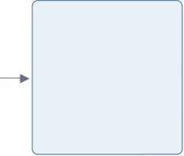




End-to-End Data Flow
PIPELINE
How a raw event becomes a searchable alert
Sources
Collectors
Ingest
Buffer
Indexer
Storage
Detection
Response
Linux • Windows • Web • IDS • AWS
Beats • Suricata
Logstash 01-ingest
Kafka topic: logs
Logstash 02-indexer
soc-* indices
Kibana rules
Alert investigation
Key routing outcomes ˢᵒᶜ⁻ˢʸˢᵗᵉᵐ.ᵃᵘᵗʰ⁻*
soc-nginx.access-* • soc-suricata.* • soc-dns.query-* • soc-file-* • soc-cicd.pipeline-* • soc-
aws.cloudtrail-* • soc-failed-*
Kafka decouples ingestion from indexing, allowing temporary downstream issues without immediately losing incoming events.
ELASTIC THREATOPS PLATFORM
Hybrid Enterprise SOC Lab 13

Slide 14


SOC-Core Implementation
ELASTIC
Validated Elastic and messaging services running in Docker
Elasticsearch ⁸.¹¹.⁴ WORKING Central storage and detection-rule backend; soc-* indices verified
Kibana ⁸.¹¹.⁴ WORKING Discover, dashboards, Security Rules, Alerts and execution results
Logstash ⁸.¹¹.⁴ WORKING Ingest and indexer pipelines operational; persisted queue enabled
Kafka ⁷.⁵.⁰ WORKING Topic logs created; consumer group logstash verified with zero lag
ZooKeeper ⁷.⁵.⁰ WORKING Kafka coordination service
Filebeat WORKING Endpoint, web, file and AWS telemetry delivered to Logstash
Health checks used
docker compose ps
/_cat/indices
/_node/pipelines
Operational result
Events searchable in Kibana and eligible for scheduled detection rules.
ELASTIC THREATOPS PLATFORM
Hybrid Enterprise SOC Lab 13

Slide 15








Active Directory & Identity Integration
IDENTITY
Centralized identity, DNS and Linux authentication for the SOC lab
Domain Services
Domain: kpk.local Controller: KPK-DC01 Windows Server 2022
AD DS + DNS + Global Catalog
Directory Design
Custom OUs for Servers, Linux Servers, Groups, Service Accounts and SOC Users.
Security Groups
SOC-Admins SOC-Analysts ThreatIntel IR-Team
ELK-Admins MISP-Users
Service Accounts
svc-misp svc-logstash svc-kibana svc-suricata
Linux domain-join validation
SOC-Core
COMPLETE
Kerberos kinit/klist verified
Verified controls
VM-MISP-01
COMPLETE
SSSD login verified
Forward and reverse DNS
LDAP and Kerberos SRV records
Identity resolution with id / getent
Non-privileged user denied sudo by design
VM-IDS-01
COMPLETE
Kerberos ticket auto-acquired
ELASTIC THREATOPS PLATFORM
Hybrid Enterprise SOC Lab 13

Slide 16







AWS CloudTrail Monitoring Pipeline
AWS
Free-tier-conscious event delivery from AWS into Elastic
CloudTrail
S3 Bucket
S3 Notification
SQS Queue
Filebeat
Logstash / Kafka
Elasticsearch
soc-cloudtrail Multi-region
aws-cloudtrail-logs-… AWSLogs/.../CloudTrail/
All object create events
cloudtrail-events
AWS S3 input
Normalize + buffer
soc-aws.cloudtrail-*
IAM design
Validated AWS detections
Dedicated Filebeat IAM user No console access
S3 read access
SQS consumer permissions: ReceiveMessage, DeleteMessage, ChangeMessageVisibility, GetQueueAttributes, GetQueueUrl
Root account activity
IAM user creation
Security group modified
△ CloudTrail StopLogging seen in Event History, but S3 ingestion was not consistently captured
Operational note: CloudTrail → S3 delivery is delayed, so rule look-back windows must be longer than near-real-time sources.
ELASTIC THREATOPS PLATFORM
Hybrid Enterprise SOC Lab 13

Slide 17


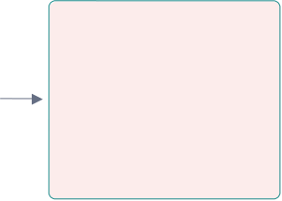
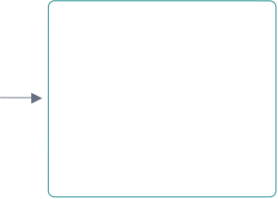
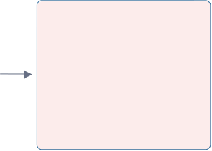
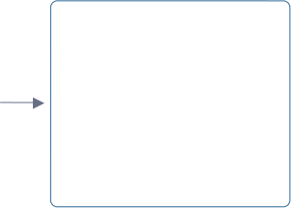

MISP Threat Intelligence Enrichment
THREAT INTEL
IOC matching turns a network event into high-confidence security context
MISP Feed
IOC Index
Suricata DNS
Logstash Enrichment
Matched Fields
Kibana Rule
IOC source
misp-ioc-intelligence
~318K indicators
Observed domain query
Lookup by domain / IP
threat.indicator.matched.*
Critical IOC alert
Validated field example
threat.indicator.matched.type = domain | atomic = ameteksen.com | provider = MISP
This proves the full enrichment chain: Suricata detection → Logstash lookup → enriched Elasticsearch document → Kibana alert.
ELASTIC THREATOPS PLATFORM
Hybrid Enterprise SOC Lab 13

Slide 18








Detection Coverage
DETECTION
Rules span cloud, network, endpoint, identity and threat intelligence
Network / IDS
Endpoint / Auth
Web / Pipeline
Threat Intel
AWS Cloud
Suricata alert
SSH brute force
Web enumeration / 404 scan
MISP IOC match
Root account activity
Critical Suricata alert
Multiple authentication failures
CI/CD pipeline failure
Malicious domain/IP enrichment
IAM user creation
Port scan
Sudo activity
Log parser failure
Security group modified
Excessive DNS queries
File integrity change
CloudTrail logging disabled*
* StopLogging event was generated in AWS, but ingestion was not consistently captured in the S3/SQS pipeline during testing.
ELASTIC THREATOPS PLATFORM
Hybrid Enterprise SOC Lab 13

Slide 19

Validation Method & Results
VALIDATION
Each rule was tested end-to-end, not only enabled in Kibana
1
Generate activity
Perform the attack simulation or administrative action
Key validated outcomes
2
Confirm indexing
Search the matching soc-* index in Discover / Elasticsearch
SOC indices populated
MISP-enriched DNS IOC alert generated
AWS root activity alert generated
IAM CreateUser alert generated
Security group modification alert generated
AD DNS, Kerberos and Linux login verified
Elasticsearch, Kibana, Logstash and Kafka healthy
3
Check rule execution
Verify the scheduled rule completed without query errors
4
Confirm alert
Validate source, timestamp, severity and event details
5
Review false positives
Ensure the event is expected and the rule is scoped correctly
Result: the project demonstrates a complete event lifecycle from telemetry generation to SOC analyst alert.
ELASTIC THREATOPS PLATFORM
Hybrid Enterprise SOC Lab 13

Slide 20


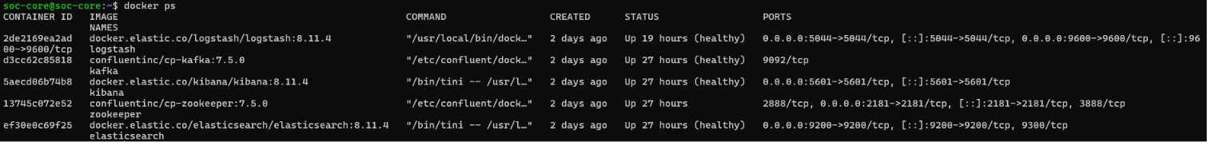
SOC-Core Service Health
Container-level verification of the Elastic processing and storage stack
PROJECT EVIDENCE
Elasticsearch, Kibana, Logstash and Kafka report healthy status; ZooKeeper is running.
This confirms that ingestion, buffering, processing, storage and visualization services are operational.

Slide 21
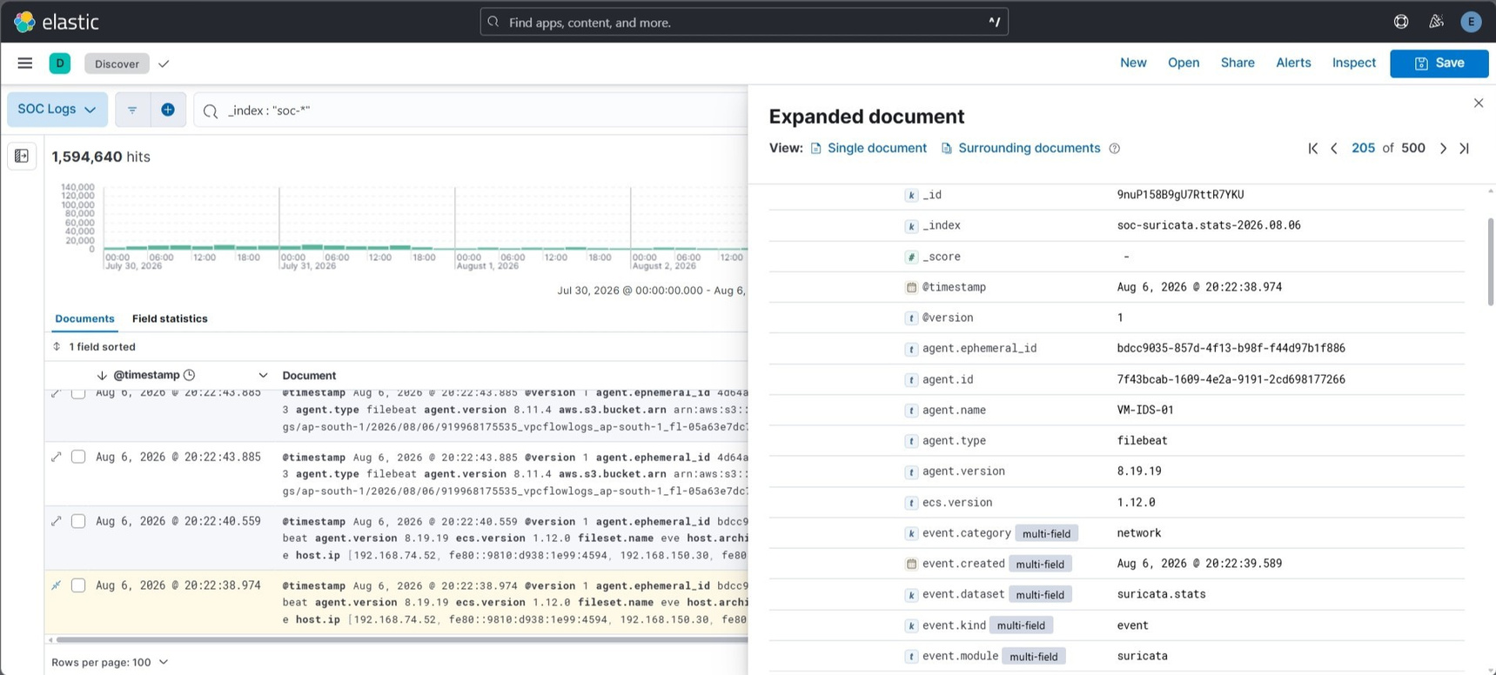
Kibana Discover — Centralized SOC Data
Searchable events from the soc-* data view with expanded Suricata fields
PROJECT EVIDENCE
Kibana Discover displays more than 1.59 million indexed SOC events across the selected time range.
The expanded document confirms Filebeat ingestion, ECS metadata, VM-IDS-01 attribution and Suricata categorization.

Slide 22
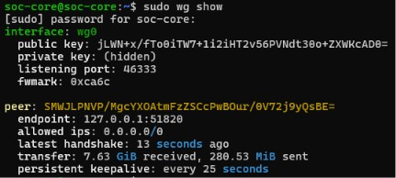
WireGuard Connectivity
Active encrypted peer session between the on-premises host and VPN gateway
PROJECT EVIDENCE
A recent handshake, configured peer and bidirectional transfer values confirm the tunnel is active.
Persistent keepalive supports reliable connectivity between the on-premises lab and the AWS-hosted VPN gateway.

Slide 23
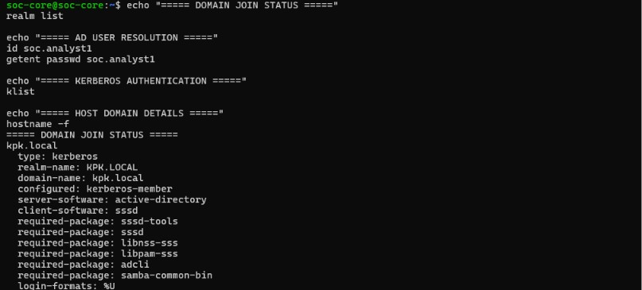
Linux Domain Join — Realm Status
SOC-Core membership in the kpk.local Active Directory realm
PROJECT EVIDENCE
realm list confirms Kerberos membership, Active Directory server software and SSSD as the Linux client.
The login policy explicitly permits soc.analyst1 and shows the required integration packages.

Slide 24
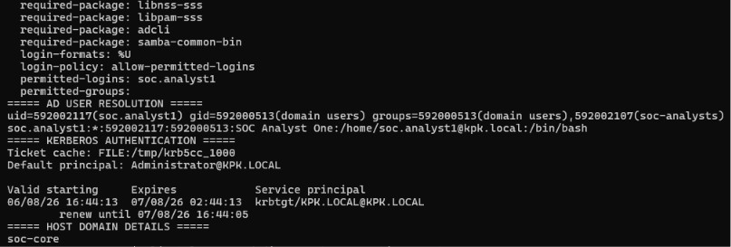
Linux Domain Join — Identity & Kerberos
AD user resolution, group membership and ticket-based authentication
PROJECT EVIDENCE
The SOC analyst account resolves with domain UID/GID values and membership in the soc-analysts group.
A valid Kerberos ticket confirms successful authentication against the KPK.LOCAL realm.

Slide 25
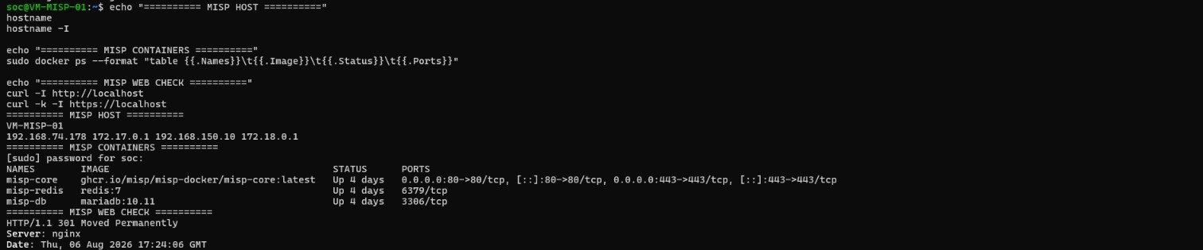
MISP Status — Host & Containers
VM-MISP-01 service stack running with the application, cache and database containers
PROJECT EVIDENCE
misp-core, misp-redis and misp-db are running, with ports 80 and 443 exposed by the core container.
The host uses 192.168.150.10 on the internal security segment and supports threat-intelligence operations.

Slide 26
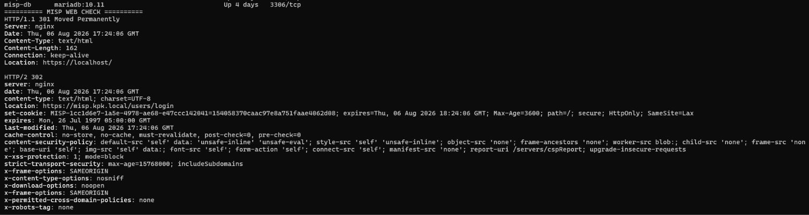
MISP Status — Secure Web Availability
HTTP-to-HTTPS redirection and delivery of the MISP login endpoint
PROJECT EVIDENCE
The HTTP endpoint returns 301 and redirects to HTTPS; the secure endpoint returns 302 to the MISP login page.
This validates Nginx availability, TLS redirection and access to misp.kpk.local/users/login.

Slide 27


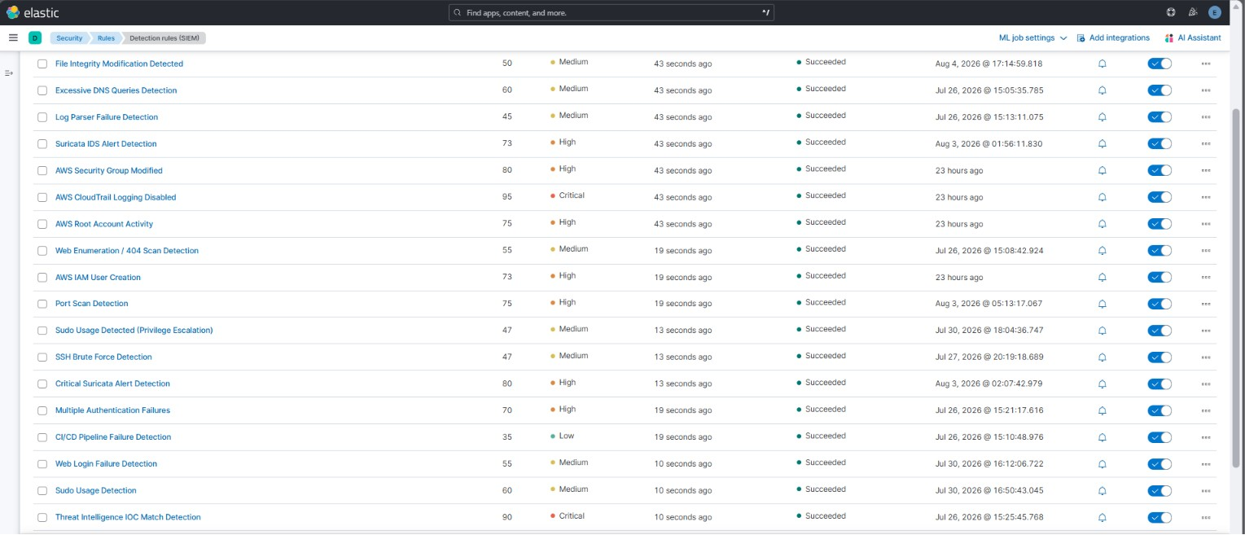

Detection Rule Inventory
Enabled Elastic detection rules with execution status and severity
PROJECT EVIDENCE
Detection rules are enabled across cloud, network, endpoint, identity and threat-intelligence use cases.
The rule list shows successful execution, assigned risk scores, severity levels and active rule toggles.
ELASTIC THREATOPS PLATFORM
Hybrid Enterprise SOC Lab

Slide 28
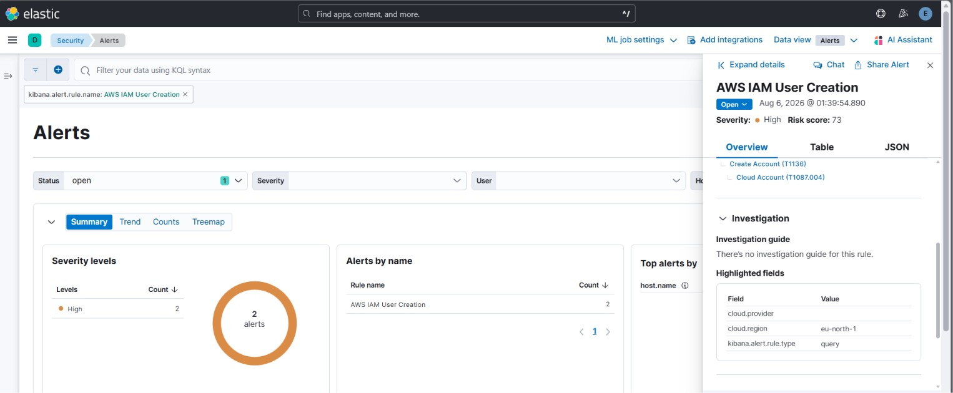
AWS IAM User Creation Alert
CloudTrail-backed detection of a newly created IAM identity
PROJECT EVIDENCE
Elastic generated a high-severity alert when an AWS IAM user-creation event was detected.
The alert is mapped to MITRE ATT&CK Create Account and confirms AWS audit events are reaching the SOC pipeline.
ELASTIC THREATOPS PLATFORM
Hybrid Enterprise SOC Lab

Slide 29
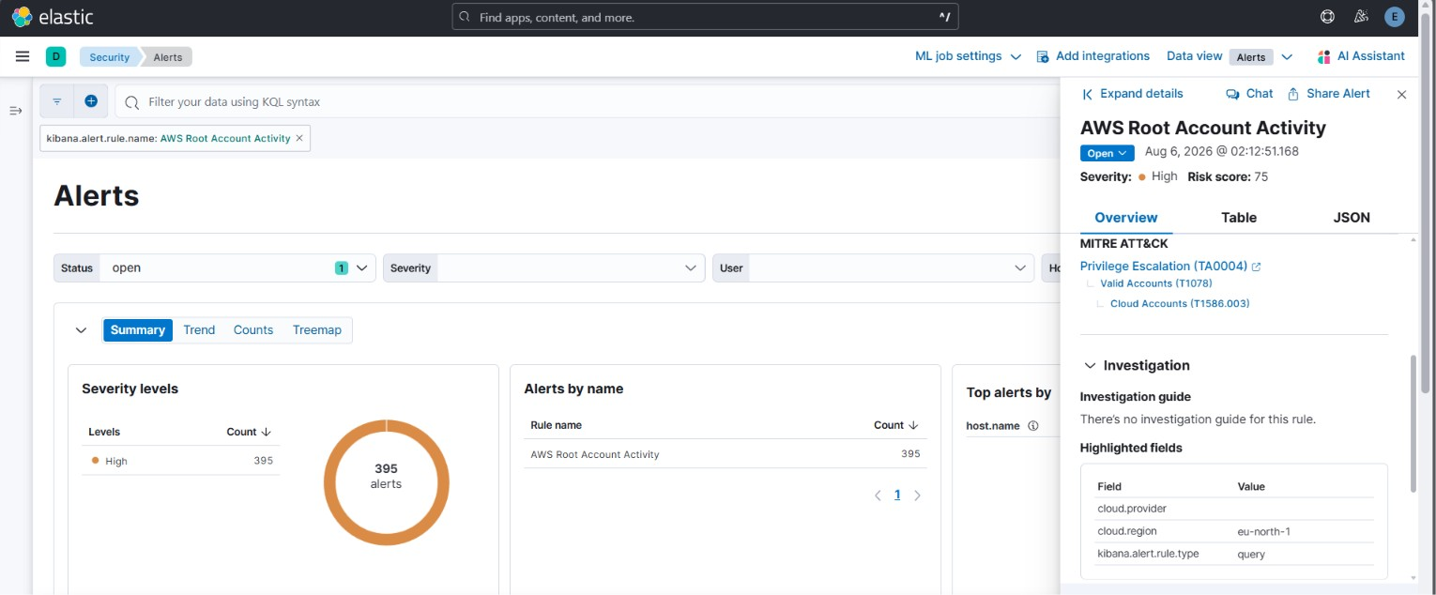
AWS Root Account Activity Alert
Monitoring use of the highly privileged AWS root identity
PROJECT EVIDENCE
Root-account activity generated a high-severity alert with a risk score of 75.
Continuous monitoring of root usage helps detect risky or unauthorized privileged cloud access.

Slide 30
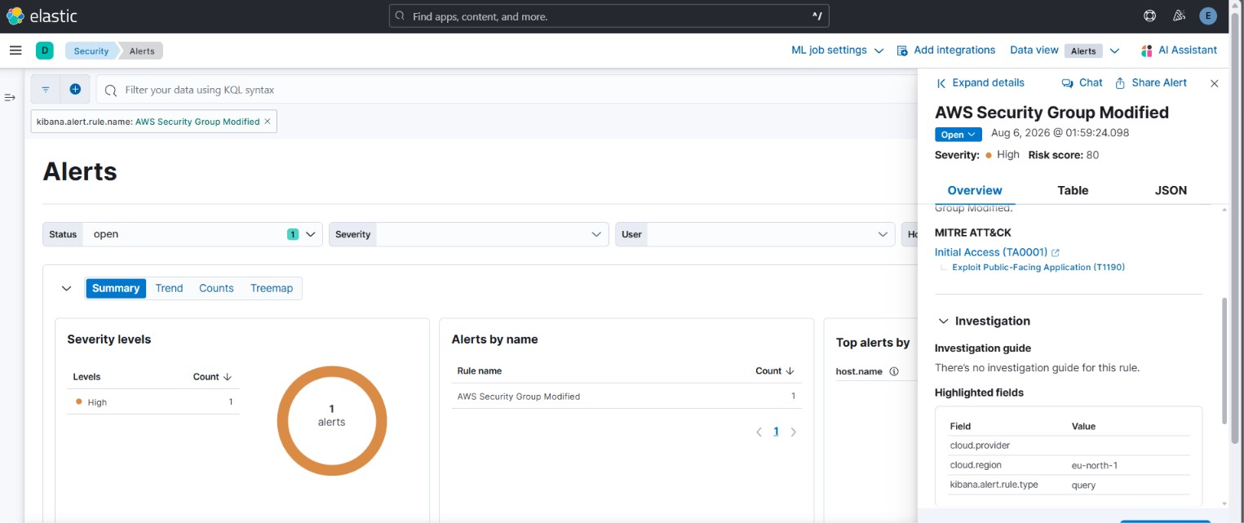
AWS Security Group Modification Alert
Detection of changes to cloud network-access controls
PROJECT EVIDENCE
A security-group modification produced a high-severity alert with a risk score of 80.
This detection helps identify changes that may expose services or weaken AWS network boundaries.

Slide 31
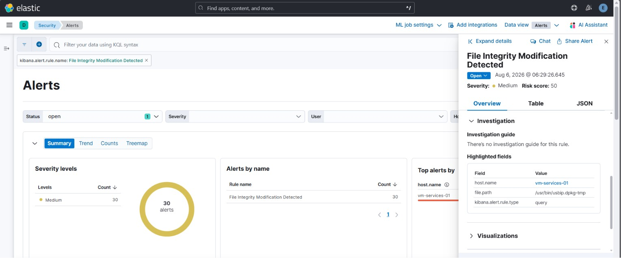
File Integrity Modification Alert
Endpoint monitoring of sensitive file-system changes
PROJECT EVIDENCE
File-integrity monitoring detected modifications on VM-SERVICES-01 and generated medium-severity alerts.
The alert preserves the host and affected path, supporting rapid investigation of unauthorized changes.

Slide 32
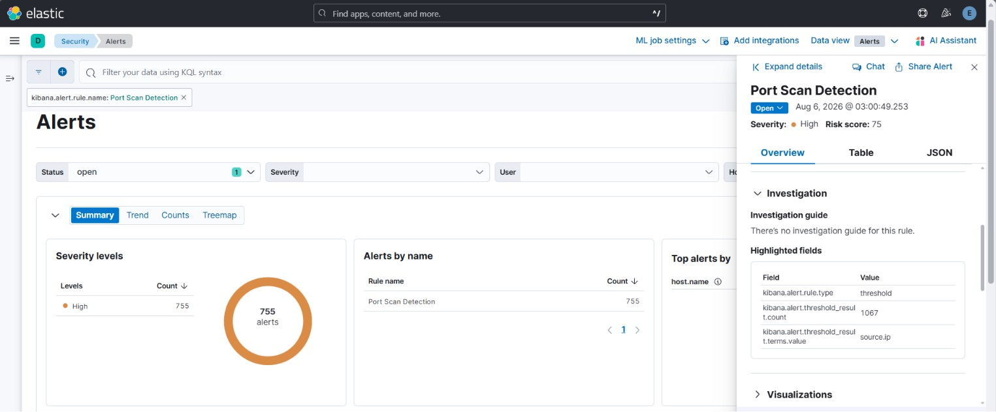
Port Scan Detection Alert
Threshold-based detection of reconnaissance activity
PROJECT EVIDENCE
Port-scan behavior generated a high-severity threshold alert grouped by source IP.
The rule identifies repeated connection attempts that may indicate network discovery or attack preparation.

Slide 33
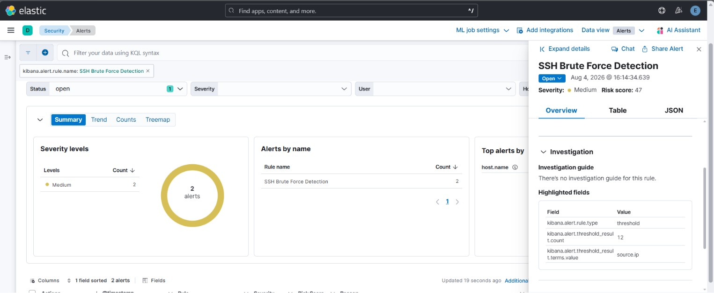
SSH Brute Force Detection Alert
Repeated authentication failures detected as a threshold event
PROJECT EVIDENCE
Multiple failed SSH attempts generated a medium-severity brute-force alert.
The threshold count and source-IP grouping help analysts distinguish sustained attacks from isolated login failures.

Slide 34
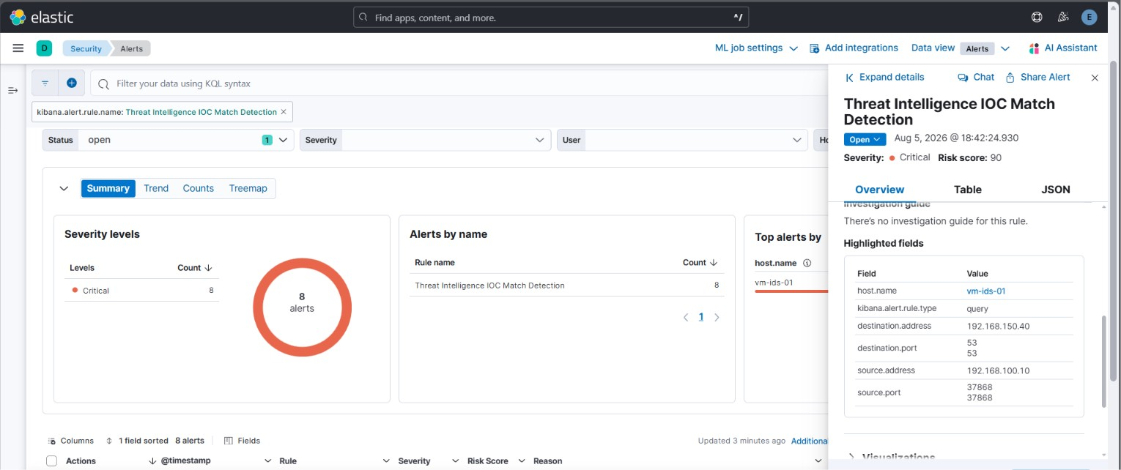
Threat Intelligence IOC Match Alert
MISP-enriched indicator matching in Elastic Security
PROJECT EVIDENCE
An IOC match produced a critical-severity alert with a risk score of 90.
The alert links network fields with threat intelligence, increasing confidence and investigation priority.

Slide 35
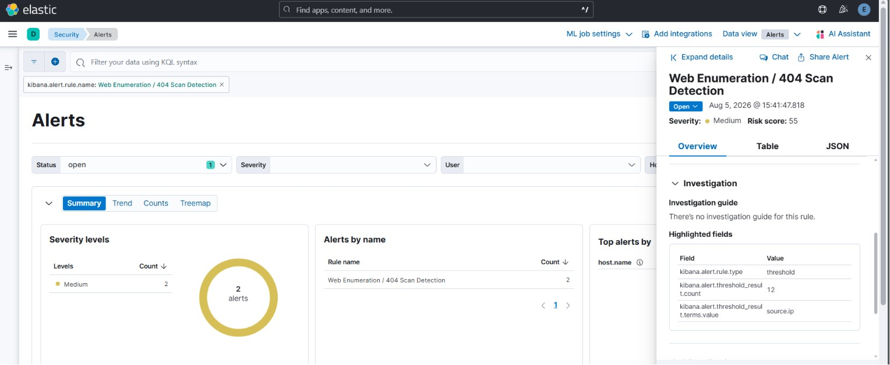
Web Enumeration / 404 Scan Alert
Detection of repeated requests for nonexistent web resources
PROJECT EVIDENCE
Web-enumeration activity generated a medium-severity threshold alert grouped by source IP.
Repeated 404 requests can indicate automated directory discovery or reconnaissance against the web service.

Slide 36
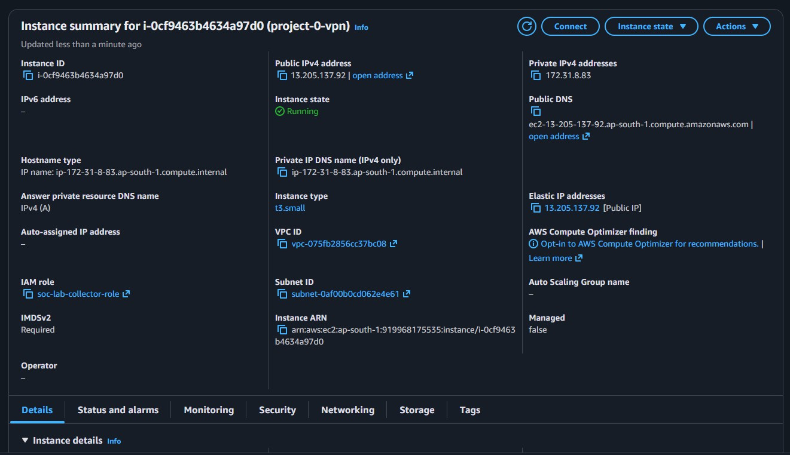
AWS VPN EC2 Instance
Cloud-hosted gateway providing the hybrid network entry point
PROJECT EVIDENCE
The project VPN EC2 instance is running with an Elastic IP, private address, VPC, subnet and IAM role.
This instance serves as the centrally reachable gateway connecting the on-premises lab to segmented SOC networks.

Slide 37
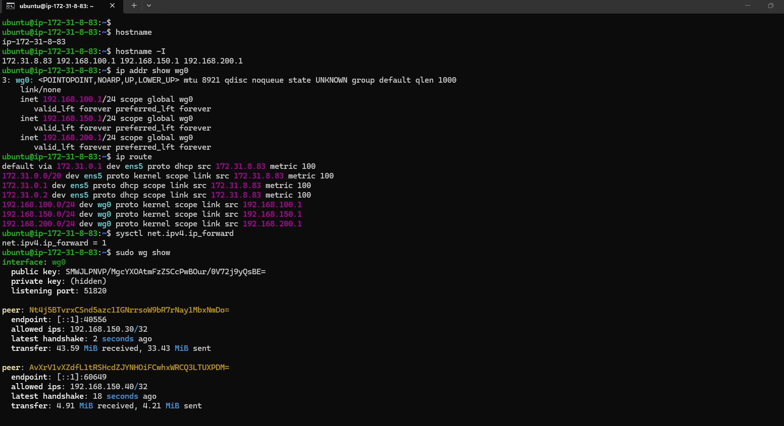
AWS VPN Gateway — Interfaces, Routes & Peers
WireGuard configuration, routing and forwarding on the EC2 gateway
PROJECT EVIDENCE
The gateway exposes WireGuard addresses for the DMZ, internal security and additional routed network segments.
IP forwarding is enabled, routes are installed and active peer handshakes confirm live encrypted connectivity.

Slide 38
Troubleshooting — Network & VPN
TROUBLESHOOTING
Real-world connectivity issues and the fixes applied
VPN blocked by organization firewall
Root cause
WireGuard default UDP 51820 could not traverse the network
Resolution
Tunnel WireGuard over wstunnel on TCP 443; evaluate OpenVPN TCP 443 / Tailscale as fallback
Routing between subnets failed
Root cause
IP forwarding / NAT / route configuration incomplete
Resolution
Enable forwarding, configure nftables/NAT and verify AllowedIPs / routes
Traffic visible in tcpdump but no IDS alert
Root cause
Suricata interface/rule coverage did not match the test traffic
Resolution
Validate af-packet interface, update rules, run suricata -T and use a known signature
Dual-homed hosts created wrong DNS entries
Root cause
Transport NIC auto-registered non-AD addresses
Resolution
Disable DNS registration on the transport interface and remove stray records
ELASTIC THREATOPS PLATFORM
Hybrid Enterprise SOC Lab 39

Slide 39


Troubleshooting — Elastic, AD & AWS
TROUBLESHOOTING
Configuration problems were isolated by testing each layer independently
SSSD user not found
Home directory missing
Cause: use_fully_qualified_names remained True or setting was placed in the wrong section
Cause: PAM home-directory creation was not enabled
Fix: Move setting to [domain/kpk.local], clear SSSD cache and restart service
Fix: Enable oddjob-mkhomedir / pam_mkhomedir and retest login
Duplicate DNS / PTR records
Cause: Manual records conflicted with dynamic registration
AWS S3 notification validation failed
Cause: Destination policy did not allow the bucket / event source
Fix: Remove duplicates and allow the DC to self-manage its record
Fix: Correct SQS access policy and aws:SourceArn
Filebeat could read SQS but not consume
Cause: Read-only policy lacked consumer actions
Rule did not fire despite an AWS action
Cause: CloudTrail delivery delay exceeded rule window
Fix: Add ReceiveMessage, DeleteMessage, ChangeMessageVisibility and queue metadata actions
Fix: Search Event History/S3 first, then increase rule look-back and wait for delivery
ELASTIC THREATOPS PLATFORM
Hybrid Enterprise SOC Lab 39

Slide 40






Security & Engineering Decisions
DESIGN
Why the implementation is more than a basic ELK deployment
1
Network segmentation
2
Encrypted hybrid transport
3
Least-privilege cloud ingestion
Separate DMZ and internal security services to reduce attack surface and lateral movement.
Use a central VPN gateway and encrypted tunnels instead of exposing internal services publicly.
Dedicated non-console IAM identity with only the S3/SQS actions required by Filebeat.
4
Buffered pipeline
5
Central identity
6
Threat-intel enrichment
Kafka protects ingestion continuity and decouples collectors from Elasticsearch availability.
AD-backed user authentication with explicit separation between authentication and sudo authorization.
MISP indicators add context before alert generation, improving triage quality.
ELASTIC THREATOPS PLATFORM
Hybrid Enterprise SOC Lab 39

Slide 41
Future Scope
ROADMAP
Priority improvements for production readiness and deeper detection
1
Identity detections
Winlogbeat/WEF coverage for AD failed logins, Kerberos abuse, privileged group changes and Golden Ticket indicators
2
Access governance
Map AD groups to Linux sudo and application roles; integrate MISP LDAP authentication
3
VPN hardening
Complete nftables policy, restrict east-west access and add monitoring for tunnel health
4
Automation
Systemd service for Filebeat, automated backups, rule export/version control and health alerts
5
Resilience
Multi-node Elasticsearch/Kafka, snapshots, ILM tuning and disaster-recovery testing
6
SOC operations
Case management, alert notifications, playbooks, threat hunting and measurable MTTD/MTTR dashboards
7
Deception & Honeypots
Deploy Cowrie and Dionaea as controlled decoys to capture attacker behaviour and enrich Elastic/MISP detections.
ELASTIC THREATOPS PLATFORM
Hybrid Enterprise SOC Lab 39

Slide 42



Future Scope: Deception & Honeypots
A controlled deception layer to expose attacker techniques before critical systems are reached
1
2
3
Deploy decoy services
Capture attacker behaviour
Enrich SOC detection
Run Cowrie for SSH/Telnet deception and Dionaea for malware/service emulation inside the isolated DMZ.
Record commands, login attempts, source IPs, payloads and interaction patterns as high-confidence telemetry.
Forward honeypot events to Elastic and correlate them with MISP IOCs to create alerts and investigation context.
Attacker interaction → Honeypot telemetry → Elastic correlation → MISP enrichment → Early warning

Slide 43



PROJECT OUTCOME
A validated hybrid SOC pipeline — from telemetry to enriched alerts.
Hybrid visibility
Secure connectivity
Actionable detection
Threat intelligence
Cloud + network + endpoint + identity
Segmented VPN-based architecture
Kibana rules and validated alerts
MISP enrichment in the event pipeline
Thank you
Questions & Discussion
ELASTIC THREATOPS PLATFORM
Hybrid Enterprise SOC Lab 44

