Slide 1

Machine Learning Project for FIFA 2018

Slide 2
Aim of the Project
The main goal is to predict the no. of wins using the best suitable model.
Perform the EDA and visualize the data.
To find out the best suitable machine learning model to predict the no. of wins.

Slide 3
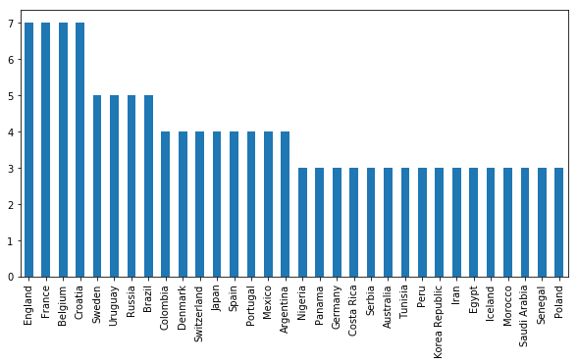
Which teams reached finals and Semi-Finals ?

Slide 4
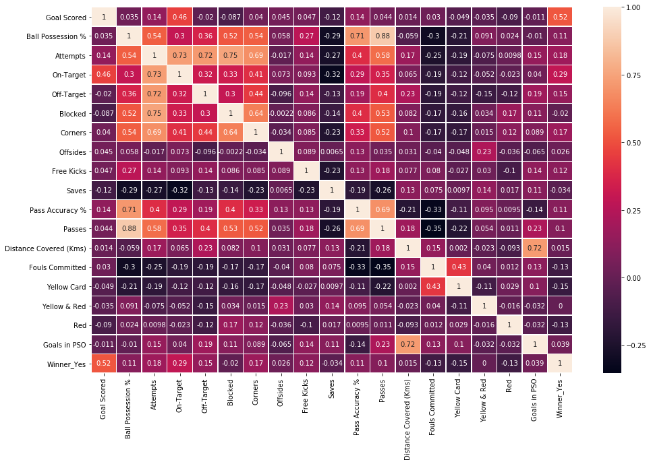
Finding the Correlations between the different fields of the dataset ?

Slide 5
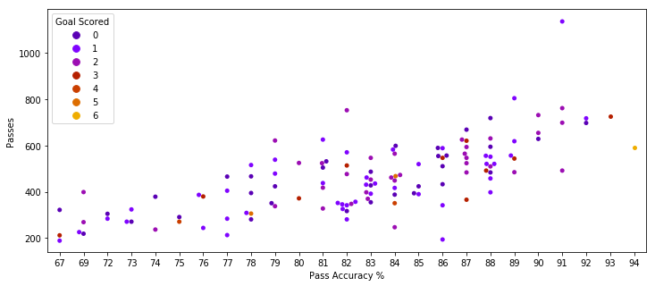
Drawing a Swarm plot to see the relation between 'Pass Accuracy %','Passess','Goal Scored'

Slide 6
Comparison of the ML models applied
ML Model | Accuracy score | Robustness i.e. less variance and bias | Comments/Remarks
Logistics Regression | 0.73 | Robust | Accuracy does not change much due to change in data
Decision Trees | 0.63 | Not Robust | Accuracy changes a lot with change in data
Decision Trees with Grid Search | 0.73 | Not Robust | Accuracy changes a lot with change in data
Random Forest | 0.65 | Not Robust | Accuracy changes a lot with change in data
Random Forest with Grid Search | 0.73 | Not Robust | Accuracy changes a lot with change in data

Slide 7
Conclusion
From the above models we see that the Decision Trees and Random Forest with GridSearch gives us the same accuracy as we get by regression and a better confusion matrix results.
So, we observe here that the Logistics Regression is the best suitable model as it provide the same accuracy that of DT and RF with Grid Search and is more Robust as it's accuracy does not change much with changes in the data

