Slide 1

EDA for IPL matches Data

Slide 2
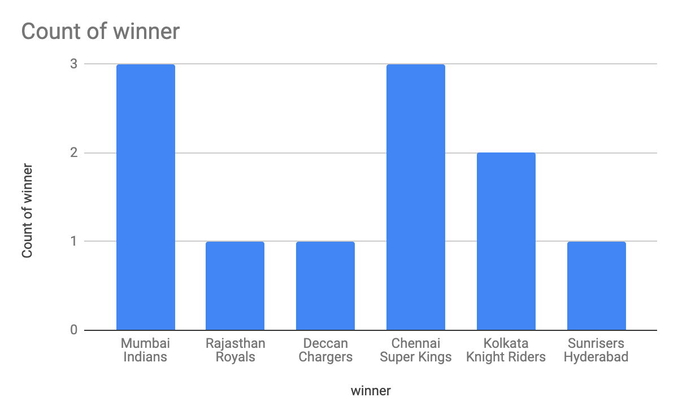
Which Team Won the IPL seasons most number of times ?

Slide 3
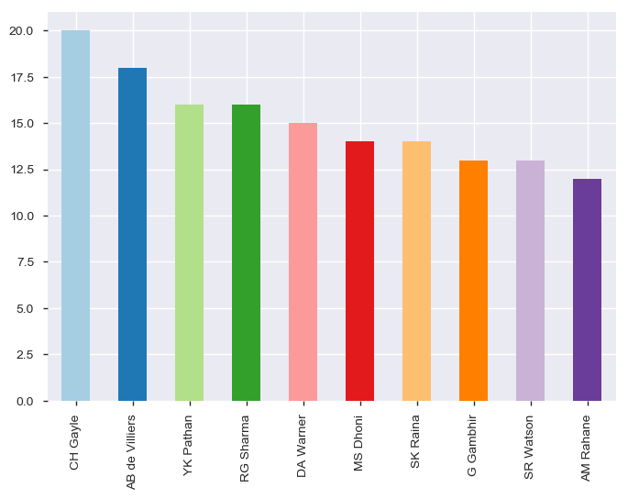
Who won Player of the match most of the times ?

Slide 4
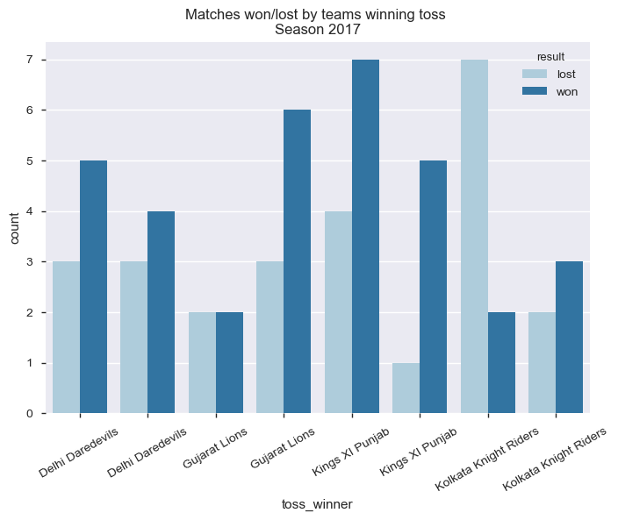
What is the impact of toss on match outcome ?

Slide 5
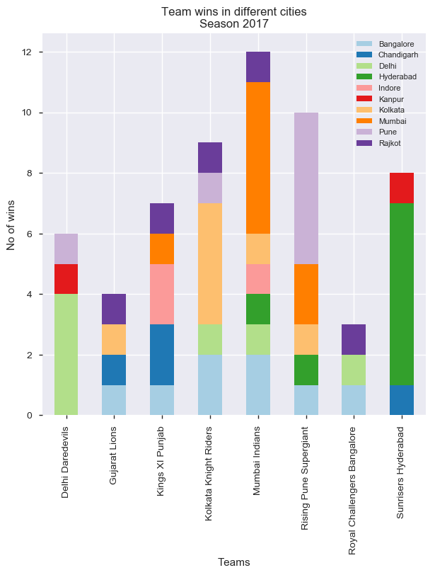
Team wins in home cities vs others cities

