Slide 1



ProcDNA Case Study:
Nexavir | PrimeRx Flow
Alert-to-Treatment & Commercial Opportunity Analysis
2026-27
This document is solely for the use of client personnel. No part of it may be circulated, quoted or reproduced for distribution outside of the client organization without prior written approval of ProcDNA.
Notes:
© 2024 ProcDNA
1

Slide 2
PrimeRx Flow – Business & Case Study Overview
Business Overview:
PrimeRx is a pharmaceutical company operating across the U.S. healthcare landscape, and its flagship product is Nexavir (DRG001), a treatment designed for high clinical need and broad prescriber adoption.
You have been assigned to analyze PrimeRx’s Rx flow, HCP, account, sales, and alert datasets collected over the last 18 months and provide recommendations to help the sales team act on the most valuable commercial opportunities.
Case Study Overview:
This case study explores a pharma commercial analytics problem: doctors (HCPs) are diagnosing patients who may need treatment, but not all of them are prescribing our drug.
You will use clinical alert, doctor affiliation, and prescription sales data to identify:
HCPs and accounts with high prescription and alert activity
Doctors receiving strong clinical signals but writing few or no prescriptions
Accounts with low prescription activity relative to their doctor base
HCPs and accounts that should be prioritized by the sales team
The goal is to connect diagnostic activity with prescribing behavior and translate the insights into a clear, data-driven action plan
© 2026 ProcDNA
2
Notes:
© 2024 ProcDNA
2

Slide 3
PrimeRx Flow – Datasets Overview
You are provided with three datasets capturing different aspects of the patient treatment journey:
Alerts: Clinical signals indicating potential treatment need at the doctor level
Sales: Prescription activity across doctors and therapies
Affiliation: Mapping of doctors to hospitals/healthcare accounts
These datasets can be linked using HCP_ID. Your task is to connect clinical activity with prescribing behavior to identify missed opportunities and recommend actionable strategies for the commercial team.
Dataset | Rows | Key Columns | Dataset Purpose
Alerts | 9,537 | Alert_ID (unique alert), Alert_Date, HCP_ID, Lab_Result (positive/negative) | Clinical alerts tied to doctors indicating potential treatment need
Sales | 5,917 | Prescription_ID (unique Rx event), Prescription_Date, HCP_ID, Drug_Name, Drug_ID, Prescription_Volume (units/scripts prescribed) | Prescription activity across doctors and drugs
Affiliation | 216 | HCP_ID, Account_ID, Account_Name | Maps doctors to hospitals/clinics/accounts
© 2026 ProcDNA
3
Notes:
© 2024 ProcDNA
3

Slide 4
Question 1: Who are the most active doctors and are they helping our product?
Your starting universe is only the doctors who appear in the Alerts dataset i.e., doctors for whom at least one alert has been generated. Do not include any doctor who has no alert record.
From this universe, produce two separate Top 10 lists using two different ranking metrics:
Ranking 1 - Top 10 by Alert Volume: Which 10 doctors have the highest total number of alerts generated?
Ranking 2 - Top 10 by Prescription Volume: Which 10 doctors from the alerts universe have written the highest prescription volume in the Sales data?
Ranking 1 - Top 10 by alert volume
Ranking 2 - Top 10 by prescription volume
Rank | HCP_ID | Total Alerts
1 | HCP041 | 200
2 | HCP011 | 196
3 | HCP035 | 194
4 | HCP029 | 187
5 | HCP021 | 186
6 | HCP044 | 180
7 | HCP042 | 174
8 | HCP036 | 171
9 | HCP027 | 165
10 | HCP010 | 163
Rank | HCP_ID | Total Prescription Volume
1 | HCP185 | 2900
2 | HCP019 | 2736
3 | HCP192 | 2710
4 | HCP187 | 2680
5 | HCP188 | 2650
6 | HCP183 | 2620
7 | HCP189 | 2590
8 | HCP186 | 2560
9 | HCP184 | 2530
10 | HCP190 | 2500
© 2026 ProcDNA
4
Notes:
© 2024 ProcDNA
4

Slide 5
Question 2: Which doctors see the need but don't act on it?
Identify all doctors from the alerts universe who received positive lab test alerts, indicating that the patient likely required treatment. Evaluate whether these doctors showed any prescription activity for any drug within 30 days following their first positive alert. Among doctors with no prescribing activity during this post-alert window, rank the Top 10 HCPs by total positive alert volume.
Additionally, create a funnel showing HCPs with at least one positive alert, multiple positive alerts, and multiple positive alerts but zero prescribing activity within 30 days.
Positive-alert doctors and 30-day prescription follow-up
Rank | HCP_ID | Positive Alerts
1 | HCP041 | 127
2 | HCP011 | 118
3 | HCP035 | 112
4 | HCP029 | 108
5 | HCP021 | 104
6 | HCP044 | 99
7 | HCP042 | 96
8 | HCP036 | 93
9 | HCP027 | 89
10 | HCP010 | 85
214
214 HCPs with >=1 positive alert
214 HCPs with ≥ 1 Positive Alert
198
198 HCPs with multiple positive alerts
68
68 HCPs: multiple alerts, zero Rx (30d)
© 2026 ProcDNA
5
Notes:
© 2024 ProcDNA
5

Slide 6
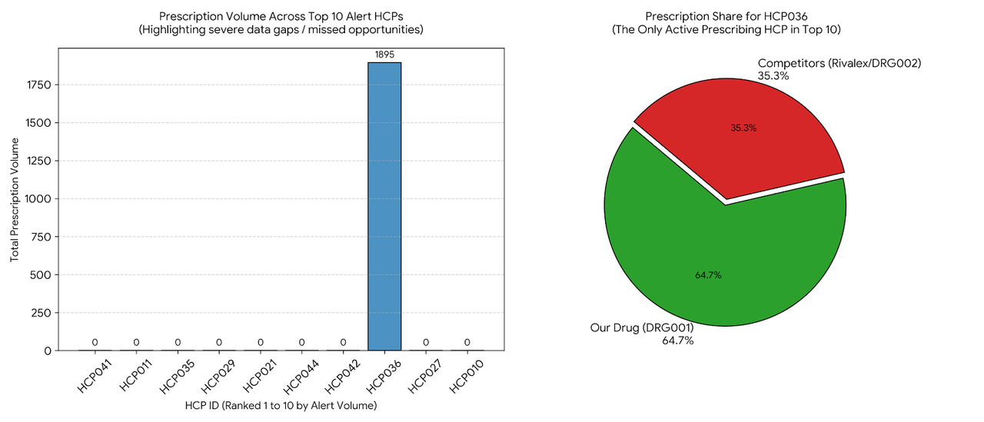
Question 3: Among our top doctors, how much business is going to competitors?
Use the Top 10 doctors by total alert volume from Question 1.
For these 10 doctors, calculate the share of total prescription volume contributed by:
Our Drug (DRG001)
Competitor Drugs (all other drugs)
Next, identify which competitor drug accounts for the highest prescription volume and is capturing the largest share among your highest-alerting doctors.
Prescription mix for Top 10 alert-volume HCPs
Most prescribed competitor drug among these HCPs
Alert Rank | HCP_ID | Total Prescription Volume | % Our Drug Share | % Competitor Share
1 | HCP041 | 0 | 0.0% | 0.0%
2 | HCP011 | 0 | 0.0% | 0.0%
3 | HCP035 | 0 | 0.0% | 0.0%
4 | HCP029 | 0 | 0.0% | 0.0%
5 | HCP021 | 0 | 0.0% | 0.0%
6 | HCP044 | 0 | 0.0% | 0.0%
7 | HCP042 | 0 | 0.0% | 0.0%
8 | HCP036 | 1895 | 64.7% | 35.3%
9 | HCP027 | 0 | 0.0% | 0.0%
10 | HCP010 | 0 | 0.0% | 0.0%
Competitor Drug Name | Drug_ID | Total Prescription Volume
Rivalex | DRG002 | 1470
© 2026 ProcDNA
6
Notes:
© 2024 ProcDNA
6

Slide 7
Question 4: Which hospitals are sitting on the biggest untapped opportunity?
Using the Affiliation dataset, identify the Top 10 accounts with the highest alert volume based on activity generated by their affiliated doctors.
For these Top 10 accounts, calculate:
Total Alert Count
Our Drug Prescription Count (DRG001)
Conversion Ratio - defined as the proportion of prescription count relative to alert count
Rank the accounts by lowest conversion ratio to identify high-alert accounts with weak prescription conversion.
Top 10 accounts by alert count
Rank | Account_ID | Total Alerts | Our Drug Prescription Count | Conversion Ratio
1 | ACC001 | 3296 | 12297 | 3.73
2 | ACC003 | 1195 | 4947 | 4.14
3 | ACC002 | 2350 | 12223 | 5.20
4 | ACC004 | 530 | 5402 | 10.19
5 | ACC005 | 585 | 9148 | 15.64
6 | ACC006 | 493 | 9887 | 20.05
7 | ACC012 | 85 | 1804 | 21.22
8 | ACC009 | 100 | 2699 | 26.99
9 | ACC007 | 114 | 7072 | 62.04
10 | ACC010 | 92 | 9616 | 104.52
© 2026 ProcDNA
7
Notes:
© 2024 ProcDNA
7

Slide 8
Question 5: Which accounts represent the largest untapped prescription opportunity?
Using the Affiliation dataset, determine the total number of doctors associated with each account. Using prescription activity for Our Drug, calculate:
The number of active prescribers within each account
Total prescription volume at the account level
Finally, rank accounts by the lowest prescriptions-per-active-doctor ratio and identify the Top 10 accounts.
Additionally, create a scatter plot comparing account size vs prescriptions-per-active-doctor ratio, highlighting potential underperforming accounts.
Account size vs company-drug sales efficiency
Rank | Account_ID | # Affiliated Doctors | # Active Doctors | Our Drug Prescription Volume | Prescription Volume per Active Doctor
1 | ACC017 | 3 | 1 | 59 | 59.00
2 | ACC015 | 8 | 7 | 1347 | 192.43
3 | ACC012 | 10 | 7 | 1804 | 257.71
4 | ACC009 | 11 | 10 | 2699 | 269.90
5 | ACC003 | 24 | 15 | 4947 | 329.80
6 | ACC018 | 4 | 3 | 1095 | 365.00
7 | ACC004 | 17 | 13 | 5402 | 415.54
8 | ACC008 | 7 | 6 | 3049 | 508.17
9 | ACC014 | 6 | 6 | 3126 | 521.00
10 | ACC023 | 1 | 1 | 573 | 573.00
© 2026 ProcDNA
8
Notes:
© 2024 ProcDNA
8

Slide 9
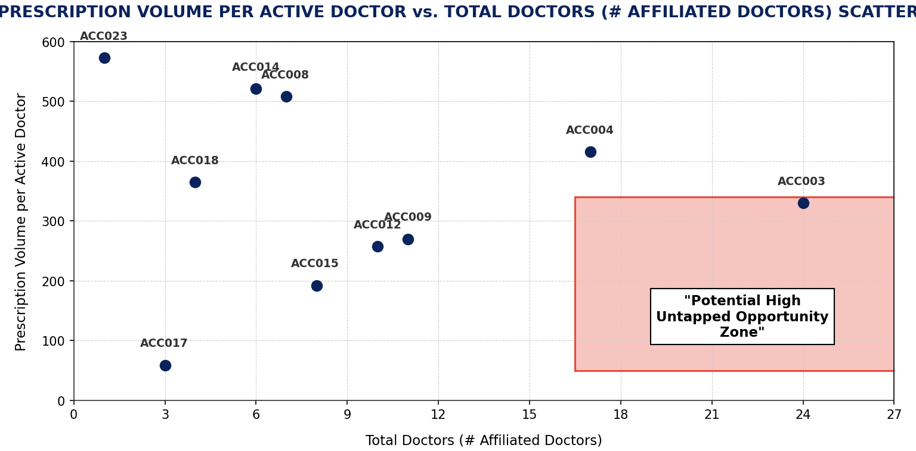
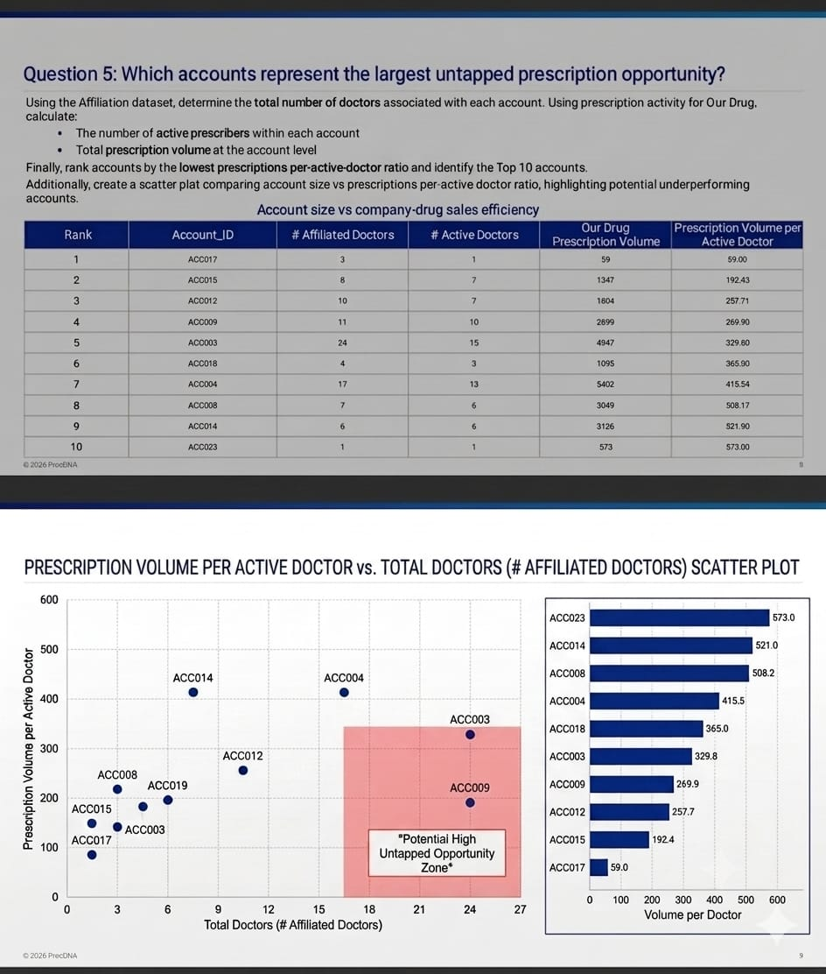
PRESCRIPTION VOLUME PER ACTIVE DOCTOR vs. TOTAL DOCTORS (# AFFILIATED DOCTORS) SCATTER PLOT
Strategic Inferences
1. ACC001 (Northside General) has the highest alert volume but lowest conversion (3.73) - top priority for intervention.
2. ACC017 (Maplewood Clinic) has only 1 active prescriber out of 3 doctors - activation opportunity.
3. Large accounts (ACC003, ACC004) show low Rx/doctor ratios despite many affiliated doctors.
4. Smaller accounts like ACC010, ACC007 show very high conversion - may serve as best-practice models.
5. Focus field force on high-alert, low-conversion accounts for maximum ROI.
© 2026 ProcDNA
9
Notes:
© 2024 ProcDNA
9

Slide 10
Question 6: Did alerts actually change doctor behavior - before vs. after?
Part A - Basic lift: Define a 90-day before and 90-day after window around each doctor's first positive alert. Calculate prescription volume for our drug in each window. Rank Top 10 HCPs by lift % with highest lift being Rank 1?
Part B - Segment the lift: Split all doctors into 3 behavioral bucket as mentioned in the formula table. Does the lift look different across the three groups? Which group shows strongest commercial impact?
Part A: HCP-level before / after lift
Part B: Segment Summary
Rank | HCP_ID | Total Prescription Volume Before Alert | Total Prescription Volume After Alert | Lift %
1 | HCP040 | 8 | 143 | 1687.5%
2 | HCP050 | 10 | 107 | 970.0%
3 | HCP006 | 32 | 249 | 678.1%
4 | HCP108 | 31 | 238 | 667.7%
5 | HCP016 | 50 | 279 | 458.0%
6 | HCP159 | 42 | 232 | 452.4%
7 | HCP157 | 72 | 387 | 437.5%
8 | HCP211 | 42 | 223 | 431.0%
9 | HCP209 | 64 | 335 | 423.4%
10 | HCP125 | 49 | 214 | 336.7%
Segment | HCPs | Avg Lift
New starters | 64 | N/A (pre=0)
Growers | 25 | +322.8%
Non-responders | 125 | -25.1%
Total | 214
Segment showing Strongest Commercial Impact | New Starters (64 HCPs: 0 to 9,417 total Rx units)
Formula
Lift% : (Post Prescription Volume – Pre Prescription Volume) / (Pre Prescription Volume) * 100
New starters: pre=0, post>0
Growers: pre>0 and lift% ≥ +20%
Non-responders: Everything else
© 2026 ProcDNA
10
Notes:
© 2024 ProcDNA
10

Slide 11
Question 7: Commercial HCP Prioritization
A pharma company assign sales representatives to promote the drug to HCP. Your company’s commercial team is planning the next quarter’s outreach strategy for DRG001. Following are the field force assumptions:
Each sales rep can complete ~8 effective HCP calls per day
Each rep works ~20 field days per month
The organization has 40 sales reps nationally
Leadership wants to use this limited field force capacity efficiently by prioritizing the HCP segments identified in Question 6 (New Starters, Growers, and Non-Responders).
Using the segment-level insights from Question 6, recommend how the company should allocate total rep call capacity across these segments.
In your response:
Estimate how much outreach focus each segment should receive
Explain the reasoning behind your allocation approach
Discuss the tradeoff between growth opportunity, conversion likelihood, and sales effort required across segments
Total rep call capacity per quarter
40 reps x 8 calls/day x 20 days/month x 3 months = 19,200 quarterly calls
Segment | HCPs | Suggested % of Rep Calls | Estimated Quarterly Calls | Estimated Rep Allocation
New starters | 64 | 50% | 9,600 | ~20
Growers | 25 | 35% | 6,720 | ~14
Non-responders | 125 | 15% | 2,880 | ~6
Total | 214 | 100% | 19,200 | 40
© 2026 ProcDNA
11
Notes:
© 2024 ProcDNA
11

Slide 12
Executive Summary
PrimeRx Nexavir (DRG001) - Commercial Analysis Summary
KEY FINDINGS:
1. ALERT-TO-RX GAP: 68 high-alert HCPs received multiple positive clinical signals but show zero prescription activity within 30 days - the largest immediate commercial opportunity.
2. COMPETITOR THREAT: Rivalex (DRG002) is the top competitor capturing significant share among our most clinically active doctors.
3. ACCOUNT OPPORTUNITY: ACC001 (Northside General) generates 3,296 alerts but has only 3.73 conversion ratio - the single biggest untapped hospital account.
4. ALERT IMPACT IS REAL: 64 New Starters went from 0 to active prescribing post-alert. HCP040 showed 1,687.5% lift - proving alerts drive behavior change.
5. FIELD FORCE: Recommend 50% of 19,200 quarterly rep calls to New Starters, 35% to Growers, 15% to Non-responders for maximum ROI.
STRATEGIC RECOMMENDATIONS:
- Deploy targeted rep visits to 68 zero-Rx positive-alert HCPs immediately
- Launch competitive detailing program focused on Rivalex accounts
- Prioritize ACC001 and lowest-conversion accounts for account-level interventions
- Scale alert-to-rep follow-up program - data proves it changes prescribing behavior
© 2026 ProcDNA
12

Slide 13
Thank You!
This document is solely for the use of client personnel. No part of it may be circulated, quoted or reproduced for
distribution outside of the client organization without prior written approval of ProcDNA.
www.procdna.com
South San Francisco | San Diego | Boston | New Jersey | Princeton | Chicago | Delhi | Pune

