Slide 1

SCHOOL OF ARTIFICIAL INTELLIGENCE | COIMBATORE
MACHINE LEARNING DRIVEN STRUCTURE-PROPERTY CORRELATION BETWEEN MECHANICAL PROPERTIES OF ALLOYS
(Predictive Modeling of Alloy Properties Using Machine Learning)
23CHY115|Introduction to Material Informatics
23PHY114 |Computational Mechanics 2
23MAT112 Mathematics for Intelligent Systems 2
BATCH B10
C. RISHITHA
(CB.AI.U4AID24109)
DIVYA RITHANYA S
(CB.AI.U4AID24113)
KARTHIKEYA Y
(CB.AI.U4AID24163)
KAUSHAL S
(CB.AI.U4AID24168)
1

Slide 2
OUTLINE:
INTRODUCTION
DATA DESCRIPTION
METHODOLOGY
RESULTS
CONCLUSION
TEAM CONTRIBUTION
REFERENCES
2

Slide 3
INTRODUCTION:
This project explores how Machine Learning (ML) can be used to predict the mechanical properties of alloys, with a special focus on High Entropy Alloys (HEAs).
High-Entropy Alloys (HEAs) are advanced metallic materials with unique properties. Their phase structure (FCC, BCC, FCC+BCC, Intermetallic, etc.) determines their performance.
Traditionally, identifying the phases through experiments is slow, expensive, and complex.
Using Machine Learning allows us to analyze large datasets quickly and predict the phase structure accurately within seconds.
We have selected Four different models [Support Vector Machine (SVM), XG Boost, Random Forest and Neural Networks]
. By comparing these models, we seek to identify the most accurate and interpretable approach for predicting alloy properties, ultimately aiding in material design and performance optimization.
3

Slide 4
DATA DESCRIPTION:
Features selected for SVM, XG Boost, Random Forest:
Number of elements in the alloy.
Valence Electron Configuration
Atomic Size Difference
Electronegativity Difference
Enthalpy of mixing
Entropy of mixing
SYNTHESIS ROUTE
Phases
Features selected for Neural Network:
[Through CBFV]
Number of elements in the alloy.
Valence Electron Configuration
Atomic Size Difference
Electronegativity Difference
Enthalpy of mixing
Entropy of mixing
Phases
Features available in the dataset:
Alloy ID
Alloy
Number of elements in the alloy.
Valence Electron Configuration
Atomic Size Difference
Electronegativity Difference
Enthalpy of mixing
Entropy of mixing
Synthesis Route
Hot cold working
Homogenization Temperature
Homogenization Time
Annealing Temperature
Annealing Time
Quenching process
Phases
References
Cleaned data
4

Slide 5
METHODOLOGY:
Data Handling
Using Lazypredict
Model Building
Feature Importance
Model Evaluation
Drop unnecessary columns
Analyze different models’ performance for this dataset used
Select a particular model
Analyze which alloy elements contribute the most to phase prediction
Evaluate using accuracy, recall, precision, F1-Score and confusion matrix
Replace missing values
Split the data into training set and testing set
Separate X(features) and y(target)
Select four models to work with this dataset
Feature Engineering
5

Slide 6
RESULTS:
SUPPORT VECTOR MACHINE
Support Vector Classifier
Developed a Support Vector Machine (SVM) model with RBF kernel to predict phases of High Entropy Alloys (HEAs).
Data Preparation:
Selected 6 important features: Num_of_Elem, VEC, Atom.Size.Diff, Elect.Diff, dHmix, dSmix, along with Sythesis_Route.
Dropped rows with missing values.
Encoded categorical variable Sythesis_Route using LabelEncoder
Encoded target Phases using LabelEncoder
Train-Test Split and Scaling
80% training, 20% testing split using train_test_split
Standardization of features using StandardScaler
Handling Class Imbalance
Applied SMOTE (Synthetic Minority Over-sampling Technique) to balance the training data before model training.
6

Slide 7
Model Details
Algorithm: Support Vector Machine (SVC) with RBF kernel.
Hyperparameters: kernel= 'rbf’random_state=42 for reproducibility.
Set during SVC model creation.
No explicit hyperparameter tuning.
Performance Metrics
Training Accuracy: ~0.75
Test Accuracy: ~0.78
Balanced Accuracy, Precision, Recall, and F1-score calculated.
Detailed classification reports generated for both training and testing phases.
Visualization & Interpretation
Permutation feature importance was computed to identify the most influential features on model prediction.
Confusion matrix plotted to visualize prediction performance
Separate confusion matrices for training and testing datasets.
7

Slide 8

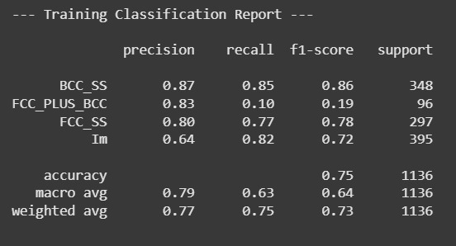
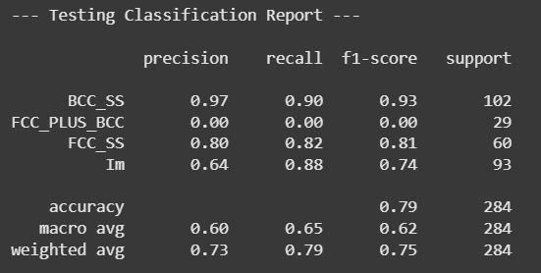
SUPPORT VECTOR MACHINE
8

Slide 9
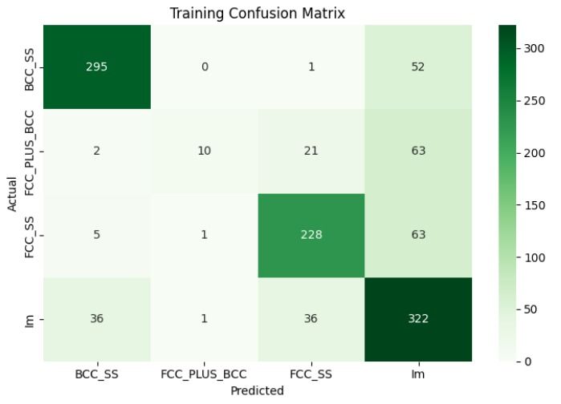
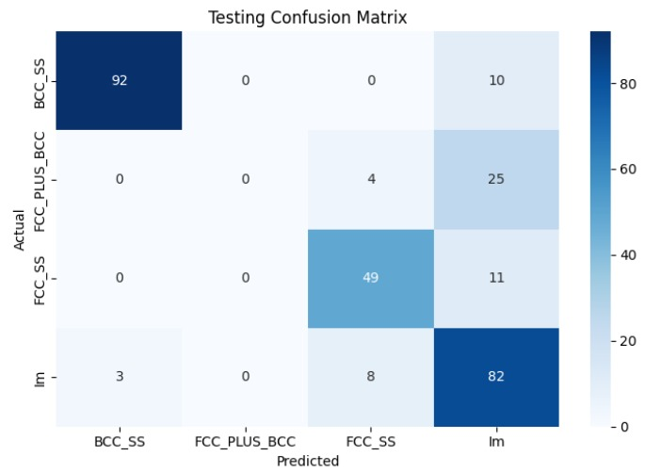
9

Slide 10
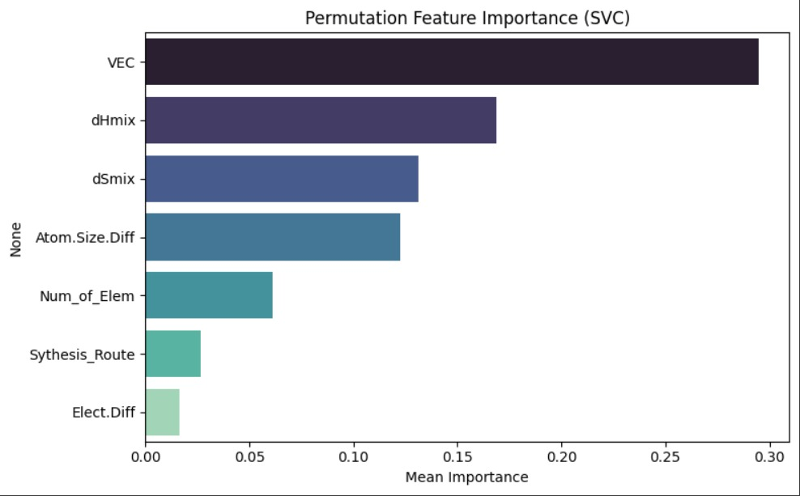
10

Slide 11
XGBOOST
XGBoost Classifier
Developed an XGBoost classifier to predict phases of High Entropy Alloys (HEAs).
Used features from alloy compositions and processing data after dropping irrelevant metadata.
Data preprocessing
Dropping unnecessary columns
Encoding categorical variables
Handling missing values
Model approach
Used XGBoostClassifier from the xgboost library.
Optimized using default hyperparameters initially
Evaluated with metrics like accuracy, confusion matrix, and classification report
Train-test split: 70% training, 30% testing
11

Slide 12
Performance
High Training Accuracy
Test Accuracy around 0.85
Evaluated using F1-score, Confusion Matrix
Visualization & Interpretation
Confusion matrix heatmap plotted using Seaborn
Feature importance could be visualized using xgboost.plot_importance (not shown in early cells, but common in such workflows)
Comparison step
Used LazyClassifier to compare many ML models and confirm XGBoost's performance was among the best
12

Slide 13

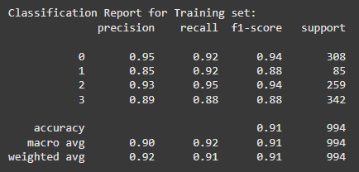
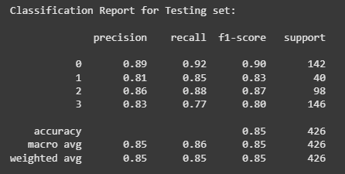
XGBOOST
13

Slide 14
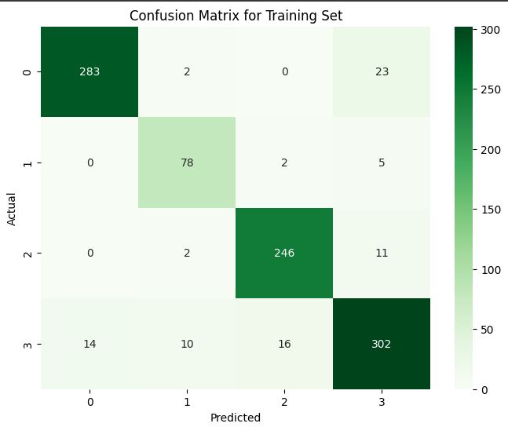
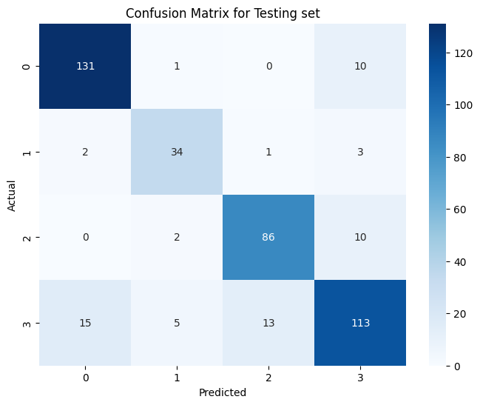
14

Slide 15
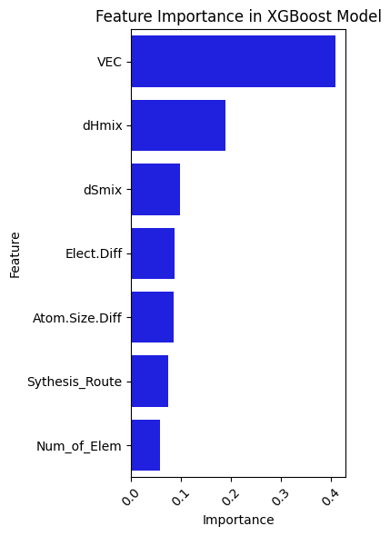
15

Slide 16
RANDOM FOREST
Random Forest Classifier
Developed a Random Forest Classifier (RFC) model to predict phases of High Entropy Alloys (HEAs).
Data Preparation
Dropped non-compositional metadata columns: References, Alloy_ID, Alloy, Hot-Cold_Working, Quench_Pro, Homog_Temp, Homog_Time, Anneal_Temp, Anneal_Time.
Handled missing values:
Numerical features: Imputed using mean values.
Categorical features: Imputed using most frequent values.
Encoded categorical variables using OneHotEncoder.
Applied standardization to numerical features using StandardScaler.
Model Details
Algorithm: Random Forest Classifier
Number of trees: 100 (n_estimators=100)
Random state: 42 (for reproducibility)
No manual hyperparameter tuning applied (default settings used).
16

Slide 17
Training Strategy
Train-test split: 80% training, 20% testing (with stratified sampling to maintain class balance).
Performance Metrics
Training Accuracy: ~0.92
Test Accuracy: ~0.85
Balanced Accuracy, Precision, Recall, and F1-score evaluated.
Classification reports and confusion matrices plotted for both training and testing sets.
Visualization & Interpretation
Feature importance analysis revealed key input variables influencing phase prediction.
Confusion matrices helped assess model prediction quality across different phases.
17

Slide 18
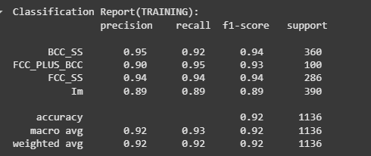
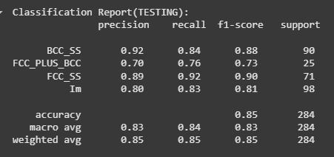
RANDOM FOREST
18

Slide 19
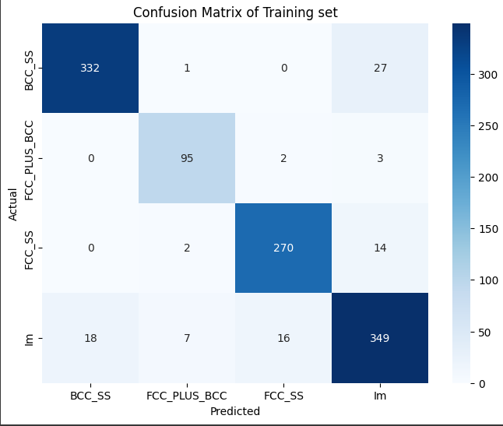

19

Slide 20
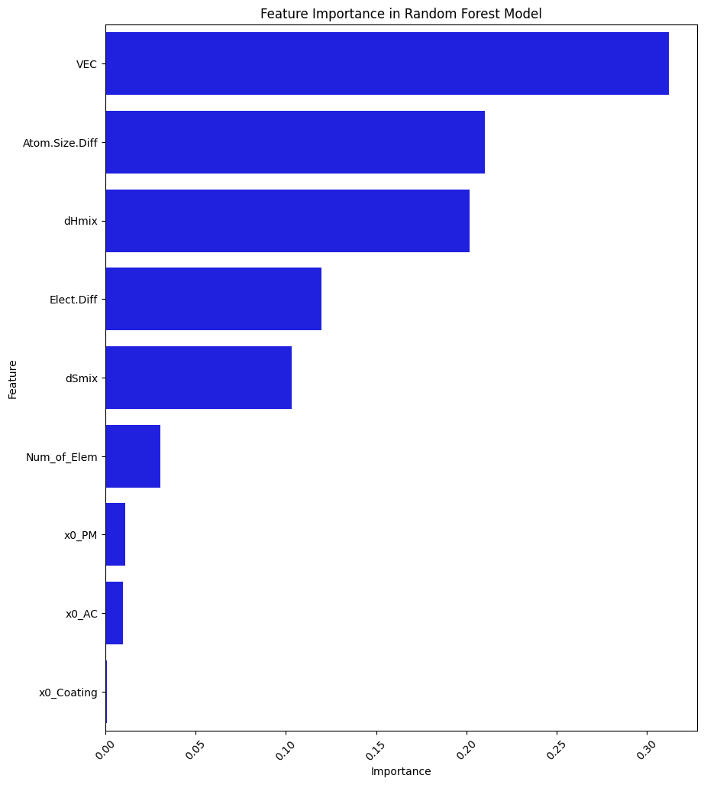
20

Slide 21
NEURAL NETWORKS
MLP Classifier
Developed a Multilayer Perceptron (MLP) model to predict phases of High Entropy Alloys (HEAs).
Used 6 composition-based features: Num_of_Elem, VEC, Atom.Size.Diff, Elect.Diff, dHmix, dSmix.
Data preprocessing
Dropped non-compositional metadata.
Encoded categorical variables.
Handled missing values.
Applied standardization (StandardScaler)
Model architecture
Two hidden layers (100 and 50 neurons)
Activation function: ReLU
Trained using the Adam optimizer with 1000 max iterations
Train-test split: 80% training, 20% testing
21

Slide 22
Performance
Training Accuracy: 0.88
Test Accuracy: 0.89
Balanced Accuracy, F1-score, and Confusion Matrix used for evaluation.
Visualization & Interpretation
PCA used for 2D visualization of class separability
Permutation feature importance identified key influencing variables
Cross-validation confirmed robustness and generalization of the model
22

Slide 23
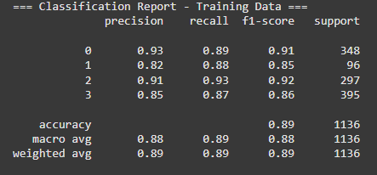
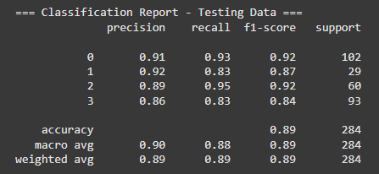
NEURAL NETWORKS
23

Slide 24
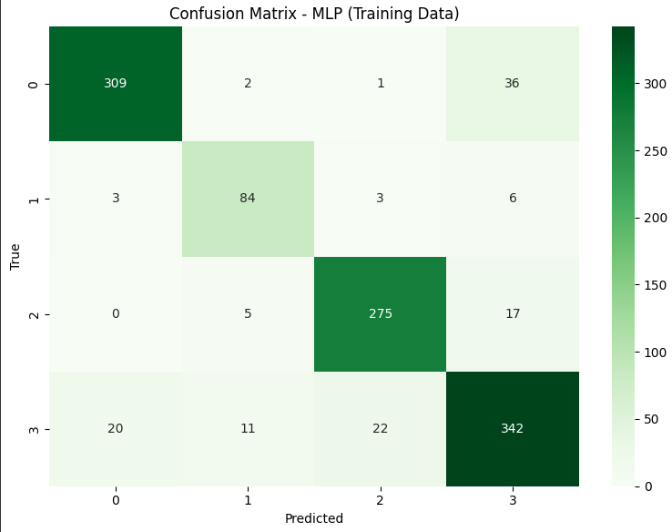
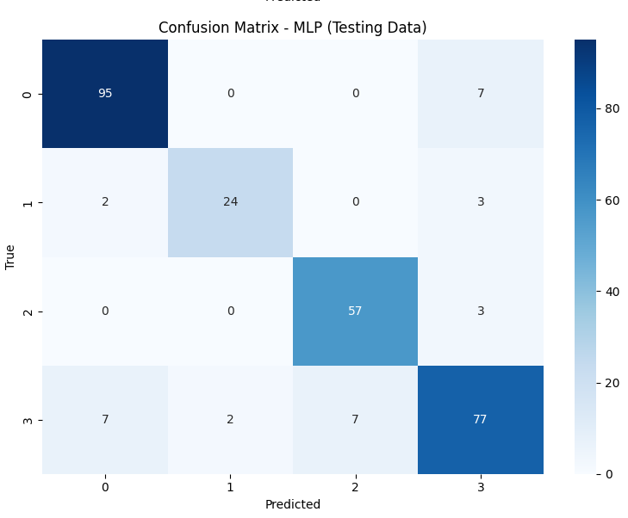
24

Slide 25
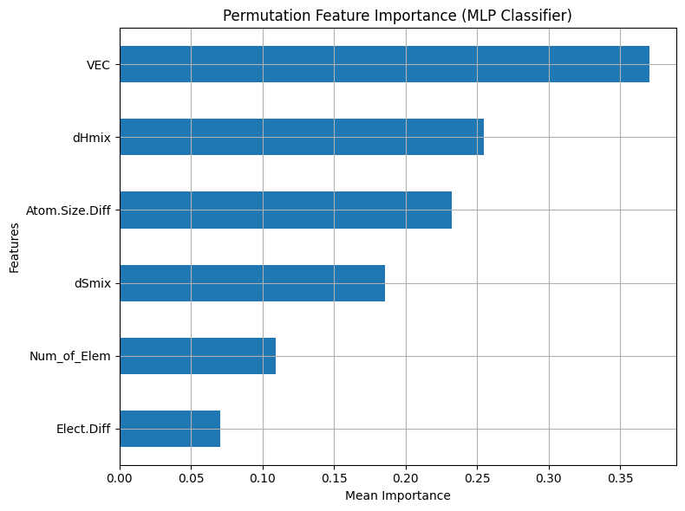
25

Slide 26
CONCLUSION:
S.No. | Models | Accuracy | Precision | Recall | F1 - Score
1. | SVM | 0.62 | 0.73 | 0.79 | 0.75
2. | XG Boost | 0.86 | 0.85 | 0.85 | 0.85
3. | Random Forest | 0.84 | 0.85 | 0.85 | 0.85
4. | Neural Networks | 0.88 | 0.89 | 0.89 | 0.89
Based on the above analysis, we can conclude that
The Neural Networks model achieved the best overall performance, making it the most reliable and consistent model
XGBoost and Random Forest also performed strongly, both achieving comparable metrics, suggesting they are good alternatives with slightly lower computational complexity compared to Neural Networks.
The SVM model, underperformed comparing to the others, indicating it may not be well-suited for this particular dataset or problem.
26

Slide 27
TEAM CONTRIBUTION:
RISHITHA C – Support Vector Machine
DIVYA RITHANYA S – Random Forest
KARTHIKEYA Y – XG Boost
KAUSHAL S – Neural Networks(MLP Classifier)
27

Slide 28
REFERENCES:
Machaka, R., Motsi, G.T., Raganya, L.M., Radingoana, P.M. and Chikosha, S., 2021. Machine learning-based prediction of phases in high-entropy alloys: A data article. Data in brief, 38, p.107346.
Gorsse, S., Nguyen, M.H., Senkov, O.N. and Miracle, D.B., 2018. Database on the mechanical properties of high entropy alloys and complex concentrated alloys. Data in brief, 21, pp.2664-2678.
Couzinié, J.P., Senkov, O.N., Miracle, D.B. and Dirras, G., 2018. Comprehensive data compilation on the mechanical properties of refractory high-entropy alloys. Data in brief, 21, pp.1622-1641.
Ye, Y.F., Wang, Q., Lu, J., Liu, C.T. and Yang, Y., 2016. High-entropy alloy: challenges and prospects. Materials Today, 19(6), pp.349-362.
King, D.J.M., Middleburgh, S.C., McGregor, A.G. and Cortie, M.B., 2016. Predicting the formation and stability of single phase high-entropy alloys. Acta Materialia, 104, pp.172-179.
Li, S., Zhang, H., Dai, D., Ding, G., Wei, X. and Guo, Y., 2019. Study on the factors affecting solid solubility in binary alloys: An exploration by Machine Learning. Journal of Alloys and Compounds, 782, pp.110-118.
Qu, N., Chen, Y., Lai, Z., Liu, Y. and Zhu, J., 2019. The phase selection via machine learning in high entropy alloys. Procedia Manufacturing, 37, pp.299-305.
28

