Slide 1
Dyslexia Detection Tool
Finding if a person has dyslexia, based on various parameters
Kavisha Mathur - PES1UG20CS203
Kaushal Suresh - PES1UG20CS201
Krishna Bajaj - PES1UG20CS217
Guide - Mr.Srinivas

Slide 2
What is Dyslexia?
Dyslexia is a disability that involves deficiencies in reading and writing capabilities, but does not affect intellect. Although this condition was commonly known as ‘word blindness’ in the 1800s, it has now been identified as a condition with a neurological origin and not as a condition to do with lack of vision.

Slide 3
EEG
Electroencephalography (EEG) is a method to record an electrogram of the spontaneous electrical activity of the brain.
EEG Scans contains different parameter like alpha, beta, gamma, videoid, age etc

Slide 4
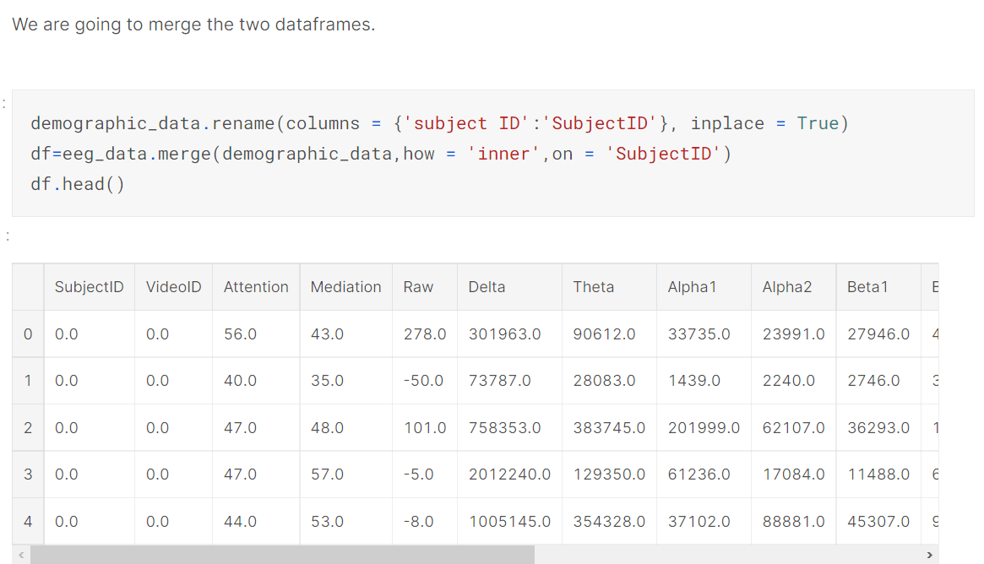
STEP 1: Exploratory Data Analysis for the EEG dataset
Data preprocessing

Slide 5
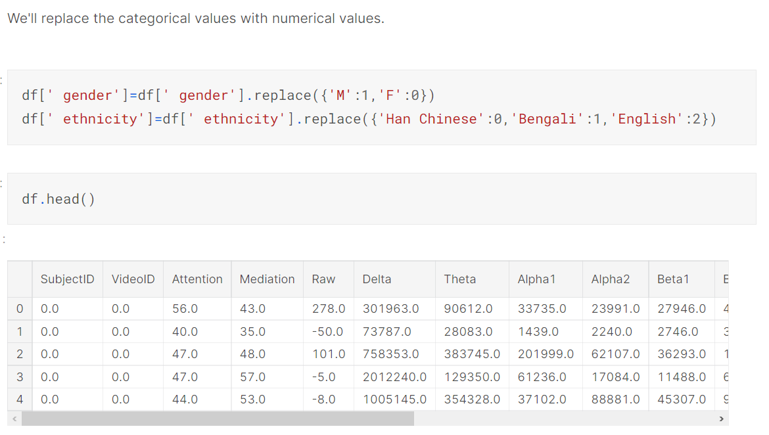
STEP 1: Exploratory Data Analysis
Data preprocessing

Slide 6
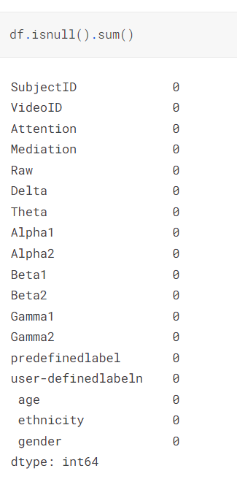
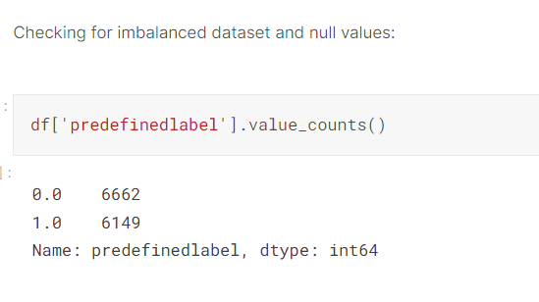
STEP 1: Exploratory Data Analysis
Checking for null values

Slide 7
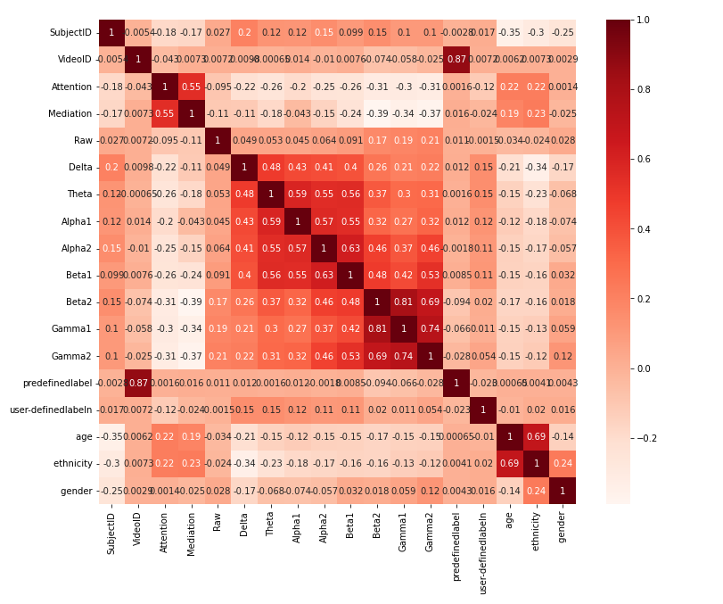
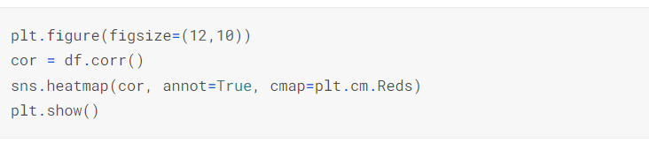
STEP 1: Exploratory Data Analysis
Correlogram plot
Feature selection:
Calculated using Mutual Info (MI) score
high_score_features=['SubjectID', 'VideoID', 'Attention', 'Mediation', 'Raw', 'Delta', 'Theta', 'Alpha1', 'Alpha2', 'Beta1','Beta2', 'Gamma1', 'Gamma2', ' age']

Slide 8
Solution
Experimenting with different machine learning approaches to find the best one
Increase accuracy

Slide 9
Implementation and Models used

Slide 10
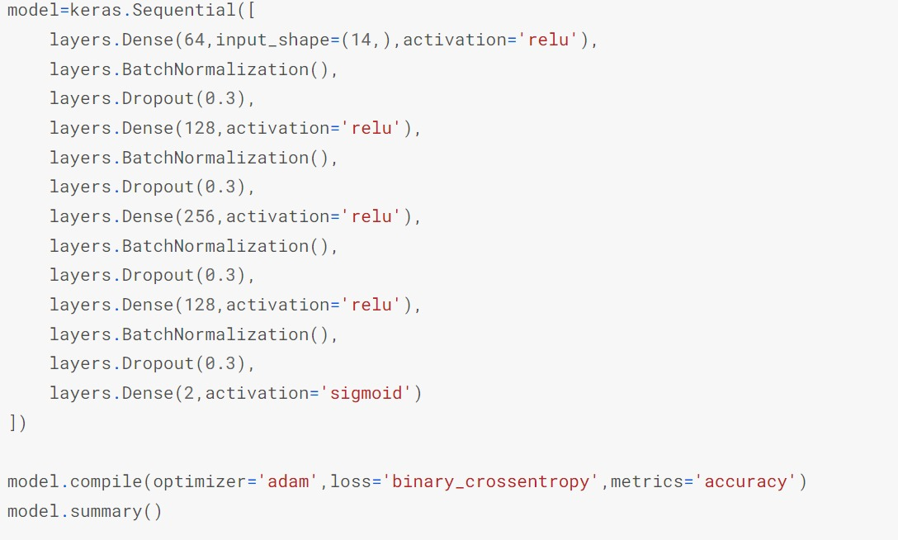
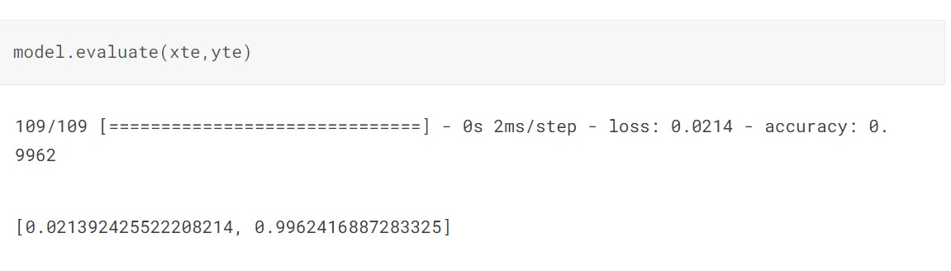
Artificial Neural Network
Artificial Neural Networks(ANN) are a computational network based on biological neural networks that construct the structure of the human brain. They are part of supervised machine learning which have input (the top 14 features) as well as corresponding output present in our dataset (‘user-definedlabeln’).
The model gave a loss of 0.0213 and an
Accuracy of 99.6%.

Slide 11
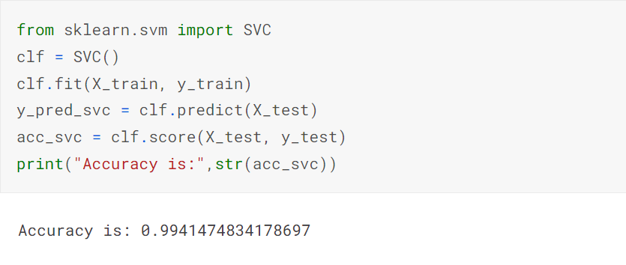
SVM
Support vector machine(SVM) is a supervised machine learning algorithm which can be used for both classification or regression challenges. It creates a best decision boundary, called a hyperplane.
The model gave an accuracy of 0.994.

Slide 12
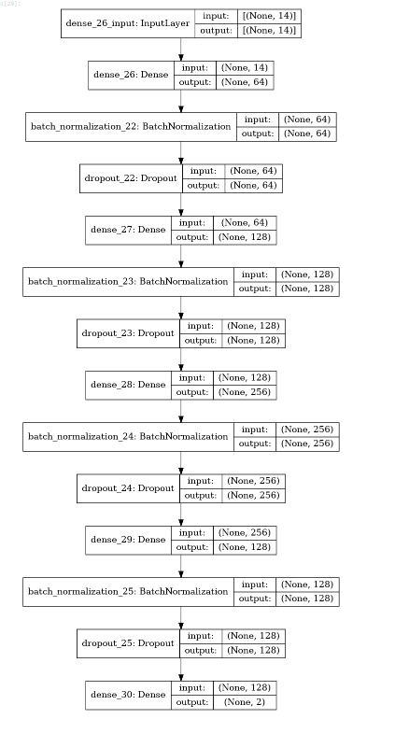
ANN Model

Slide 13
Standardised Tests
Standardised Tests has results like audio discrimination, visual discrimination, speed, memory etc

Slide 14
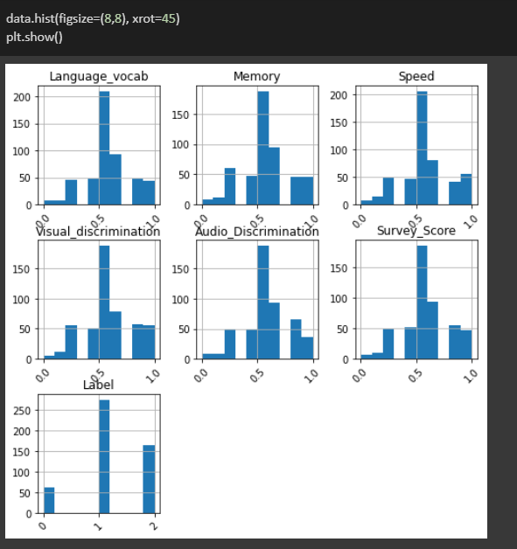
STEP 1: Exploratory Data Analysis for the dataset
Data Preprocessing already done
Data Visualisation
HISTOGRAM

Slide 15
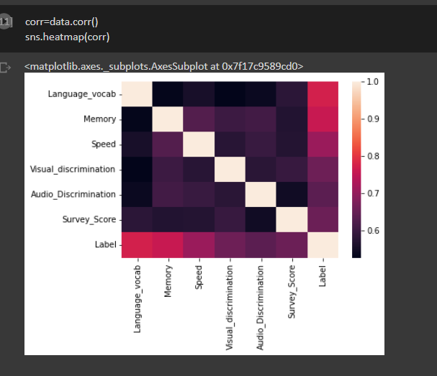
STEP 1: Exploratory Data Analysis for the dataset
Heatmap

Slide 16
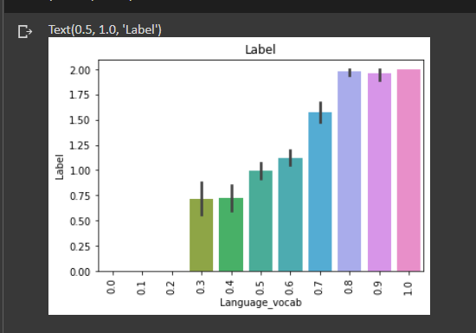
STEP 1: Exploratory Data Analysis for the dataset
Bar Plot

Slide 17
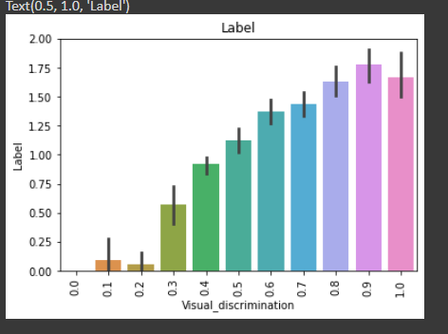
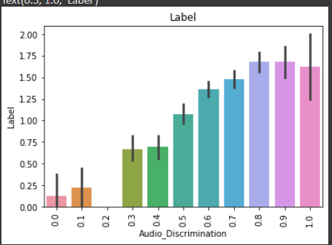
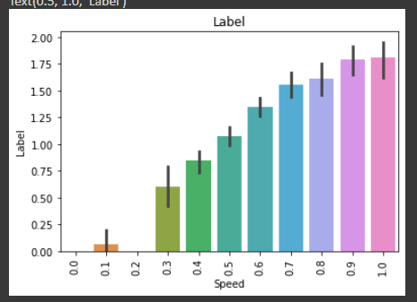
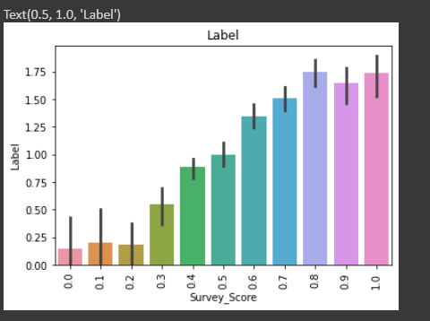
STEP 1: Exploratory Data Analysis for the dataset

Slide 18
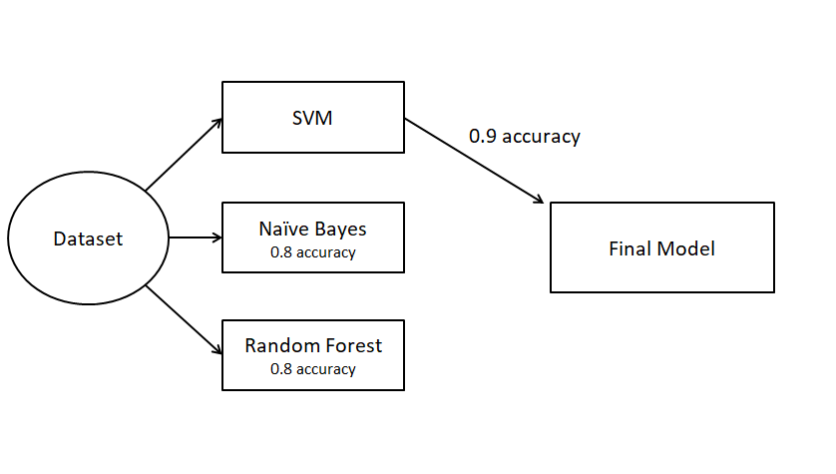
Models ran

Slide 19
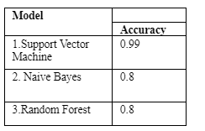
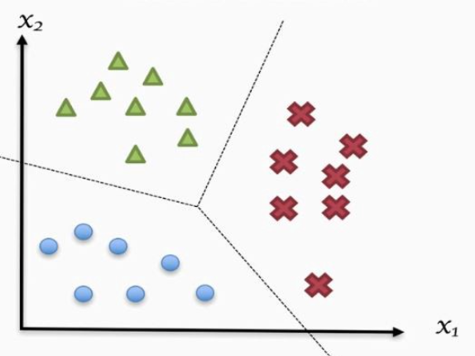
Models ran

Slide 20
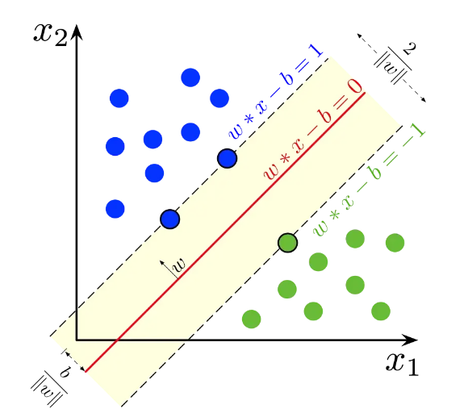
Maths
SVM

Slide 21
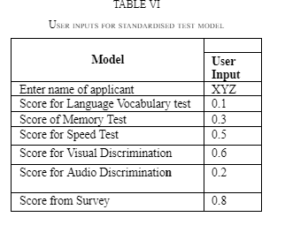
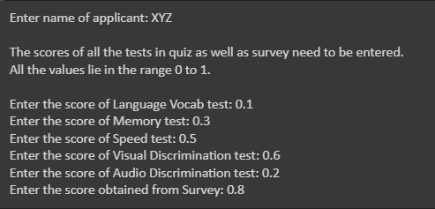
Output

Slide 22
Handwritten test
Handwriting Test has results like normal, corrected or reversal

Slide 23

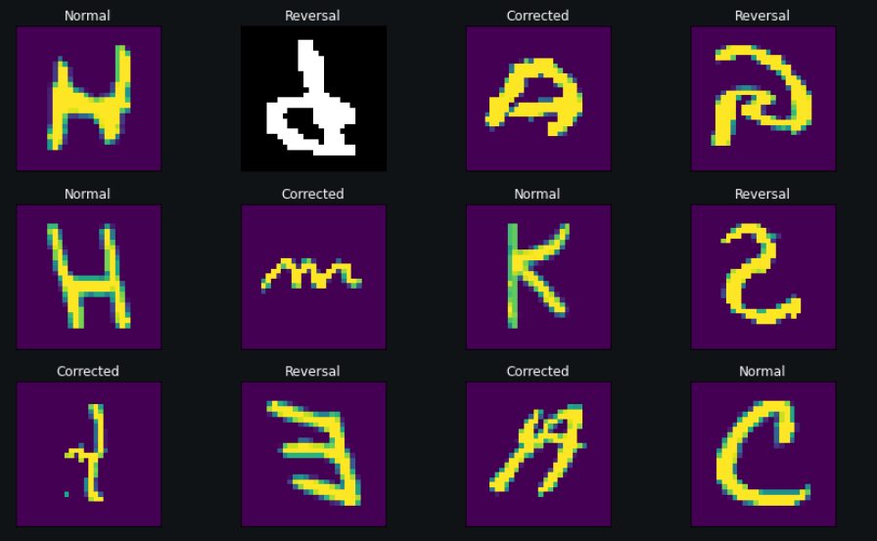
STEP 1: Exploratory Data Analysis for the dataset
Contains three classification class (Corrected, Normal and Reversal)

Slide 24
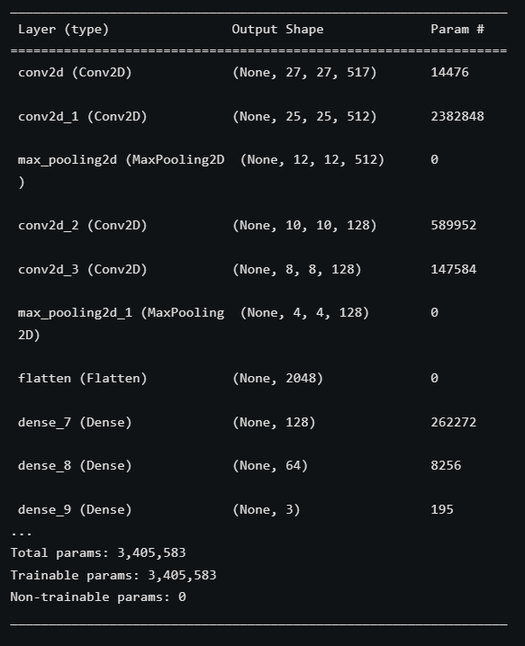
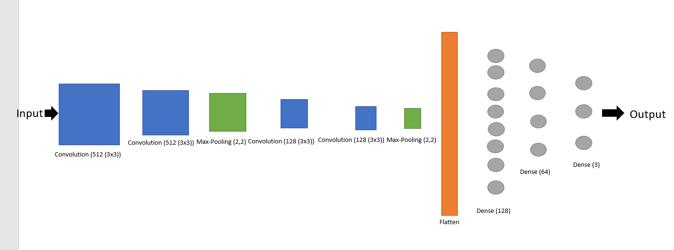
Models Used
Convolutional neural network was used for image classification.
Convolutional neural network (CNN, or ConvNet) is a class of artificial neural network (ANN), most commonly applied to analyze visual imagery.

Slide 25
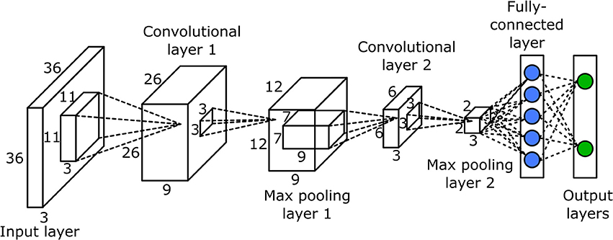
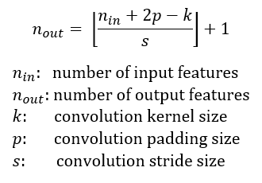
Maths

Slide 26
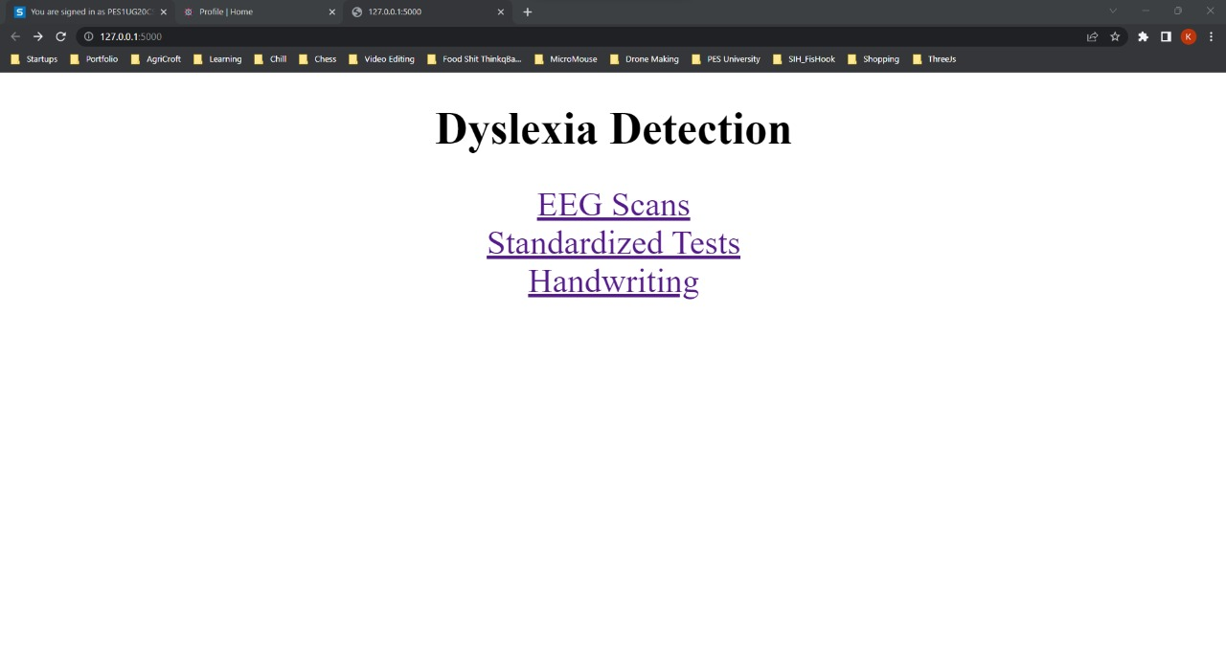
Final Product

Slide 27


