Slide 1
SoundBox A Web Music Player
By
Akshat Sharma 19012011077
Kaushal Vibhakar 19012011091

Slide 2
Project Idea
Project Goal
Our product is a web based music application that allows users to listen to their music libraries using a server program on their home computer and a web based client to connect to that server and stream the music.

Slide 3
Project Idea
Target Audience
Our target audience is a computer user who wants to listen to their music remotely without having to carry around a digital music player. Also, the target user has a decently high speed internet connection on both ends of the transaction. The target audience is also skilled enough on computers to install the program and use the web to sign in to our web site and use the web client.

Slide 4
Implementation
Programming Languages
Frontend Technology – Javascript, ReactJs,
Tailwind CSS .
Data Sources
Using Music Database API
Firebase
Tools
Visual Studio Code

Slide 5
Implementation
Modules in our Web Application
Login Module
Signup Module
Profile Page
Discover Page
Around Us Page
Top Artist and Top Charts Page
Common Header – Login/Signup (Not Logged In)
– Siderbar (Logged In)
– Searchbar (Logged In)

Slide 6
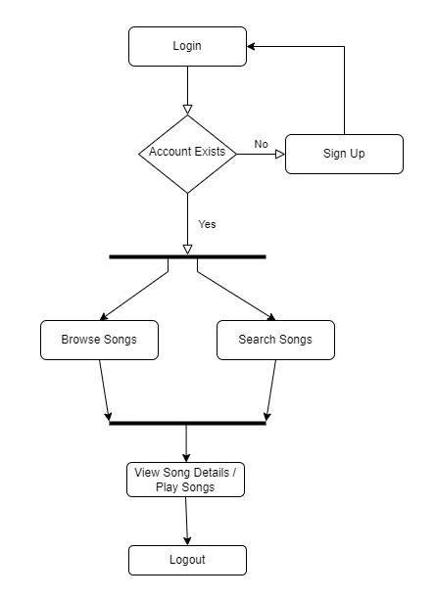
Flowchart

Slide 7
Some similar music web applications
Spotify Web Player
Resso Web Player
Hungama Web Player
Youtube Music Web Player

Slide 8
Thank you

